Slide 1
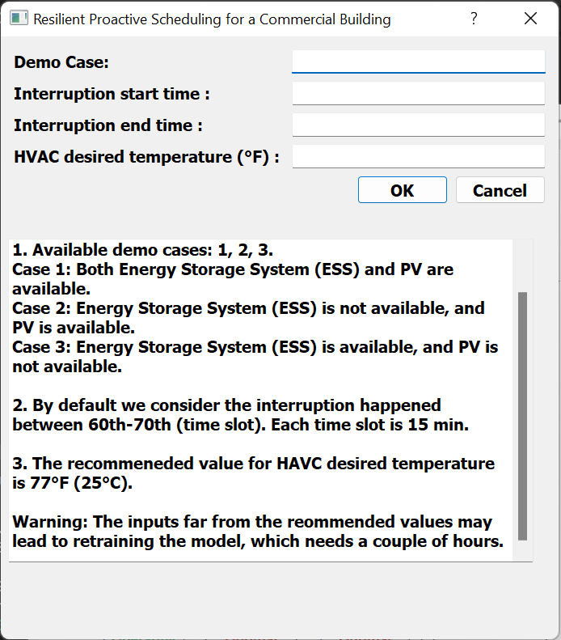
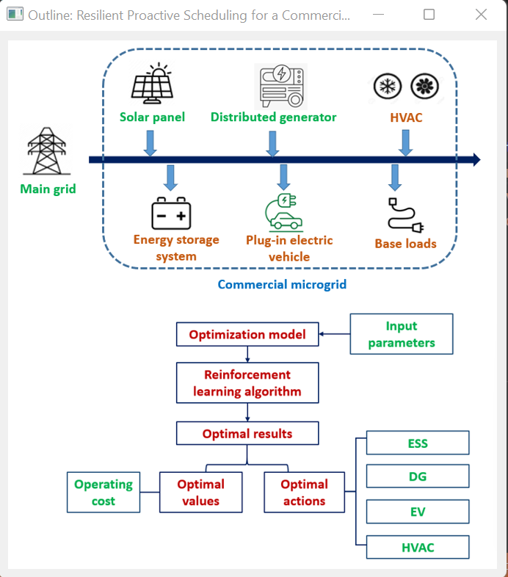

Slide 2
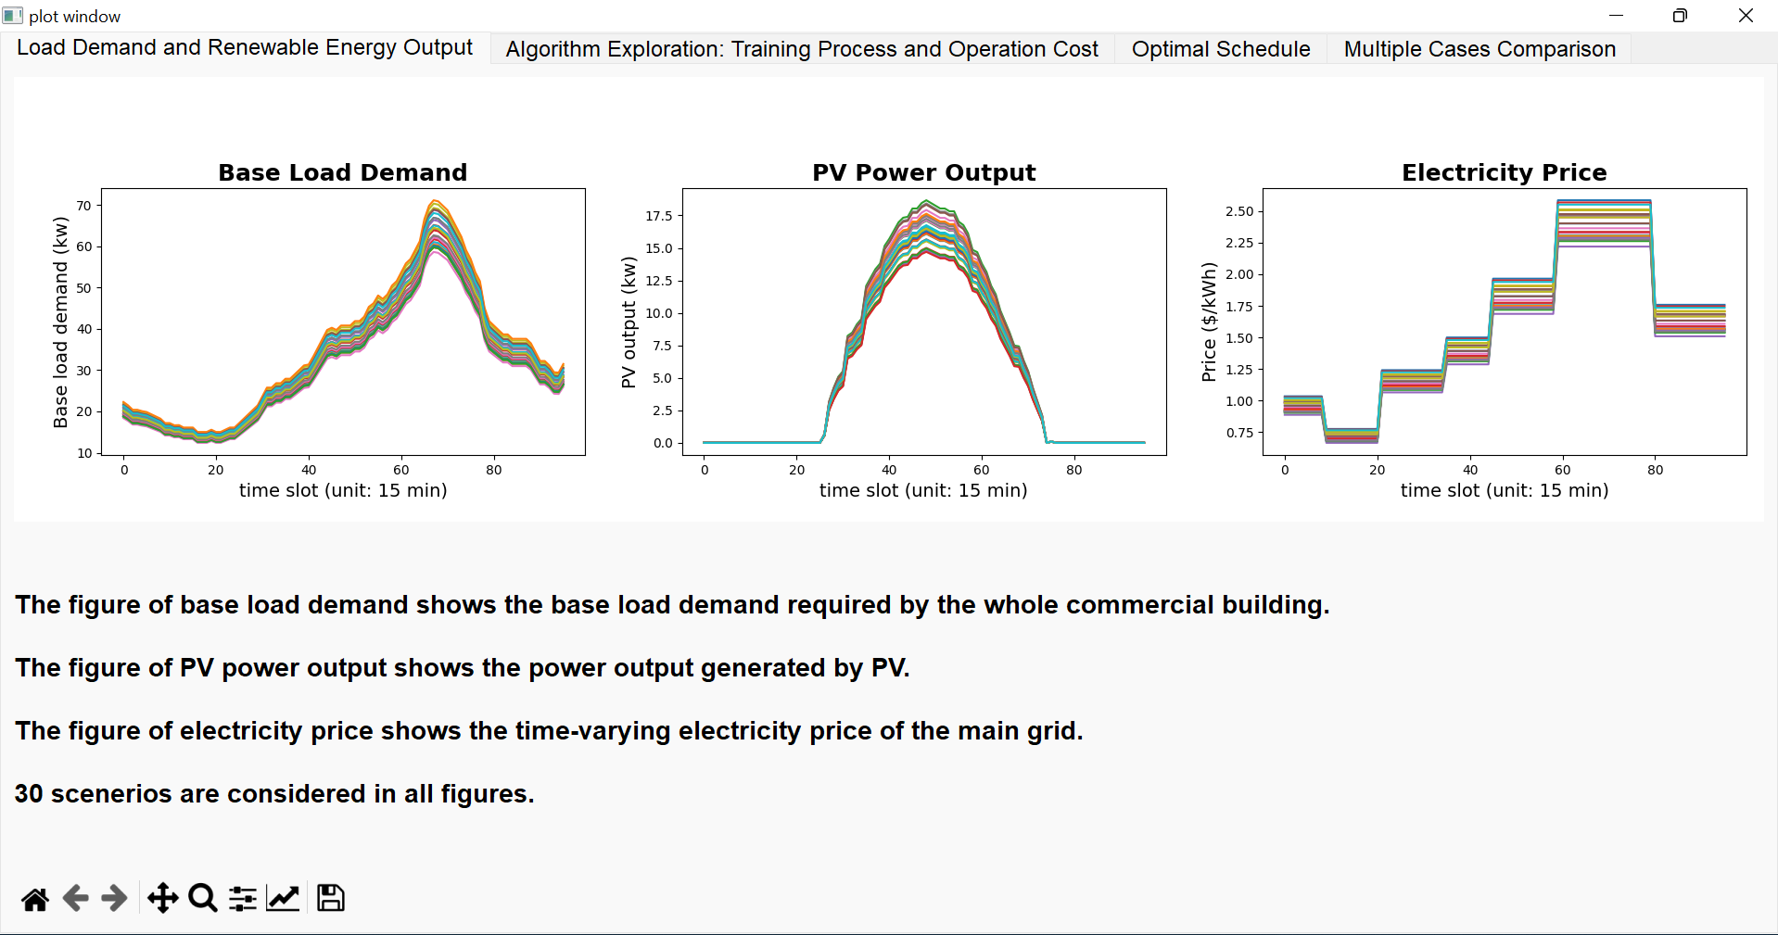

Slide 3
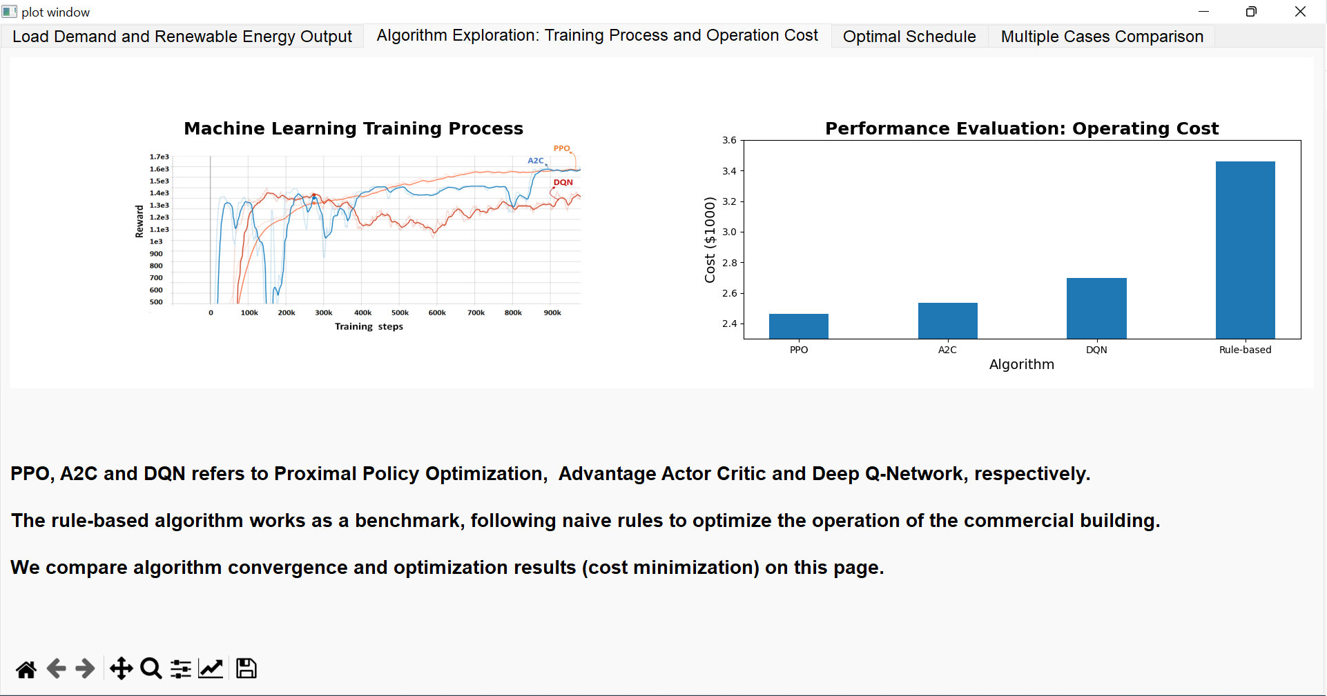
Case 1
Notes:
3189.8304207365895, 3214.8304207365895, 3609.0804207365895

Slide 4
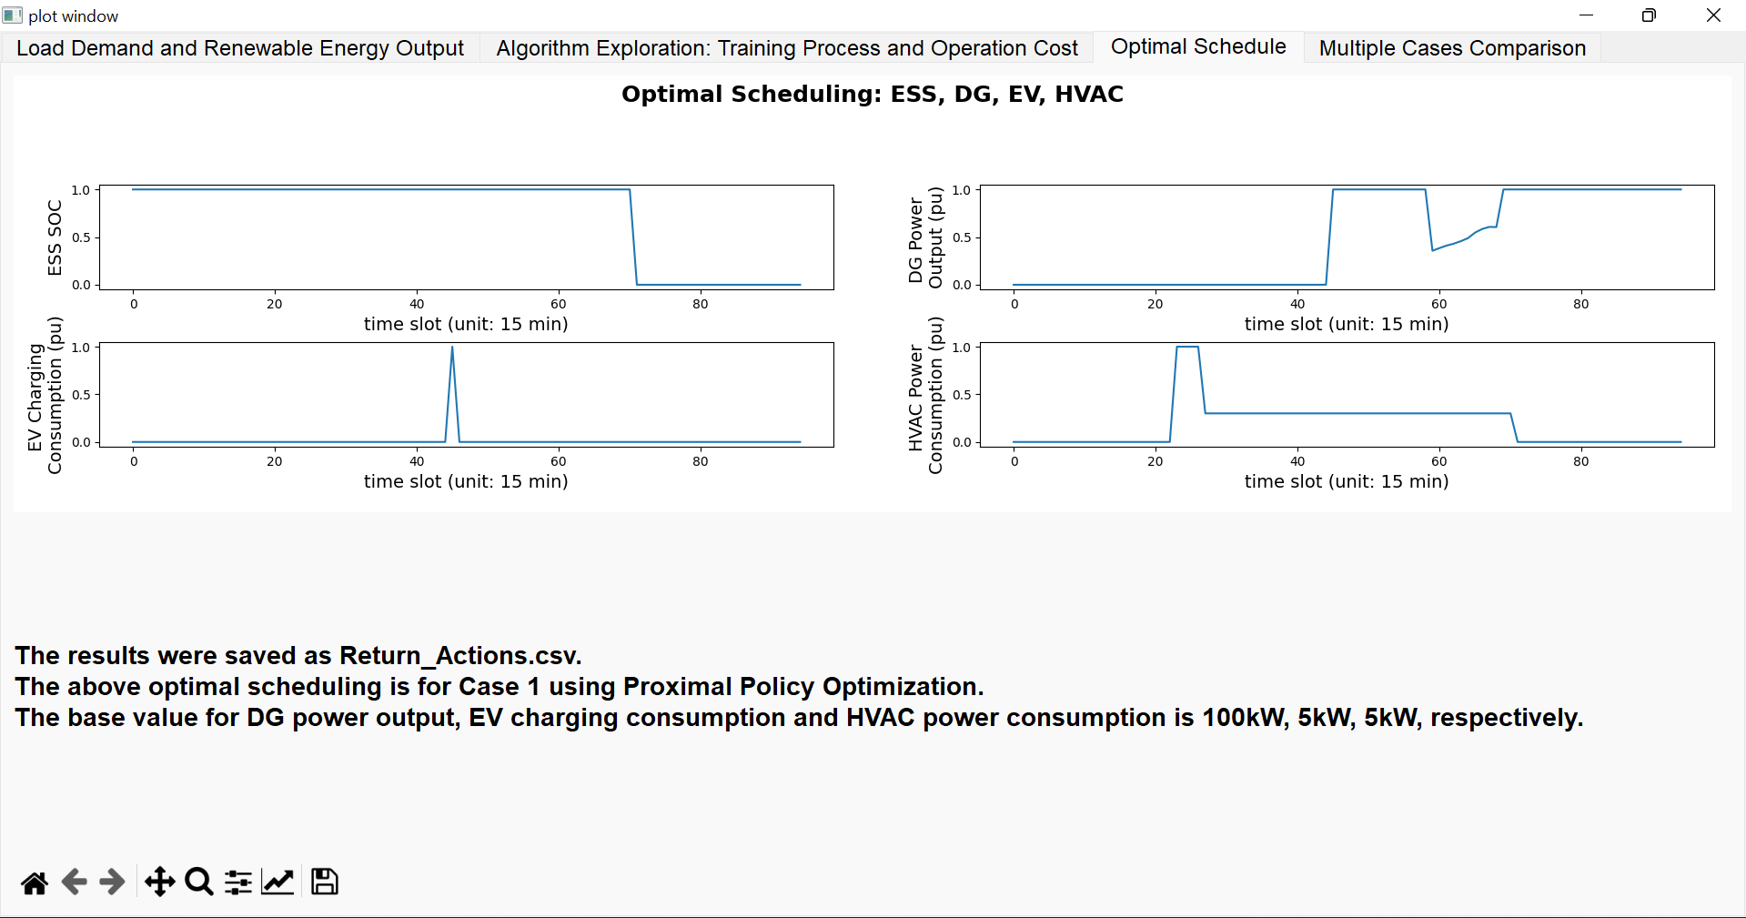
Case 1 (PPO)

Slide 5
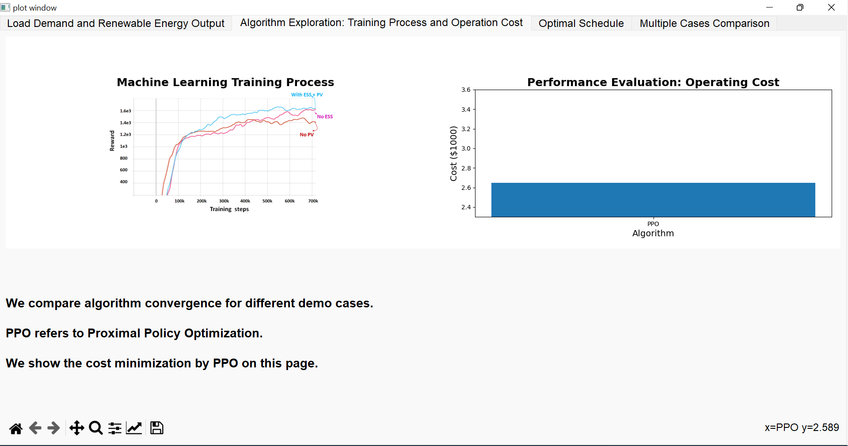
Case 2
Notes:
3349.8304207365904, 3214.8304207365895, 3464.0804207365895

Slide 6
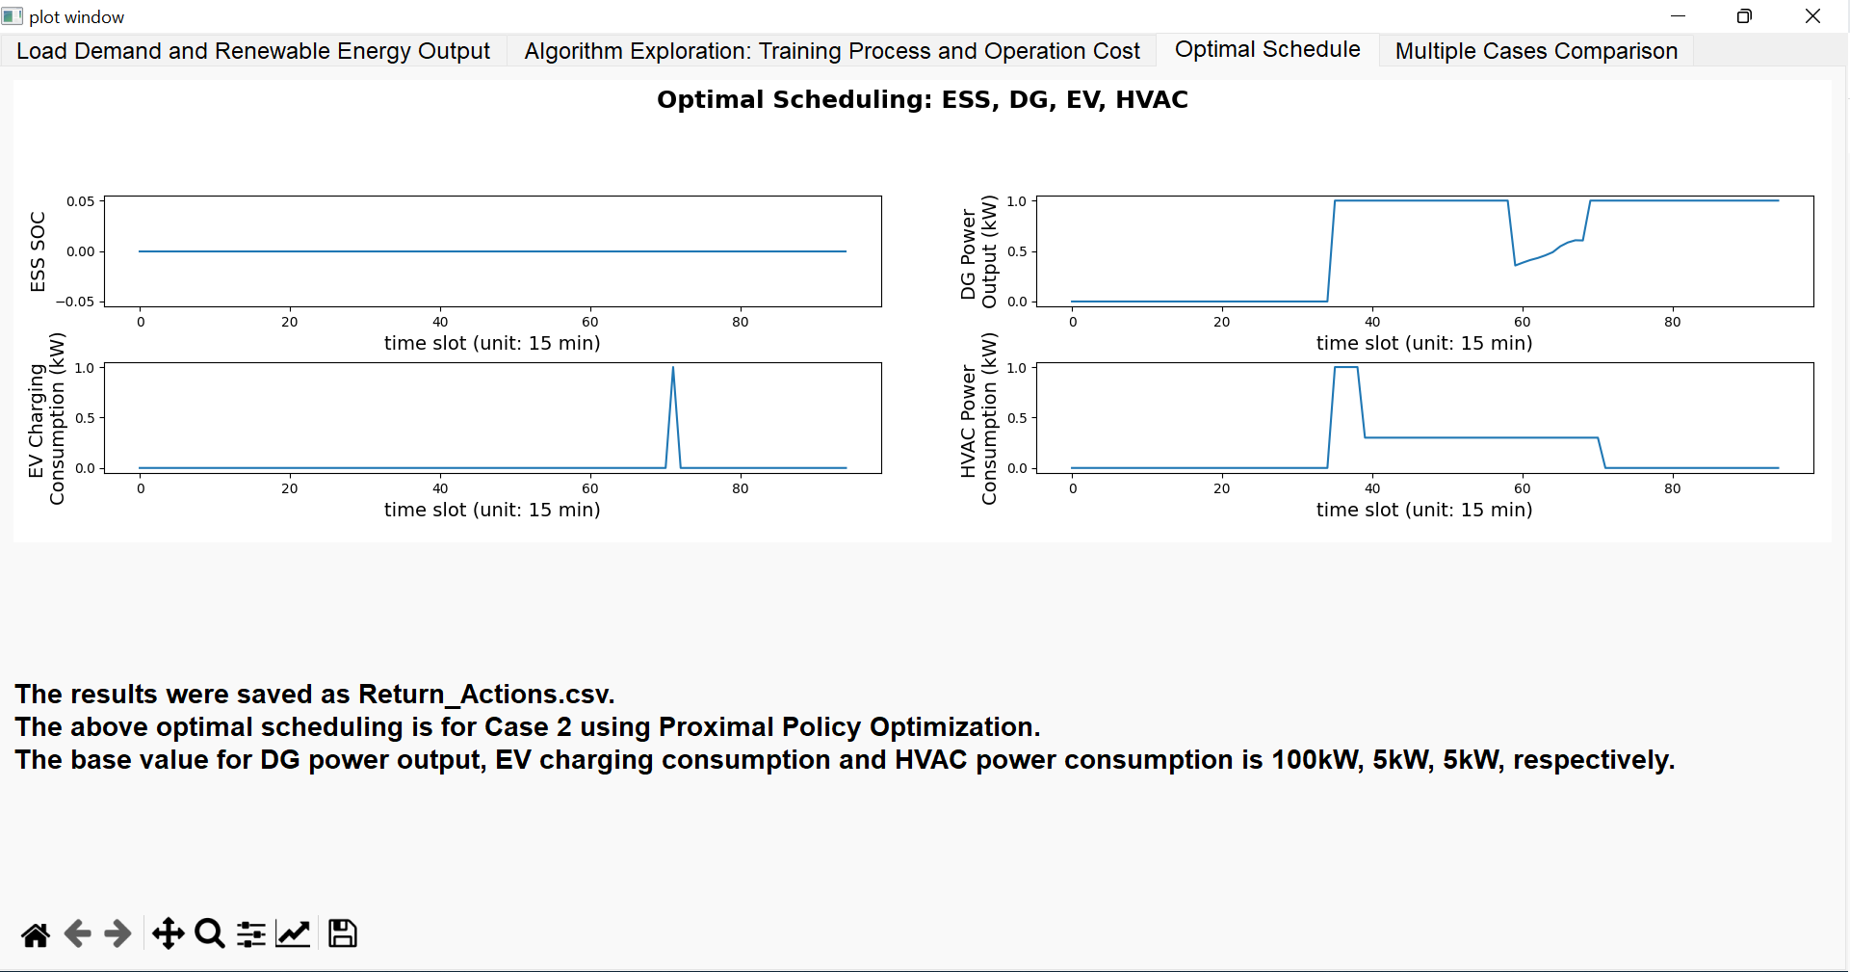
Case 2 (PPO)
Notes:
3349.8304207365904, 3214.8304207365895, 3464.0804207365895

Slide 7
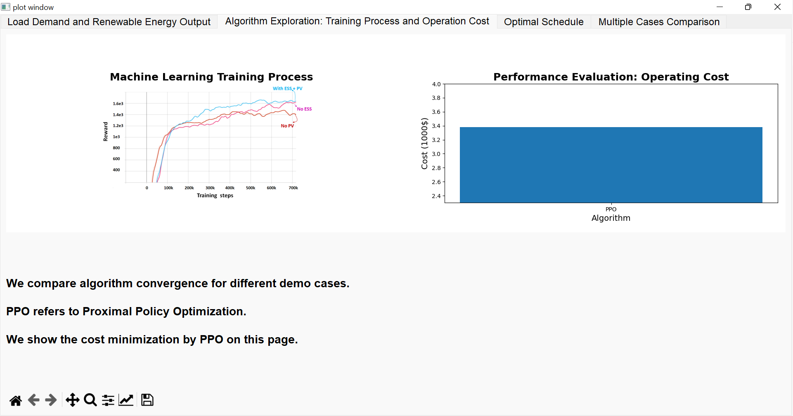
Case 3
Notes:
3240.539, 3265.539, 3659.789

Slide 8
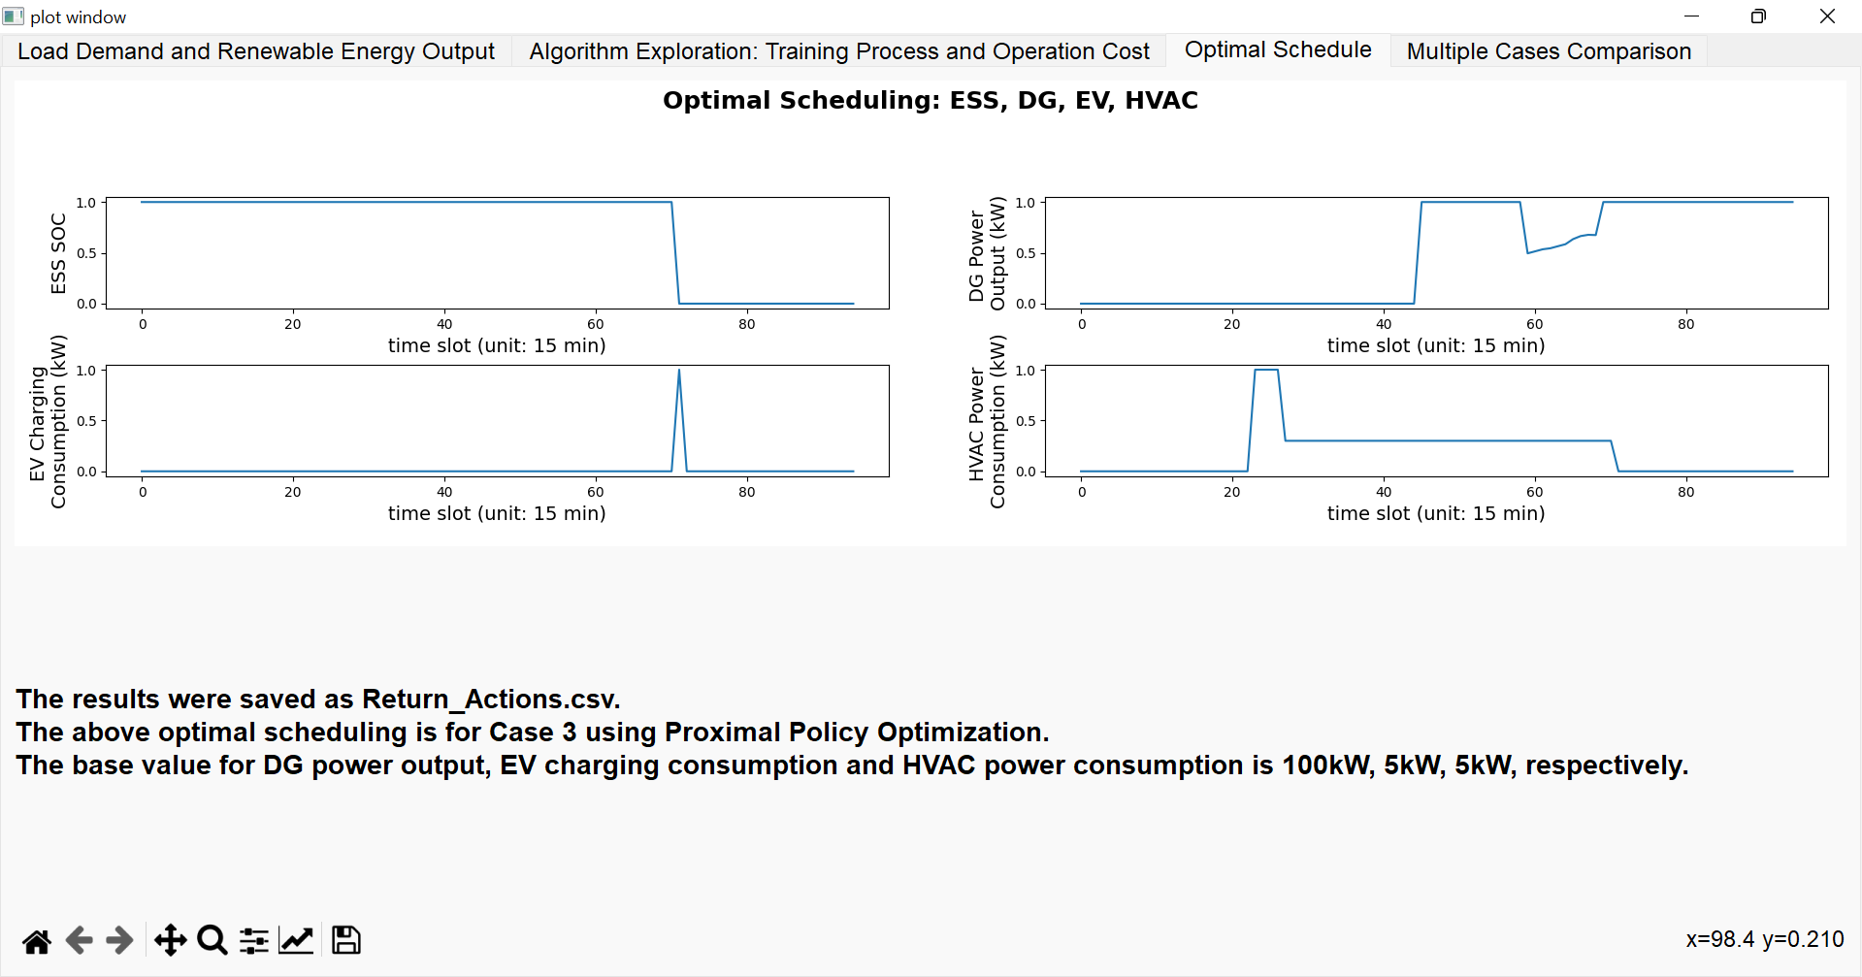
Case 3(PPO)

Slide 9
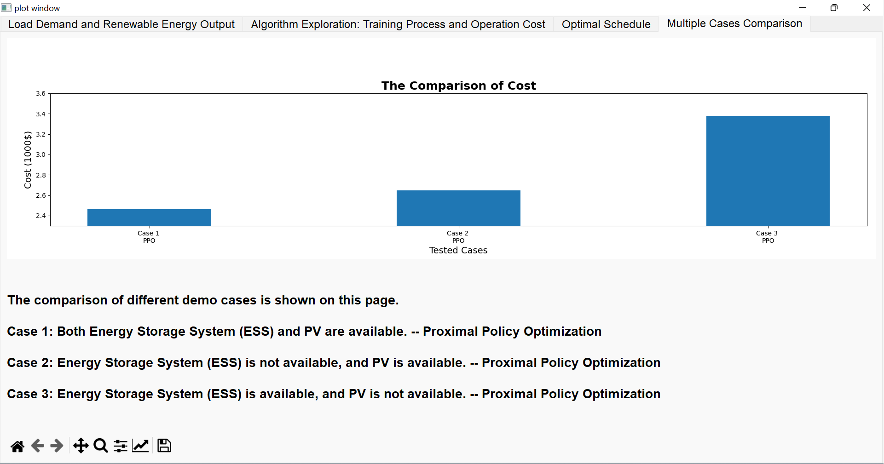
Notes:
'With both ESS and PV (PPO)': 3.1898304207365897, 'Without ESS (A2C)': 3.2148304207365896, 'Without PV (PPO)': 3.240539

