Slide 1
Building information:
Interruption time: intervals 60-70
PV capacity: 20kW？
3 best model using A2C, PPO, and DQN
3 best model using PPO for 3 cases: ESS+RDG, no ESS, no RDG
HVAC: temperature setting is 25, power consumption 5kW, when temperature reach temperature set, the power consumption is 1.5kW

Slide 2
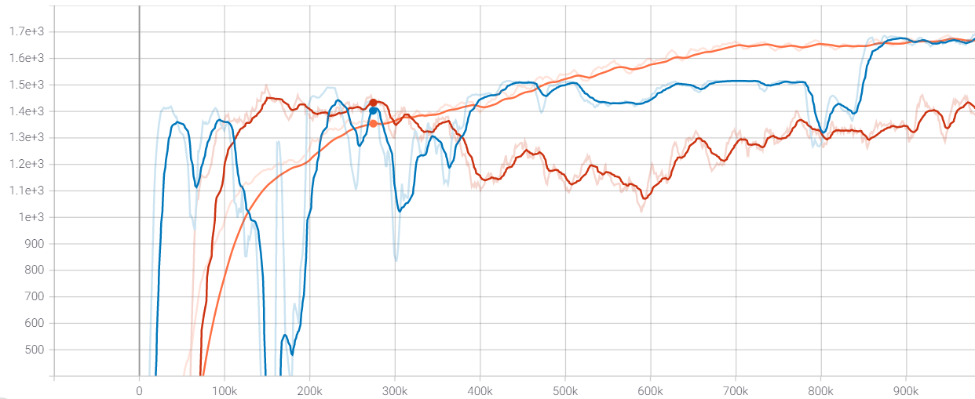
PPO
1.7e3
1.6e3
1.5e3
1.4e3
1.3e3
1.2e3
1.1e3
1e3
900
800
700
600
500
A2C
DQN
Reward
Rewards
0 100k 200k 300k 400k 500k 600k 700k 800k 900k
Training steps
Training steps

Slide 3
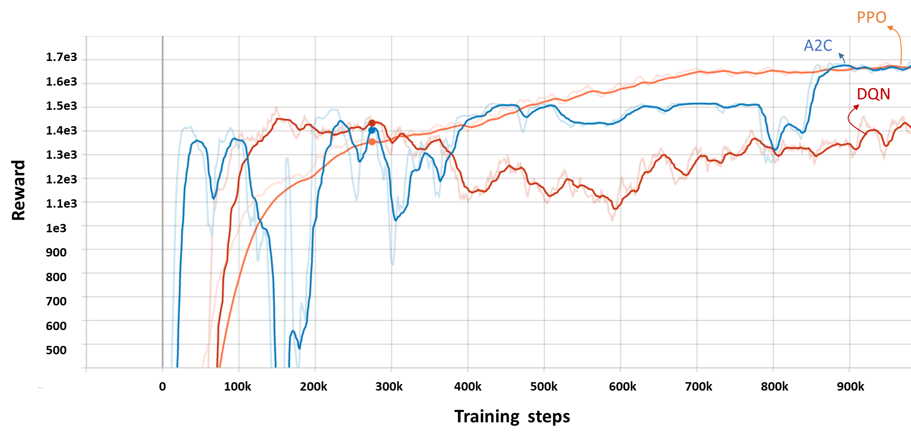

Slide 4
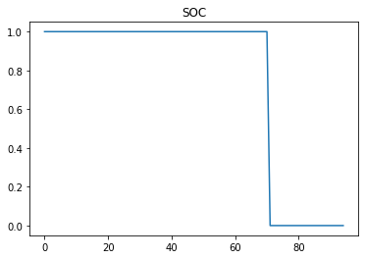
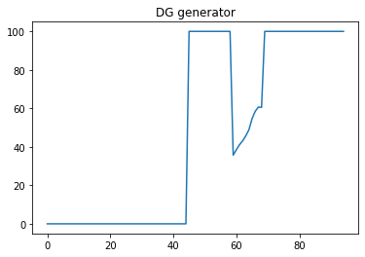
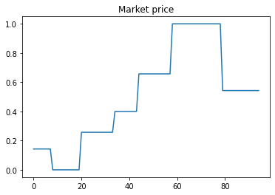
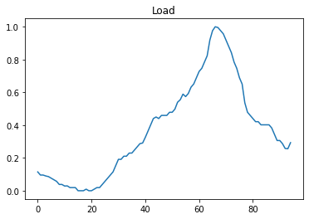
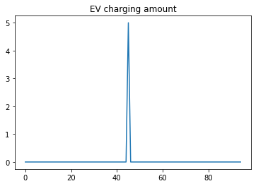
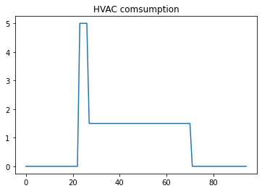
Optimal Operation
(kW)
(kW)
(kW)

Slide 5
Operation Cost
Algorithms | Operation cost
PPO | 2462.29
A2C | 25362.91
DQN | 2698.79
Rule-based model | 3461.79

Slide 6
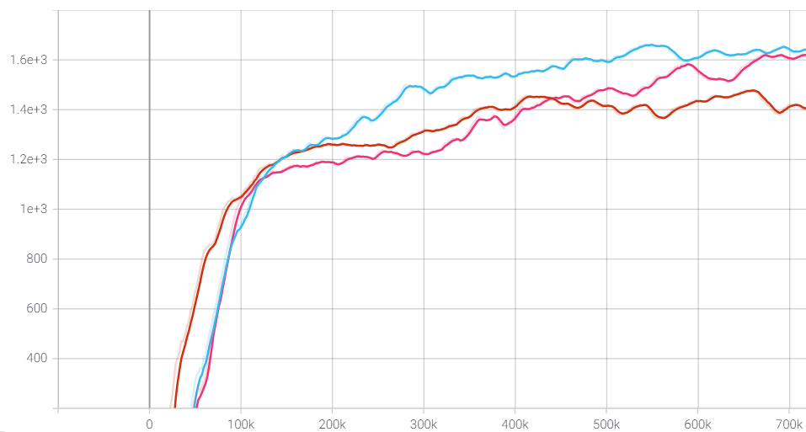
With ESS + PV
1.6e3
1.4e3
1.2e3
1e3
800
600
400
No ESS
Reward
No PV
Rewards
0 100k 200k 300k 400k 500k 600k 700k
Training steps
Training steps

Slide 7
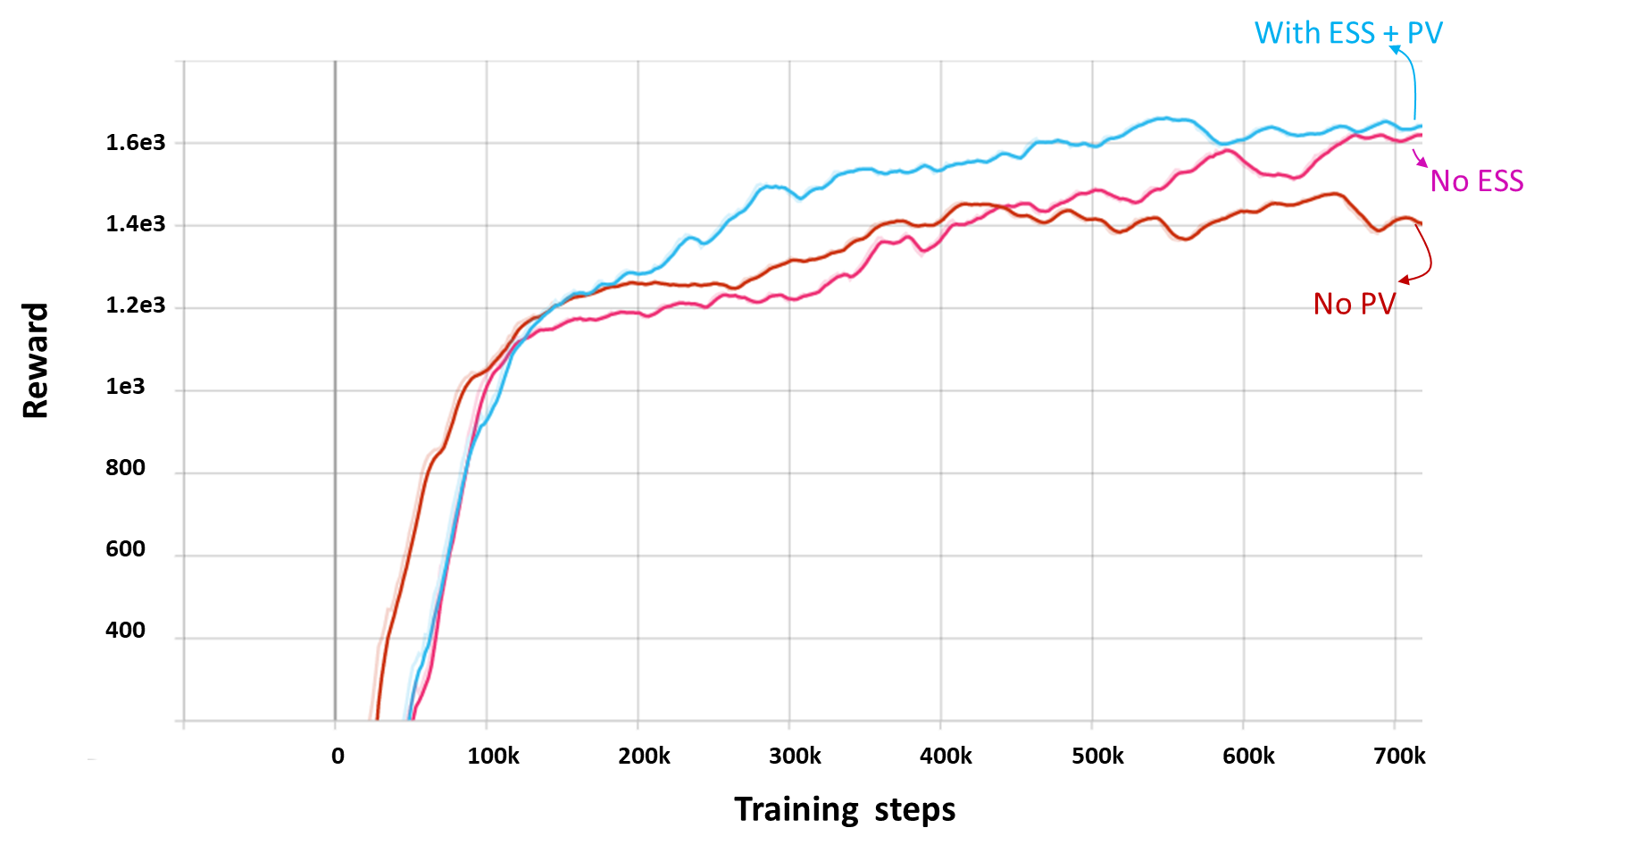

Slide 8
Operation Cost
Algorithms | Operation cost
PPO – No ESS | 2615.29
PPO – No RDG | 3377.58
PPO – with ESS+RDG | 2462.29

