Slide 1
the-Sergio
Jacob Buchowiecki, Andy Montes,
Claude Phan, Roberto Rodriquez

Slide 2
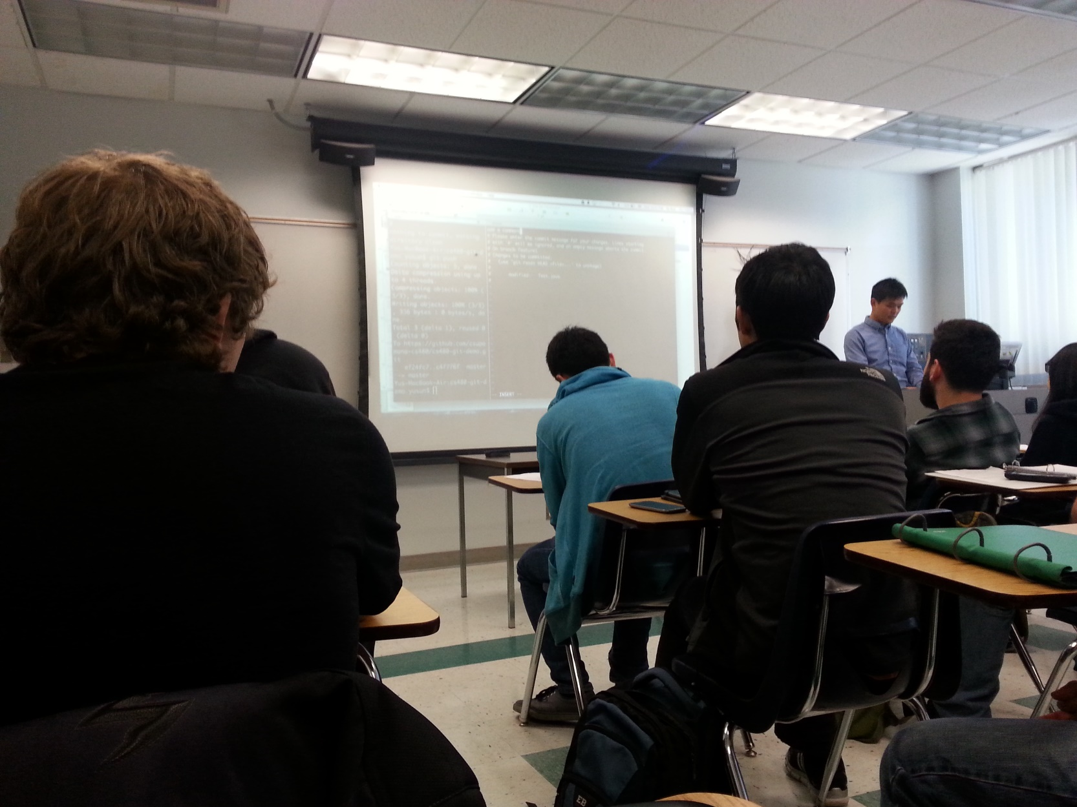
Imagine….
Notes:
Imagine…sitting in class…waiting for the bell to ring

Slide 3
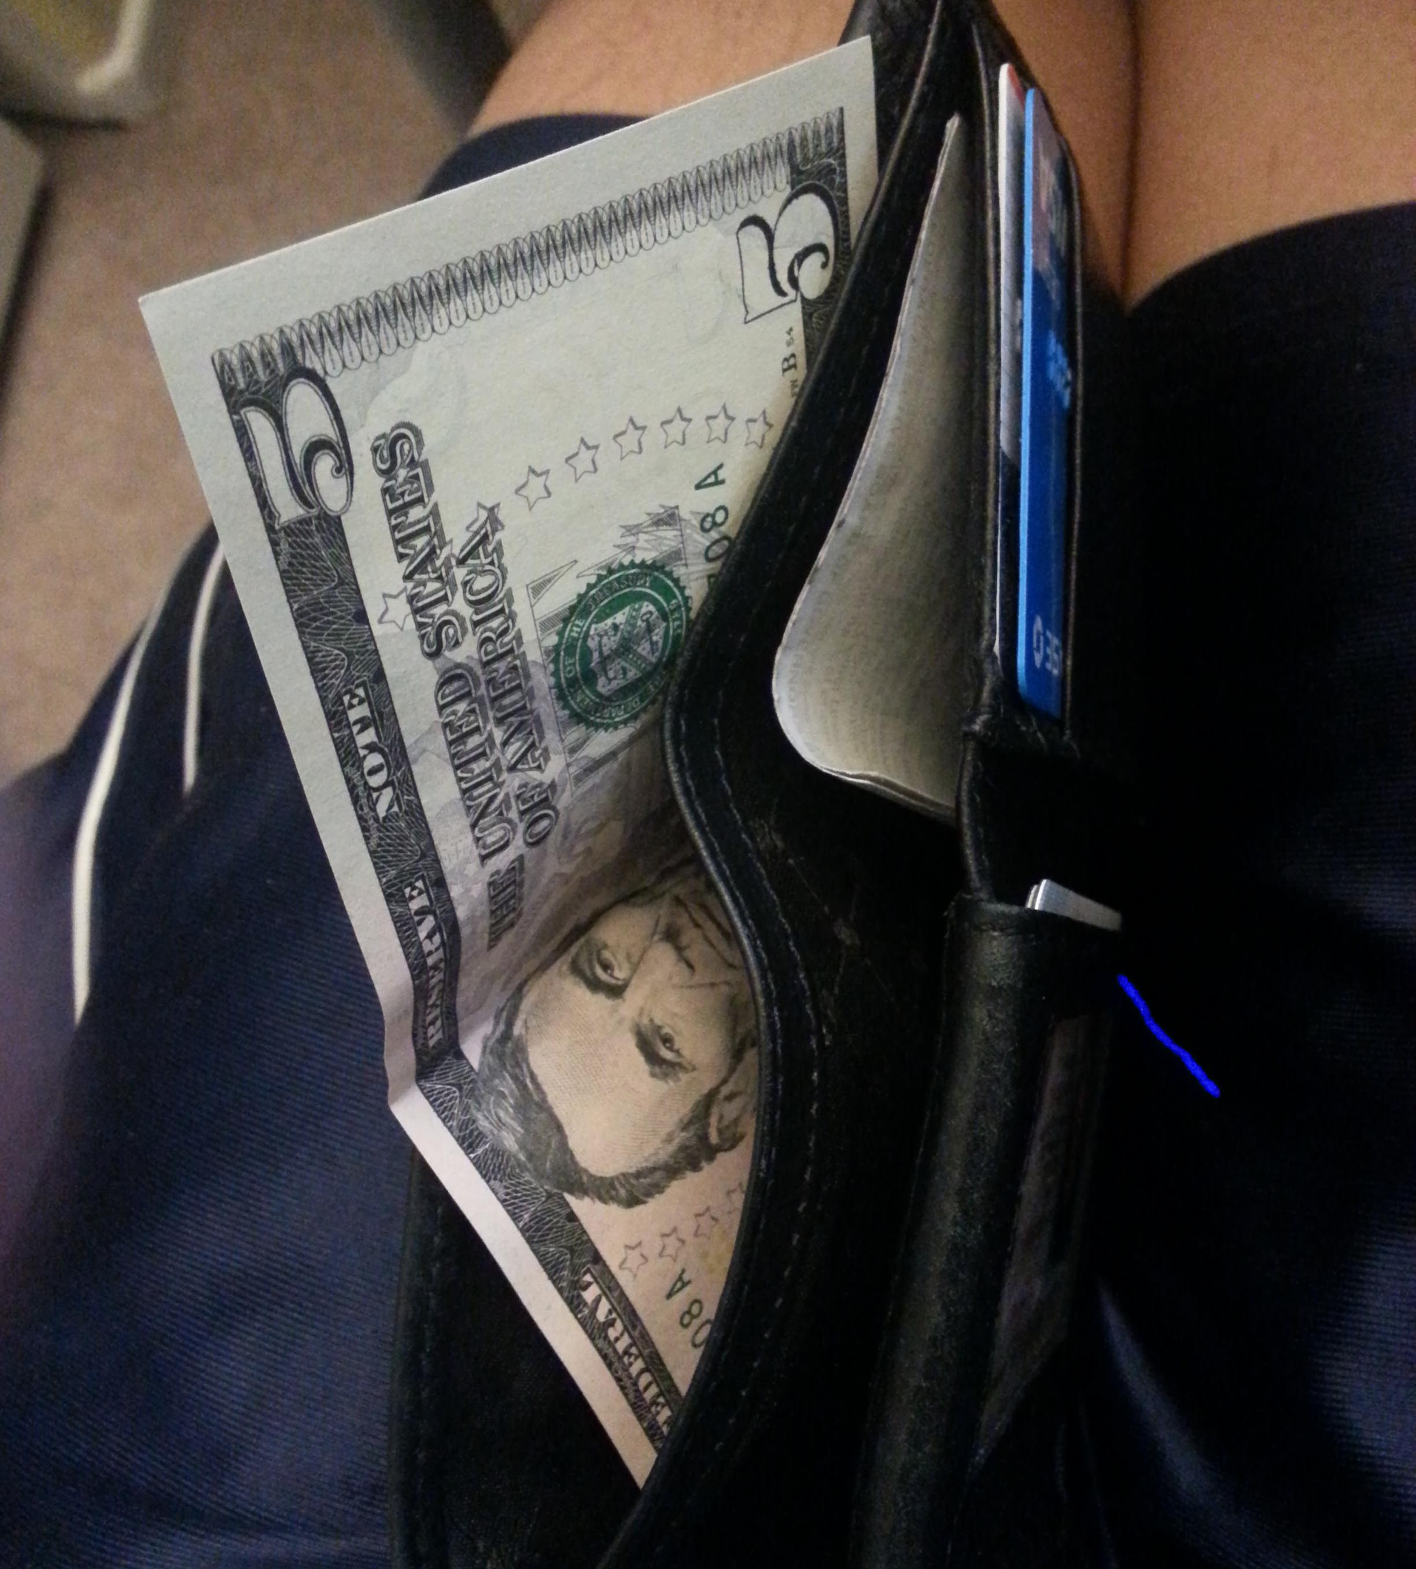
At last….
Notes:
….At last!... You jump up with joy! It’s lunch time another boy yelled! But wait….mom only gave you $5 for lunch….with so many choices and so little time…what is a young boy supposed to do?

Slide 4
Your faced with the toughest of questions...
Notes:
Your faced with the toughest of questions….What can I buy for lunch with only $5? Only if there was a way to answer such a question….

Slide 5
Introducing…..
Notes:
Introducing Cal Poly Pomona’s newest web service, Budget Grubbin!. Simply enter the amount you would like to spend for food here on campus and up comes a list of food options! It’s that easy!
Budget Grubbin with revolutionize the way people decide what they can and cannot buy. Sneak peek at Budget Grubbin v2.0, instead of entering a dollar amount, enter a maximum calorie amount, and Budget Grubbin, will help you budget your caloric intake!.

