Slide 1
Triio
by MAV Technical Group

Slide 2
Meet the Team
Michelle Chuong
4th year
Interesting facts:
Computer Science was not my first choice for a major
I spend $20 on Disneyland churros every visit
Anthony Haddox
5th year
Interesting facts:
Double major in Political Science and Computer Science
I used to work on an ice cream truck
Vivian Tat
5th Year
Interesting facts:
My birthday is New Year’s Eve
I like to sing loudly when I’m alone

Slide 3
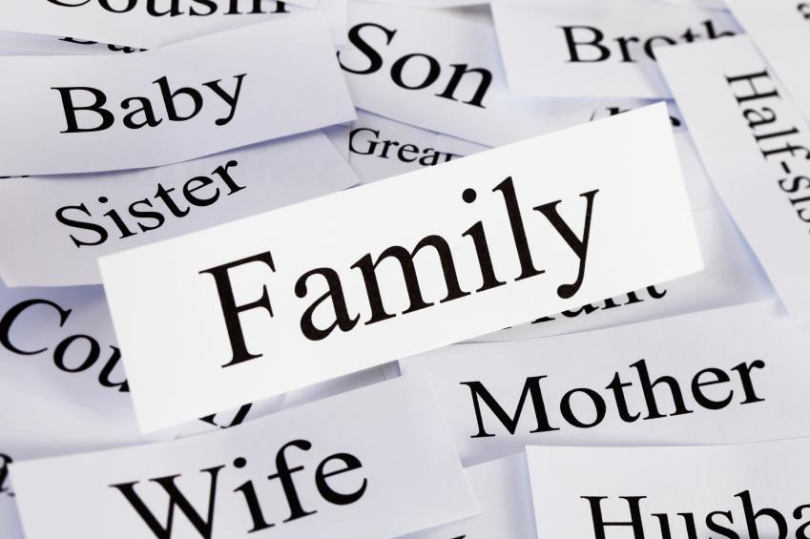
The Problem?
Families are complex structures
Tons of members
Different types of families
Where do you start?

Slide 4
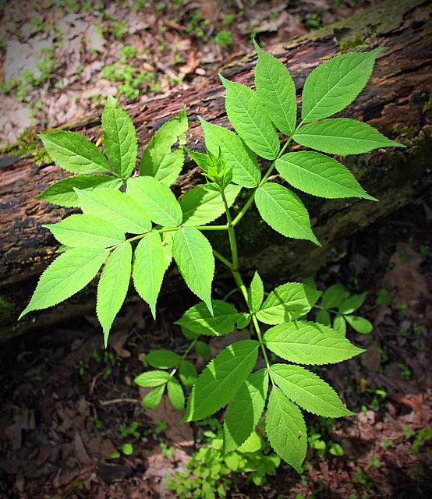
It starts with you...

Slide 5

Triio
Simple
Easy to use
Scalable
Free

Slide 6

Triio
Simple
Easy to use
Scalable
Free

