Slide 1
By
Seulki
Hetal
Khamille

Slide 2
The Problem

Slide 3

The Problem

Slide 4



Slide 5


Slide 6
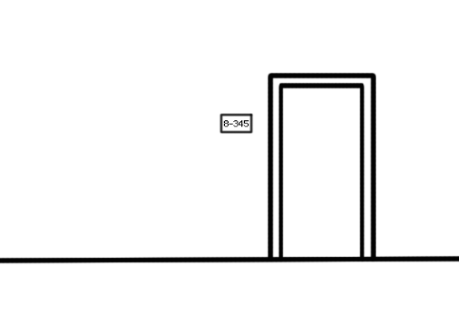

Hear about CSS and want to participate in Prog Comp

Slide 7

Hear about CSS and want to participate in Prog Comp

Slide 8

Hear about CSS and want to participate in Prog Comp

Slide 9

Hear about CSS and want to participate in Prog Comp

Slide 10


Work really hard & solve the code…

Slide 11

But now I can’t figure out how to log into my cpp.edu email address
I thought I sent my code but I haven’t got a response
I lost my source code I wish I could review it all in one convenient location
?

Slide 12
I wish there was
a better way!
?

Slide 13
Solution Make a web service for submissions

Slide 15

Advantage for Users
Allow to see previous submission
Do not need to submit via e-mail

Slide 16

Advantage for administrator
Don’t have to worry about weird Students’ email accounts.
Easy to manage all students’ codes

Slide 18

Thank you!

