Slide 1
Kafka @ DomaniRX SSNC Surya

Slide 2
Background
Kafka Topic Naming standards
Users and Consumer Groups

Slide 3
TOPIC Naming Standards
TOPIC:
<ENV>>.<B/I>.<SOURCE_APP_NAME>.<BUSINESS OBJECT>.<ACTION>
ENV: Indicates the environment name. Ex: DEV, TEST,QC,UAT, PRD etc.
B: Indicates that the scope of the topic can be extended (Bridged) to other Kafka clusters.
L: Indicates that the topic is for "Local" usage and the scope of the topic is within the cluster.(By Default all Topics should be local unless explicitly requested to be mirrored.In that case, it would need to have prefix B)
SOURCE_APP_NAME: Indicates the application name from where the events will be triggered. Ex: Finance,payment etc.
BUSINESS OBJECT: Indicates the type of function. Ex: Adjustment, cycle, etc.
ACTION: Indicates the type of event. Ex: CREATE, DELETE, UPDATE, PUBLISH etc.
Examples:

Slide 4
Users and Consumer Groups
Kafka Consumer group Creation - Standards
You group consumers into a consumer group by use case or function of the group. One consumer group might be responsible for delivering records to high-speed, in-memory microservices while another consumer group is streaming those same records to Batch Process. Consumer groups have names to identify them from other consumer groups.
A consumer group has a unique id. Each consumer group is a subscriber to one or more Kafka topics. Each consumer group maintains its offset per topic partition. If you need multiple subscribers, then you have multiple consumer groups. A record gets delivered to only one consumer in a consumer group.
Each consumer in a consumer group processes records and only one consumer in that group will get the same record. Consumers in a consumer group load balance record processing.
Follow Consumer naming something like
GROUP.<ENV>.<APPLICATIONNAME>.<SHORT TOPICNAME>
eg:GROUP.DEV.PAYMENT.STATUS

Slide 5
Users
Dev_app_finance
Dev_app_payment

Slide 6
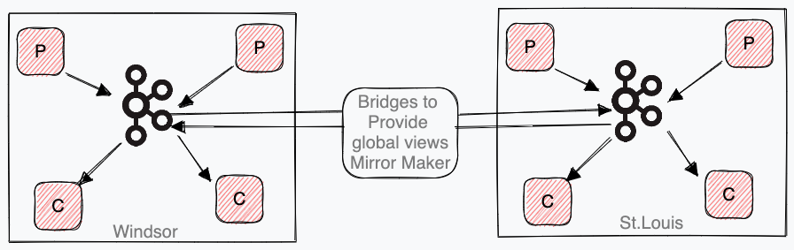
Architecture Topology
Local/Regional Clusters, Local Access + Bridging
Independent clusters into each location or region, and have clients access only their local cluster.
Globally managed bridging agents for required (global) topics topic to present a global view over those instances.
If single location services move around, then the bridging is reconfigured at the "global" level, individual clients are not impacted.
P = Producers and C= Consumers

Slide 7
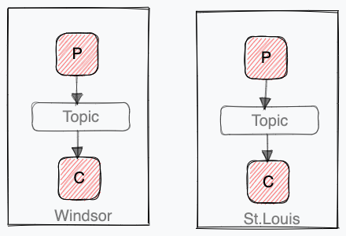
ONE TO ONE Bridging is not required for this. Kafka will not replicate the messages to another region for this pattern. This will be referred as a local topic

Slide 8
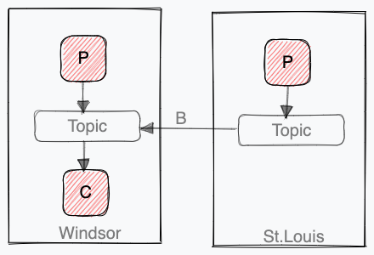
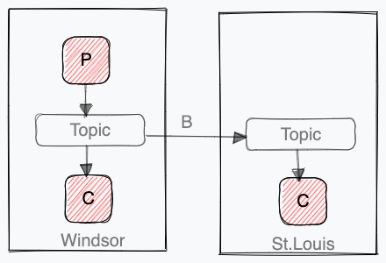
MANY TO ONE
The bridges are consumer centric. All messages for a topic will be bridged to the region where the consumer is active. When the consumer moves to a different region, the bridges needs to be re-configured to push it to the new region. This should be part of failover and fail-back activities.
ONE TO MANY
The bridges are producer centric. All messages for a topic will be bridged from the producer’s active site to other the required regions. When the producer moves to a different region, the bridges needs to be re-configured to source it from the new region. This should be part of failover and fail-back activities

Slide 9
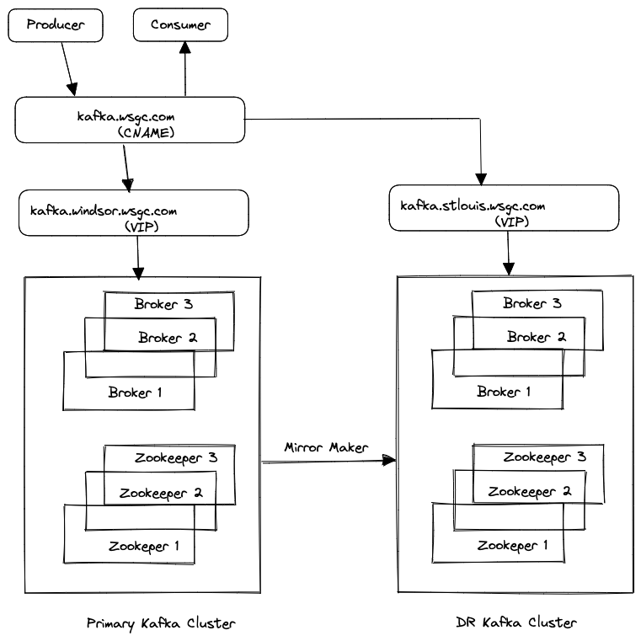
Kafka PROD-DR Replication

