Slide 1

Game Developers: Brian Long, Ryan Stegmann, Xia Vang
Artists: Kyla Vondrak, Thien Nguyen, Luis Pichardo, Andrew Smith
Music Composer: Jaelyn Denise

Slide 2


Story
A family picnic has run amok with an infestation of various creatures and insects. The player must defend the picnic with their squishing powers and various abilities in order to save the picnic from the ongoing infestation.

Slide 3



Genre
Action
Strategy
Casual
System Requirements
Android 2.3.1+
IOS 6.0+
PC/Mac

Slide 4
Game Mechanics
2D Top-Down view
First person (no character or movement)
Player Actions: Tapping/Clicking
Goal:
Player must protect the picnic basket in the middle of the screen from randomly spawning insects

Slide 5
Game Mechanics
Player must survive through a wave of insects in order to progress to next level
Picnic Basket Health: 5
Each click on insect deals 1 damage

Slide 6
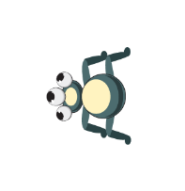

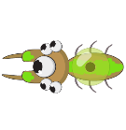
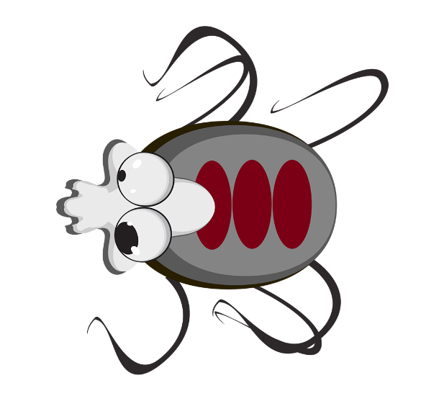
Enemy Types
Ant: 1 health (normal speed)
Beetle: 3 health (slow speed)
Flying Insect: 2 health (fast speed)
Boss insect: 25 health (slow speed)

Slide 7
Gameplay
A set amount of insects will spawn randomly on screen each wave
Player must squish insects and prevent bugs from eating the picnic
Survival & Progression
Kill all insects or ensure picnic health hasn’t reached zero

Slide 8

Gameplay
First wave introduces easy-to-kill bugs (ants)
Second wave introduces harder-to-kill bugs (beetles)
Third wave introduces fast and tough bugs (flies)
Fourth wave: assortment of previous bugs with higher difficulty
Fifth wave: Boss encounter!

Slide 9
Power ups (Future Implementation)
Magnifying glass to burn an area.
Candy to distract insects away from your picnic.
Bug spray to clear the screen of insects.
*Power ups will be less effective against bosses.

Slide 10

Game Controls
Tapping/clicking to defeat enemies
Gestures may be implemented in the future for various power-ups.

Slide 11


Game Interface
Main Menu:
Play: Start the game (or level select implemented in the future)
Settings: Sound & Music settings
In-game buttons consist of a pause and power ups(future).

Slide 12
Monetization
Free-to-play, however players can purchase power ups and various future implementations with cash.
Ideas for future implementations may include: Cosmetic rewards such as bug skins, tapping effects (confetti, rainbows, snowballs, etc.), and goal skins.

Slide 13

Replayability
The replayability of the game relies on level advancement which increases the difficulty of the game.
Increasing difficulty this way will give the player a feel of progression and satisfaction upon completing difficult levels.
Difficult levels will challenge the player and encourage them to attempt several times until completion.

Slide 14
Sequel
No Sequel is planned, but continuous development on the game after being publish is suggested.

Slide 15
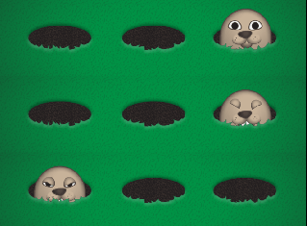
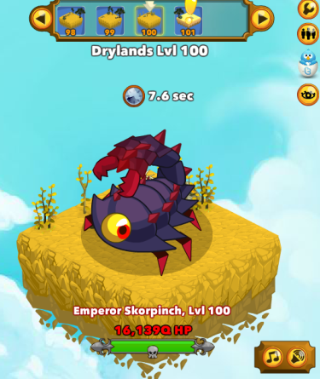
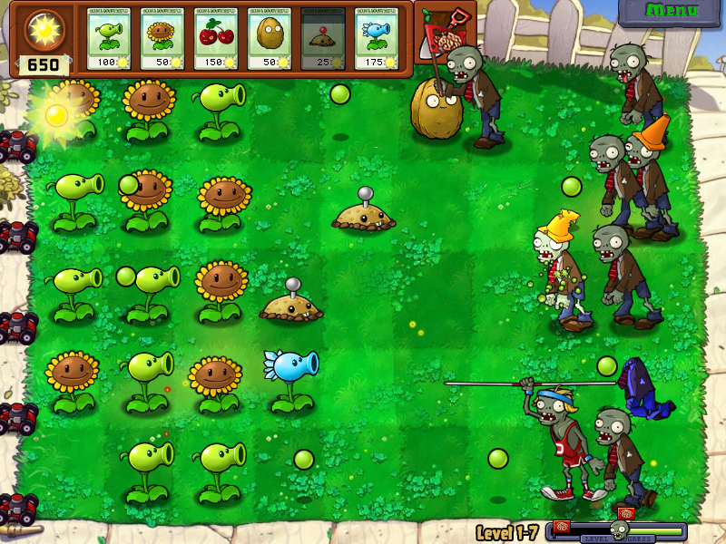
Inspirations
Whack-a-Mole
Clicker Heroes
Plants vs. Zombies

Slide 16
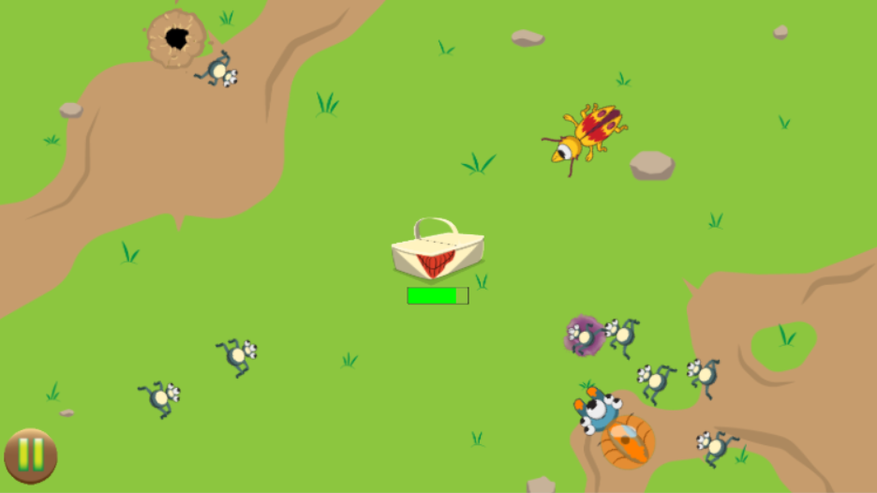

Screenshot

Slide 17
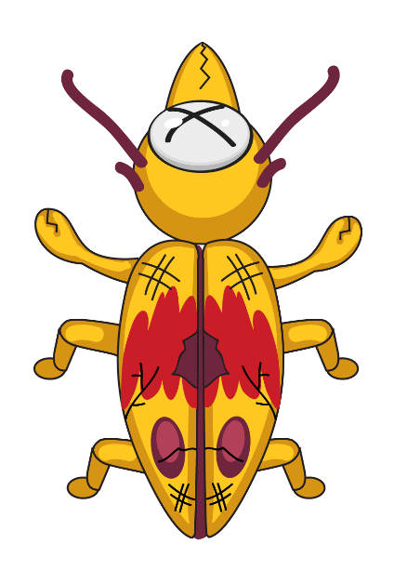
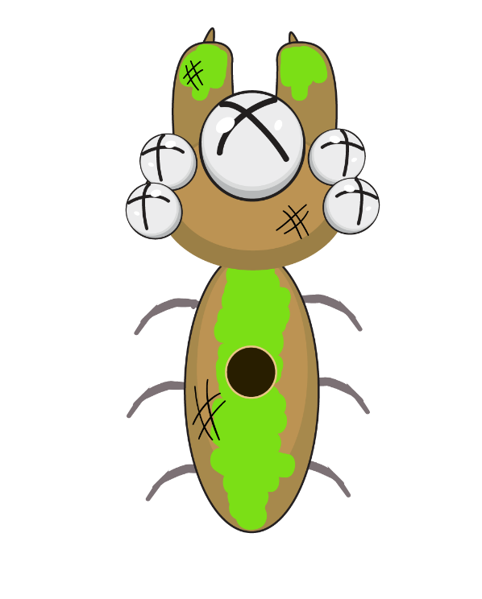
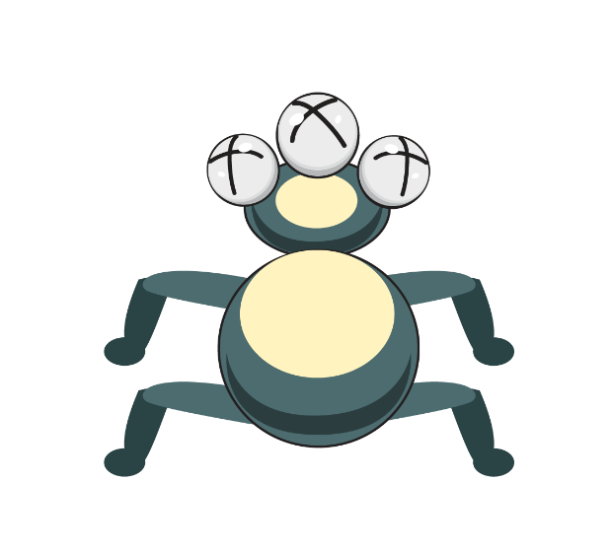
Questions?

