Slide 1


Slide 2
Presenters:
Grover Wimberly IV – Founder, Selatria Project
Paul Vela – Co-Founder, Administrative Director
October 6, 2016
http://www.whimindie.com

Slide 3
About Us
Whim Indie started in December 2012
Released two games. ANTics in May of 2014 and Selatria Part One in September of 2016. Third unannounced game in development.
Two development teams (though some teams share personnel)
Our teams collaborate remotely during the week and in our studio on Saturdays.

Slide 4
Mission Statement
“Create. Communicate. Collaborate.”
Vision:
  Whim Independent Studios prides itself on providing challenging and rewarding experiences to individuals committed to developing truly excellent gaming experiences.
In simple terms, our games are intentionally difficult.

Slide 5
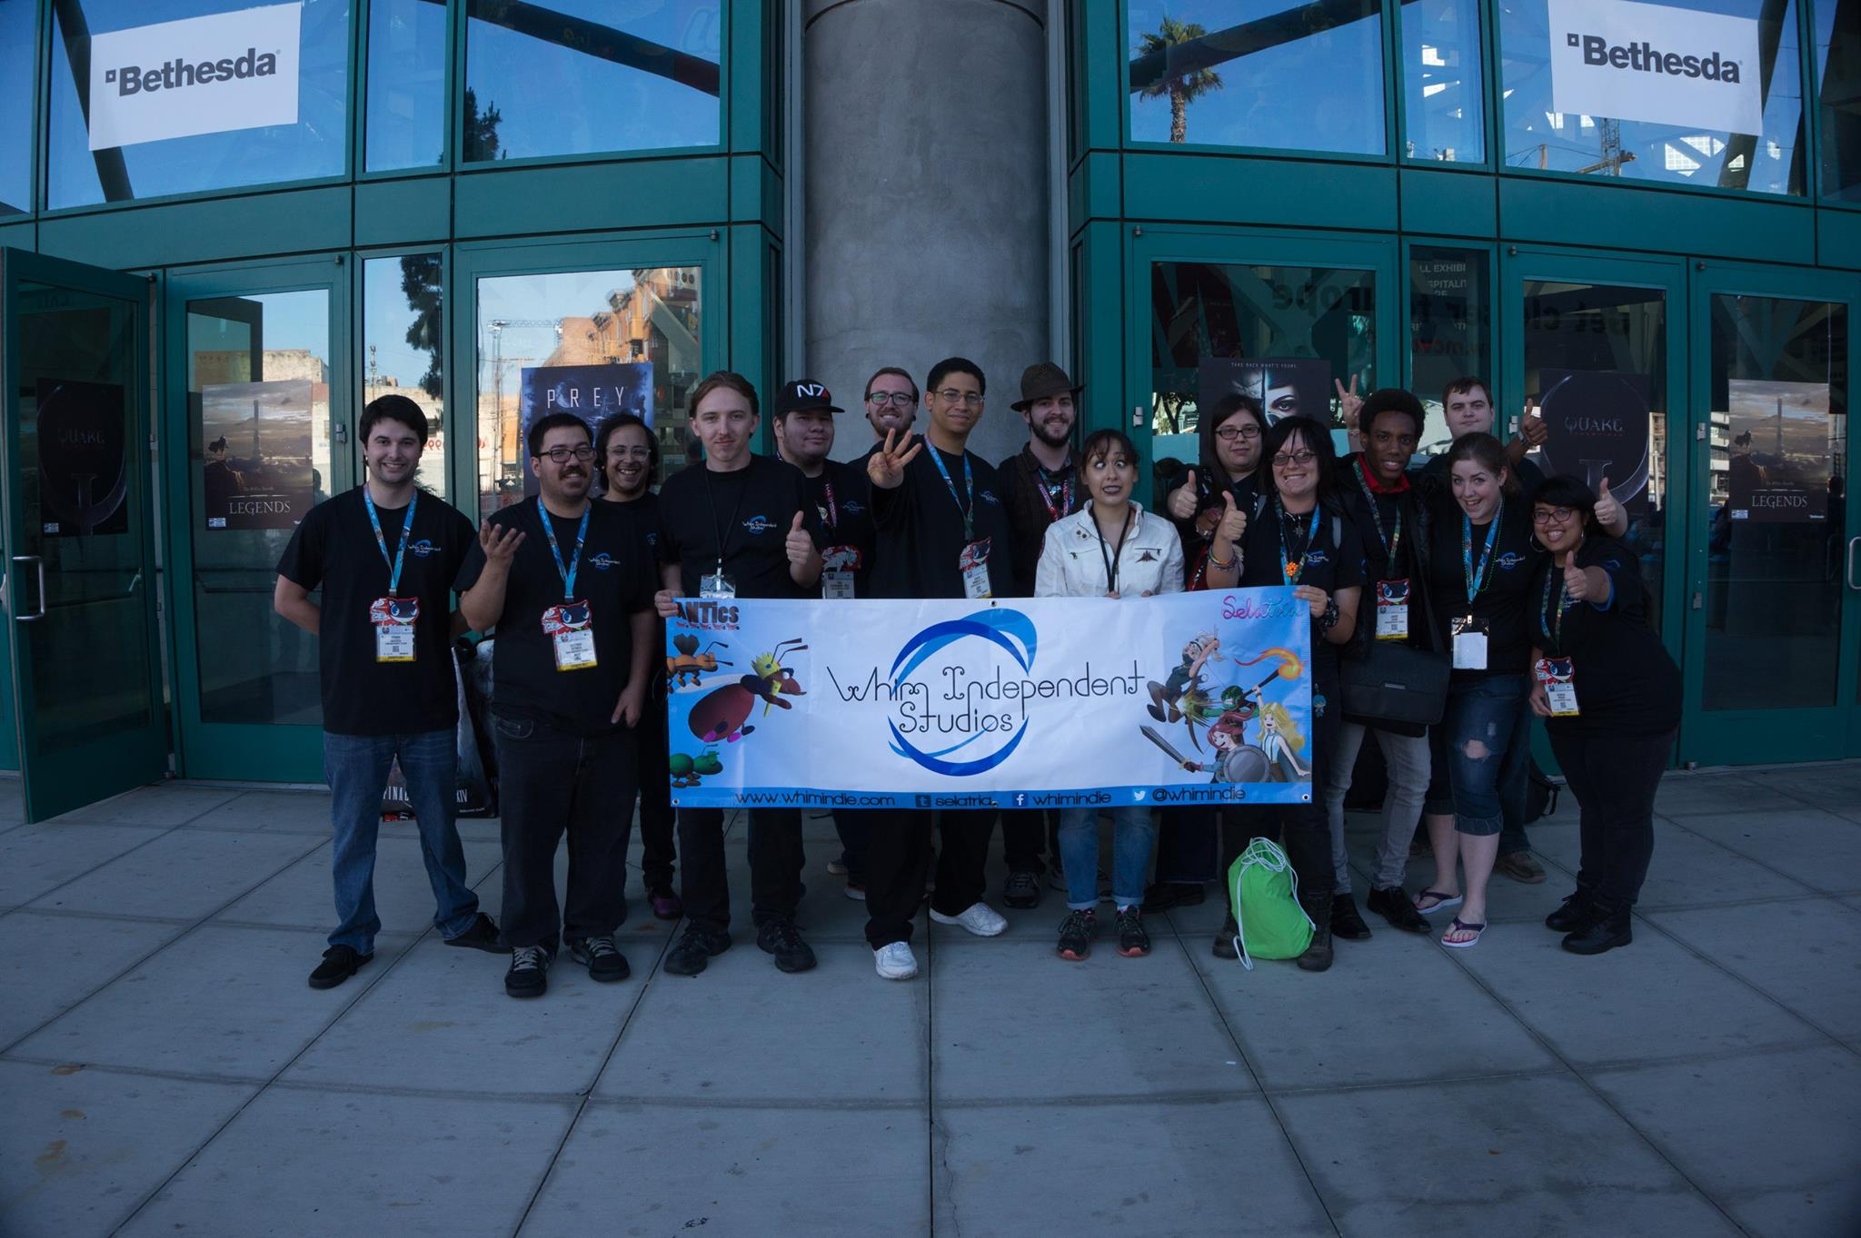

Slide 6


Slide 7
Selatria
2D role-playing game
RPG Maker VX game engine
Using Tankentai framework (Ruby) as a base + our own customized scripting
Has been in development since January 2011, released first half in September 2016.
Coordinated effort between two artists, four game designers, several voice actors, sound engineers, writers, and composers

Slide 8


Slide 9
ANTics
Arcade-style attain high score survival game
Our first completed game for Android/iOS/PC
Developed on ActionScript3/Flash
Took a year to complete
Team consisted of one programmer, two game designers, composer, sound effects, and two artists.

Slide 10
Game Engines

Slide 11
Game Engines
Simple: RPG Maker, IG Maker, Game Maker Studio, Construct 2, M.U.G.E.N, etc...
Intermediate: Unity, libgdx, sphere, ActionScript (Flash), etc...
Advanced: Unreal Engine, Closed Proprietary Engine, Your own original game engine

Slide 12
Most Important!
The simpler the engine, the higher the bar needs to be set.
There is no "good" or "bad" game engine. Players care about whether it's fun or not.
Use the tools necessary to accomplish your goals. Don't reinvent the wheel.

Slide 13
Resources

Slide 14
Resources – The Big Players
Pixel Prospector – Knowledge-base of all Different sectors – Game Design, Business, Marketing, Art/Sounds
http://www.pixelprospector.com/game-development
Reddit /r/gamedev – Valuable source of information on current trends in game dev industry
Http://www.reddit.com/r/gamedev

Slide 15
Resources – Slack
Slack – Professional Team Communication Tool. (FREE!) http://www.slack.com
Software companies use Slack to send files, updates, etc.
Has social media terms to contact team members ( @ tag )
Dropbox/Google Drive Integration
Chat channel available to not have to email

Slide 16
Resources – HackNPlan
HackNPlan – Team Management Software. Organize plans and keep track of milestones and production http://www.hacknplan.com/
Very similar to software development programs like JIRA, Trello, Rally to be able to figure out how close/far the project is to being done.
Free and good for metrics, analysis, and organization.

Slide 17
Resources – OpenGameArt
http://www.opengameart.org/
Contains many free resources. Free to use and modify art, backgrounds, models, sound effects, songs and music.
Make sure to look at the license to use.
In most cases, assets built here can be used as a template to build on top of to speed development. Don't re-invent the wheel if you don't need to!

Slide 18
Resources – Unity Asset Store
https://www.assetstore.unity3d.com/en/
Free and commercial assets you can use for your project
Can access from the engine itself or via web browser

Slide 19
Game Distribution

Slide 20
The Big Players
Steam (PC/Linux) – Greenlight $100 Fee
Google Play (Android) – Play Store $25 Fee once forever
App Store (iOS/Mac) – Yearly $99 Fee Per Platform

Slide 21
Other Distribution Sites!
Itch.io http://itch.io - Game Distribution Site, Any genre. Can also post work-in-progress
Game Jolt - http://gamejolt.com/ - Another indie game distribution site.
Aldorlea Games http://www.aldorlea.org/ - Story/Visual Novels, RPGs
Big Fish Games - Focus on casual games Casual Games (Requirement: Must have mouse controls) http://www.bigfishgames.com/
Kongregate - For Free Games only http://www.kongregate.com/
Humble Storehttps://support.humblebundle.com/hc/en-us/articles/202742080-Humble-Store-FAQ

Slide 22
Professional Reach
International Game Developers Association (IGDA) http://www.igda.org/ - IGDA Los Angeles and IGDA Orange County
Global Game Jam http://globalgamejam.org/ – Every January. Held at USC and UC Irvine. People from all over meet over three days to create a functional game from scratch. Industry personnel review and judge games, website hosts completed projects.
GDC (Every Spring) http://www.gdconf.com/ – Game Developers' Conference in San Francisco. Great for networking (Though expensive)

Slide 23
Other Tips?
I asked the team to give to give tips to students interested in indie game development.
Too many to list here!
List - http://bit.ly/1QNQMzI

Slide 24
Questions?

Slide 25
Thank you!

