Slide 1
Psychic Showdown

Slide 2
Presenters
Sera Young - Team Leader
Yuan Hao Liu – Programmer
Michael Lopez - Programmer

Slide 3
Overview
Genre: Strategy
Combination Grid-based and Card-based
System Requirements: PC
Notes:
The game’s genre is strategy.
The game combines grid-based combat, a common element of turn based strategy games, with card-based gameplay, a form of gameplay that more often than not uses turns. In that respect, these two subgenres work together really well.
Playable on most PCs as it won’t be resource intensive.

Slide 4
Game Mechanics
A single unit is controlled on the board.
Board Size is 5x7 to better facilitate one on one gameplay
Obstacles will be present on the board to interfere with movement and attacking, as well as create something else for characters to interact with.
3 playable characters: Psychokinesis User, Pyrokinesis User, and Martial Artist
Characters have decks of 20 cards, and use PSY to play cards.
Notes:
A rectangular board allows us to direct the flow of movement. Characters are encouraged to move towards their opponent, and in the direction with the most room to move. Less space to the left and right of the character means trying to run in circles to avoid your opponent is impossible.
Obstacles can be picked up, and thrown with psychic powers. They cannot be walked through. They have health so they can be broken.
Psychokinesis user is a pretty standard psychic character. Primarily she lifts things with her mind and throws them though she also has an assortment of generic psychic powers. Pyrokinesis user sets things on fire. The Martial Artists uses psychic powers to strengthen their body.
Decks of 20 cards, half of which are a basic card based on the character’s class. The rest are chosen from a card pool available to each character. No more than 2 copies of any card is allowed.
PSY is a resource that characters have to play cards. It refills at the start of their turn, and increases by 1 to a maximum of 5.

Slide 5
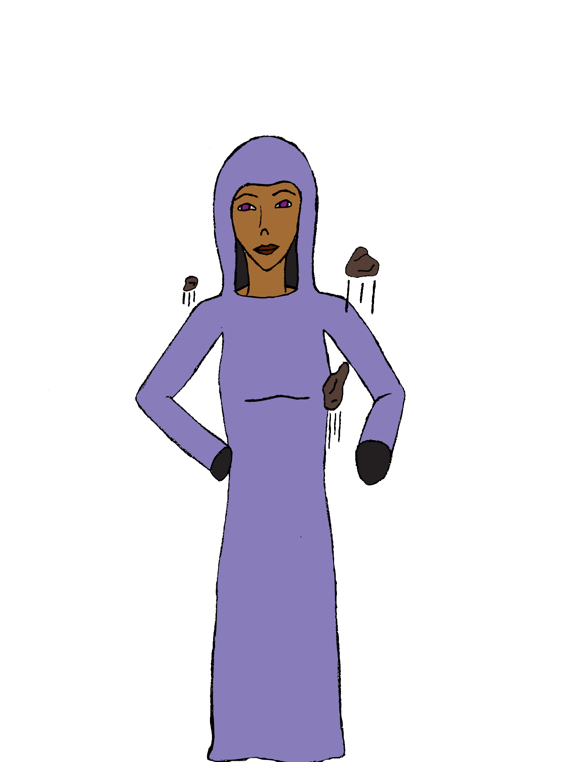
Psychokinesis user
Primarily interacts with obstacles, usually by lifting and throwing them with powers
Has abilities like teleportation and telepathy, in addition to telekinesis.
Purple theme for representing the use of her powers, card frames and backs, and used in her design.
Notes:
She can lift characters or obstacles and move them using her cards. If they slam into each other they take damage. Usually this means she’s the least affected by obstacles since she can just move them where she wants to, though it’s not that easy because she has to “waste” a card doing it.
Teleport allows her to move without being blocked by obstacles. Telepathy allows her to read her opponent’s mind, and thus see their hand.
The card backs and frames aren’t yet designed but they’re one of the next assets we’re planning to make.

Slide 6
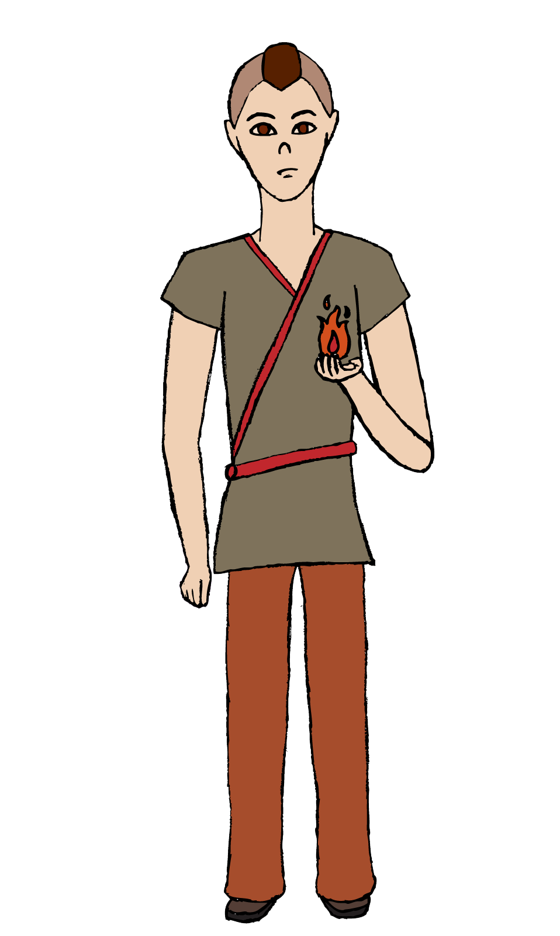
Pyrokinesis user
Interacts with most things by lighting them on fire.
All of his abilities are centered around fire, especially lighting panels on fire, but he can deal direct damage as well.
Red theme for representing the character and card backs and frames.
Notes:
More specifically he lights the panel they’re standing on on fire. This deals damage to anyone every time they enter it and when they start their turn on it, it can even hurt the user. It goes away after a couple turns.
He has a couple cards that allow him to draw cards (while lighting himself on fire as a downside) or move a few extra squares (while lighting the squares on fire) .

Slide 7
Martial artist
Mostly close combat so deals damage by punching and kicking.
To make up for their limited range they can move more than the other two characters and their basic card, “Psych Up” increases the next damage they deal by 1, making it so they don’t have to be close to their enemy to use it.
Brown theme in character design, and card backs and frames.
Notes:
He can throw obstacles with at least one card, and he has a number of cards that instantly break them.
Psyche up has a number of weaknesses as well, notably: if an opponent has only a few life left it can’t be used to finish them off and will likely be entirely worthless since the base damage on your next attack will probably finish them off.

Slide 8
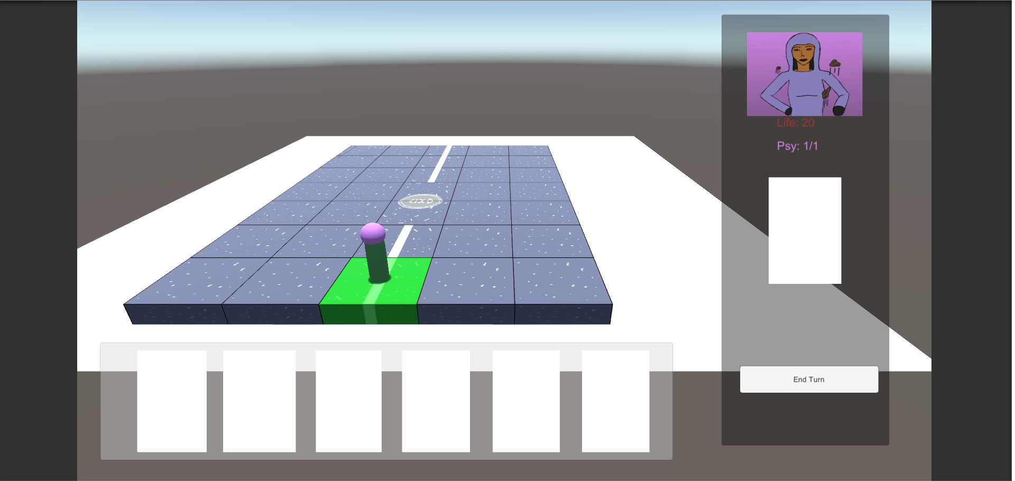
Game Screenshot
Board the character’s fight on, made to look like a street.
Information Panel on the right to give you information when you hove over a character.
Card UI at the bottom to hold your cards.

Slide 9
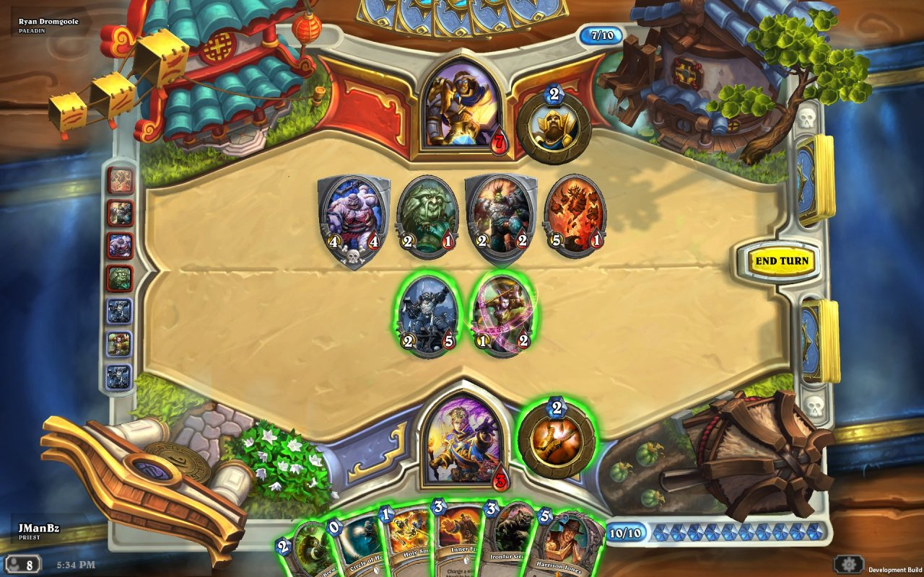
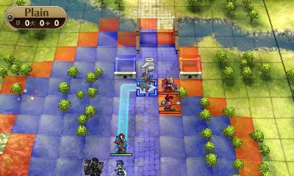
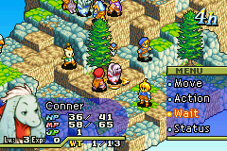
Inspiration
Notes:
Hearhtstone – Very Successful characte- based card game.
Fire Emblem – Long running Nintendo strategy franchise. Inspired highlighted squares.
Final Fantasy Tactics – Inspired low-unit number tactical game. Has a minimum of 1 controllable unit and a maximum of 6.

