Slide 1
Scalable Processing and Analysis of Call Detail Records
Team
Sushma Chandavarapu (sxc149730)
Nithya Subramanian (nxs143630)
Kibuem Kim (kxk118120)
Baoye Xue (bxx140230)
Naga Jyothi Davuluri (nxd140230)
Keerthi Kaku (kxk144130)

Slide 2
Problem Definition
A large volume of call detail records(CDR) is generated everyday from millions of phone calls.
These CDR data can be used to reveal vital information about an individual or a community.
Processing this huge volume of data for extracting any specific information, in particular, detection of different communities is a challenging task.
In this project, we provide a scalable approach to process a huge volume of CDRs and identify different communities.

Slide 3
Outline
Clustering of Data Using K-Means Clustering Algorithm
Analysis of Data
Clustering and Analysis of Users
Prediction based on the Analysis

Slide 4
Template of data
<user-id> <date> <time> <call-duration> <latitude-longitude>
"AAH03JAAQAAAO9VAA/","20120701","12:25:01","38","23.724199","90.405602"
"AAH03JAAQAAAO9VAA/","20120701","23:11:04","11","23.701700","90.429199"

Slide 5
K-Means Clustering Algorithm
An unsupervised learning algorithm.
Main idea is to define k centers, one for each cluster.
The centers should be placed as far as possible from each other.
Then each point belonging to a given data set is taken and associated with the nearest center.
When there is no pending point, k new centroids of the clusters need to be recalculated.

Slide 6
Algorithmic Steps
Let X = {x₁,x₂,x₃,……..,x_{n}} be the set of data points and V = {v₁,v₂,…….,v_{c}} be the set of centers.
Randomly select ‘c’ cluster centers.
Calculate the distance between each data point and cluster centers.
Assign the data point to the cluster center whose distance from the cluster center is minimum of all the cluster centers..

Slide 7

Algorithmic Steps
Recalculate the new cluster center using:
where, ‘c_{i}’ represents the number of data points in i^{th} cluster.
Recalculate the distance between each data point and new obtained cluster centers.
If no data point was reassigned then stop, otherwise repeat from step 3).

Slide 8
Our Approach towards Location Based Clustering
3 clusters are made based on the latitude and longitude using K-means.
The following are determined by running queries against the data of each cluster:
The cluster that has count & maximum calls made.
The cluster that has maximum duration of call.
The number of users in each cluster whose call duration is maximum.
The number of calls made and their duration at a specified time of the day.
Grouping of the data by date and sum durations.

Slide 9
Spark Query Results
A mobile company usually charges users telephone calls using duration.
This query results will group the data by date and sum durations.
We assume that the unit of duration is minute and charge per minute is 19.2c.
Net profit to company on each day is as follows:
Date: 20120701, Duration Sum: 1.6681724E7, Daily Net Profit: $3202891.01
Date: 20120703, Duration Sum: 1761476.0, Daily Net Profit: $338203.39
Date: 20120704, Duration Sum: 1154730.0, Daily Net Profit: $221708.16
Date: 20120705, Duration Sum: 316639.0, Daily Net Profit: $60794.69
Date: 20120706, Duration Sum: 4903445.0, Daily Net Profit: $941461.44
Date: 20120707, Duration Sum: 7018680.0, Daily Net Profit: $1347586.56

Slide 10
Spark Query Results
This query print out the calls made in an interval.
Knowing data transmission traffic is important because a certain time interval can have exceptionally and relatively high traffic.
Index: 23, UserId: AAH03JAC7AAAcQ2APV, Date: 20120701, Time: 10:23:52, CallDuration: 92, Latitude: 23.693100, Longitude: 90.439201
Index: 90, UserId: AAH03JAC5AAAdAgAbK, Date: 20120701, Time: 10:23:22, CallDuration: 61, Latitude: 23.727501, Longitude: 90.416100
Index: 455, UserId: AAH03JAC6AAAc0xAJz, Date: 20120701, Time: 10:23:38, CallDuration: 21, Latitude: 23.782200, Longitude: 90.426903
Index: 611, UserId: AAH03JACgAAEUL6Aoo, Date: 20120701, Time: 10:23:44, CallDuration: 27, Latitude: 23.795300, Longitude: 90.393898
Index: 718, UserId: AAH03JAC6AAAczXAIs, Date: 20120701, Time: 10:23:20, CallDuration: 2, Latitude: 23.802200, Longitude: 90.361099
Index: 766, UserId: AAH03JABeAANU2IAov, Date: 20120701, Time: 10:23:39, CallDuration: 660, Latitude: 23.718300, Longitude: 90.430603
Index: 795, UserId: AAH03JACVAAA/vPAHd, Date: 20120701, Time: 10:23:42, CallDuration: 34, Latitude: 23.952200, Longitude: 90.287498
Index: 807, UserId: AAH03JAC4AAAcxEAgH, Date: 20120701, Time: 10:23:39, CallDuration: 25, Latitude: 23.784201, Longitude: 90.431099
Index: 868, UserId: AAH03JAC8AAAbYGAcW, Date: 20120701, Time: 10:23:31, CallDuration: 20, Latitude: 23.716900, Longitude: 90.419701
Index: 1073, UserId: AAH03JAC6AAAcytAOG, Date: 20120701, Time: 10:23:57, CallDuration: 41, Latitude: 23.689699, Longitude: 90.438904
Index: 1504, UserId: AAH03JAC3AAAdDCAjd, Date: 20120701, Time: 10:23:21, CallDuration: 36, Latitude: 23.731899, Longitude: 90.415802
Index: 2228, UserId: AAH03JACdAAEDz2ACl, Date: 20120701, Time: 10:23:39, CallDuration: 25, Latitude: 23.712799, Longitude: 90.426903
Index: 2381, UserId: AAH03JABkAAHvEcAj9, Date: 20120701, Time: 10:23:52, CallDuration: 74, Latitude: 23.798611, Longitude: 90.380280
Index: 2488, UserId: AAH03JAC7AAAcPeAaE, Date: 20120701, Time: 10:23:27, CallDuration: 46, Latitude: 23.771900, Longitude: 90.397499
Index: 2922, UserId: AAH03JABiAAJKrMASR, Date: 20120701, Time: 10:23:33, CallDuration: 339, Latitude: 23.707199, Longitude: 90.410301
and so on . . . . . .

Slide 11
Data Analytics
Number of records 250001
Number of users 157212
Number of calls on 20120701 is 129498
Number of calls on 20120703 is 14816
Number of calls on 20120704 is 10907
Number of calls on 20120705 is 2588
Number of calls on 20120706 is 36912
Number of calls on 20120707 is 55279
Max call duration = 3601.0

Slide 12
Query Results of Location Based K-Means Clustering
Number of calls made in
Cluster1: 89105
Cluster2: 30752
Cluster3: 130143
Number of users in each cluster
Cluster1: 58973
Cluster2: 21413
Cluster3: 82983

Slide 13
Query Results of Location Based K-Means Clustering
Max Call Duration in each cluster and users who made that call
Cluster1: 3601.0
UserId:
AAH03JABTAAAP4EAAc AAH03JABeAALBUmACf AAH03JABeAANU01AeU AAH03JABiAAJKrDAml AAH03JABjAAIR71AYK AAH03JABjAAIR7RAjW AAH03JABjAAIR9GAXh AAH03JABjAAIR9nAWR AAH03JABuAAACX2AJf AAH03JAC+AAAcVnAiI AAH03JAC2AAAeIVApc AAH03JAC4AAAcuPAmi | AAH03JAC5AAAdAZAWr AAH03JAC6AAAc0JAY+ AAH03JAC6AAAc0mAXS AAH03JAC6AAAc0xAim AAH03JAC6AAAcyXAGs AAH03JAC7AAANRhAW+ AAH03JAC7AAANRiAMs AAH03JAC7AAAcQCAQW AAH03JAC8AAAMY9AfE AAH03JAC8AAAbX2AkL AAH03JAC8AAAbZMAVk

Slide 14
Query Results of Location Based K-Means Clustering
Cluster2: 3601.0
UserId:
AAH03JABeAANU0tAXo
AAH03JABjAAIR8RABl
AAH03JAC2AAAeJFAcG
AAH03JAC4AAAcxMApP
AAH03JAC7AAAcOTAOB
AAH03JAC9AAAbWPAgi

Slide 15
Query Results of Location Based K-Means Clustering
Cluster3: 3601.0
UserId:
AAH03JAB/AAAQwpAmo AAH03JAB3AAGCIHAok AAH03JABeAANU0mAe3 AAH03JABeAANU0zAAa AAH03JABeAANU1yAfG AAH03JABiAAJKrTAek AAH03JABjAAIR8zATF AAH03JABkAAHvEfAfI AAH03JABkAAHvEmAmE AAH03JAC+AAAcVIAYe AAH03JAC2AAAeJdAlJ AAH03JAC2AAAeKUAG5 AAH03JAC3AAAdBTAdU AAH03JAC3AAAdBkAOr AAH03JAC3AAAdDgAGQ | AAH03JAC4AAActTAab AAH03JAC5AAAdA+AU9 AAH03JAC6AAAcxUAVt AAH03JAC6AAAcxiAEN AAH03JAC6AAAcy1ANy AAH03JAC6AAAcySAFw AAH03JAC6AAAczWAoi AAH03JAC6AAAczwAVV AAH03JAC7AAAcOmAYk AAH03JAC7AAAcOtAdn AAH03JAC7AAAcQ/APK AAH03JAC8AAAbZMAJP AAH03JAC9AAAbWWANo AAH03JACkAAEAzEAav

Slide 16
Advantages of the algorithm
Fast, robust and easier to understand.
Relatively efficient
Gives best result when data set are distinct or well separated from each other.

Slide 17
CDR User Clustering Analysis
Phone users can be grouped according to their call records.
The company may want to group and analysis their mobile users to evaluate different value level of users based on their calling behavior.
The clustering model is a suitable data mining approach to find natural groupings within mobile customers, based on their mobile usage behaviors.
Using Pig Latin to preprocess the huge size of the CDR data.
Extracting features based on the user calling time and frequency behaviors.
Using K-means to do clustering based on extracted features.
Using Hive to query and analyze the clustering results.

Slide 18
Data Pre processing and Feature Extraction Using Pig Latin
Total 157211 users in the sample CDR dataset.
Processing on the raw data to get format data, define UDF to fromat data.
Extracting four features from the format data.
Features extracted from calling date, time and duration.
Id | userId | Date | Calling Time | Duration

Slide 19
Features
Number of Calls: The total number of calls for each user.
Distinct Date: The total number of distinct date made for each user.
Most Frequent Time Segment: The time segment that each user made calls in.
00:00~05:59 06:00~11:59 12:00~17:59 18:00~23:59
Total Duration: The total duration of calls made by each user.
Number of Calls | Distinct Date | Most Frequent Time Segment | Total Duration

Slide 20
K-Means Clustering Using Spark Table 1 Cluster Characteristics
ClusterID | TotalUsers | AvgNumCalls | AvgCallingDays | AvgDuration
0 | 113378 | 1 | 1 | 69
1 | 534 | 3 | 1 | 3212
2 | 10064 | 3 | 1 | 766
3 | 30402 | 3 | 1 | 329
4 | 2842 | 2 | 1 | 1533

Slide 21
Hive Tables and Queries
Load all cluster file into one external table PREDICTION
Load partitioned data by clusterId to five cluster table
Query using hive
1. number of users in each cluster
2. average number of calls in each cluster
3. average duration for each cluster
4. average days for each cluster
5. number of users of time period for each cluster

Slide 22
User Cluster Analysis
All mobile users are clustered into 5 distinguishable groups using the kmeans tools. The main characteristics of each group are shown in Table 1.
The number of users made calls with less durations is the largest, while the with the longer duration time, the number of users are the smallest. This complies with our knowledge.
The number of calls made in cluster 0 is the smallest.
Because the dataset contains only the records on two days "20120701" and "20120707", so all the average number of calling days is 1.

Slide 23
Table 2 Number of users for different time segment in each cluster
ClusterId | TimeSegment | TotalUsers
3 | 1 | 1370
3 | 2 | 8354
3 | 3 | 14718
3 | 4 | 5960
2 | 1 | 788
2 | 2 | 2678
2 | 3 | 4650
2 | 4 | 1948
0 | 1 | 2896
0 | 2 | 30074
0 | 3 | 57770
0 | 4 | 22638
4 | 1 | 358
4 | 2 | 658
4 | 3 | 1266
4 | 4 | 560
1 | 1 | 158
1 | 2 | 70
1 | 3 | 202
1 | 4 | 104
The number of users made calls with less durations is the largest, while the with the longer duration time, the number of users are the smallest. This complies with our knowledge.
The number of calls made in cluster 0 is the smallest.
Because the dataset contains only the records on two days "20120701" and "20120707", so all the average number of calling days is 1.

Slide 24
User Clustering
5 Clusters represent different group of users based on their calling time and frequency behaviour
Pre processing
Feature extracting
Clustering
Query & Analysis

Slide 25
Time Series Analysis
It is a forecast on the performance of the company’s ventures on an hourly basis.
The plot is created for an actual training set where the number of calls in one hour time slots are available.
The learning used from the packages of weka tool includes Linear Regression.
They both predict the number of calls forecasted a few days into the future with periodicity as hourly.
The rise and fall in the number of calls helps in determining the infrastructure necessities of the company.

Slide 26
Time Series Analysis
When the result of an action is of consequence, but cannot be known in advance with precision, forecasting may reduce decision risk by supplying additional information about the possible outcome.
Once data have been captured for the time series to be forecasted, the analyst’s next step is to select a model for forecasting.
Various statistical and graphic techniques may be useful to the analyst in the selection process.

Slide 27
Time Series Analysis
The best place to start with any time series forecasting analysis is to graph sequence plots of the time series to be forecasted.
A sequence plot is a graph of the data series values, usually on the vertical axis, against time usually on the horizontal axis.
The purpose of the sequence plot is to give the analyst a visual impression of the nature of the time series.

Slide 28
Time Series Analysis
Dataset
Divide into timeslots
Group By Date
Count the number of records per group
Predict the growth in calls on a daily basis

Slide 29
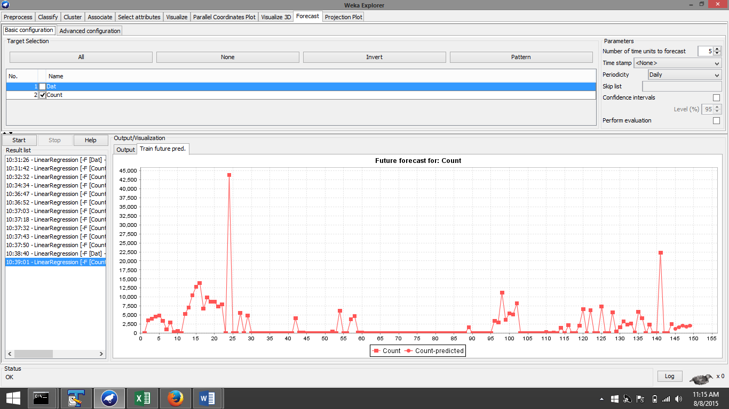
Time Series Snapshots
Count is the parameter in linear regression

Slide 30
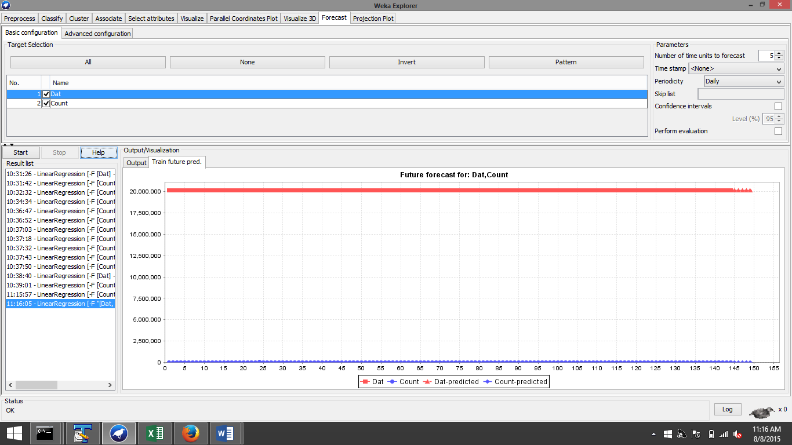
Time Series Snapshots
Count and Date becomes the combined predictor variables

Slide 31
Summary
Clustering for Community Detection
Analyse Users
Time series analysis of number of calls

