Slide 1

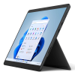
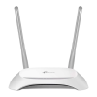
Robots
Server
HTTP (initialisation)
Web socket
HTTP
Web socket (execution)
Router
Clients
Key
Direct wi-fi connection
Logical connection

