Slide 1





NAAN MUDHALVAN PROJECT
Cook Book-Your Virtual Kitchen Assistant
1 Introduction
Project Title: Cook Book
Team id:NM2025TMID47650
Team leader Name: C.S. Vanshika
Mail id: csvanshika2007@gmail.com
Team Members:
1. V. Menaka – vmenaga274@gmail.com -Demo video making
2. D. Dowlin Jeffia – dowlindev7373@gmail.com- CodeDeveloper
3.A. Anusha -anusha995248@gmail.com - Document
4. C.S. Vanshika - csvanshika2007@gamil.com- Document
1

Slide 2
2. Project Overview
Purpose:
SmartCook is a React.js-based online cookbook application that allows users to browse,
save, and share recipes. It aims to make cooking easier by providing detailed recipes,
step-by-step instructions, and personalized recommendations.
Features:
- Browse recipes by category, cuisine, or ingredients
- Save favorite recipes to personal profile
- Add and edit user-submitted recipes
- Responsive UI for mobile and desktop
2

Slide 3
3. Architecture
Component Structure:
- Header (navigation bar)
- RecipeList (list of recipes)
- RecipeDetail (individual recipe page)
- Favorites (user’s saved recipes)
- AddRecipeForm (form to add new recipes)
- Footer
State Management:
Using React Context API to manage global state for recipes and user favorites.
Routing:
React Router v6 handles navigation between Home, Recipe Detail, Favorites, and Add Recipe
pages.
4. Setup Instructions
Prerequisites:
– Node.js
– MongoDB
– Git
– React.js
– Express.js – Mongoose – Visual Studio Code
Installation Steps
1. Clone the Repository
5. Folder Structure
Client:
/src
/components
Header.js
RecipeList.js
RecipeDetail.js
AddRecipeForm.js
3

Slide 4
/pages
Home.js
Favorites.js
/context
RecipesContext.js
/assets
images/
Utilities:
- api.js for fetching recipes from API
- helpers.js for common formatting functions
6. Running the Application
Frontend:cd client
npm start
Backend:cd server npm start
Access:http://localhost:3000
7. Component Documentation
Key Components:
- RecipeList: Displays recipe cards fetched from API. Props: recipes[].
- RecipeDetail: Shows full recipe details. Props: recipeId.
Reusable Components:
- RecipeCard – used in RecipeList and Favorites.
- Button – styled button component used throughout the app.
8. State Management
Global State:
Managed by RecipesContext for recipes, favorites, and user login status.
Local State:
Form input states managed inside AddRecipeForm.
9. User Interface
Include screenshots or GIFs of:
- Home page showing recipes
- Recipe detail page
- Adding a recipe
4

Slide 5
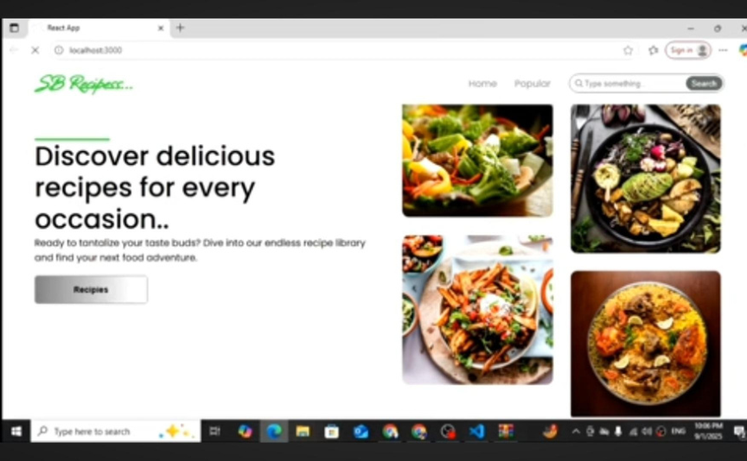
10. Styling
CSSFrameworks/Libraries:
Tailwind CSS for styling; Styled Components for scoped styles.
Theming:
Dark and light mode toggle implemented via context.
11. Testing
TestingStrategy:
Jest + React Testing Library for unit and integration tests.
Code Coverage:
Using jest --coverage to ensure 80%+ coverage.
12. Screenshots or Demo
Addactualscreenshotsorademo link:
- Demo Link: https://smartcook-demo.netlify.app
5

Slide 6
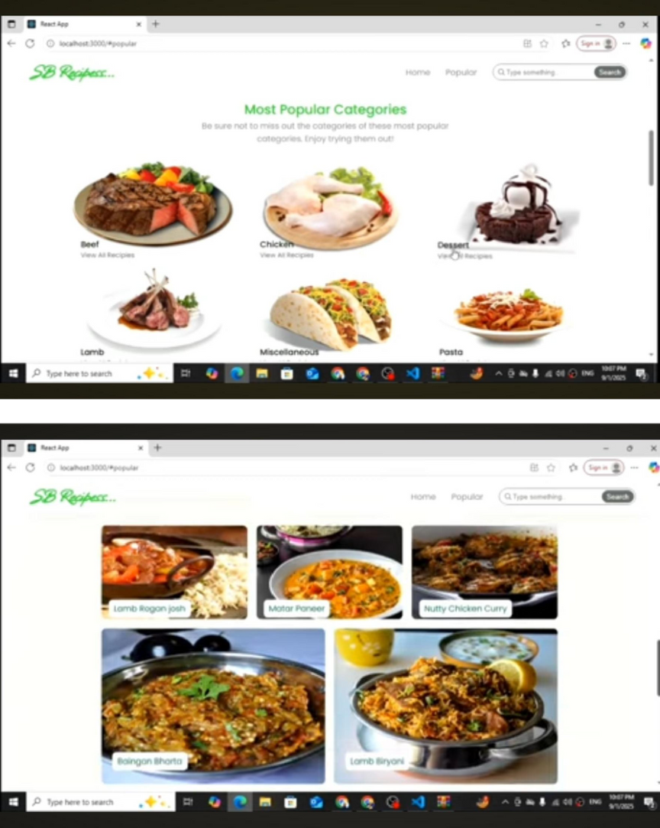
13. Known Issues
Search filteringmaybe slow with very large recipe lists.
Image upload sometimes fails on slow networks.
6

Slide 7
14. Future Enhancements
Addshopping list generation from recipe ingredients
Introduce push notifications for new recipes
Offline mode for saved recipes
7

