Slide 1
Final Project Proposal

Slide 2
01
Introduction
02
Statment of Problem
CONTENTS
03
So what then?
Objective, and proposed system
04
Who will benefit?
Significance.
05
scope and limitation

Slide 3

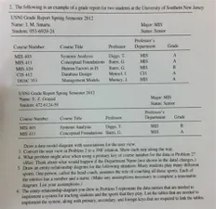
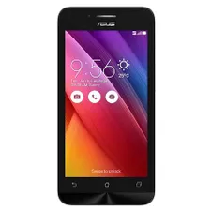
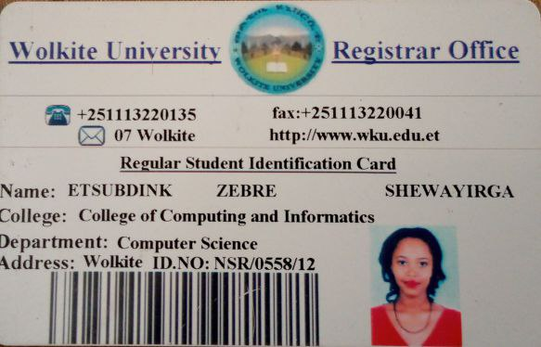

Intro.
We are proposing a mobile application based on problems we ourselves faced in our past 3 years of campus experience to let our smart phones serve as ID card, communication media,announcement board, a registration and grade checking device.

Slide 4

Statment of problem
What is wrong?
registration process being manual and exhausting.
announcements on paper are not noticed that much.
destructivity of usign telegram as a communication media b/n students and teachers.
procastinative attitude of many students
property security issue (specifically laptops)
manual comment boxes
lost ID readmission process .
attendance trick

Slide 5
So what then?
So...............?

Slide 6
So what then?
Objective
General Objective
simplify the challenges of students to some extents by digitalizing the system of students ID card.

Slide 7
So what then?
Objective
Specific Objective
ID card for students in a mobile application
Register laptop serial numbers with the id of the student in digital way
Making a reminder notification for assignments and exam dates
Make the attendance system of students be based on Geo-positioning
Make a communication way for the students as a telegram group in the app
registration of students using their phone (BUT ONLY IF THE STUDENT IS IN CAMPUS).

Slide 8
So what then?
Proposed system

Slide 9
Who will benefit ?
Significance of the project
For Students
Simplify registration system
Simplify ID card re-admission
Simplify commenting
Get notified for announcements
Get notified for tasks not complete yet.
Dormitory attendance will be enough if we are in the campus.
Decrease social media destruction too.

Slide 10
Who will benefit?
Significance of the project
For Teachers
✓Easy attendance control from their phone.
✓For attaching course related materials to the students in their groups.
For Gate guards and cafe workers
✓Decrease conflicts happening in case of ID cards.
✓For laptops security.✓

Slide 11
Scope of the project
Enable students view their grade report immediately after registration
•Easy manipulation of announcements
•Registration of students
•Creating a communication media or groups for each department classes
•Provide feedback or comments.
•Digitalizing the attendance system for class and dormitory.

Slide 12
Project limitation
Our project is a vast system which needs all of the system in the campus. We are attempting to develop a moremodern and digitalized system however developing student management system needs all systems to be developed under the consideration of QR based. So we are limited to build the real world system that are associated with the students ID.

Slide 13
Feasibility of the project
Economic feasibility:
We estimated that the cost for development of this software will be fair when we compare the benefits we get from it.
Technical feasibility:
This project will focused on gaining and understanding of the present technical resource of the organization and applicability to the expected need of the proposed system:
Operational feasibility:
This will focus on how well the project plan satisfies the requirements identified in the requirement analysis phase.

Slide 14
How?
Methodology
System model
Data collection
Observation and interview
Spiral
System analysis and design
OOAD

Slide 15
Thank you!
● Yeabsra Ayehualem ●
● Fasika Damtew ●
● Cheru Turga ●
● Etsubdink Zebre ●

