Slide 1
CHAPTER 4
Search in complex environmnet
Group name Id
Eyerusalem abiy 0565/12
Lidiya tibebeu 0911/12
Sara moges 1263/12

Slide 2
Outline
Introduction
Local search and optimization
Local search in continous space
Search with Non-determnstic action
Search in Partially Observable Environments
Online Search Agents and Unknown Environments

Slide 3
Search in Complex Environments
the problem of finding a good state without worrying about the path to get there, covering both discrete and continuous states.
relax the assumptions of determinism and observability .
In a nondeterministic world, the agent will need a conditional plan and carry out different actions depending on what it observes
guides the agent through an unknown space that it must learn as it goes, using online search.

Slide 4
Local Search and Optimization Problems
Local search algorithms operate by searching from a start state to neighboring states, without keeping track of the paths, nor the set of states that have been reached.
That means they are not systematic
Local search algorithms can also solve optimization problems, in which the aim is to find the best state according to an objective function.
one of local search algorithms is:
hill climbing algorithm

Slide 5
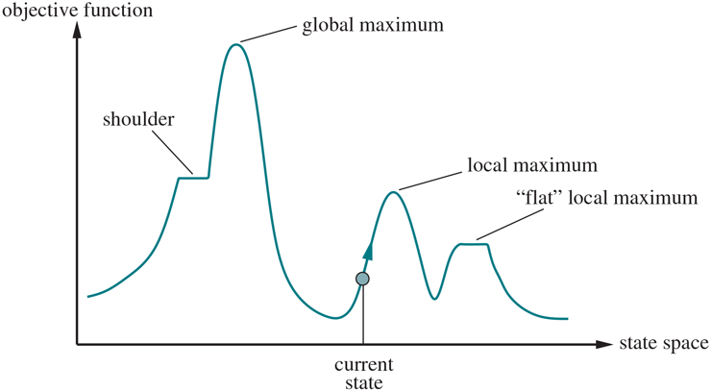
Hill-climbing search
a Heurstic search algorithm which continuously moves in the direction of incerasing value to find the peak mountain or the best solution.
it keeps track of one current satet and on each iteration moves to the neoghboring state with highest value

Slide 6
Local Search in Continuous Spaces
The main idea is to exploit the relation between the continuous model and its discrete counterpart.
A local search is first conducted in the continuous space until a local optimum is reached.
It then switches to a discrete space that represents a discretisation of the continuous model to find an improved solution from there.
one of local search in continous space is constrained optimization.

Slide 7
Constrained optimization
An optimization problem is constrained if solutions must satisfy some hard constraints on the values of the variables.
For example, in our airport-siting problem, we might constrain sites to be inside Romania and on dry land (rather than in the middle of lakes).
The difficulty of constrained optimization problems depends on
the nature of the constraints and the objective function.
The best-known category is that of linear programming problems.

Slide 8
Search with Nondeterministic Actions
Each action has a set of possible outcomes (resulting states) A solution is not a sequence of actions, but a contingency plan, or a strategy: if after pushing the lift button, lift arrives, then take the lift; else take the stairs.

Slide 9
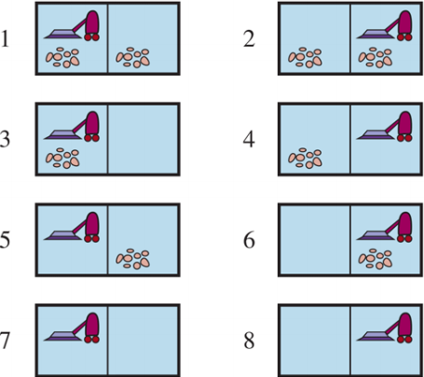
The erratic vacuum world
The erratic vacuum world have eight state and three actions-Right,left and suck. The goal is to clean up all the dirt(state7 or 8).
The eight possible states of the vacuum world; states 7 and 8 are goal states.

Slide 10
Cont...
If the enviromnet is fully obeservable ,determnitsic and completely known,then the problem is easy to solve and the solution is action sequence.
for example, if the initial state is 1,then the action sequence[Suck,Right,Suck]will reach the goale state,8.

Slide 11
Cont...
in the eratic vacuum world.the environment is non determnstic,
then the suck action works as follows:
1.when applied it dirty square the action cleans the square and sometimes,cleans up dirty in an adjacent square,too
2 when applied to clean square,the action sometimes deposits dirt on the carpet.

Slide 12
Cont...
to provide a formulaion pf this problem we need to generalize the noation of tansition model
here a RESULT(s,a)function returnes a set of possible outcomes states.
for example,the erratic vaccume world,the suck action in state1 cleans up either just the curent locatin,or both locations:
RESULTS(1,Suck)={5,7}

Slide 13
Search in Partially Observable Environments
in Partially Observable Environments,the agents percepts are not enough to pin down the exact state.
some of the agents functions will be aimed at reducing uncertanity about the current state.
in this ,the agent knows its actiOns and gole state.

Slide 14
Cont...
Example:
mazegame
automatic taxi
hill climbing
Beyond classic search :one of search in partally observable environmnets
an agent for partially observable environments

Slide 15
An agent for partially observable environments
there are two main diffrences vetween this agent with fully observable determnitsic environments
1.the solution will be a condtional plan rather than a squence:
to ececute an if then else expression,the agnet will need to test the codittion
execute the approprate baranch of the conditional
2.the agent will need to mainatin its beliefe state as it performs ctions and recievs percepts
this process resmbles the prediction obsravtion update process

Slide 16
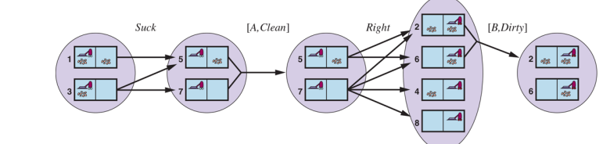
Cont...
two predction update cycle of biefe state maintenance in the vacume world with local sensing

Slide 17
Online Search Agents and Unknown Environments
In unknown environments ,where the agent does not know
what states exist or
what its action do
It is suitable in dynamic or semi daynamic environmnets
helpful in non determnstic domains.
one of online search agents and unknown environments is online search agent

Slide 18
online search agents
online agents in an observable environmnets recieves a percept telling it what stste it reached.
an environment in which a random walk will take exponentially many steps to find the goal.

Slide 19
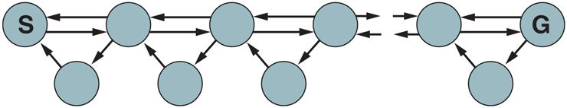
Cont...
for each state the top row except s ,backward progress is twice as likely as forward progress.

Slide 20
THANK YOU

