Slide 1
Development
Adventure

Slide 2

Rules
Development Card
Incident Card

Slide 3
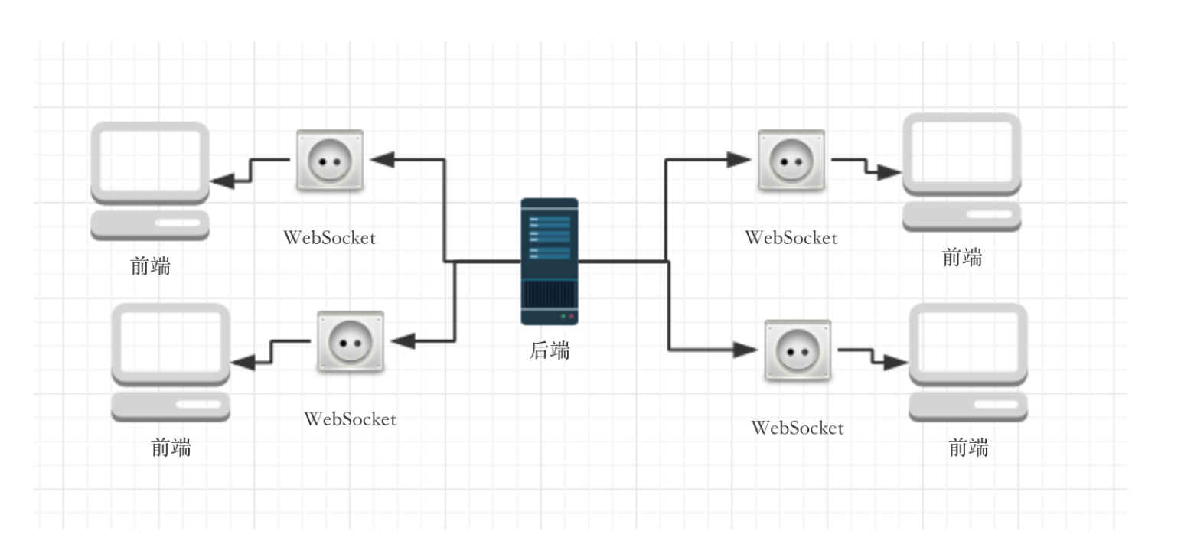
structure

Slide 4
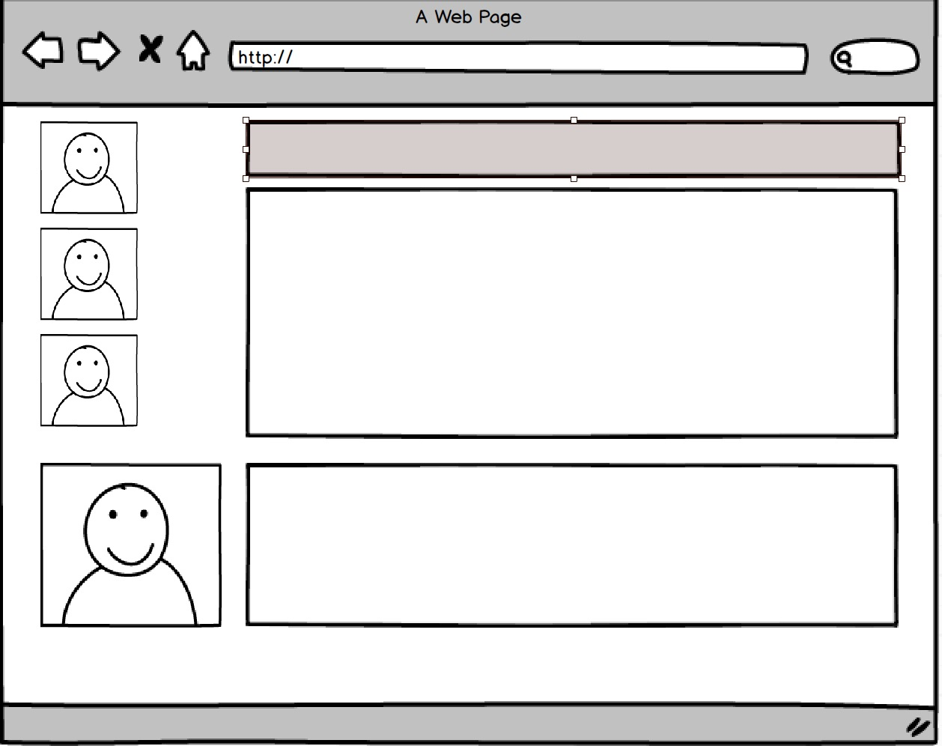
Frontend

Slide 5
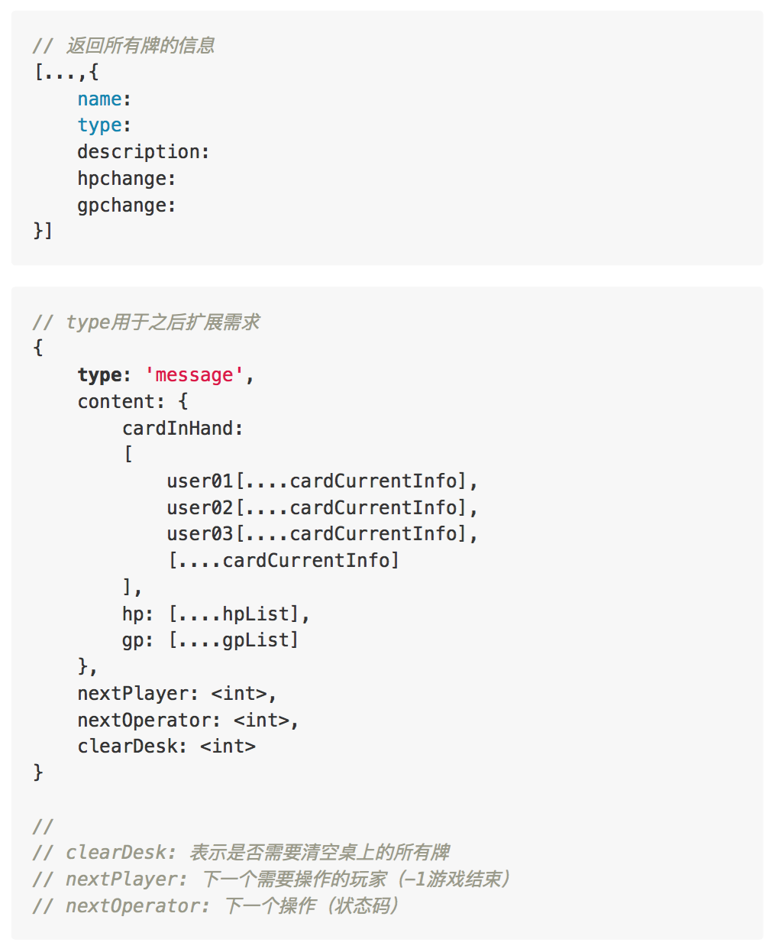
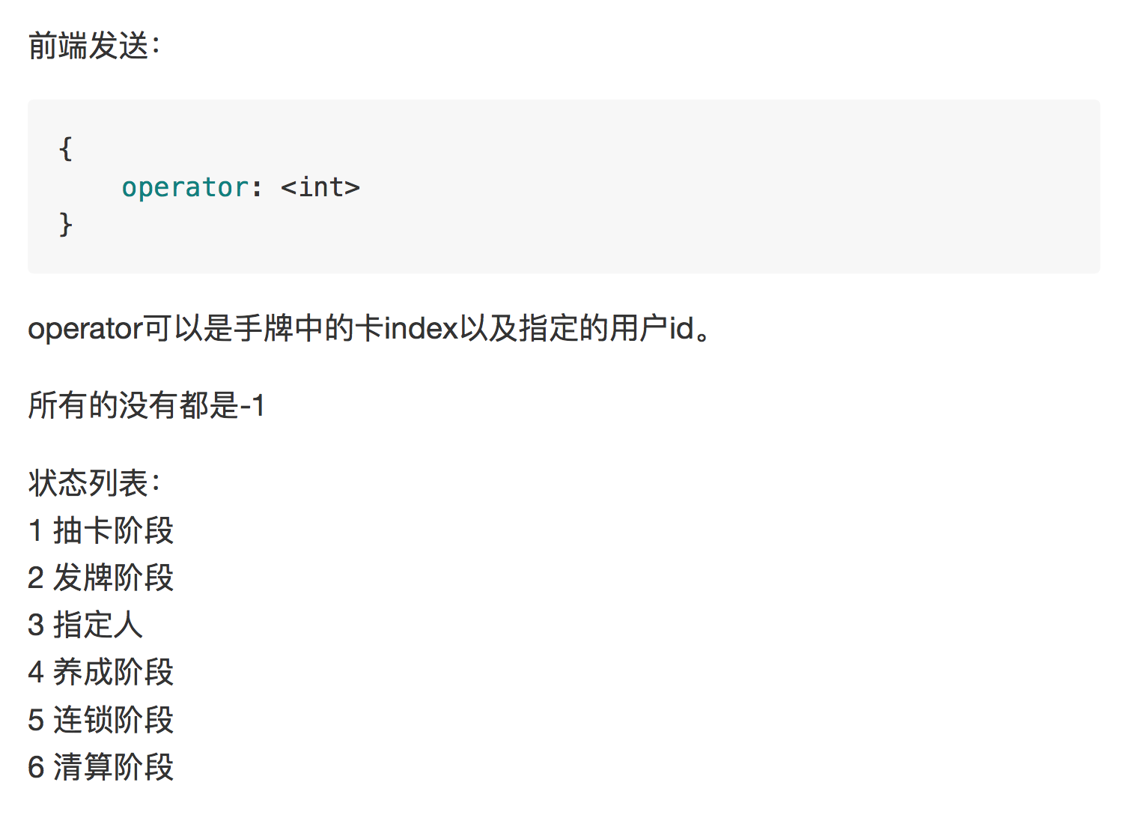
Backend

