Slide 1
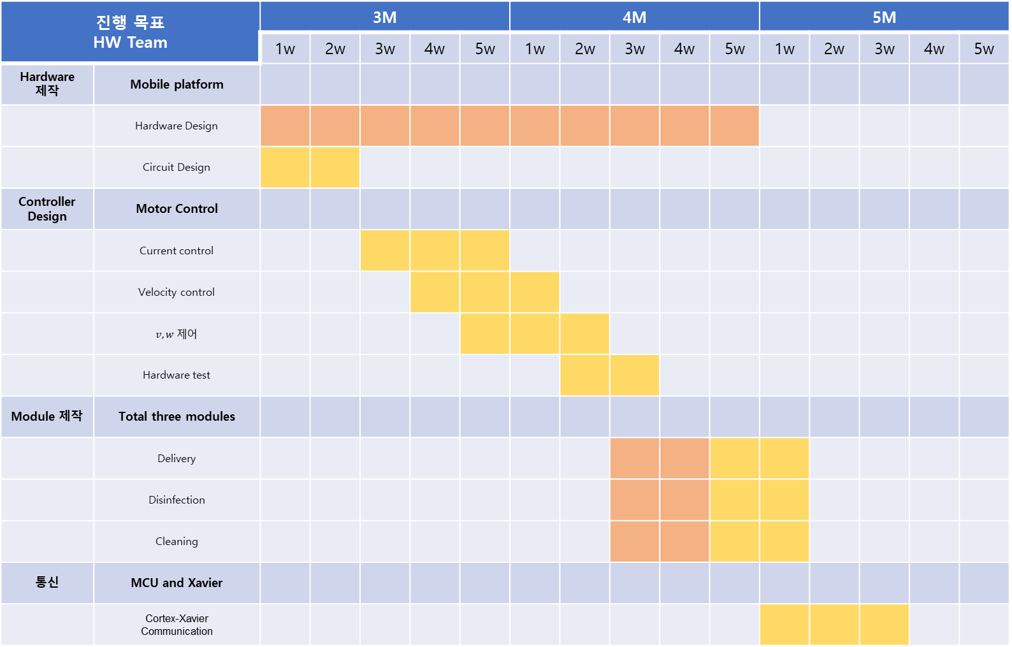
진행 목표 HW Team |  | 3M |  |  |  |  | 4M |  |  |  |  | 5M
 |  | 1w | 2w | 3w | 4w | 5w | 1w | 2w | 3w | 4w | 5w | 1w | 2w | 3w | 4w | 5w
Hardware 제작 | Mobile platform
 | Hardware Design
 | Circuit Design
Controller Design | Motor Control
 | Current control
 | Velocity control
 | $v,w 제$어
 | Hardware test
Module 제작 | Total three modules
 | Delivery
 | Disinfection
 | Cleaning
통신 | MCU and Xavier
 | Cortex-Xavier Communication
장재우
김태겸

