Slide 1
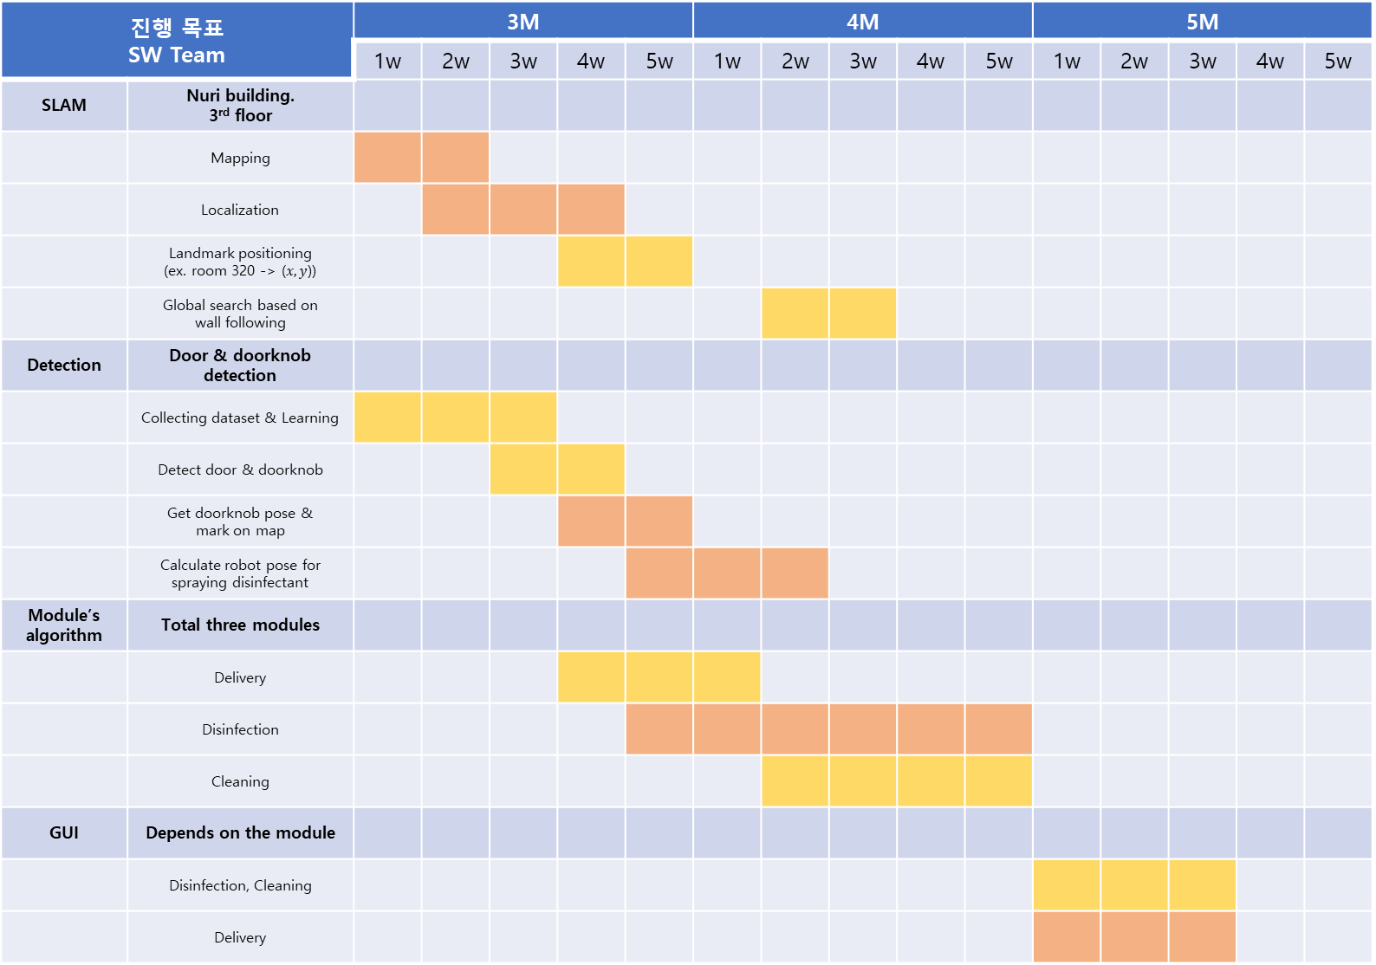
진행 목표 SW Team |  | 3M |  |  |  |  | 4M |  |  |  |  | 5M
 |  | 1w | 2w | 3w | 4w | 5w | 1w | 2w | 3w | 4w | 5w | 1w | 2w | 3w | 4w | 5w
SLAM | Nuri building. 3rd floor
 | Mapping
 | Localization
 | Landmark positioning (ex. room 320 -> ($x,y$))
 | Global search based on wall following
Detection | Door & doorknob detection
 | Collecting dataset & Learning
 | Detect door & doorknob
 | Get doorknob pose & mark on map
 | Calculate robot pose for spraying disinfectant
Module’s algorithm | Total three modules
 | Delivery
 | Disinfection
 | Cleaning
GUI | Depends on the module
 | Disinfection, Cleaning
 | Delivery
문석준
최석원

