Slide 1




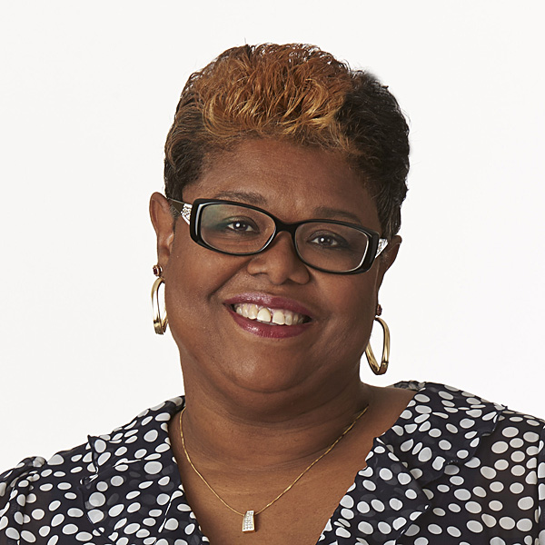
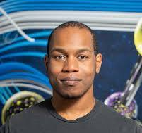
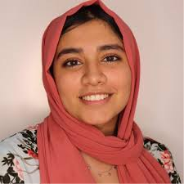





INTEGRATING CLOUD COMPUTING TOOLS IN INTRODUCTORY PROGRAMMING INSTRUCTION
SGX3 is funded by the National Science Foundation under award number 2231406.
Introduction
Modified Course Syllabus
Welcome to CMP224, an Introductory Java Programming course. This course aims to build not only programming skills but also a collaborative learning environment where everyone is encouraged to participate, ask questions, and support one another. Success in this course requires preparation, consistent effort, and mutual respect. Students are expected to come to class ready to engage, work hard, and contribute to a community that values learning and growth. The 3 credits course meets three times a week for 50 minutes.
Assignments are a key part of the learning process and are designed to challenge students to explore beyond what is covered in lectures. It is normal to encounter concepts during assignments that are unfamiliar at first — this is part of the learning journey. Students are encouraged to think critically, seek help early, collaborate appropriately with peers, and make use of available resources such as office hours and discussion forums. While exams will focus on conceptual understanding with simpler coding tasks, programming assignments will involve more complex design and implementation work, requiring deeper engagement and more time. With consistent effort, all students are capable of succeeding in this course.
Course Goals
Understanding Core Programming Concepts: Students will grasp essential programming principles such as variables, data types, control structures (loops, conditionals), functions, and basic data structures (arrays, lists).
Developing Problem-Solving Skills: Students will learn to analyze problems, create logical algorithms, and translate solutions into code, fostering critical thinking and computational reasoning.
Writing Clean, Efficient Code: Students will practice coding with clarity, proper documentation, and organization, emphasizing best practices for readability and maintainability.
Science Gateway Goal: Introduce students to SGX3 resources (Jetstream2)
Grade computation
Software Installation Readiness - (Virtual Machine – Jetstream2, GitHub): 10%
Lab work: 20%
Quizzes: 10%
Programming Projects: 30%
Exams: 30%
Course Name: | Computer Programming I (Java I)
Course Number: | CMP 224 VU
Department: | School of Science, Technology, Health, and Human Services
Anticipated Enrollment: | 10
Prerequisites: | None
Key Content: | Week 1: Intro to Java; Installation of SGX3 Resources: Jetstream2 VM, VS Code Weekly Quiz Week 2: Understanding the concept of Java – Video Weekly Quiz Week 3: Basic Objects. Weekly Quiz Week 4: Branch Statement, Variables Weekly Quiz Week 5: Implementation of Objects, Basic Methods and Classes. Virtual Thursday Lab. Weekly Quiz Week 6: Conditional Statements Weekly Quiz Week 7: Loops Weekly Quiz Week 8: Algorithm development Exam 1 Week 9: Arrays Weekly Quiz Week 10: Object references Array Lists Weekly Quiz Week 11: Reviews Virtual Lab Week 12: Testing our Programs Week 13: Recursion Weekly Quiz Week 14: File Input/Output Weekly Quiz Week 15: Course summary and reviews, Final Project Due Final Exam
Description: | CMP 224 introduces problem solving and computer programming using the programming language Java. The course teaches how real-world problems can be solved computationally using the object-oriented metaphor that underlies Java. Some of the concepts and techniques covered in the course include data types, expressions, objects, methods, conditionals, iteration, program testing and debugging, interactive programs, data abstraction, interfaces, inheritance, polymorphism, and arrays. No previous programming experience is required; however, this course is intended for Computer Science majors or those who plan on applying to the major. Non-majors are strongly encouraged to take one of our programming courses designed for non-majors. Use of a laptop computer on which you can install software is required.
Project Repo:
Mentor Suggestions
Mentor Feedback:
Does the class meet once or twice a week? It looks like some of the weeks could be combined to free up more time for better pacing and exposure. From the looks of it:
Week 1 and 2 could be covered in week 1.
Weeks 3, 4, and 5 could be covered in week 3.
Weeks 6 and 7 could be covered in week 6.
Weeks 9 and 10 could be covered in week 9.
In the course syllabus, please provide more details on the projects students will complete. Will they be self-directed, or will faculty provide guidance (e.g., developing a CRUD application)? Also, clarify the timeline for these projects.
Include the schedule for quizzes so that students know what checkpoints to expect and when.
Specify which IDE students will be using (e.g., Eclipse, VS Code, etc.). Having a standardized toolset may help reduce technical issues during debugging.
Expand on Jetstream2 by giving context and background information for those who may not be familiar with the service. Explain its purpose and why it is being used in the course.
What resources are being used when teaching students to write clean and efficient code?
Jetstream2
In this course, Jetstream2 is being used to provide students with consistent, on-demand computing environments for coding, testing, and running Java programs and other software tools. This approach eliminates issues related to hardware or software differences on personal computers and ensures that every student can access the same setup, regardless of their device.
By working with Jetstream2, students will also gain experience using cloud infrastructure—an increasingly important skill in both academia and industry. Through this platform, you will learn how to interact with virtual machines, manage computing environments, and explore how scalable systems can support software development and data processing tasks.
Jetstream2 is a cloud-based computing environment funded by the National Science Foundation (NSF) and designed to support research and education across a wide range of scientific disciplines. It is a part of the XSEDE (Extreme Science and Engineering Discovery Environment) and is operated by Indiana University in collaboration with several partner institutions.
Jetstream2 provides users with access to powerful virtual machines (VMs) that function similarly to cloud computing services like Amazon Web Services (AWS) or Microsoft Azure, but specifically geared toward academic use. It enables students, researchers, and educators to run computational workloads, host data analysis environments, and explore complex scientific problems using scalable resources—all from a web-based interface.
Suggested Expansion Topics
Git: introductory tutorial and hands-on workshop
Artificial Intelligence with Java
Understanding APIs: concepts and building APIs with Java
Course goals:
By the end of this course, successful students will be able to:
Demonstrate knowledge and understanding of fundamental programming constructs such as variables, expressions, assignments, input and output operations, control constructs, objects, classes, methods, and recursion.
Deploy appropriate theory, practices and tools for problem definition, specification, design, implementation, and testing of programs that use the basic programming constructs listed in the previous item.
Use object-oriented design (inheritance, interfaces, polymorphism, abstract classes) as a mechanism for problem solving as well as facilitating modularity and software reuse.
Work productively as part of a team and demonstrate your ability for organization, communication, and collaboration in teams.
Demonstrate honesty and professionalism by adhering to the Voorhees Academic Honesty Policy, as well as policies that are specific to this course.
Grade computation will be as follows:
Software Installation Readiness: 10%
Lab work: 20%
Quizzes: 10%
Programming Projects: 30%
Exams: 30%
References
Textbook: Introduction to Java Programming, 10th Ed., by Y. Daniel Liang, Prentice-Hall, 2014,
ISBN-0133813460.
https://moodle.dallastown.k12.pa.us/pluginfile.php/379743/mod_resource/content/1/Java%20Text%20-%20Liang.pdf
Authors
[Insert Picture] | Swanier, Cheryl Role: Faculty Participant Voorhees University cswanier@msn.com
[Insert Picture] | Fields, Alexander Role: Faculty Mentor Texas Advanced Computing afields@tacc.utexas.edu
[Insert Picture] | Faiyaz, Sajida Role: Faculty Mentor Austin Community College Sajida.faiyaz@austincc.edu
Goals
Understanding Core Programming Concepts: Students will grasp essential programming principles such as variables, data types, control structures (loops, conditionals), functions, and basic data structures (arrays, lists).
Developing Problem-Solving Skills: Students will learn to analyze problems, create logical algorithms, and translate solutions into code, fostering critical thinking and computational reasoning.
Writing Clean, Efficient Code: Students will practice coding with clarity, proper documentation, and organization, emphasizing best practices for readability and maintainability.
Science Gateway Goal: Introduce students to SGX3 resources (Jetstream2)
Event Site: https://hackhpc.github.io/facultyhack-gateways25

