Slide 1
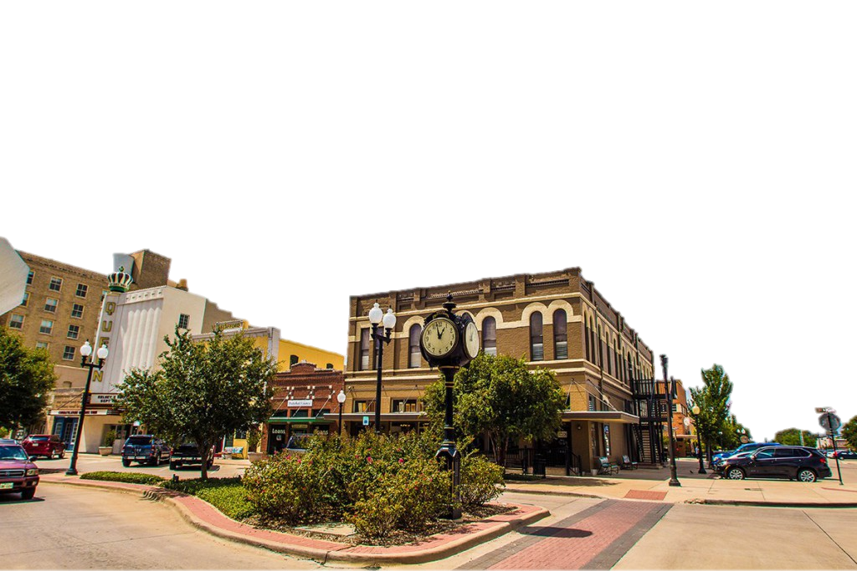
CITY OF BRYAN
BY GROUP 4 | POWERPOINT BY CHRISTIAN SANCHEZ

Slide 2
MIAN ISSUE: PEOPLE JUST AREN’T COMING TO BRYAN
HOME OF BLINN COLLEGE
POPULATION OF 84,367
FOUNDED IN 1871
INTRODUCTION

Slide 3
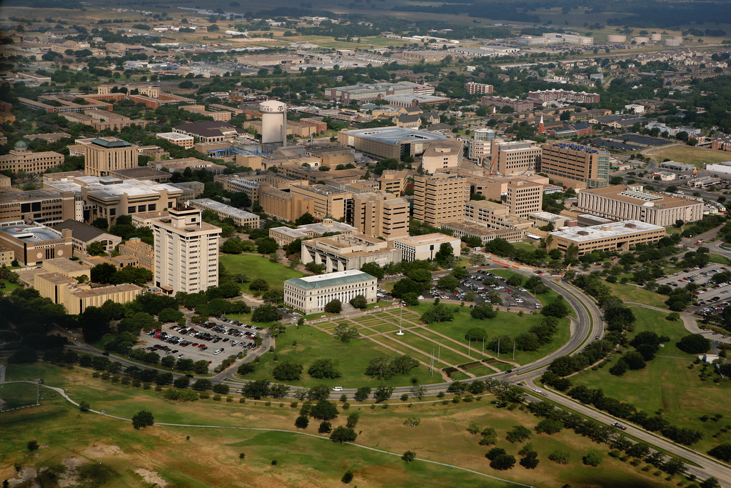

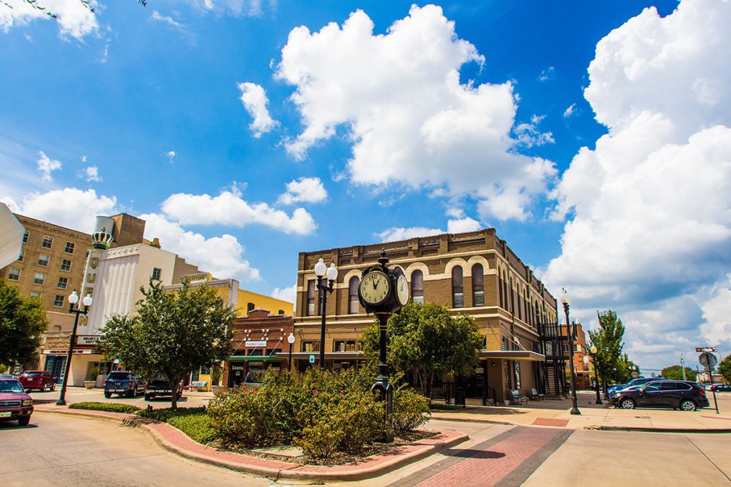
ANALYSIS OF THE FIRM
AND ITS ENVIRONMENT
INFLUENCERS IN PERFORMANCE: AMOUNT OF PEOPLE COMING TO A&M
KEY ELEMENTS: GENERAL POPULATION AND CITY REVENUE
KEY ISSUES: GETTING PEOPLE TO BRYAN, IMPROVING NEGATIVE CONNOTATION

Slide 4
Financially: Stagnant over the last year, but increased heavily from 2015
Basic Strategies: Improve infrastructure and revamp subdivisions
Key Resources: Vacant land and potential areas to improve
ANALYSIS OF THE FIRM
AND ITS ENVIRONMENT
Vision: Promotes a “diversity of unique experiences, traditions and innovation”
INTERNAL
Key Values: Assisting and improving the community

Slide 5
ANALYSIS OF THE FIRM AND ITS ENVIRONMENT
INTERNAL
Inability to attract people from College Station and surrounding areas
Bryan’s potential and their niche in the community
MAIN
STRENGTH
MAIN
WEAKNESS

Slide 6
General Environment Factors: A&M bringing an abundance of people and almost diluting Bryan’s population
Industry Growth: 25 by 25 program, double edged sword
Competitors: Big cities, particularly the ones with a large university
Industry rivalry and threat of substitutes
ANALYSIS OF THE FIRM
AND ITS ENVIRONMENT
Stakeholders: Citizens, city employees, local businesses, and environment
External stakeholders: Outside customers and tourists
Threats: Immense growth of A&M
Opportunities: Immense growth of A&M
EXTERNAL
EXTERNAL

Slide 7
???
???
???
???
IMPLEMENTATION PLAN

Slide 8
CONTROL PLAN
???
???
???
???

Slide 9
1
2
???
3
???
???
CONCLUSION

Slide 10
Works Cited
???

