Slide 1

Symbolic Finite Automata and M2L-str⟨σ⟩
Margus Veanes

Slide 2
Key takeaway from this tutorial
Really cool model! Recommended if you like finite alphabets
Best automata I’ve had in a long time, will tell all my friends!
Automata
vs
Symbolic Automata
Foundational model for strings/trees over finite alphabets
Great properties (Boolean operations, decidable equivalence)
Foundational model for lists/trees over arbitrary alphabets
Great properties (Boolean operations, decidable equivalence)
Faster, more general, sexier, opportunity for new algorithms

Slide 3
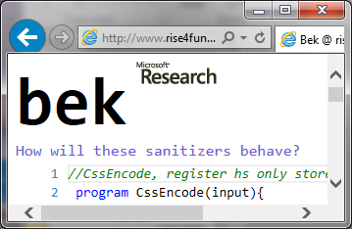
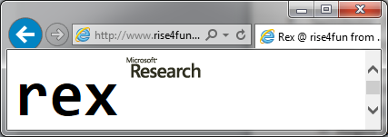



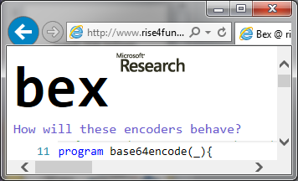
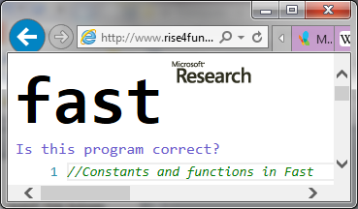
Some applications
Testing (unit, fuzz)
Regex processing
Web security
SMT extension
Work in progress: Backend for Monadic Second Order logic over finite sequences

Slide 4
SFA Application 1 Regexes in parameterized unit testing
Rex component in Pex
Generate values for s that reach the return branches
s is a string of Unicode characters (16-bit bit-vectors)
bool IsValidEmail(string s)
{
string r1 = @"^[A-Za-z0-9]+@(([A-Za-z0-9\-])+\.)+([A-Za-z\-])+$";
string r2 = @"^\d.*$";
if (System.Text.RegularExpressions.Regex.IsMatch(s, r1))
if (System.Text.RegularExpressions.Regex.IsMatch(s, r2))
return false; //branch 1
else
return true; //branch 2
else
return false; //branch 3
}
Solve: s∈L(r1)∩L(r2) [eg. s = “3@a.b”]
Solve: s∈L(r1)\L(r2) [eg. s = “a@b.c”]
Solve: s∉L(r1) [eg. s = “a@..c”]

Slide 5
SFA Application 2 Password generation
Given constraints:
Length is k: "^[\x21-\x7E]{k}$"
Contains 2 capital letters: "[A-Z].*[A-Z]"
Contains a digit: "\d"
Contains a non-word character: "\W"
Task: Generate random instances with uniform distribution that match all the above conditions.
http://www.rise4fun.com/Bek/c3j

Slide 6
Extensions
output
transducers
lookahead
extended SFAs
trees
symbolic tree automata
registers
symbolic automata/transducers with registers
alternation
alternating SFAs

Slide 7
Tutorial Overview
Part 1 (sFAs)
Part 2 (Extensions)
symbolic finite automaton or sFA
properties
key algorithms
sM2L-str
key difference to M2L-str
translation to sFAs
Cartesian Product of Effective Boolean Algebras
output
Symbolic finite transducer
lookahead
lookahead elimination via Monadic Decomposition
tree automata
Minimization
code generation
sequential code gen
parallel code gen

Slide 8
Tutorial Overview
Part 1 (sFAs)
Part 2 (Extensions)
symbolic finite automaton or sFA
properties
key algorithms
sM2L-str
key difference to M2L-str
translation to sFAs
Cartesian Product of Effective Boolean Algebras
output
Symbolic finite transducer
lookahead
lookahead elimination via Monadic Decomposition
tree automata
Minimization
code generation
sequential code gen
parallel code gen

Slide 9
symbolic automata Properties

Slide 10
Symbolic Finite Automaton (SFA)
Alphabet is an effective Boolean Algebra A
Labels are predicates over A
λ x. 'a' ≤ x ≤ 'd'
one symbolic transition:
p
q
for x∈ 〚'a' ≤ x ≤ 'd'〛
'a'
denotes
many concrete
transitions:
'c'
p
'b'
q
'd'

Slide 11
SFA Execution Example
λx. x mod 2=1
λx. x mod 2 =0
λx. x mod 2=0
p
q
λx. x mod 2=1
1 | 2 | 5 | 3
p
p
q
p
p
p is final → accept the input

Slide 12

Alphabet Effective Boolean Algebra
Ψ → 2^{D}
Domain
Predicates

Slide 13
Alphabet SMT^{int}
D = Integers
Ψ = integer linear arithmetic formulas (with one fixed free variable)
〚ϕ ∧ ψ〛= 〚ϕ〛∩ 〚ψ〛
〚⊥〛= ∅ ,〚¬ ϕ 〛= D \〚ϕ〛
Satisfiability: 〚ϕ〛≠ ∅

Slide 14
Alphabet 2^{{a,b}}
{∅,{a},{b},{a,b}}
{a,b}
^{c}
{a,b}
∅
∪
∩
id
{a}
{a,b}
SFA over 2^{{a,b}} :
p
{b}
q
regex :
a*b(a|b)*

Slide 15
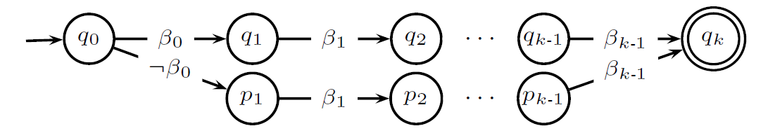
Alphabet 2^{bvk}
D = {n | 0 ≤ n < 2^{k}}
Ψ = BDDs of depth k
Boolean operations are BDD operations
Below〚β_{i}〛= {n ∈ D | i'th bit of n is 1}
β_{i} has fixed size
independent of i

Slide 16
Boolean operations (intersection)
ϕ₁
A₁:
p₁
q₁
p₁
p₂
ϕ₁∧ϕ₂
q₁
q₂
A₁×A₂:
X
ϕ₂
A₂:
p₂
q₂
delete when ϕ₁∧ϕ₂ unsat

Slide 17
Intersection example
let ϕ_{k}(x) ⇔ ((x mod k) = 0)
ϕ₂
A:
a₁
a₂
ϕ₂∧ϕ₃
ϕ₆
¬ϕ₆
a₁
b₁
a₂ b₂
A×B:
¬ϕ₆∧
¬ϕ₃
ϕ₃
B:
X
b₁
b₂
ϕ₆∧¬ϕ₃
a₁ b₂
¬ϕ₃

Slide 18
Boolean operations (complement)
First determinize then swap final and nonfinal states
delete unsat. guards
¬ϕ∧¬ψ
¬ϕ∧¬ψ
{s}
s
ϕ∧¬ψ
ϕ
{q}
p
q
determinize
{p}
{q,r}
ψ
r
ϕ∧ψ
{r}
¬ϕ∧ψ

Slide 19
Are SFAs a useful extension of classical automata?
Can classical automata theory and algorithms be extended to work modulo large (infinite) alphabets ∑ ?
The answer is nontrivial. For example.
NFA determinization is O(|∑|2^{n})
DFA minimization is O(|∑|n log n)
What happens when ∑ is infinite?

Slide 20
Why care about symbolic representation at all?
One reason: scalability in string analysis
ASCII where |∑| = 2⁷
(Unicode strings) UTF16:|∑| = 2¹⁶
working with character code-points: integers
characters are not opaque
arithmetic operations
intervals

Slide 21
Perhaps SFA → NFA ?
Given SFA Create NFA whose characters are minterms of predicates occurring in the SFA
Minterms (ϕ,ψ) = {ϕ∧ψ, ϕ∧¬ψ, ψ∧¬ϕ, ¬ϕ∧¬ψ} (keep satisfiable combinations only)
May blow up exponentially, e.g., the following SFA has 2^{k} minterms (alphabet 2^{bvk})

Slide 22
symbolic automata key algorithms

Slide 23
Minimization
What is minimization
Classic algorithms
A new symbolic algorithm (D’Antoni-Veanes [POPL14])

Slide 24
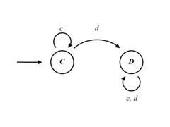
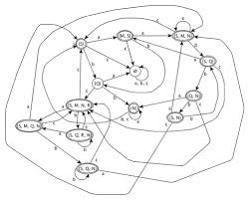
What is automata minimization?
both automata accept the same language

Slide 25
DFA minimization
Minimization = find and collapse all equivalent states
(equivalent = not distinguishable)
p,q distinguishable:
∃ w s.t.
p
w
Non final
q
w
Final

Slide 26
Moore’s algorithm
Minimize(M) :
let D = { {p,q} | p ∈ F, q ∈ Q\F}
repeat until D does not change:
choose {p’,q’} ∈ D
p –a–> p’, q –a–> q’ ∈ δ_{M}
add {p,q} to D
return ≡_{M} = Q×Q \ D
p
a
p’
distinguishable
distinguishable
q
a
q’

Slide 27
Symbolic Moore’s algorithm
Minimize(M) :
let D = { {p,q} | p ∈ F, q ∈ Q\F}
repeat until D does not change:
choose {p’,q’} ∈ D
p –φ–> p’, q –ψ–> q’ ∈ δ_{M} where sat(φ∧ψ)
add {p,q} to D
return ≡_{M} = Q×Q \ D
p
φ
p’
distinguishable
sat(φ∧ψ)
distinguishable
q
ψ
q’

Slide 28
Sometimes Moore is Less
18 sec for 15 characters!
the culprit
should scale up to 128 characters!

Slide 29
Hopcroft’s algorithm: intuition
Q\F
F

Slide 30
Hopcroft’s algorithm: intuition
S
B
a
a
a

Slide 31
Hopcroft’s algorithm: intuition
B
b
P₁
P₂
P₄
b
P₃
Keep partitioning with respect to B
for every input symbol

Slide 32
Hopcroft’s algorithm: intuition
Let’s assume we already split according to B
B
P₁
P₂

Slide 33
Hopcroft’s algorithm: intuition
Let’s assume I already split according to B
B
P₁
P₂
Do I need to consider both P₁ and for P₂ future splitting?

Slide 34
Hopcroft’s algorithm: intuition
Let’s assume I already split according to B
a
B
a
P₁
a
P₂
Do I need to consider both P₁ and for P₂ future splitting?

Slide 35
Hopcroft’s algorithm: intuition
Let’s assume I already split according to B
a
B
a
P₁
a
P₂
Do I need to consider both P₁ and for P₂ future splitting?

Slide 36
Hopcroft’s algorithm: intuition
Let’s assume I already split according to B
a
B
a
P₁
a
P₂
Do I need to consider both P₁ and for P₂ future splitting?
NO I ONLY NEED ONE!

Slide 37
Hopcroft’s algorithm
P := {F, Q\F}
W := {if |F|< |Q\F| then F else Q\F}
while W != { }
R:=pickFrom(W)
foreach a in Σ
S := δ⁻¹(R,a)
while ∃ T ∈ P. T∩S ≠ {} ∧ T \S ≠ {}
P,W := split(P, P∩S , P\S)
return collapse states according to P
log n iterations
O(|Σ|n log n)

Slide 38
Finitize the alphabet using minterms
φ₁
φ₂
φ‘₁
φ‘₂
φ‘₅
φ‘₈
φ‘₄
φ'₃
φ‘₆
φ₃
φ‘₇
Predicates:
{x>5, x<10, x=3}
Minterms:
{x=3, x≤5, 5<x<10, x≥10}

Slide 39
Symbolic Hopcroft’s algorithm
P := {F, Q\F}
W := {if |F|< |Q\F| then F else Q\F}
while W ≠ {}
R:=pickFrom(W)
foreach φ in Minterms(M)
S := δ⁻¹(R, φ)
while ∃ B ∈ P: B∩S ≠ ∅ ∧ B\S ≠ ∅
P,W := split(P, P∩S , P\S)
return collapse states according to P
Exponentially many minterms ☹

Slide 40
A new symbolic algorithm
B
ϕ
P₁
p
ψ
P₂
q
ϕ\ψ
What if ¬ (ϕ⇔ψ)?

Slide 41
Example
x≥2
B
x<2
x≥5
5
6
r
p
q
x<5
true
Both p and q go to r, but…
x≥2 ⬄ x≥5 ? NO
Then p is distinguishable from q

Slide 42
Example
x≥2
B
x<2
x≥5
5
6
r
p
q
x<5
true

Slide 43
Does it work?
Evaluated on
Randomly generated DFAs
Symbolic automata resulting from real regular expressions
Automata with many minterms
Symbolic automata over complex theories
Automata resulting from Monadic Second Order logic solving

Slide 44
Randomly generated DFAs
5 billion DFAs: 10 to 100 states, 2 to 50 symbols From [Almeida, Moreira, Reis, TR05]

Slide 45
SFAs generated from regexes (regexplib.com)
3000 regexes over UTF16 alphabet (2¹⁶ elems) From [regexplib.com]
Both axis logscale
More States =>
Moore Worse

Slide 46
A corner case of Minterm generation
This SFA has 2^{k} minterms!!
Logscale
brics.automata.dk
Uses intervals instead of BDDs

Slide 47
Randomly generated SFAs over string x int
Randomly generated 10 SFAs over string x int and minimized all the intersections, complement, difference, and union of such SFAs
Random generation causes many predicate overlaps → minterms

Slide 48
Tutorial Overview
Part 1 (sFAs)
Part 2 (Extensions)
symbolic finite automaton or sFA
properties
key algorithms
sM2L-str
key difference to M2L-str
translation to sFAs
Cartesian Product of Effective Boolean Algebras
output
Symbolic finite transducer
lookahead
lookahead elimination via Monadic Decomposition
tree automata
Minimization
code generation
sequential code gen
parallel code gen

Slide 49
M2L-str = monadic second-order logic over strings
Equivalent to regular languages
Example:
∃ x,y. x<y ∧ a(x) ∧ b(y)
finite alphabet say Σ = {a,b}
there exist positions x and y
x occurs before y
label of x is a
label of y is b
DFA
b
a
a,b
q₀
a
q₁
b
q₂

Slide 50
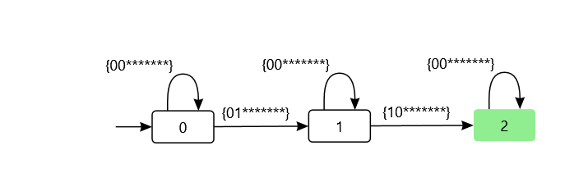
M2L-str ➔ DFA
M2L-str(Σ)-formulas: (suppose Σ = ASCII)
Φ := Φ∧Φ | Φ∨Φ | ¬Φ | ∃x.Φ |
Singleton(x) | x₁⊆x₂ | x₁<x₂ | a(x) (where a ∈Σ)
For every subformula Φ, inductively compute the corresponding DFA(Φ):
DFA(Φ₁∧Φ₂) = DFA(Φ₁) × DFA(Φ₂)
DFA(¬Φ) = ¬DFA(Φ)
(let Σ = ASCII): DFA(x₂<x₁) =
What about ∃x.Φ ?
******* is reserved 7-bit-pattern for ASCII symbols

Slide 51
∃x₁.Φ(x₁…x_{k}) ➔ DFA
First, Construct DFA for Φ(x₁…x_{k})
over alphabet 2^{k}×Σ then project to alphabet 2^{k-1}×Σ
0100b
100b
100b
1100b
DFA(Φ(x₁,x₂,x₃,x₄)) :
remove 1st bit
[..,a_{i},..]
p
q
p
q
p
100b
i∈x₁
determinize
100b
i∈x₂
i∉x₃
DFA(∃x₁.Φ(x₁,x₂,x₃,x₄)):
p
q
i∉x₄
a_{i} = b`

Slide 52
sM2L-str ➔ sFA
[(*1*0,_),(*0*1,_)] ∈L(SFA(x₂<x₄))
sFA(x_{i} < x_{j}) ➔
sFA(X_{j}(x_{i})) ➔
sFA(P_{α}(x_{i})) ➔
a ⊧ α
[(*0,_),(*1,a)] ∈ L(SFA(P_{α}(x₂))
sFA(ϕ∧ψ) ➔ sFA(ϕ) × sFA(ψ)
sFA(¬ϕ) ➔ sFA(ϕ)^{C} × Π_{xi∈foFV(ϕ)}( )
sFA(∃ x_{i}ϕ) ➔ sFA(ϕ)↾i

Slide 53
sM2L-str (or M2L-str⟨σ⟩)
Ex: σ = integers
∃ x,y. x<y ∧ P_{even}(x) ∧ P_{odd}(y)
label of x is even
label of y is odd
λx.(x mod 2 = 1) ∈ Pred(σ)
SFA
odd
even
true
q₀
even
q₁
odd
q₂
SFA:
[6,2,1] ∈L(SFA)

Slide 54
What is different about M2L-str⟨σ⟩ compared to M2L-str?
The alphabet is given by an Effective Boolean Algebra A
the set of characters (elements of type σ) may be infinite
Ψ_{σ} is a set of predicates over elements of type σ, closed under Boolean operations
Formulas are constructed as before except for atoms P_{ψ}(x) where ψ ∈ Ψ_{σ} and x is f.o.
semantics: let w = [a₁,...,a_{k}] and i ∈ {1...k} w ⊧ P_{ψ}(i) iff a_{i} ⊧ ψ

Slide 55
Example
= ∀x((Odd(x) ⇒ P_{even}(x)) ∧ (Even(x) ⇒ P_{odd}(x)))
[a₁,...,a_{k}] ⊧ ϕ iff for i∈[1..k]:odd(a_{i}) ⇔ even(i)

Slide 56
New kinds of optimizations
P_{ψ}(x) ∧ P_{ϕ}(x) is equivalent to P_{ψ∧ϕ}(x) where ψ, ϕ∈ Ψ_{σ}
the formula ψ∧ϕ ∈ Ψ_{σ} may be unsatisfiable
¬P_{ψ}(x) is equivalent to P_{¬ψ}(x)

Slide 57

Can we convert M2L-str⟨σ⟩ ➔ M2L-str ?
Yes!
But, in the worst case, at an exponential cost.
Given Φ in Pred(σ-wS1S):
take Ψ = {ψ | P_{ψ}(x) occurs in Φ}
let Σ = {P_{m} | m ∈minterms(Ψ)}
replace P_{ψ}(x) in Φ by P_{m1}(x) ∨... ∨ P_{mk}(x) where {m₁...m_{k}} = minterms that intersect ψ
e.g ψ₄
minterms are nonempty regions in
ψ₁
ψ₂
ψ₄
ψ₃
ψ₅

Slide 58
sM2L-str ➔ sFA
What is the alphabet of the SFA of Φ(X₁...X_{k})?
Cartesian Product Algebra for A×2^{k}
Key Challenges:
How to implement Boolean algebra for A×B given implementations of Boolean algebras for A and B in particular when B = 2^{k}?
How to project A×2^{k} to A×2^{k-1} ?
Concrete scenario: suppose B = BDD solver, A = SMT solver

Slide 59
Representation 1 for A×B
If-Then-Else dags
Shannon expansion whose
Nonterminal nodes are predicates of A
Terminal nodes are (inequivalent) predicates of B (BDDs)
represents the predicate in A×B: λ(x,y). ((¬α₁(x)∧¬α₂(x))∧β₁(y)) ∨ ((¬α₁(x)∧α₂(x))∧β₂(y)) ∨ (α₁(x)∧β₂(y))
α₁
α₂
β₁
β₂

Slide 60
Representation 2 for A×B
Algebraic Decision Diagrams, given B = 2^{k}, with depth k
Shannon expansion whose
Nonterminal nodes are individual bits (1..k)
Terminal nodes are inequivalent predicates of A
represents the predicate in A×B: λ(x,y). ((¬β₁(y)∧¬β₂(y))∧α₁(x)) ∨ ((¬β₁(y)∧β₂(y))∧α₂(x)) ∨ (β₁(y)∧α₂(x))
β₁
construct the leaves with a predicate-trie
β₂
α₁
α₂

Slide 61
Predicate-trie
Using distinguishing elements: a₁,a₂,...
1:
i:
2:
ψ₄
a_{i} ⊨ ψ
a_{i} ⊭ ψ
3:
ψ₁
ψ₂
ψ₃

Slide 62
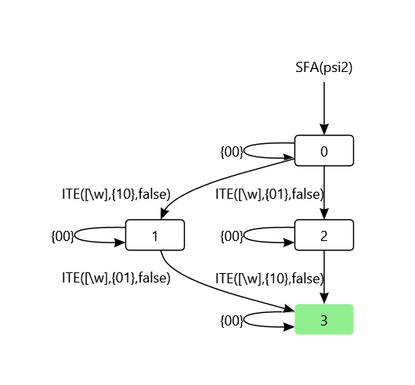
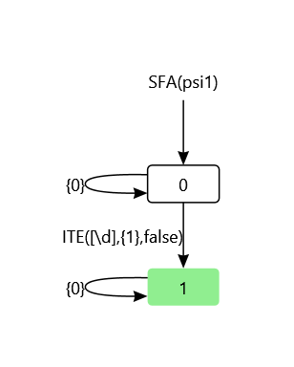
Examples: B = regex char. class
psi₁= Singleton(x)∧P_{\d}(x)
psi₂ = Singleton(x₁)∧P_{\w}(x₁)∧ Singleton(x₂)∧P_{\w}(x₂)∧¬(x₁=x₂)

Slide 63
Example: password generation
Ψ_{σ} = regex char. classes over ASCII:
(in M2L-str⟨σ⟩^{(+ syntactic sugar)})
PasswPred = ∃X.(|X|=12 ∧ P_{\w}(X) ∧ P_{[^oeiOEI4-9]}(X)) ∧ ∀y.(P_{\d}(y) ⇒ ∃z.(y = z+1 ∧ P_{\D}(z)))
For example:
“cOnnEct2wIfI” ∉ L(SFA(PasswPred)) “c0nn3ct2w1f1” ∈ L(SFA(PasswPred))

Slide 64
Further thoughts on translating M2L-str⟨σ⟩ to SFA⟨σ⟩
Presented translation from M2L-str⟨σ⟩ to SFA⟨σ⟩ does not require determinization
Alternatively one may consider:
Nondeterministic SFAs
complementation?
minimization?
Alternating SFAs
minimization?
projection?

Slide 65
Other possible symbolic extensions of MSO logics:
WS1S⟨σ⟩
WS2S⟨σ⟩
M2L-tree⟨σ⟩
S1S⟨σ⟩
S2S⟨σ⟩

Slide 66
part 1 Conclusion

Slide 67
Symbolic automata
A versatile and powerful model for strings (and trees) over complex domains
Completely subsume classical automata
Separation of concerns between automata structure and alphabet
Opportunity for new algorithms that exploit SAT and SMT solvers

Slide 68
Part 2 (Extensions)

Slide 69
Tutorial Overview
Part 1 (sFAs)
Part 2 (Extensions)
symbolic finite automaton or sFA
properties
key algorithms
sM2L-str
key difference to M2L-str
translation to sFAs
Cartesian Product of Effective Boolean Algebras
output
Symbolic finite transducer
lookahead
lookahead elimination via Monadic Decomposition
tree automata
Minimization
code generation
sequential code gen
parallel code gen

Slide 70
Symbolic Finite Transducer (SFT)
Labels are guarded transformation functions
Concrete transitions:
Symbolic transition:
p
1920 transitions
guard
p
λ x. 80₁₆ ≤ x ≤ 7FF₁₆/
[C0₁₆|x_{⟨10,6⟩}, 80₁₆|x_{⟨5,0⟩}]
‘\x80’/ “\xC2\x80”
…
‘\x7FF’/
“\xDF\xBF”
bitvector operations
q
q

Slide 71
SFT Execution Example
x mod 2 =1/[x-1]
x mod 2 =0/[]
x mod 2 =0/[x, x]
p
q
x mod 2 =1/[x-1]
Input tape
1 | 2 | 5 | 3
p
p
q
p
p
Output tape
0
2 2
4
2

Slide 72
Applications of SFTs
Security analysis of sanitizers
USENIX SECURITY’11 (Hooimeijer,Livshits,Molnar,Saxena,Veanes)
Analysis of string encoders/decoders
CAV’13 (D’Antoni,Veanes)

Slide 73
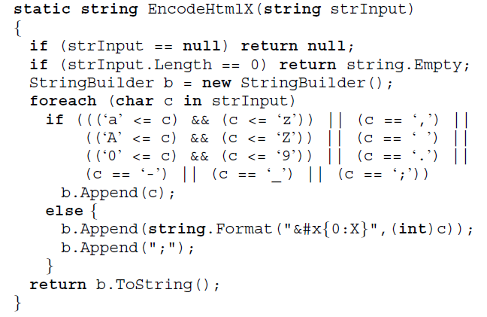
A string sanitizer
A string transformation function.
Untrusted data
Sanitized data
“im.png' …”
“img.png&#x35; …”

Slide 74
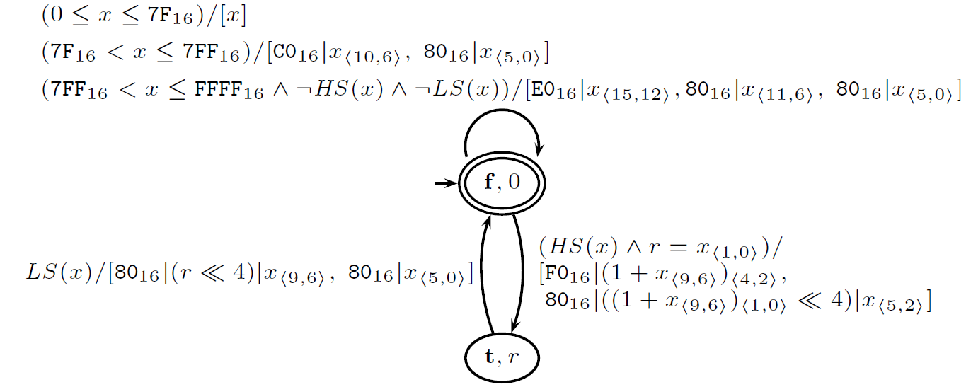
SFT Example
Utf8 encoder
Input: valid utf16 encoded string
Output: equivalent utf8 encoded string
For example utf8encode(“\uFF28\uFF29”) = “\xEF\xBC\xA8\xEF\xBC\xA9”
Equiv. classical transducer has 2¹⁶ transitions
5 states & 11 transitions

Slide 75
SFA Example
Utf8 validator (for up to 2 octet encodings)
Rejects invalid utf8 encoded strings
Regex R_{utf8}: ^([\x00-\x7F]|[\xC2-\xDF][\x80-\xBF])*$
Accepts“../../”
λ x. 0 ≤ x ≤ 7F₁₆
λ x. C2₁₆ ≤ x ≤ DF₁₆
p
q
λ x. 80₁₆ ≤ x ≤ BF₁₆
Rejects “..%C0%AF../”

Slide 76
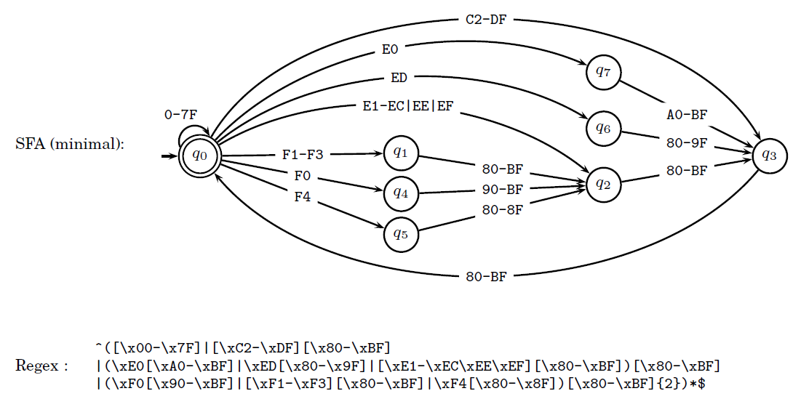
Complete R_{utf8}

Slide 77
SFT Application Analysis scenario
Valid inputs A = SFA(R_{utf8})
Invalid inputs (attack vectors) A^{c} = Complement(A)
Inputs accepted by Utf8Decode D = Domain(Utf8Decode)
Does Utf8Decode accept an invalid input? A^{c} ∩ D ≠ ∅? (e.g. "%c0%ae%c0%ae" ∈ D)

Slide 78
We also want to analyze outputs
Want to analyze questions such as: Does Utf8Encode produce a bad output? ∃x(Utf8Encode(x) ∈ Complement(SFA(R_{utf8}))) ?

Slide 79
Bek (a frontend language for SFTs)
program smileycipher(w) {
return iter(c in w) {
case(true): yield(0xD83D,(c - 'a') + 0xDE00);
};
}
http://www.rise4fun.com/Bek/ZH0

Slide 80
Why SFTs and SFAs?
They have good algebraic properties (POPL'12)
SFTs are closed under composition
Equivalence is decidable in the single-valued case
domain of an SFT is an SFA
SFAs are closed under Boolean operations
Useful for various analysis tasks

Slide 81
SFT composition
A•B = λx.B(A(x))
a1
x>0/ [x+1,x+2]
a2
A
B
b1
x<5/ []
b2
x<4/[x,x]
b3
A•B
a1
b1
x>0 ∧ x+1<5 ∧ x+2<4 / [x+2, x+2]
a2
b3

Slide 82
SFT Algorithms
Composition:
Equiv. checking for single-valued-SFTs:(undecidable in general)
Algorithms use SMT for satisfiability checking of character formulas
SFT A • B
in
SFT A
out
in
SFT B
out
in
SFT A
out
≠
A and B not equivalent
∃ “input string”
in
SFT B
out

Slide 83
Property analysis (USENIX Sec'11)
Does it matter if a sanitizer is applied twice? Idempotence:
Does order of sanitizers matter? Commutativity:
A • A
A
A
≠
A not idempotent
∃ “input string”
A
B • A
B
A
≠
A and B not commutative
∃ “input string”
A • B
A
B

Slide 84

Safety analysis
Using solver
Algorithms for SFAs and SFTs.
extensions of classical algorithms modulo Th(Σ)
Example: suppose good output = "catfree"
Catfree = [^\uDE38-\uDE40]*
bad output:
ContainsACat = Complement(Catfree)
∃x(smileycipher(x) ∈ ContainsACat) ?
∅ ≠ {x | smileycipher(x) ∈ ContainsACat}
Does there exist an input x that causes a "cat" in the output ?
http://www.rise4fun.com/Bek/nDx

Slide 85
Tutorial Overview
Part 1 (sFAs)
Part 2 (Extensions)
symbolic finite automaton or sFA
properties
key algorithms
sM2L-str
key difference to M2L-str
translation to sFAs
Cartesian Product of Effective Boolean Algebras
output
Symbolic finite transducer
lookahead
lookahead elimination via Monadic Decomposition
tree automata
Minimization
code generation
sequential code gen
parallel code gen

Slide 86
ESFAs and ESFTs
Unlike in the classical case look-ahead breaks many properties
e.g. equivalence of ESFAs is undecidable
x₁≤FF ∧ x₂≤FF ∧ x₃≤FF / [x₁>>2, ((x₁&3)<<4)|(x₂>>4), ((x₂&0xF)<<2)|(x₃>>6), x₃&0x3F]
q
above ESFT, reads 3 and writes 4 symbols
(base64encoder)
M
a
n
M
a
n
T
W
F
u
T
W
F
u
http://www.rise4fun.com/Bex/tutorial/guide

Slide 87
Lookahead elimination
To support ESFA/ESFT based analysis techniques [LPAR-17, POPL’12, VMCAI’13, CAV’13]
Analysis scenario:
Powered by SMT
Monadic decomposition
multivariable transitions p → q must be decomposed
SFT T
r
p
Extended SFT
ϕ₁₁(x)
q
Input
r
ϕ₁₂(y)/…
Sanitizer
p
q
ϕ₂₁(x)
ϕ₂₂(y)/…
ϕ(x,y)/…
Regex describing XSS attack vectors
SFA A
Analysis
Check: Inverse_Image(T,A) = ∅

Slide 88
Example of a monadic formula
Consider integer linear arithmetic
ϕ(x,y) = x + (y mod 2) > 5
((x > 5) ∧ even(y)) ∨ ((x + 1 > 5) ∧ odd(y))
Monadic width = 2
Cartesian
Cartesian

Slide 89

Example of a nonmonadic formula
Consider integer linear arithmetic
ϕ(x,y) = x < y
(x < 0 ∧ 0 ≤ y) ∨ (x < 1 ∧ 1 ≤ y) ∨ …
No finite decomposition exists

Slide 90
What is monadic decomposition?
Some terminology:
Unary formula ≡ formula with (at most) one free variable
MNF ≡ Monadic Normal Form ≡ Boolean combination of unary formulas
ϕ(x,y)
monadic decomposition
ϕ_{MNF}(x,y)
is monadic if ϕ has an equivalent MNF
Related to variable independence (Libkin 2003)

Slide 91
Formal definition of Monadic Decomposition
{ <, = , +, -, modk }
Q.F.L.A.
Ζ
Fix: Signature Σ, r.e. fragment F of Σ-formulas, and r.e. Σ-structure M
Assumptions aboutF :
Closed under Boolean operations: ϕ, ψ ∈ F ⇒ ϕ∧ψ, ϕ∨ψ, ¬ϕ ∈ F
Closed under value substitutions: ϕ ∈ F, a ∈ M ⇒ ϕ[x/a] ∈ F
Decidable: M ⊧ ∃x ϕ(x) is decidable for ϕ(x) ∈ F
Main two questions:
Decide if ϕ is monadic, i.e., does ϕ have a MNF in M?
2) Assume ϕ is monadic, construct a MNF of ϕ using a solver for F
x + (y mod2) > 5
(x > 5 ∧ y mod2 = 0) ∨ (x > 4 ∧ y mod2 = 1)
e.g. Z3

Slide 92
Monadic Decomposition algorithm (intuition)
Ex: ϕ(x,y) ≡ y>0 ∧ y&(y-1)=0 ∧ x&(y%7)≠0
Intuition:
Mark all (a,b) s.t. ϕ(a,b) holds
Define b ~ c ≡ ∀x(ϕ(x,b) ⇔ ϕ(x,c)) 3 ~equiv classes: [1]~, [2]~, [4]~
Construct β_{b}(y) s.t.∀y(β_{b}(y)⇔b ~ y) e.g. β₁(y) ≡ ∃n(y = 2^{n} ∧ n mod 3 = 0)
Final decomposition is: β₁(y) ∧ ϕ(x,1) ∨ β₂(y) ∧ ϕ(x,2) ∨ β₄(y) ∧ ϕ(x,4)
y
 | • |  | • |  | • |  | • |  | •
 |  |  |  | • | • | • | •
 |  | • | • |  |  | • | •
 | • |  | • |  | • |  | • |  | •
8
7
6
5
4
3
2
1
 | 1 | 2 | 3 | 4 | 5 | 6 | 7 | 8 | 9
 | • |  | • |  | • |  | • |  | •
 |  |  |  | • | • | • | •
 |  | • | • |  |  | • | •
 | • |  | • |  | • |  | • |  | •
4 ~ 32
2 ~ 16
1 ~ 8
x

Slide 93
Monadic decomposition algorithm (CAV’14)
Avoids DNF and full exploration of X~ and Y~
Theorem:
If ϕ is monadic then mondec(ϕ) is in MNF and equivalent to ϕ.

Slide 94
mondec impl. (z3py)

Slide 95
Some experiments

Slide 96
Remarks about monadic decomposition
When can we decide if ϕ is monadic?
General case: undecidable
follows from undecidability of variable-independence (Libkin 03).
Decidable cases:
Integer Linear arithmetic.
Algebraic real arithmetic with addition and multiplication
EUF
Potential applications (other than Symbolic Automata/Transducers):
theorem proving
program analysis
program synthesis
optimization problems
database applications

Slide 97
Tutorial Overview
Part 1 (sFAs)
Part 2 (Extensions)
symbolic finite automaton or sFA
properties
key algorithms
sM2L-str
key difference to M2L-str
translation to sFAs
Cartesian Product of Effective Boolean Algebras
output
Symbolic finite transducer
lookahead
lookahead elimination via Monadic Decomposition
tree automata
Minimization
code generation
sequential code gen
parallel code gen

Slide 98
Why symbolic tree automata?
Trees are common input/output data structures
XML query, type-checking, etc…
Natural Language translators (from parse tree to parse tree)
Compilers/optimizers (from parse tree to parse tree)
Tree manipulating programs: data structures algorithms, ontologies, etc…
Augmented Reality
http://www.rise4fun.com/Fast/tutorial/guide

Slide 99
Symbolic bottom-up tree automata
Φ(x)(q₁, q₂)
q
q
a
a
q₁
q₂
t₁
t₂
t₁
t₂
a ⊨ Φ

Slide 100
Symbolic tree automaton (STA)
All left children are positive
x>0(q, p) = q x>0(q, q) = q x>0() = q
x≤0(q, p) = p x≤0(q, q) = p x≤0() = p
q final state
3
3
0
2
2

Slide 101
Symbolic tree automaton (STA)
All left children are positive
x>0(q, p) = q x>0(q, q) = q x>0() = q
x≤0(q, p) = p x≤0(q, q) = p x≤0() = p
q final state
3
q
3
0
q
q
2
2

Slide 102
Symbolic tree automaton (STA)
All left children are positive
x>0(q, p) = q x>0(q, q) = q x>0() = q
x≤0(q, p) = p x≤0(q, q) = p x≤0() = p
q final state
3
q
p
3
0
2
2

Slide 103
Symbolic tree automaton (STA)
All left children are positive
x>0(q, p) = q x>0(q, q) = q x>0() = q
x≤0(q, p) = p x≤0(q, q) = p x≤0() = p
q final state
q
3
3
0
2
2

Slide 104
HTML Sanitization
Removing malicious active code from HTML documents is a tree transformation
body
body
script
div
SANITIZE
div
malicious
code
p
p
“Today I’m happy”
“Today I’m happy”

Slide 105

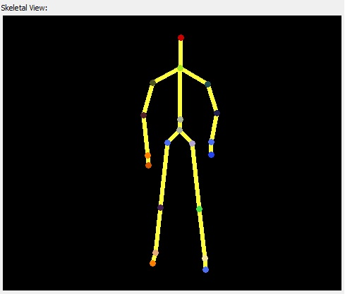
AR Interference Analysis
Recognizers output data that can be seen as a tree structure
Spine
Hip
Neck
….
Knee
Head
….
Ankle
Foot

Slide 106

Apps as Tree Transformations
Applications that use recognizers can be modeled as FAST programs
trans addHat: STree -> STree
Spine(x,y) to Spine(addHat(x), y)
| Neck(h,l,r) to Neck(addHat(h), l, r)
| Head(a) to Head(Hat(a))

Slide 107

Composition of Programs
Two FAST programs can be composed into a single FAST program
p₁
p₁;p₂
p₂

Slide 108
Properties of interest
Composition: T(x) = T₂(T₁(x))
Type-checking: given two languages I,O T(I) is always in O
Pre-image: compute the input that produces a particular output
Program Equivalence
To achieve speed (HTML sanitizer)
Check if XML queries only outputs trees in a SCHEMA
Counterexamples if type-checking fails
Different sanitizers commute
A;B is the same as B;A
Many operations of
tree automata
cause blowup of size
need efficient minimization

Slide 109
Minimization of symbolic tree automata
Good theories can be reused [LICS16]

Slide 110
Symbolic tree automata minimization
Minimization = find and collapse all equivalent states
(equivalent = not distinguishable)
p,q distinguishable in M:
t_{p}
t_{q}

Slide 111
How to minimize STAs
Symbolic generalization of Moore ‘s algorithm for STAs
Reduction of Symbolic Tree Automata minimization to Symbolic Finite Automata minimization

Slide 112
Reduce STA to SFA minimization
p
Tuple alphabet still forms a decidable Boolean algebra
p₁
⟨ϕ,[•,p₂]⟩
p
STA
^{ϕ}
SFA
p₂
⟨ϕ,[p₁,•]⟩
p
p₁
p₂
minimize [POPL14]
Theorem 6: ≡_{STA} = ≡_{SFA}
≡_{SFA} ⊆ Q×Q

Slide 113
Encouraging experiments
Tree automata generated from Fast case studies

Slide 114
Tutorial Overview
Part 1 (sFAs)
Part 2 (Extensions)
symbolic finite automaton or sFA
properties
key algorithms
sM2L-str
key difference to M2L-str
translation to sFAs
Cartesian Product of Effective Boolean Algebras
output
Symbolic finite transducer
lookahead
lookahead elimination via Monadic Decomposition
tree automata
Minimization
code generation
sequential code gen
parallel code gen

Slide 115
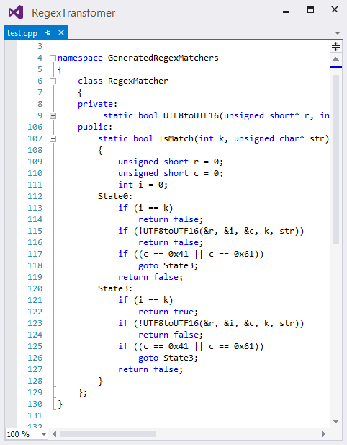
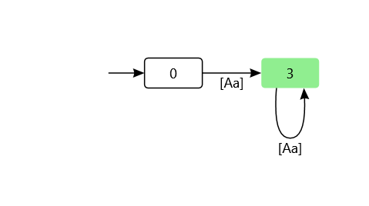
IsMatch generation Example from SFAs
"^(?i:a)+$"
to SFA
to c++
UTF8 decode next character c from str
state 0 is nonfinal
state machine
state 3 is final
predicate (?i:a)
i.e. [Aa]

Slide 116
One reason to specialize IsMatch: is to avoid DOS attacks
“Evil” regexes:
regex: @"^(([a-z])+.)+[A-Z]([a-z])+$" input: "aaa...aaa"
regex: "^(_?a?_?a?_?)+$" input: "_a_aa_aa_..._aa@"

Slide 117
Bek → Monadic ESFTs → parallel code
parallelization [POPL’15]

Slide 118
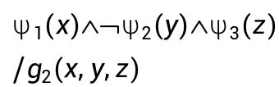
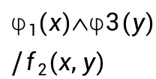
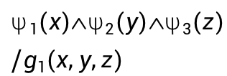
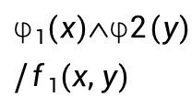
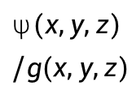
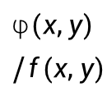
Monadic ESFT → Cartesian ESFT
Cannot parallelize when character groups have different width
width = 2
width = 3
$$(x,y)/f(x,y)$$
$$(x,y,z)/g(x,y,z)$$
p
q
r
Monadic decomposition [CAV’14]
$$1(x)2(y)/f1(x,y)$$
$$1(x)2(y)3(z)/g1(x,y,z)$$
p
q
r
$$1(x)3(y)/f2(x,y)$$
$$1(x)➢2(y)3(z)/g2(x,y,z)$$

Slide 119
Cartesian ESFT → k-SFT

Slide 120
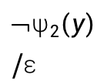
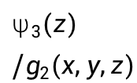
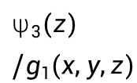
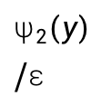
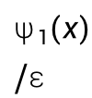
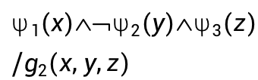
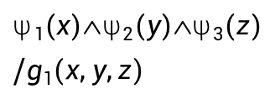
Split Predicates
$$1(x)2(y)3(z)/g1(x,y,z)$$
q
r
$$1(x)➢2(y)3(z)/g2(x,y,z)$$
$$1(x)/$$
$$2(y)/$$
$$3(z)/g1(x,y,z)$$
q
r
$$➢2(y)/$$
$$3(z)/g2(x,y,z)$$
lookback

Slide 121
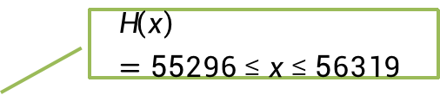
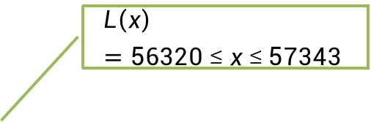
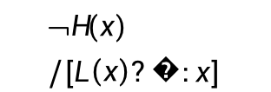
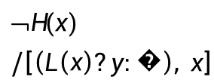


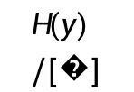
k-SFTs
Let Rep be the 2-SFT that repairs strings containing “bad surrogates”:
$$L\left(x\right)=56320 ≤ x ≤ 57343$$
$$H\left(x\right)=55296 ≤ x ≤ 56319$$
$$➢H(x)/[L\left(x\right)?�:x]$$
$$H(y)/[�]$$
k
$$H(y)/[�]$$
q₀
q₁
lookback
$$➢H(x)/\left[\left(L\left(x\right)?y:�\right), x\right]$$
$$/[�]$$
Replacement character
\uFFFD

Slide 122
Use of Rep
Built-in into the logic of some string encoders (for robustness)
UTF-16 string
Rep
UTF-16 string without bad surrogates
HtmlEncode
CssEncode
…

Slide 123
k-SFTs are parallelizable

Slide 124
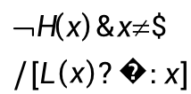
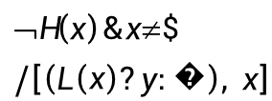
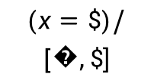
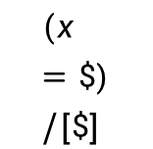


Parallelization Step 1
Extend the alphabet with a special EOI symbol $\$$(to avoid final outputs)
H(y)/ε
$$H(y)/[�]$$
$$➢H\left(x\right)\&x≠\$/[L\left(x\right)?�:x]$$
q₀
q₁
$$➢H\left(x\right)\&x≠\$/\left[\left(L\left(x\right)?y:�\right), x\right]$$
$$(x=\$)/[\$]$$
$(x=\$)/[�,\$$]
$$\text{T}/ε$$
q₂
$$\text{T}/ε$$
q₃

Slide 125












Parallelization Step 2
Create a finite alphabet using minterms
(nonempty regions in the Venn diagram of all guards)
T
$$➢H\left(x\right)\&x≠\$$$
$$H(y)$$
$$H(y)$$
$$a$$
q₀
q₁
$$b$$
$$H\left(x\right)$$
$$➢H\left(x\right)\&x≠\$$$
$$c$$
$$➢H\left(x\right) ∧ x ≠ \$$$
$$x=\$$$
$$x=\$$$
$$x=\$$$
$$\text{T}$$
q₂
$$\text{T}$$
q₃

Slide 126











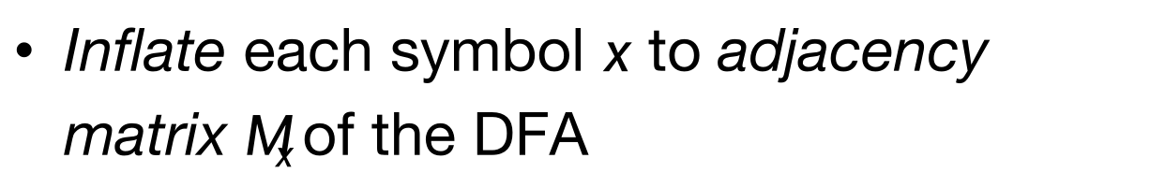
Parallelization Step 3
Inflate each symbol $x$ to adjacency matrix $Mx$of the DFA
$$Ma$$
0 | 1 | 0 | 0
0 | 1 | 0 | 0
0 | 0 | 0 | 1
0 | 0 | 0 | 1
$$b$$
$$a$$
$$a$$
$$Mb$$
1 | 0 | 0 | 0
1 | 0 | 0 | 0
0 | 0 | 0 | 1
0 | 0 | 0 | 1
q₀
q₁
$$b$$
$$c$$
$$c$$
$$a,b,c$$
$$Mc$$
0 | 0 | 1 | 0
0 | 0 | 1 | 0
0 | 0 | 0 | 1
0 | 0 | 0 | 1
q₂
$$a,b,c$$
q₃

Slide 127






Parallelization Step 4
Input (Unicode string)
Encode δ_{DFA} as matrix multiplication
[JACM’80, CACM’86, ASPLOS ’14]
$$\backslash uDE38$$ | $$\backslash uD83D$$ | $$\backslash uD83D$$ | $$\backslash uDE38$$ | $$\backslash uD83D$$ | $
Map to symbols
$$b$$ | $$a$$ | $$a$$ | $$b$$ | $$a$$ | $$c$$
Inflate
$$Mb$$ | $$Ma$$ | $$Ma$$ | $$Mb$$ | $$Ma$$ | $$Mc$$
$$b$$
$$a$$
$$a$$
Scan
q₀
q₁
$$b$$
$$I$$ | $$Mb$$ | $$MbMa$$ | $$MbMaMa$$ | $$MbMaMaMb$$ | …
$$c$$
$$c$$
$$a,b,c$$
q₂
q₃
Project
$$a,b,c$$
$$q0$$ | $$q0$$ | $$q1$$ | $$q1$$ | $$q0$$ | $$q1$$

Slide 128

Parallelization Step 5
Input
Compute
output
$$\backslash uDE38$$ | $$\backslash uD83D$$ | $$\backslash uD83D$$ | $$\backslash uDE38$$ | $$\backslash uD83D$$ | $
Compute states
q₀ | q₀ | q₁ | q₁ | q₀ | q₁
Get output functions
$$x.$$ $$[L\left(x\right)?�:x]$$ | ε | $$[�]$$ | $$y x.$$ $$[\left(L\left(x\right)?y:�\right), x]$$ | ε | $$[�,\$]$$
Apply output functions
$$[�]$$ | ε | $$[�]$$ | $$[\backslash uD83D\text{,} \backslash uDE38]$$ | ε | $$[�,\$]$$
Flatten
$$"��\text{😸}�"$$

Slide 129




Tools using symbolic automata
DReX
genic
proving correctness
of string encoders
efficient string
manipulations
automatic
program inversion
theory of
sequences
intelligent tutoring system
for theory of computation
analysis of tree manipulations
SVPAlib
AutomataDotNet
open source
Java library
open source
.Net library
http://github.com/AutomataDotNet

