Slide 2

Analysis of Insertion sort.
This is an efficient algorithm for sorting small number of elements.
eg: Sorting a hand of cards using insertion sort.

Slide 3
Pseudocode for insertion sort.
INSERTION-SORT(A)
1 for j ←2 to length[A]
2 do key ← A[j]
3 ⊲ Insert A[j] into the sorted sequence A[1..j-1]
4 i ← j - 1
5 While i > 0 and A[i] > key
6 do A[i+1] ← A[i]
7 i ←i-1
8 A[i+1] ← key

Slide 4
Example
Illustrate the operation of the Insertion sort on the array A=< 7 , 4 , 8 , 3 , 5 , 2 , 1 , 9 , 6 >
7 | 4 | 8 | 3 | 5 | 2 | 1 | 9 | 6
4 | 7 | 8 | 3 | 5 | 2 | 1 | 9 | 6
4 | 7 | 8 | 3 | 5 | 2 | 1 | 9 | 6
3 | 4 | 7 | 8 | 5 | 2 | 1 | 9 | 6

Slide 5
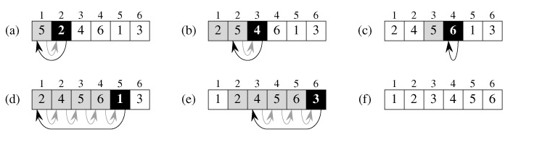
Example
The operation of INSERTION-SORT on the array A = 〈5, 2, 4, 6, 1, 3〉. Array indices appear above the rectangles, and values stored in the array positions appear within the rectangles. (a)-(e) The iterations of the for loop of lines 1-8. In each iteration, the black rectangle holds the key taken from A[j], which is compared with the values in shaded rectangles to its left in the test of line 5. Shaded arrows show array values moved one position to the right in line 6, and black arrows indicate where the key is moved to in line 8. (f) The final sorted array.

Slide 6
Exact analysis of Insertion sort
Time taken for the algorithm will depend on the input size(number of elements of the array)
Running Time (Time complexity):
This is the number of primitive operations or steps executed of an algorithm on a particular input.

Slide 7
Running Time : T(n)
Each execution of the i^{th} line takes time c_{i} where c_{i} is a constant.
For each j=2,3,…,n , we let t_{j} be the number of times the while loop test in line 5 is executed for that value of j.

Slide 8
Running Time : T(n)
INSRTION-SORT(A) cost Times
1 for j ← 2 to length[A] c₁ n
2 do key ← A[j] c₂ n-1
3 ⊲ Insert A[j] into the sorted
⊲ sequence A[1..j-1] 0 n-1
4 i ← j – 1 c₄ n-1
5 While i > 0 and A[i] > key c₅ ∑ ^{n} _{j=2} t_{j}
6 do A[i+1] ← A[i] c₆ ∑ ^{n} _{j=2} ( t_{j} - 1)
7 i ←i-1 c₇ ∑ ^{n} _{j=2} ( t_{j} - 1)
8 A[i+1] ← key c₈ n-1

Slide 9
Running Time(contd.)
T(n) = c₁ n + c₂ (n-1) + c₄ (n-1) + c₅ ∑ ^{n} _{j=2} t_{j}
+ c₆ ∑ ^{n} _{j=2} ( t_{j} - 1) + c₇ ∑ ^{n} _{j=2} ( t_{j} - 1) ₊
c₈(n-1)
Best Case T(n)→ an+b
Worst Case T(n) →cn² + dn + e
Analysis is tedious one.
  In the RAM model also we had problem so we move to asymptotic notation.

Slide 10
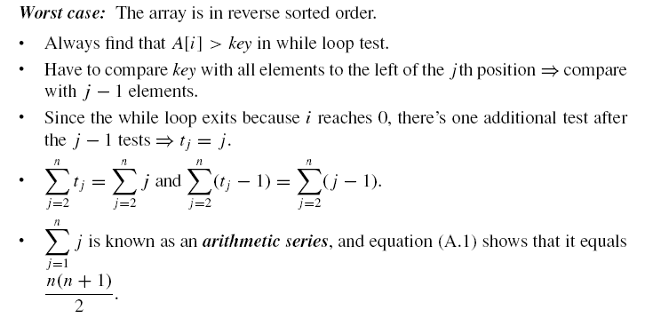
Worst Case T(n) →cn² + dn + e

Slide 11
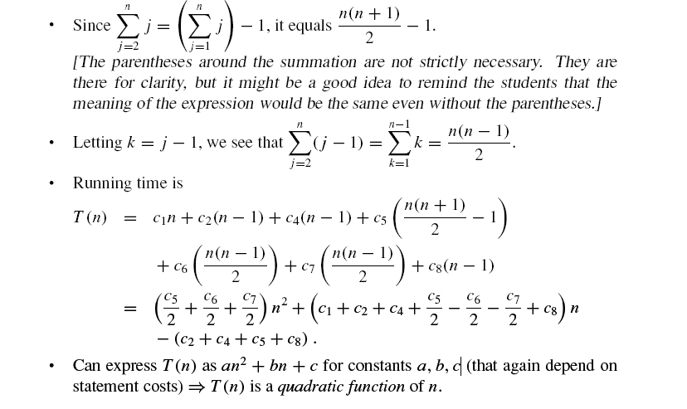
Worst Case T(n) →cn² + dn + e

Slide 12
Asymptotic Notations
RAM Model have some problems.
Exact analysis is very complicated.
Here we focus on determining the biggest term in the complexity function.
Sufficiently large size of n.

Slide 13
Asymptotic Notations(Contd.)
Step count is determined to be
c₁n² +c₂n + c₃ , c₁> 0
Let’s take the ratio r(n)=
c₂n + c₃
c₁n²
r(n)
When n is large r(n) tends to zero.
n

Slide 14
Asymptotic Notations(Contd.)
Since the term c₂n + c₃ is not significant ,the run time is approximately
c₁n²
Let n₁and n₂ be two large values of n.Therefore
t(n₁) n₁²
t(n₂) n₂²
Therefore the run time is expected to increase by a factor of 4 when the instance size is double.

Slide 15
Asymptotic Notations(Contd.)
Introduction to Graphs.
Draw the following graphs and find the intersection points.
1.y=2x² + 3x and y= 13x
2.y=2^{x} and y=x²

Slide 16
Asymptotic Notations(Contd.)
Suppose that programs A and B perform the same task. Assume that one person has determined the step counts of these programs to be t _{A}(n)=2n²+3n and t _{B}(n)=13n. Which program is the faster one ?
What is the answer if the step count of the program B is 2^{n}+n² ?

Slide 17
Asymptotic Notations(Contd.)
There are three notations.
O - Notation
Θ - Notation
Ω - Notation

Slide 18
Asymptotic Notations (Contd.)
A way to describe behavior of functions in the limit. We’re studying asymptotic efficiency.
Describe growth of functions.
Focus on what’s important by abstracting away low-order terms and constant factors.
How we indicate running times of algorithms.
A way to compare “sizes” of functions:
O ≈ ≤
Ω ≈ ≥
Θ ≈ =
o ≈ <

Slide 19
Big O - Notation
Introduced by Paul Bechman in 1892.
We use Big O-notation to give an upper bound on a function.
Definition:
O(g(n)) = { f(n) : there exist positive constants c and n_{o} such that 0 ≤ f(n) ≤ cg(n) for all n ≥ n_{o}}.
Eg:What is the big O value of f(n)=2n + 6 ?
c=4
n_{o} = 3
g(n)=n therefore f(n)=O(n)

Slide 20
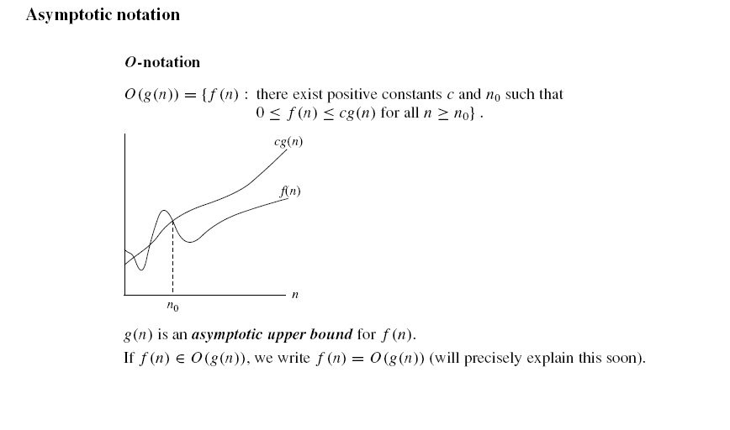

Slide 21
Big O ratio Theorem.
Definition: - Let f(n) and g(n) be two non negative functions and be such that exits.
f(n)=O(g(n)) iff
for some finite constant a.

Slide 22
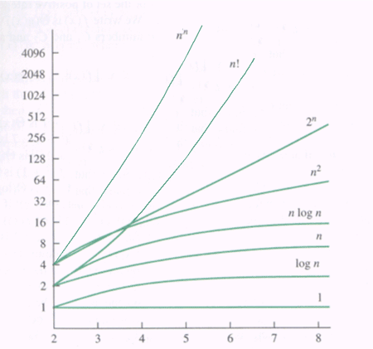
graphs of functions

Slide 23
Big O - Notation
In general, we have the following theorem:
a_{n} x^{n} + ... + a₁ x + a₀ is O( x^{n} ) for any real numbers a_{n} , ..., a₀ and any nonnegative number n .

Slide 24
Big O – Notation(Contd.)
Find the Big Oh value for following fragment of code.
for i ← 1 to n
for j ← 1 to i
Print j
O(n²)

Slide 25
Big O – Notation(Contd.)
Assignment (s ←1)
Addition (s+1)
Multiplication (s*2)
Comparison (S<10)
O(1)

Slide 26
Big O – Notation(Contd.)
Find the Bog O value for the following functions.
(i) T(n)= 3 +5n + 3n²
(ii) f(n)= 2^{n} + n² +8n +7
(iii) T(n)= n + logn +6
Answers:
(i) O(n²)
(ii) O(2^{n})
(iii) O(n)

Slide 27
Back to the example
Alternative calculation:
cost
times
c₁
1
c₂
n+1
c₃
n
T(n) = c₁ + c₂ (n+1) + c₃ n = (c₁ + c₂) + (c₂ + c₃) n = c₄ + c₅ n
→ O (n)
Proof: c₄ + c₅ n ≤ c n → TRUE for n≥1 and c ≥ c₄ + c₅

Slide 28
Simple Big-O
All O(1)

Slide 29
Want least upper bound
All useful algorithms are O(2^{n}), so saying an algorithm is O(2^{n}) is not very useful
Try and find the least O( f (n) ) expression
If f(n) is the smallest possible, then it is said to be a tight upper bound; if f(n) is O(n²), it is also O(n³), however, the first expression is better.
Not to be confused with tight asymptotic bound → big theta (Θ)

Slide 30
Ω - Notation
Which will provide the lower bound of the function.
Definition:
Ω(g(n)) = { f(n) : there exist positive constants c and n₀ such that 0 ≤ cg(n) ≤ f(n) for all n ≥ n_{o}}
eg:Find the Ω value of the of functions.
(i) f(n)=6 *2^{n} + n²
(ii) f(n)=3n + 2

Slide 31
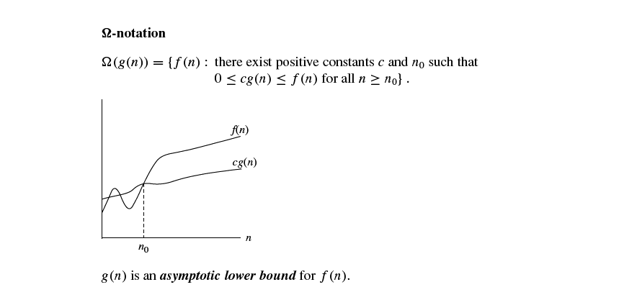

Slide 32
Omega ratio Theorem.
Definition: - Let f(n) and g(n) be two non negative functions and be such that exits.
f(n)= Ω (g(n)) iff
for some finite constant a.

Slide 33
Ω - Notation
In general, we have the following theorem:
a_{n} x^{n} + ... + a₁ x + a₀ is Ω ( x^{n} ) for any real numbers a_{n} , ..., a₀ and any nonnegative number n .

Slide 34
Θ - Notation
This is used when the function f can be bounded both from above and below by the same function g.
Definition:
Θ(g(n)) ={ f(n): there exist positive constant c₁, c₂, and n₀ such that 0≤ c₁ g(n) ≤ f(n) ≤ c₂g(n) for all n ≥ n₀ }

Slide 35
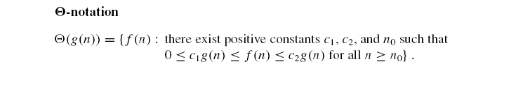
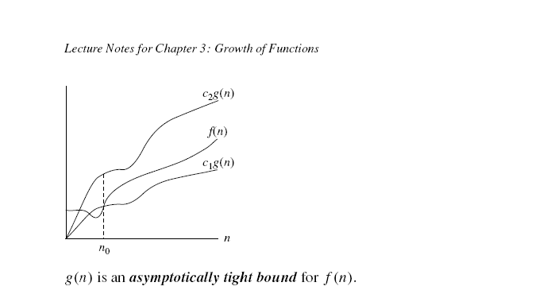

Slide 36
Theta ratio Theorem.
Definition: - Let f(n) and g(n) be two non negative functions and be such that and
f(n)= Θ (g(n)) iff
exist.
and
for some finite constant a.

Slide 37
Θ - Notation(Contd.)
In general, we have the following theorem:
a_{n} x^{n} + ... + a₁ x + a₀ is Θ ( x^{n} ) for any real numbers a_{n} , ..., a₀ and any nonnegative number n .

Slide 38
Summary (Contd.)
Asymptotic Notations.
O - Notation
Θ - Notation
Ω - Notation

Slide 39
Thank You

