Slide 1
DAA 214

Slide 2
Contents for Today
Tree
Binary Tree
Complete Binary Tree
Heaps
Heap Algorithms
- Maintaining Heap Property
- Building Heaps
- HeapSort Algorithms
DAA 214

Slide 3
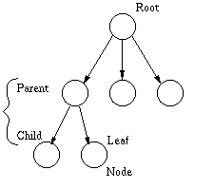
Tree
A tree is a connected, acyclic, undirected graph and
Has components named after natural trees
-root -branches -leaves
Drawn with root at the top
Examples
Root
branch
leaf
DAA 214

Slide 4
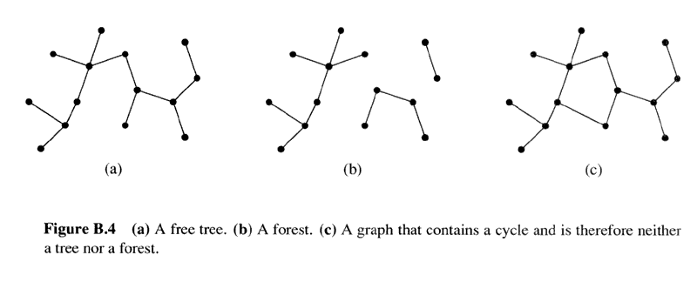
Trees (Contd.)
DAA 214

Slide 5
Tree Terminology
Root
Node
Parent
Child
Leaf
Siblings
Degree of a node
Depth of a node
Height of a tree
DAA 214

Slide 6
Tree Terminology (Contd.)
Root:It is node with no parent.
Node: It is a vertex of the tree where a data element is stored.
Parent : It is a single node that directly precedes a node.
Child : It is a node that directly follows a node.
Leaf : It is a node with no children,Items at the very bottom of a hierarchical tree structure.
Siblings: The nodes which share same parent
Degree of an node:The number of children it has
Depth:The depth of x in T is the length of the path from the root r to a node x.
Height:The largest depth of any node in a tree is the height.
DAA 214

Slide 7
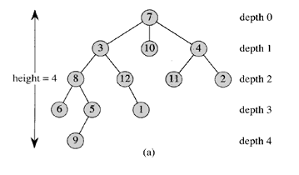
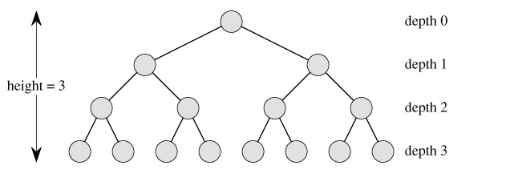
Tree Terminology (Contd.)
DAA 214

Slide 8
Binary tree
A binary tree is a tree structure in which each node has at most two children.
Each element in a Binary Tree has degree ≤2.
Examples
DAA 214

Slide 9
Full Binary Tree
A Binary tree of height h that contains exactly 2^{h+1}-1 nodes
Height, h= 2, ∴ nodes = 2²⁺¹-1= 7
DAA 214

Slide 10
Complete Binary Tree
It is a Binary tree where each node is either a leaf or has degree ≤ 2.
Completely filled, except possibly for the bottom level and level above
Each level is filled from left to right.
All nodes at the lowest level are as far to the left as possible
Full binary tree is also a complete binary tree.
DAA 214

Slide 11
Examples of Complete Binary Trees
Followings are not CBTs
Degree > 2
Not Completely filled
Filled from right to left
DAA 214

Slide 12
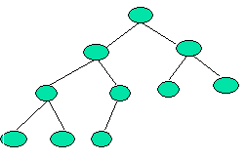
Height of a complete binary tree
Height of a complete binary tree that contains n elements is ⎣log₂(n)⎦
Example
Above is a Complete Binary Tree with height = 3
No of nodes: n = 10
∴Height = ⎣log₂(n)⎦ = ⎣log₂(10)⎦ = 3
DAA 214

Slide 13
Heaps
A Complete Binary Tree with the heap property.
Heap Property: The value of each node is greater than or equal to those of its children.
Examples
14
14
12
7
12
7
10
8
6
10
8
6
5
4
3
DAA 214

Slide 14
Heaps (contd.)
A heap can be represented in a one-dimensional array
Example
1
16
2
3
14
10
4
5
6
7
8
7
9
3
Heap
8
9
10
2
4
1
A
1 2 3 4 5 6 7 8 9 10
16 | 14 | 10 | 8 | 7 | 9 | 3 | 2 | 4 | 1
Array
DAA 214

Slide 15
Heaps (contd.)
After representing a heap using an array: A
we can notice that,Root of the tree is A[1]
Given node with index i,
PARENT(i) is the index of parent of i;
PARENT(i) = ⎣i/2⎦
LEFT_CHILD(i) is the index of left child of i ;
LEFT_CHILD(i) = 2×i
RIGHT_CHILD(i) is the index of right child of i;
RIGHT_CHILD(i) = 2×i +1
Example on the board
DAA 214

Slide 16
Heap property
Using the array representation of a heap we can rewrite the earlier heap property as
The heap is based on a complete binary tree
Therefore, heaps has properties that are same as complete binary trees
- e.g.. Height of a heap that contains n elements is ⎣log₂(n)⎦
A[PARENT(i)] ≥ A[i]
DAA 214

Slide 17
Heap property
For max-heaps (largest element at root), max-heap property: for all nodes I ,excluding the root, A[PARENT(i )] ≥ A[i ].
For min-heaps (smallest element at root), min-heap property: for all nodes i ,excluding the root, A[PARENT(i )] ≤ A[i ].
DAA 214

Slide 18
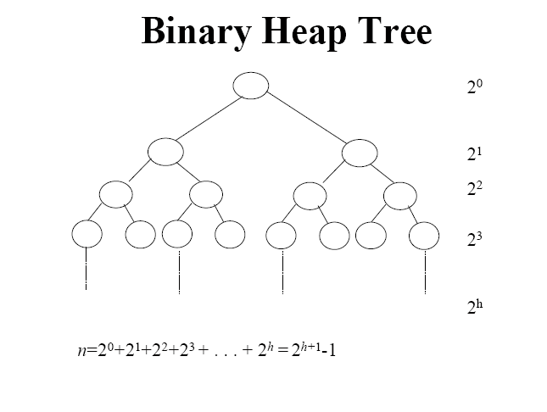
DAA 214

Slide 19
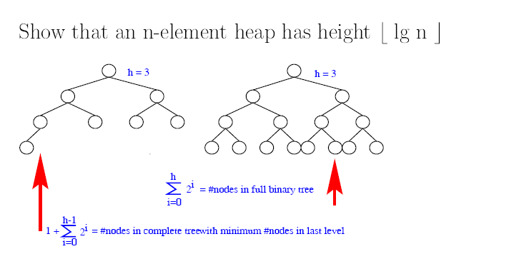
Heap Tree.
DAA 214

Slide 20
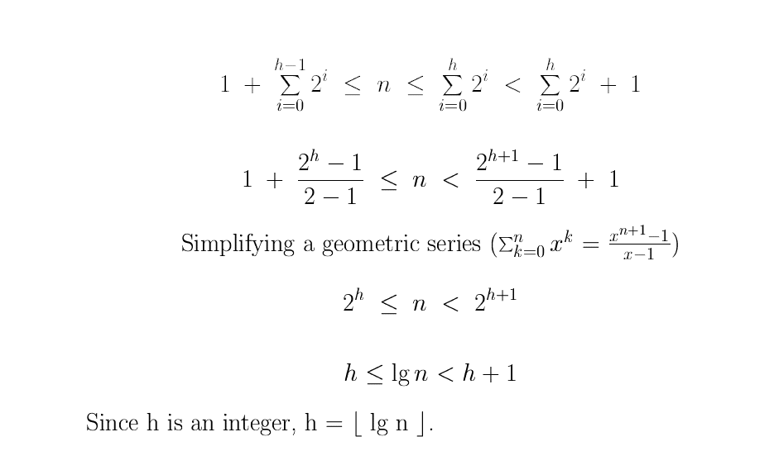
DAA 214

Slide 21
Heap Algorithms
HEAPIFY:
To maintain heap property
BUILD_HEAP
To build heap from an unsorted input array
HEAPSORT
Sorts an array in place.
A[PARENT(i)] ≥ A[i]
DAA 214

Slide 22
HEAPIFY
The HEAPIFY algorithm checks the heap elements for violation of the heap property and restores heap property;
Input: An array A and index i to the array. i =1 if we want to heapify the whole tree. Subtrees rooted at LEFT_CHILD(i) and RIGHT_CHILD(i) are heaps
Output: The elements of array A forming subtree rooted at i satisfy the heap property.
A[PARENT(i)] ≥ A[i]
DAA 214

Slide 23
Maintaining the Heap Property
Procedure HEAPIFY (A,i)
1. l ← LEFT_CHILD (i);
2. r ← RIGHT_CHILD (i);
3. if l ≤ heap_size[A] and A[ l ] > A[ i ]
4. then largest ← l;
5. else largest ← i;
6. if r ≤ heap_size[A] and A[r] > A[largest]
7. then largest ← r;
8. if largest ≠ i
9. then exchange A[i] ↔ A[largest]
10. HEAPIFY (A,largest)
DAA 214

Slide 24
Example
You are given the following array.
A
1 2 3 4 5 6 7 8 9 10
7 | 24 | 19 | 21 | 14 | 03 | 10 | 2 | 13 | 11
Now we are going to maintain the heap property
Drawing a heap would make our work easy
7
24
19
21
14
03
10
2
13
11
DAA 214

Slide 25

HEAPIFY (A,1)
7
24
24
19
7
19
21
14
03
10
21
14
03
10
2
13
11
2
13
11
HEAPIFY (A,2)
24
24
21
19
7
19
7
14
03
10
21
14
03
10
2
13
11
2
13
11
HEAPIFY (A,4)
DAA 214
To be contd.

Slide 26
HEAPIFY (A,1) (contd.)
24
24
21
19
21
19
7
14
03
10
7
14
03
10
2
13
11
2
13
11
HEAPIFY (A,4)
Important point Although we represent this process using a heap actually all the task in done on the input array
24
21
19
13
14
03
10
2
7
11
Resulting Heap
DAA 214

Slide 27
Array view of HEAPIFY Algorithm
7 24 19 21 14 03 10 02 13 11
24 7 19 21 14 03 10 02 13 11
24 21 19 07 14 03 10 02 13 11
24 21 19 13 14 03 10 02 07 11
24
21
19
13
14
03
10
2
7
11
DAA 214

Slide 28
Analysis of Heapify Algorithm.
The running time of MAX-HEAPIFY on a subtree of size n rooted at given node i is the Θ(1) time to fix up the relationships among the elements A[i], A[LEFT(i)], and A[RIGHT(i)], plus the time to run MAX-HEAPIFY on a subtree rooted at one of the children of node i.
The children's subtrees each have size at most 2n/3-the worst case occurs when the last row of the tree is exactly half full-and the running time of MAX-HEAPIFY can therefore be described by the recurrence
T (n) ≤ T(2n/3) + Θ(1).
The solution to this recurrence, by case 2 of the master theorem, is T (n) = O(lg n). Alternatively, we can characterize the running time of MAX-HEAPIFY on a node of height h as O(h).
DAA 214

Slide 29
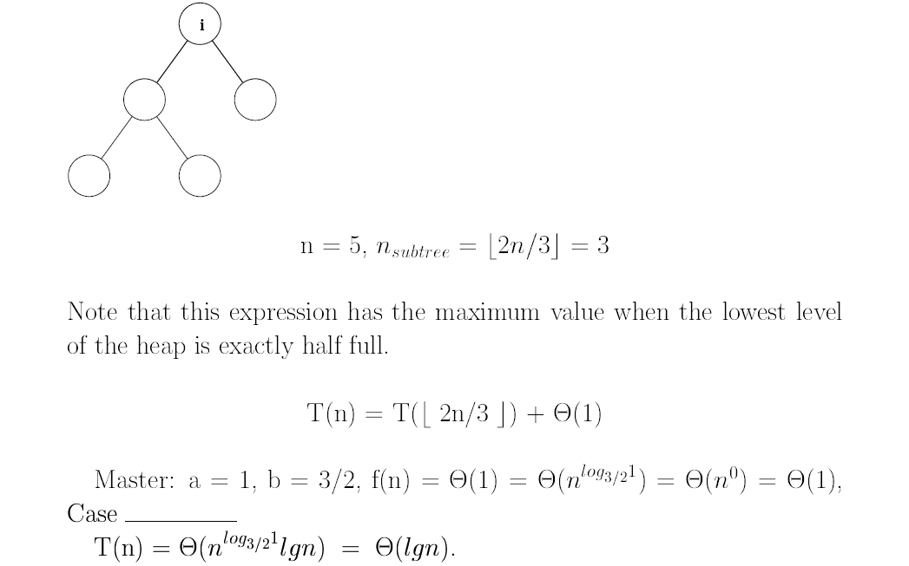
Recursive Analysis.
DAA 214

Slide 30
BUILD_HEAP
Input : An array A of size n = length [A], heap_size[A]
Output : A heap of size n
Procedure BUILD_HEAP (A)
1. heap_size[A] ← length[A]
2. for i ← ⎣length[A]/2⎦ downto 1
3. HEAPIFY(A,i)
Exercise: We are given the following unordered array to build the heap.
A
1 2 3 4 5 6 7 8 9 10
4 | 1 | 3 | 2 | 16 | 9 | 10 | 14 | 8 | 7
DAA 214

Slide 31
Solution
Step1
i = ⎣length[A]/2⎦ = ⎣10/2 ⎦ =5
HEAPIFY(A,5)
A
1 2 3 4 5 6 7 8 9 10
4 | 1 | 3 | 2 | 16 | 9 | 10 | 14 | 8 | 7
4
1
3
i
2
16
9
10
14
8
7
Rest of the steps on the board
DAA 214

Slide 32
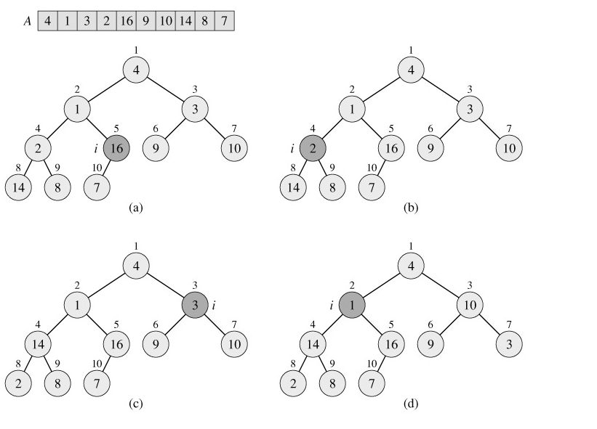
DAA 214

Slide 33
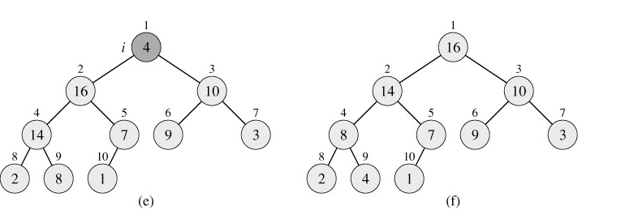
The operation of BUILD-MAX-HEAP, showing the data structure before the call to MAX-HEAPIFY in line 3 of BUILD-MAX-HEAP. (a) A 10-element input array A and the binary tree it represents. The figure shows that the loop index i refers to node 5 before the call MAX-HEAPIFY(A, i). (b) The data structure that results. The loop index i for the next iteration refers to node 4. (c)-(e) Subsequent iterations of the for loop in BUILD-MAX-HEAP. Observe that whenever MAX-HEAPIFY is called on a node, the two subtrees of that node are both max-heaps. (f) The max-heap after BUILD-MAX-HEAP finishes.
DAA 214

Slide 34
Analysis of Build Heap Algorithm.
We can compute a simple upper bound on the running time of BUILD-HEAP as follows. Each call to HEAPIFY costs O(lg n) time, and there are O(n) such calls. Thus, the running time is O(n lg n).
This upper bound, though correct, is not asymptotically tight.
We can derive a tighter bound by observing that the time for MAX-HEAPIFY to run at a node varies with the height of the node in the tree, and the heights of most nodes are small.
Our tighter analysis relies on the properties that an n-element heap has height ⌊lg n⌋ and at most ⌈n/2h+1⌉ nodes of any height h.
DAA 214

Slide 35
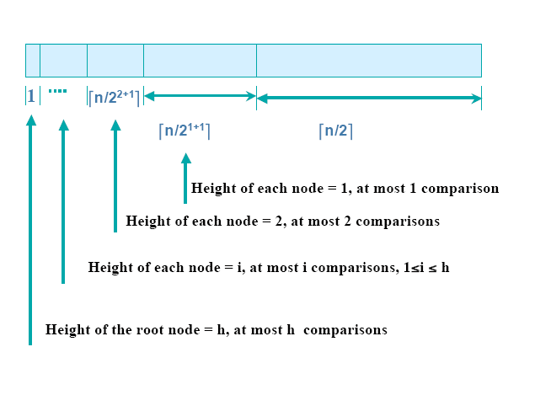
Analysis of Build Heap Algorithm.
DAA 214

Slide 36
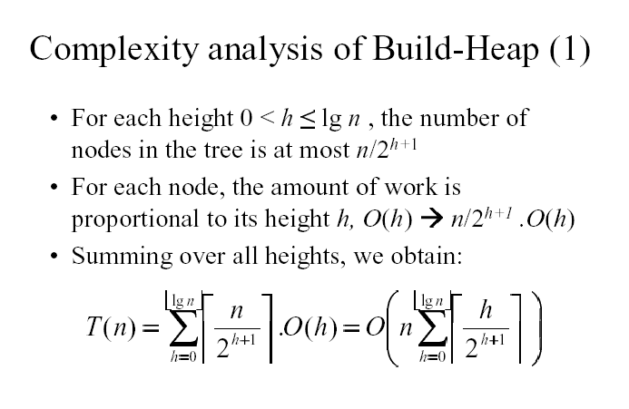
DAA 214

Slide 37
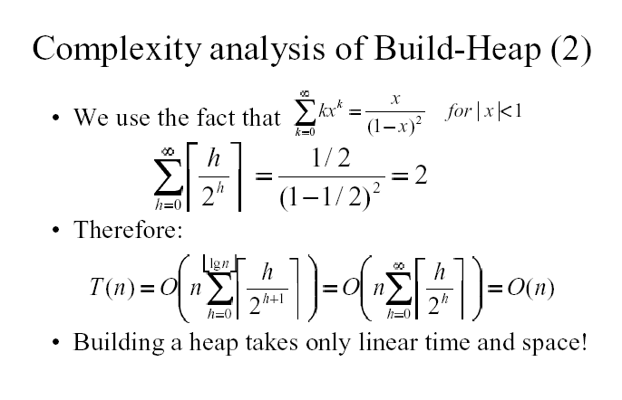
DAA 214

Slide 38
The HEAPSORT Algorithm
Input : Array A[1…n], n = length[A]
Output : Sorted array A[1…n]
Procedure HEAPSORT(A)
1. BUILD_HEAP[A]
2. for i ← length[A] down to 2
3. Exchange A[1] ↔ A[i]
4. heap_size[A] ← heap_size[A]-1;
5. HEAPIFY(A,1)
DAA 214

Slide 39
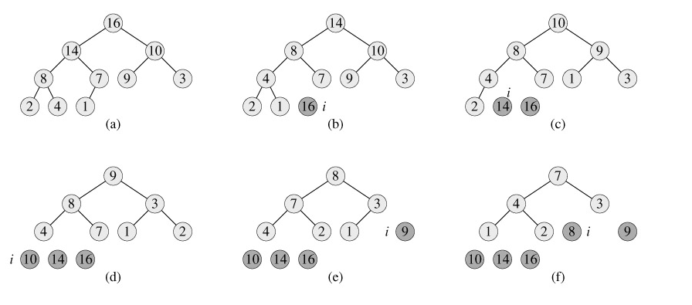
The operation of HEAPSORT.
DAA 214

Slide 40
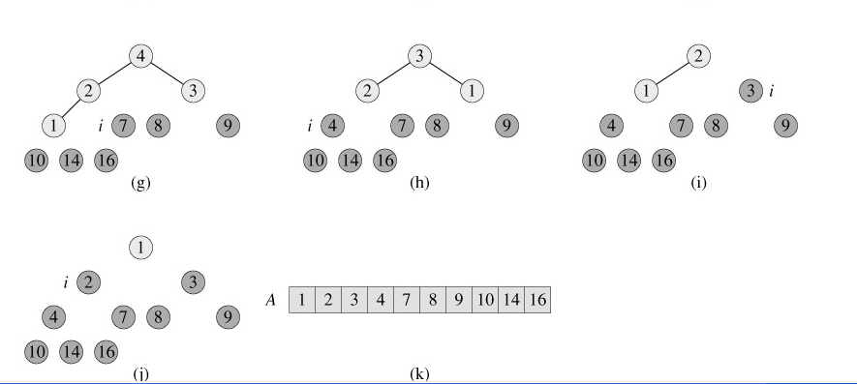
The operation of HEAPSORT.
DAA 214

Slide 41
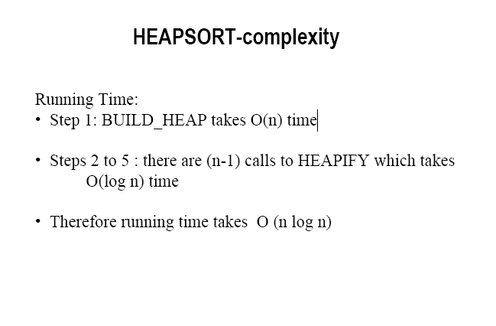
DAA 214

Slide 42
Priority queues.
Heapsort is an excellent algorithm, but a good implementation of quicksort, usually beats it in practice. Nevertheless, the heap data structure itself has enormous utility.
In this section, we present one of the most popular applications of a heap: its use as an efficient priority queue. As with heaps, there are two kinds of priority queues: max-priority queues and min-priority queues. We will focus here on how to implement max-priority queues, which are in turn based on max-heaps;
DAA 214

Slide 43
Priority queues.
priority queue is a data structure for maintaining a set S of elements, each with an associated value called a key. A max-priority queue supports the following operations.
INSERT(S, x) inserts the element x into the set S. This operation could be written as S ← S ∪ {x}.
MAXIMUM(S) returns the element of S with the largest key.
EXTRACT-MAX(S) removes and returns the element of S with the largest key.
One application of max-priority queues is to schedule jobs on a shared computer. The max-priority queue keeps track of the jobs to be performed and their relative priorities. When a job is finished or interrupted, the highest-priority job is selected from those pending using EXTRACT-MAX. A new job can be added to the queue at any time using INSERT.
DAA 214

Slide 44
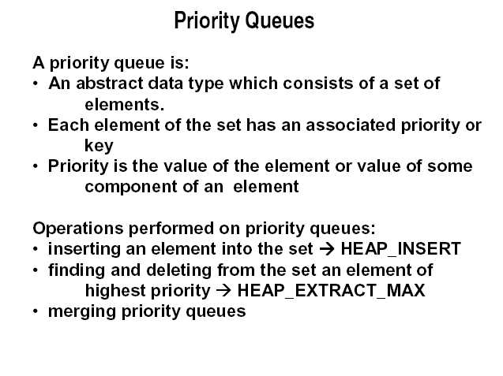
DAA 214

Slide 45
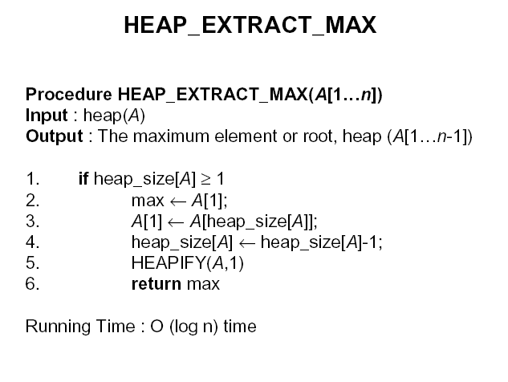
DAA 214

Slide 46
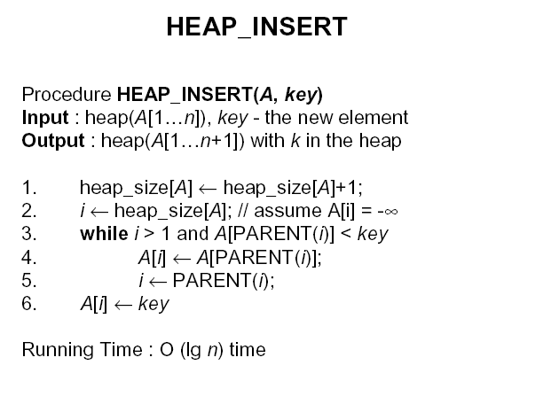
DAA 214

Slide 47
Summary
Complete binary Tree
Heap property
Heap
Maintaining heap Property(HEAPIFY)
Building Heaps
HeapSort Algorithm
Priority queues.
Heap Extract Max.
Heap Insert.
DAA 214

Slide 48
Next Lecture
String Matching
Thank You
DAA 214

