Slide 1
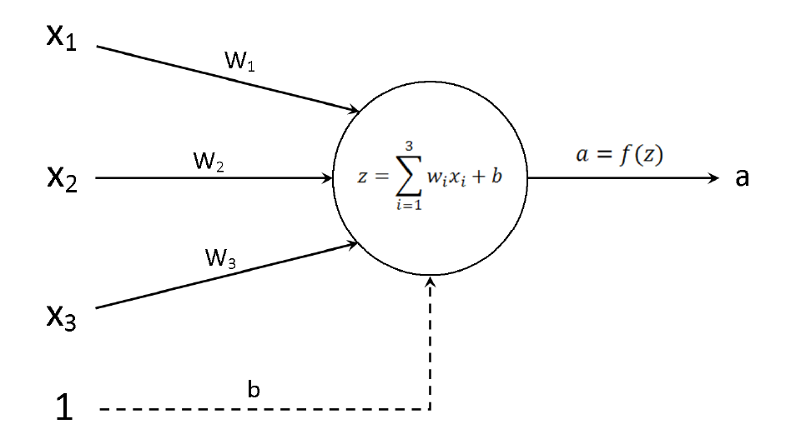
Feed forward
N_INPUTS →
W1,1 | W2,1 | W3,1
W1,2 | W2,2 | W3,2
W1,3 | W2,3 | W3,3
W1,4 | W2,4 | W3,4
W1,5 | W2,5 | W3,5
x1
x2
x3
σ()
N_NEURONS →
N_NEURONS →
N_NEURONS →
a1 | a2 | a3 | a4 | a5

Slide 2
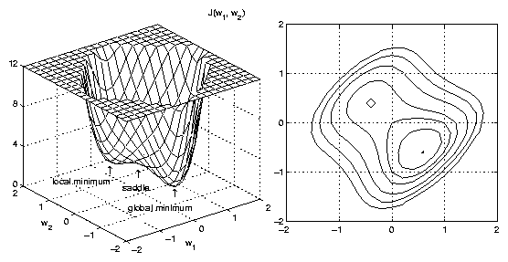
0
0
0
0
0
1
0
0
0
0
0.3
0.2
0.4
0.3
0.1
0.8
0.2
0.3
0.1
0.2
MSE = 0.61
Notes:
A: output activations
Y: targets
N: number of examples
MSE: mean squared error cost function
Source of the error surface image:
http://neuron-ai.tuke.sk/hudecm/texty+dokumenty/spc/ai/NN_Fundamentals/www.rdt.monash.edu.au/%257Eapp/CSC437nn/Lnts/Figs/Galsg.gif

Slide 3
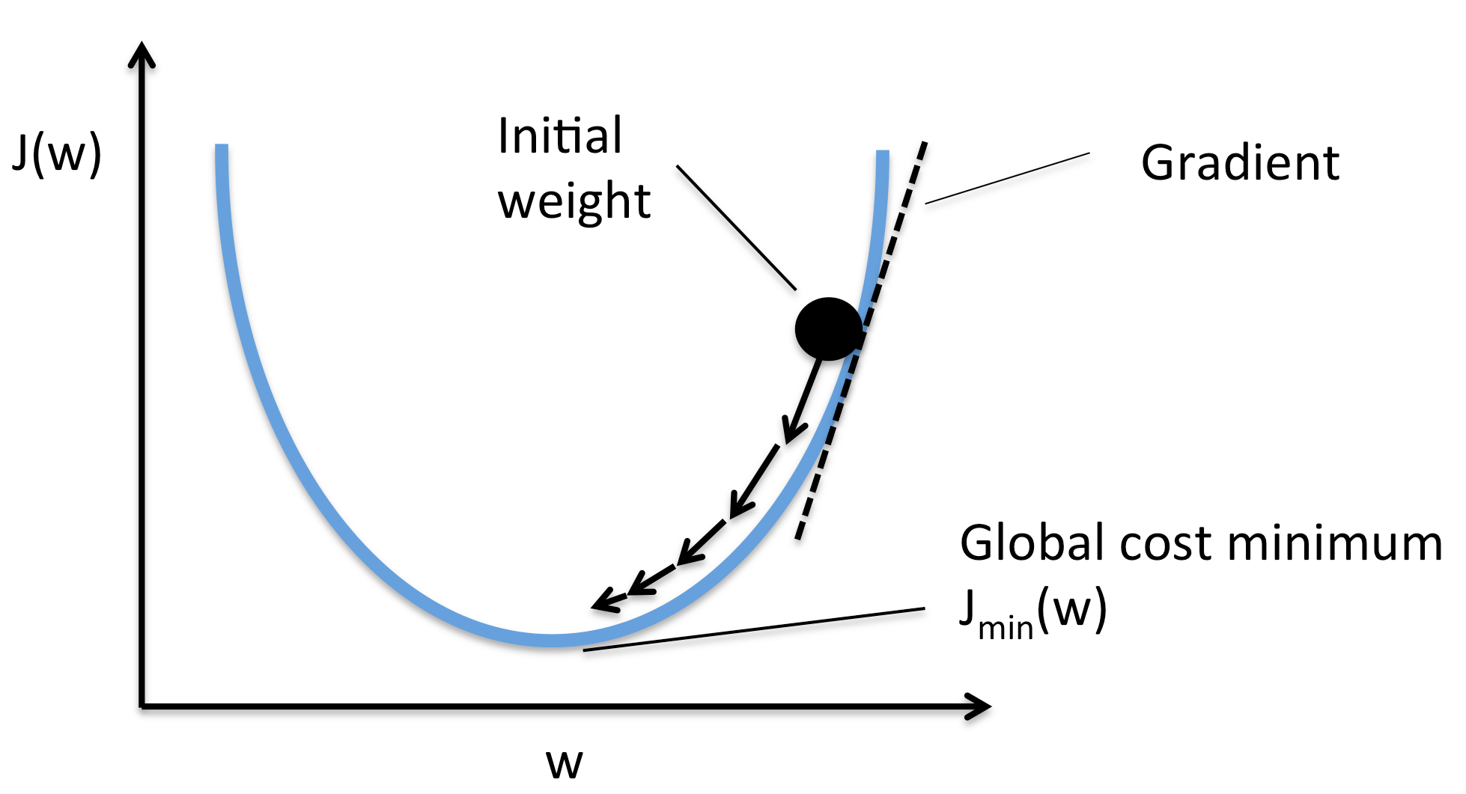
Gradient Descent
Notes:
a: activations of the output layer
y: targets
N: number of samples
z: net sum of the input (before sigmoid)
x: input
w: weight
η: eta, the learning rate
MSE: mean squared error cost function
Source of Gradient Descent image:
http://sebastianraschka.com/images/faq/closed-form-vs-gd/ball.png
On the diagram, J() is the MSE cost function.

Slide 4
Output layer error and weight gradients

Slide 5
Backpropagation of errors
Notes:
Don't forget this, this is very importan!
These derivatives are the MEMBERS of the 'big' chain-rule derivation!
These members have to be multiplied together in order to get the gradient of MSE with respect to the parameters in question!
E.g. we are not interested in {dAN / dAM}, we are interested in {dMSE / dAM} which is obtained by:
{dMSE / dAO} * {dAO / dAN} * {dAN / dAM}

Slide 6
Introducing the delta notation
Don't forget this, this is very importan! The previous derivatives are the MEMBERS of the 'big' chain-rule derivation!
They need to be multiplied together in order to get the gradient of MSE with respect to the parameters!
E.g. we are not interested in {dAM / dAL}, we are interested in {dMSE / dAL} which is obtained by the chain rule:

Slide 7
Calculating the weight gradients
The layer's delta is also called the layer's error (it is actually the gradient of MSE with respect to the net sum, Z.
It is not equivalent to the weights' error though!
Why do we need the delta notation? Because in every step of the backprop algorithm, besides the previous layer's delta, we also want to compute the gradient of MSE with respect to the weights, which is also determined using the current layer's delta. For example:

Slide 8
Notes:
Don't forget this, this is very importan!
These derivatives are the MEMBERS of the 'big' chain-rule derivation!
These members have to be multiplied together in order to get the gradient of MSE with respect to the parameters in question!
E.g. we are not interested in {dAN / dAM}, we are interested in {dMSE / dAM} which is obtained by:
{dMSE / dAO} * {dAO / dAN} * {dAN / dAM}

Slide 9
at the output layer.
at the first hidden layer

