Slide 1
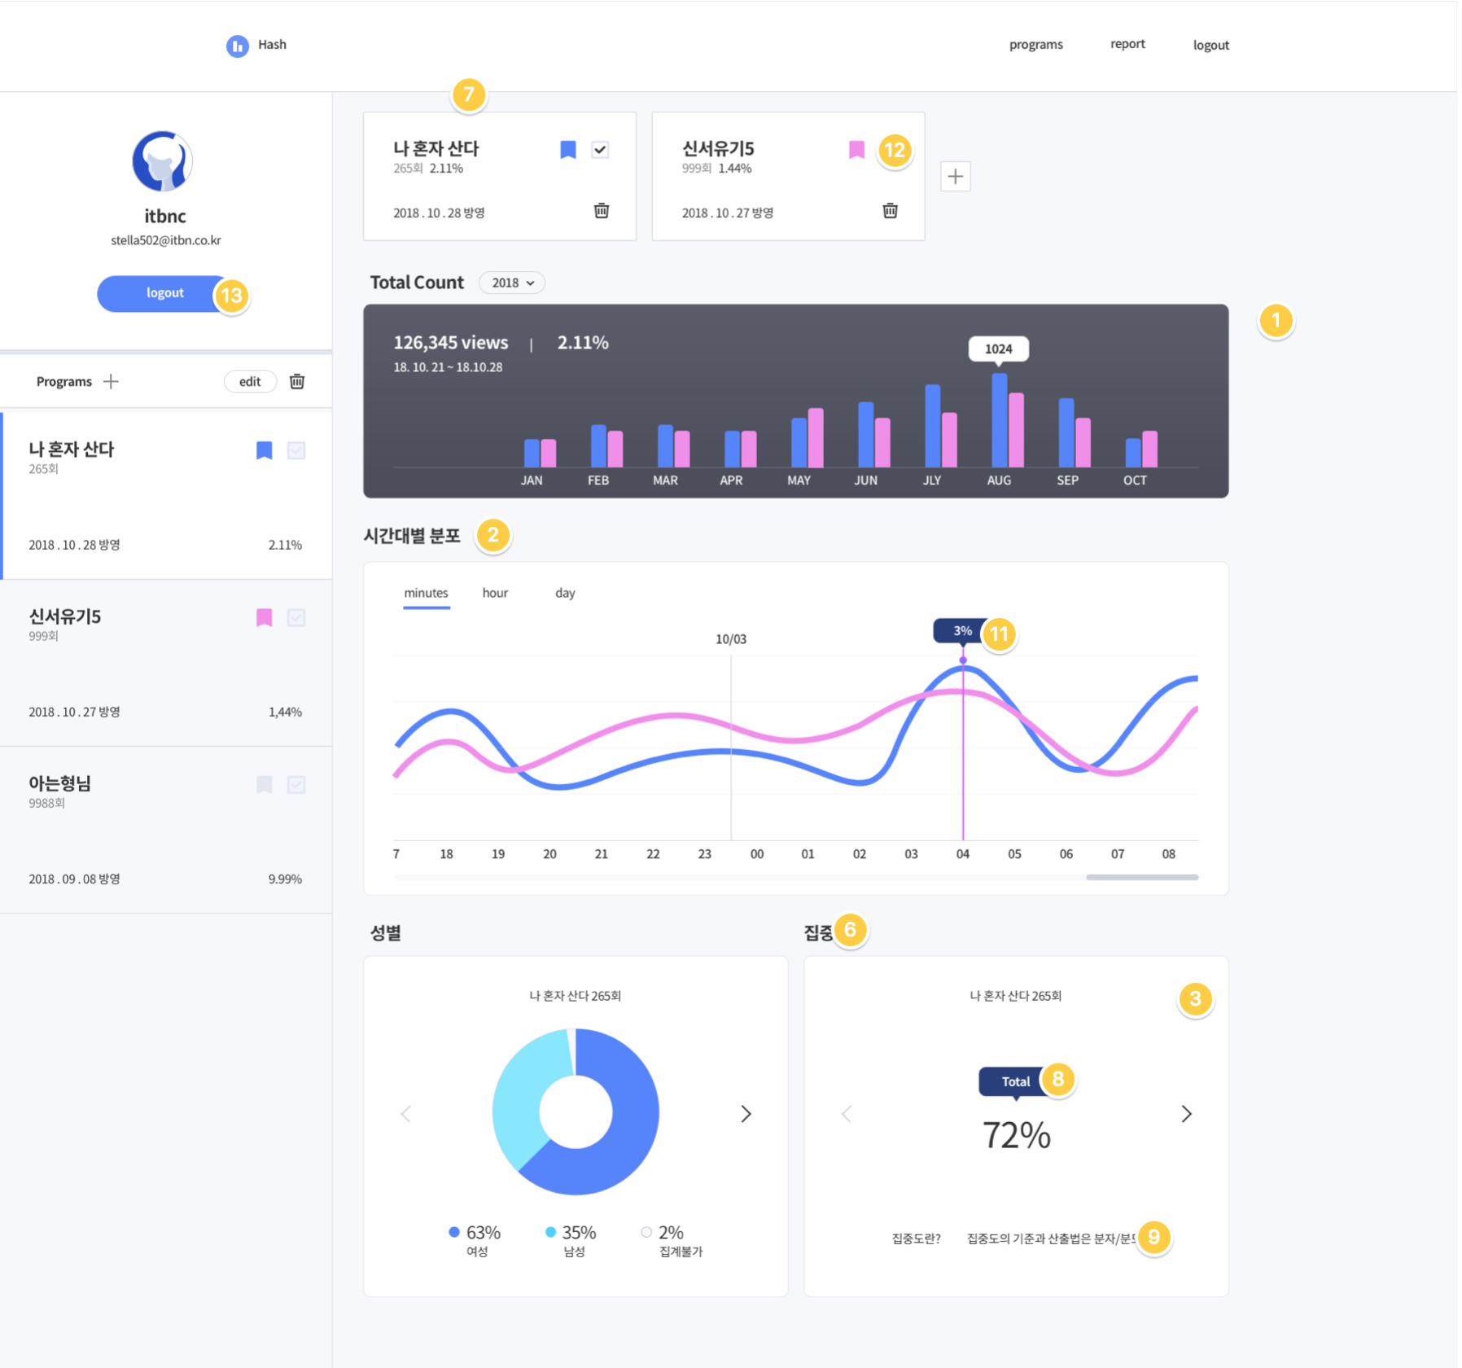
Navbar
side-container
main-container

Slide 2
Nav-wrapper
side-profile-wrapper
Side-menu-wrapper
Side-program-wrapper program-active
Program-header
Program-footer
Side-program-wrapper

Slide 3
filter-wrapper
main-rating-wrapper
main-rating-wrapper
Sub-rating-wrapper
Main-chart-wrapper

Slide 4
filter
Filter-plus
Filter-header
Filter-footer
Rating-header
Rating-body
Chart-wrapper

