Slide 1
Highlight-Save
Created : 2019/10/01
Updated : 2019/10/01

Slide 2


What is it ?
<div>Icons made by <a href="https://www.flaticon.com/authors/smashicons" title="Smashicons">Smashicons</a> from <a href="https://www.flaticon.com/" title="Flaticon">www.flaticon.com</a></div>
<div>Icons made by <a href="https://www.flaticon.com/authors/smashicons" title="Smashicons">Smashicons</a> from <a href="https://www.flaticon.com/" title="Flaticon">www.flaticon.com</a></div>
Pages
Documents
Summarize

Slide 3
How’s this will work?
Highlight some content in Page
Mark each part something like (Title, content, .. )
Save that to File (maybe PDF, Word, Text)

Slide 4
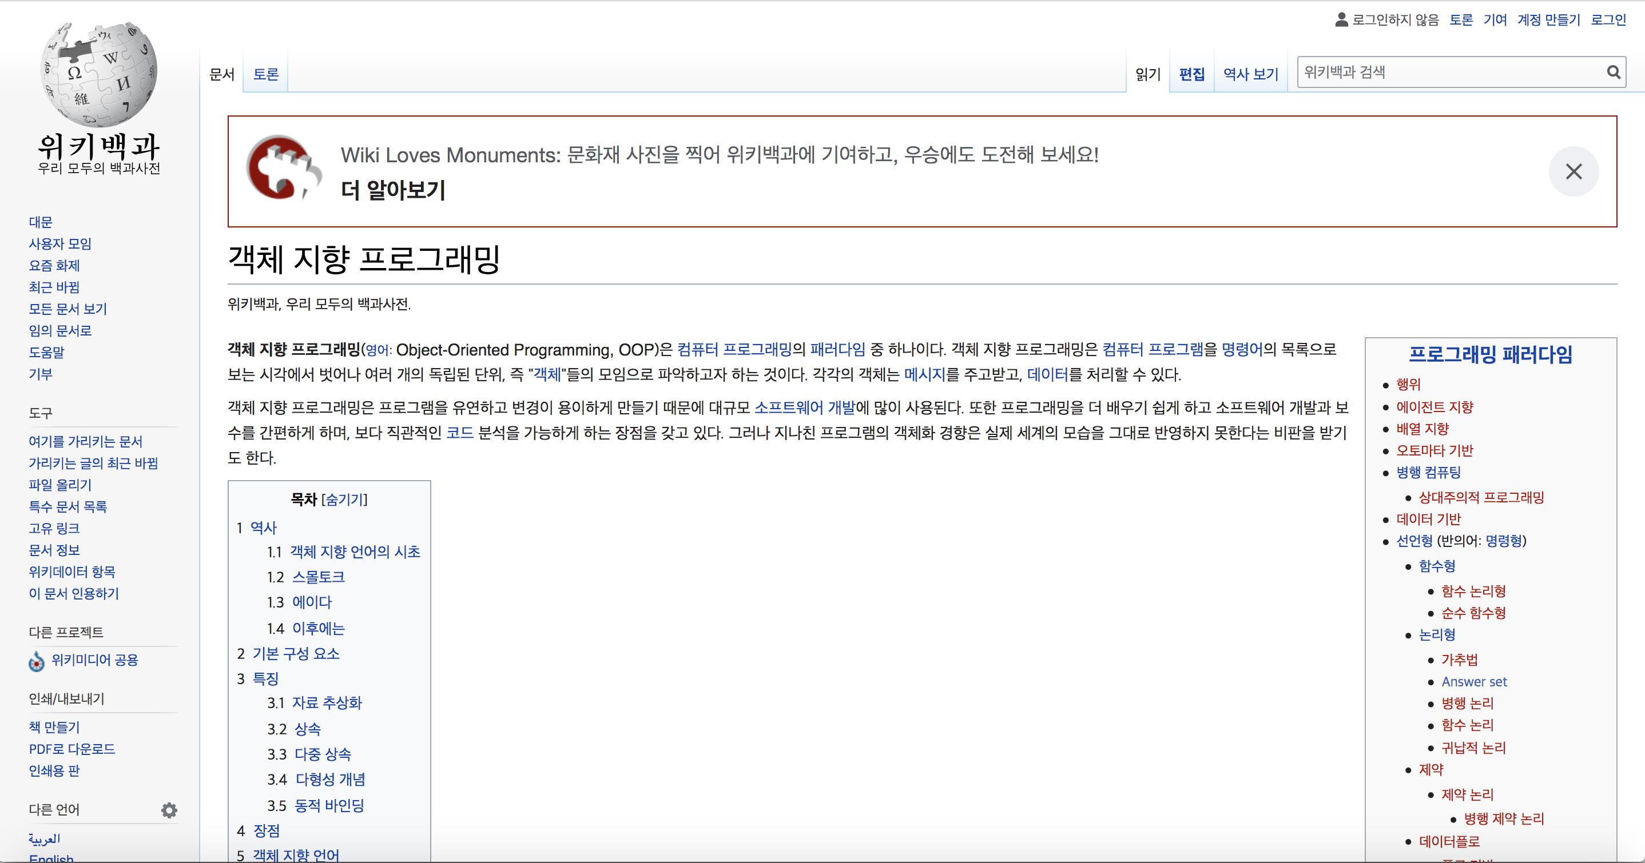
1. HighLight

Slide 5
2. Mark
Title1
Content1-1
Content1-2
Conten1-3

Slide 6
3. Save
Document1. *
객체지향 프로그래밍
컴퓨터 프로그래밍 패러다임 중 하나이다.
여러 개의 독립 단위, 즉 …
프로그램을 유연하고 변경이 용이하게 …

