Slide 1
the relationship between pedestrian counts and traffic light cycle times
Songyang Cheng
Tyler Caraza-Harter
10/24/2019

Slide 2
Pedestrian Count Distribution on Weekday/Weekends
Group by different day in a week, the volume of Pedestrian does not vary too much, because we can see the 3rd quantile is not too much far away from 1st quantile.

Slide 3
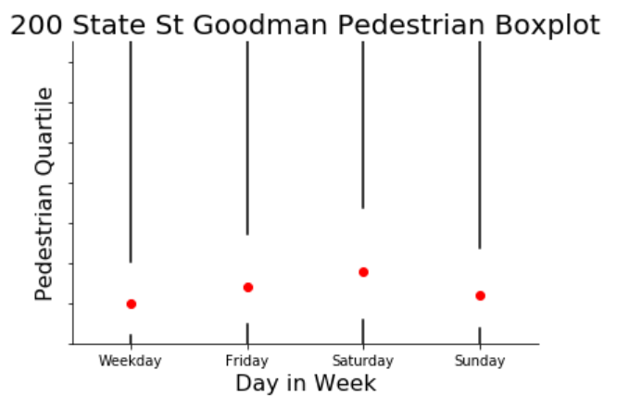
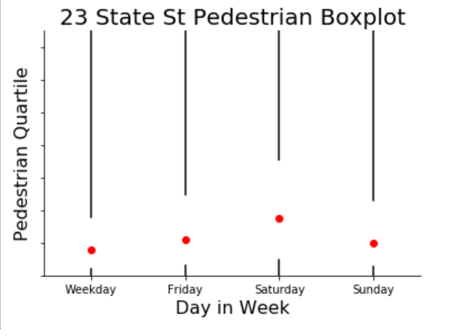
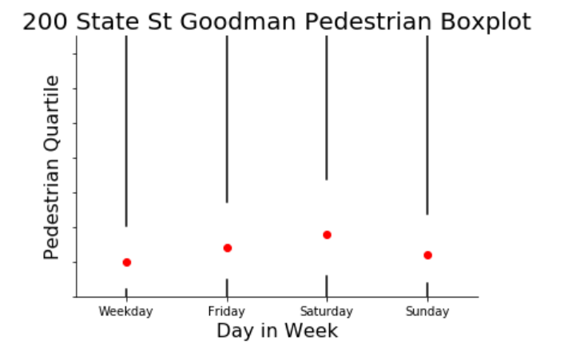
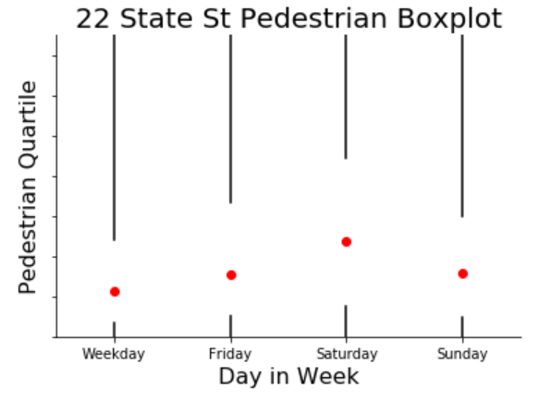

Slide 4
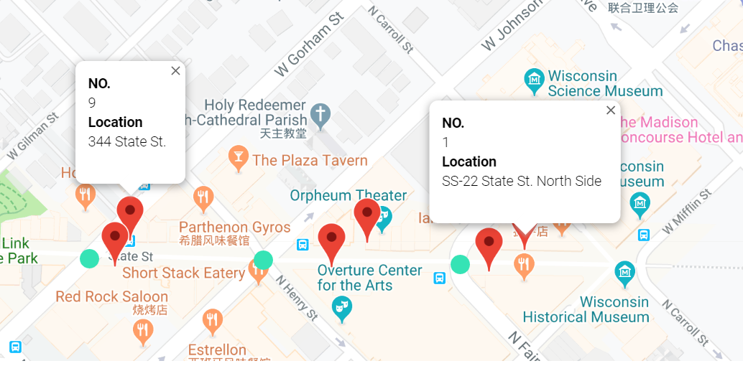
Pedestrian Counter Positions

Slide 5
Relationship Across Time between Traffic Light Cycle and Pedestrian Volume
Pedestrian Flow:
two peaks on Weekdays (commuting), one peak on Weekends
people who walk on Saturday is almost as twice large as the number who walk on weekdays
Traffic Light:
Not favor pedestrians

Slide 6
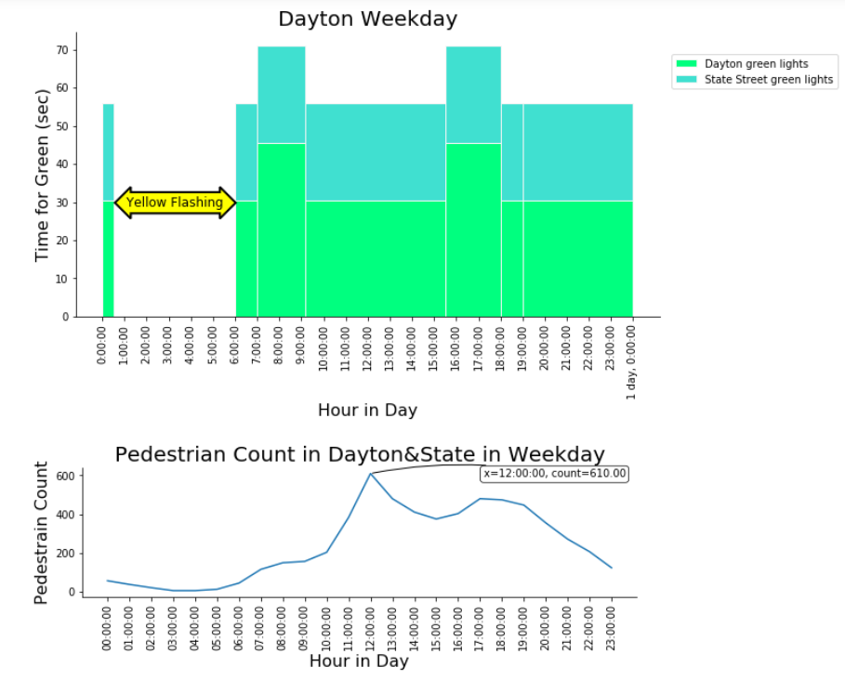
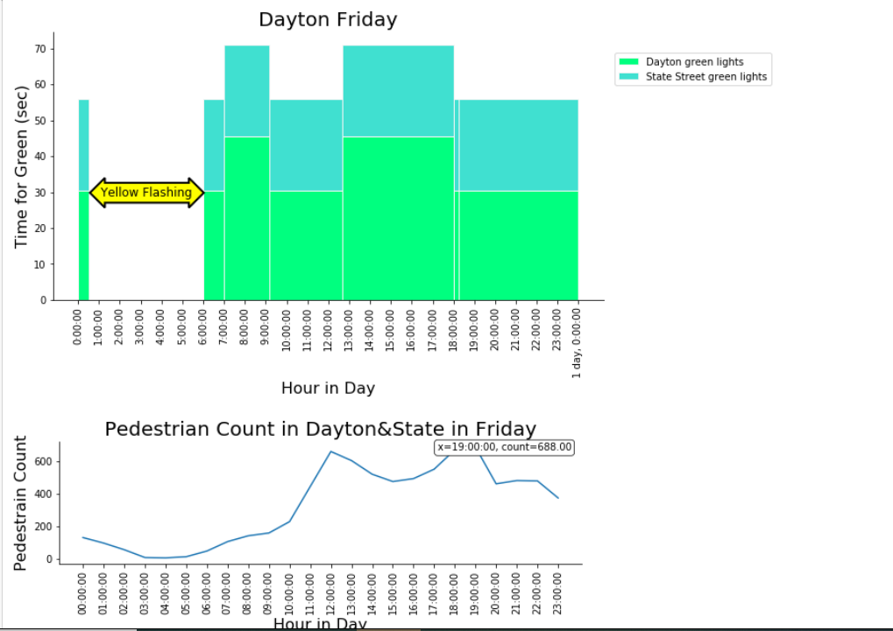
Dayton Weekdays

Slide 7
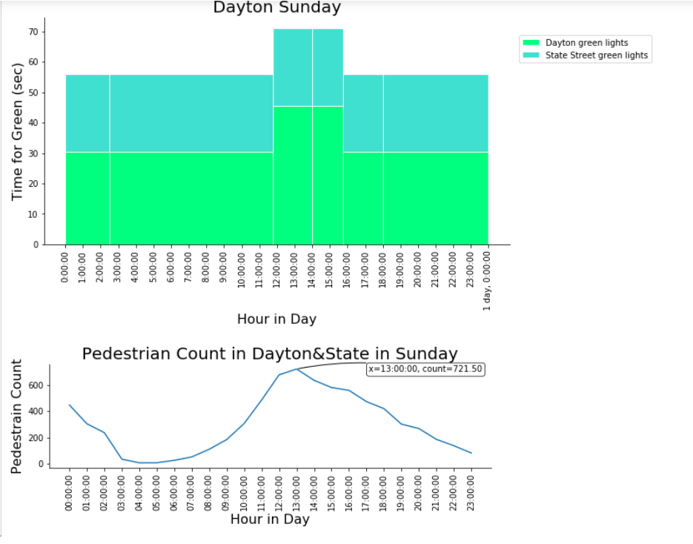
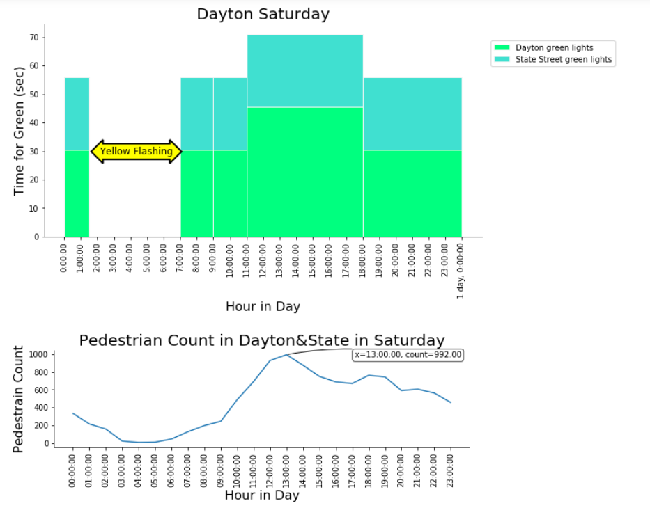
Dayton Weekends

Slide 8
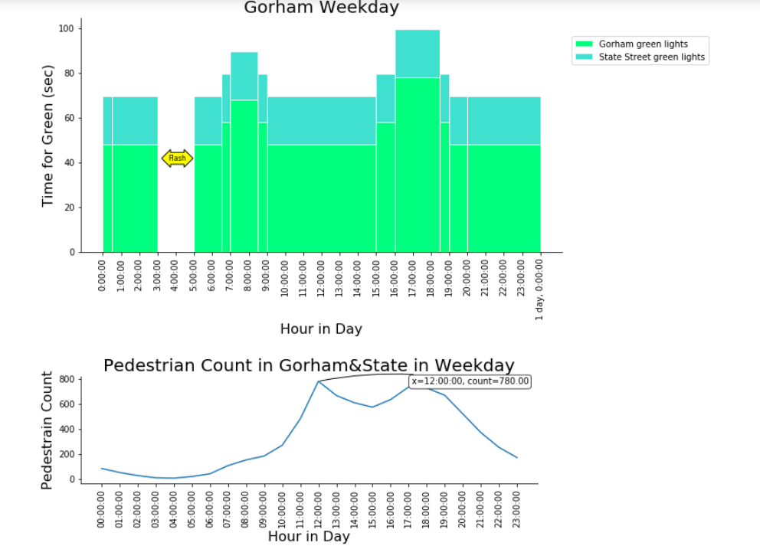
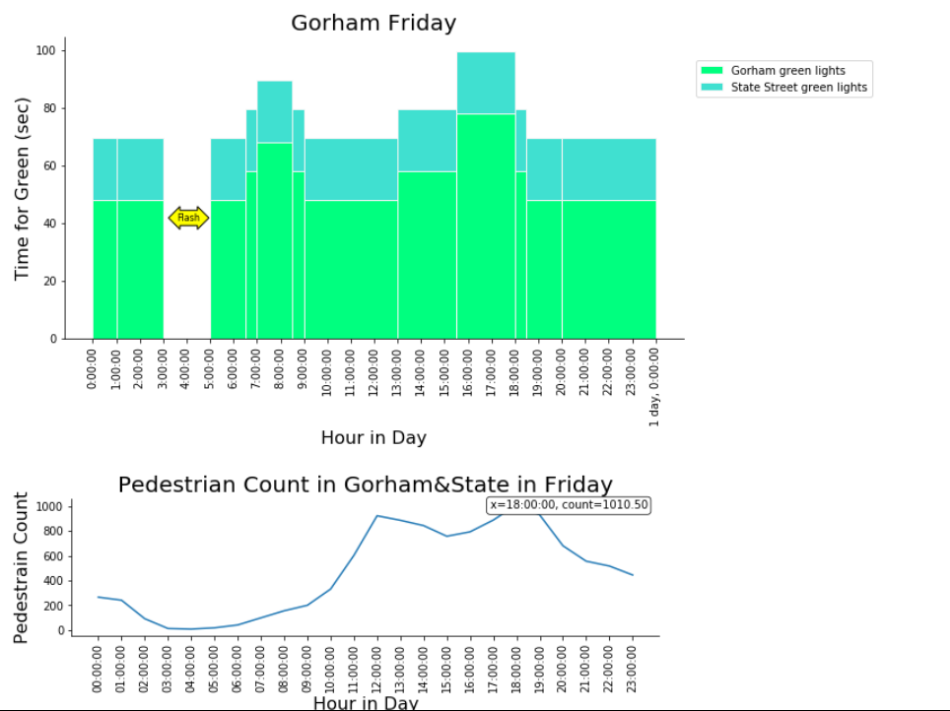
Gorham Weekdays

Slide 9
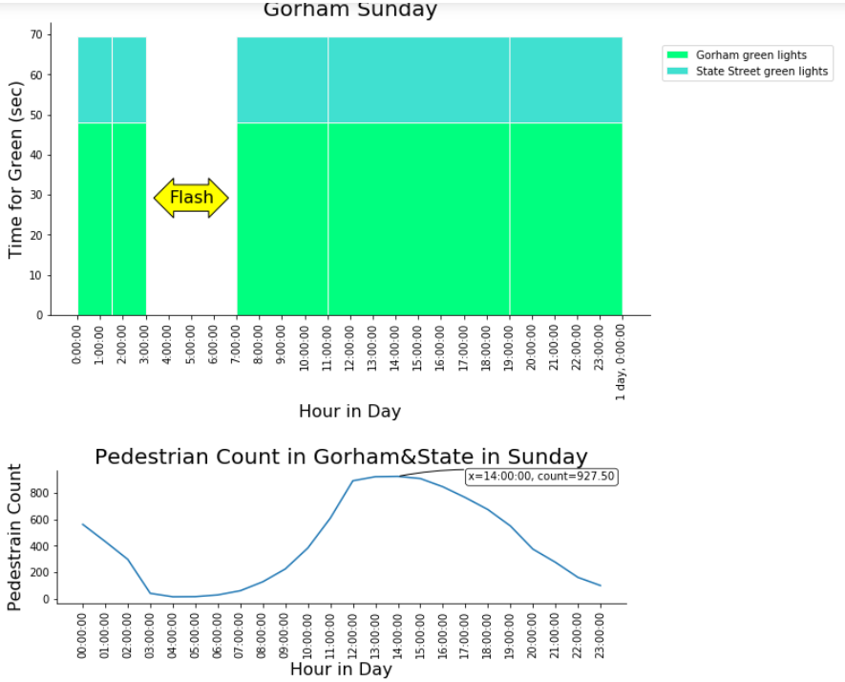
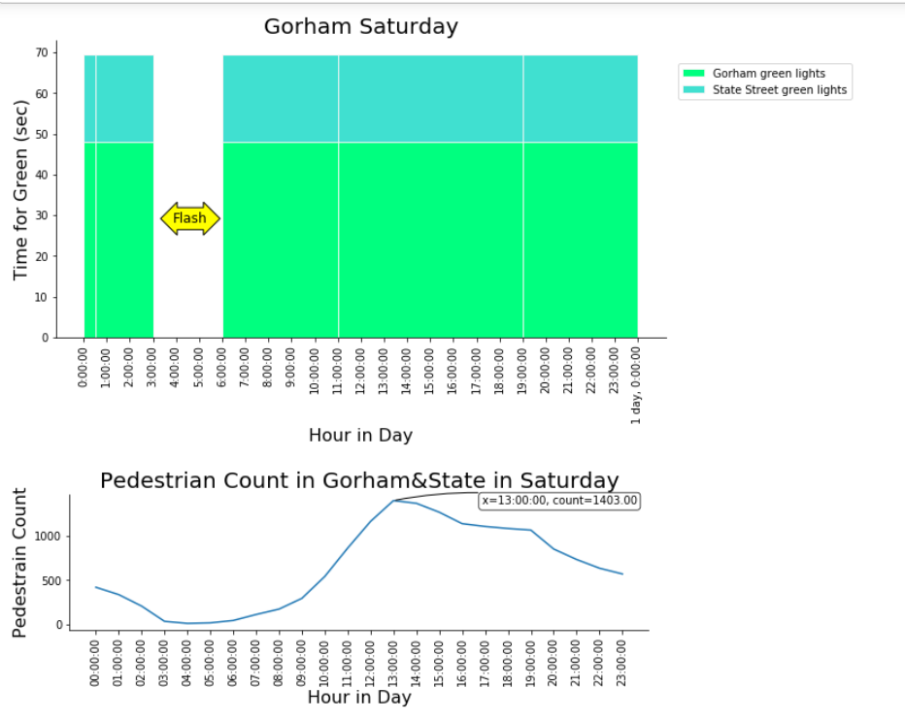
Gorham Weekends

Slide 10
Lights Cycle
Go across Main Street(Dayton/Gorham/Johnson) = go along State St
wait for a long time
The time they wait is about three to even four times than the other way around.

Slide 11
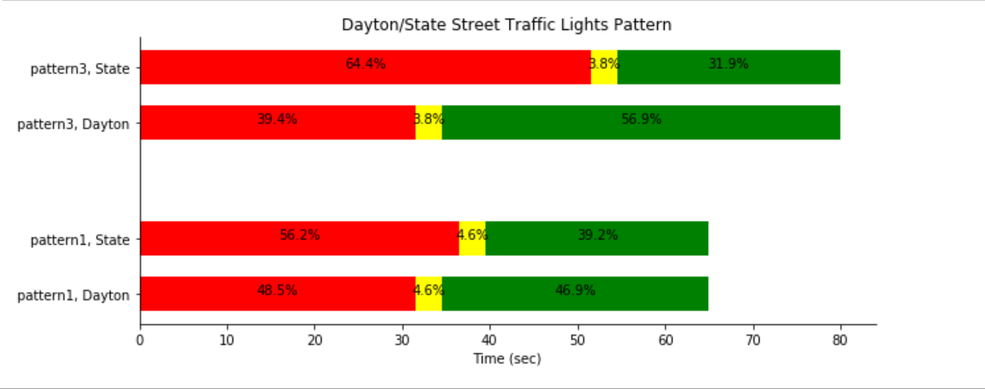
Dayton

Slide 12
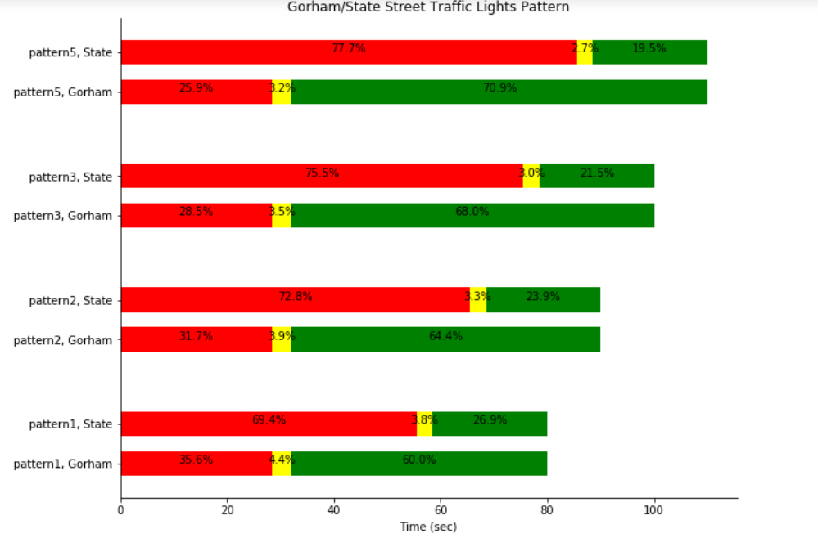
Gorham

Slide 13
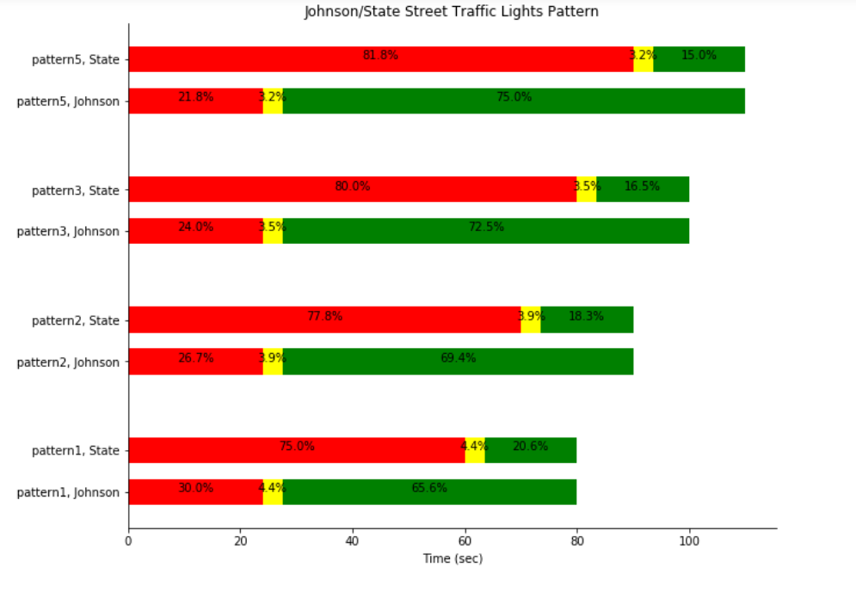
Johnson

Slide 14
Metric to Measure How Good A Light Cycle is
Assumptions:
2/5 pedestrians will go across both Main Street and Cross Street, 2/5 pedestrians will only go across Main Street (go along State Street) 1/5 pedestrians will go across only State Street
Define anger index = 1/3000*(waiting time)^2
Conclusion:
Light Cycle from 12 to 19 pm needs modificaiton

Slide 15
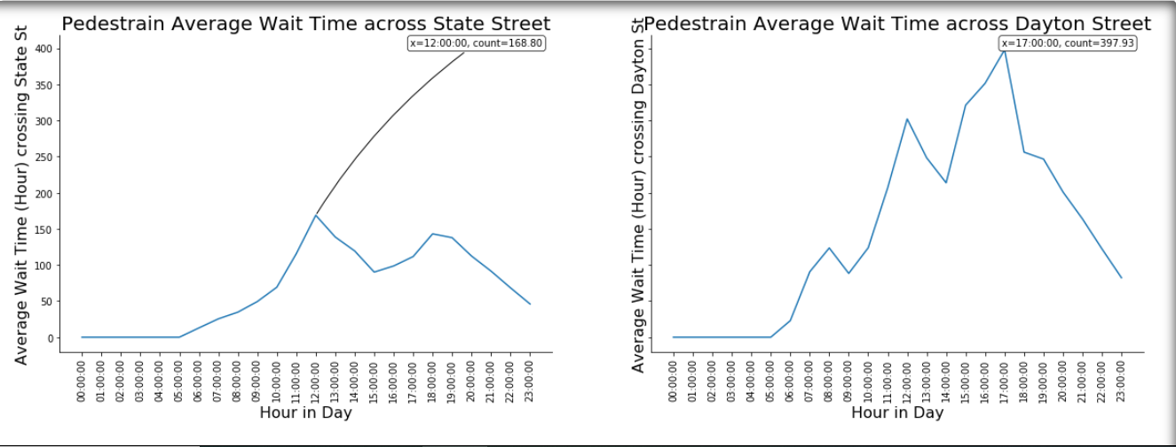
Waiting Time

Slide 16
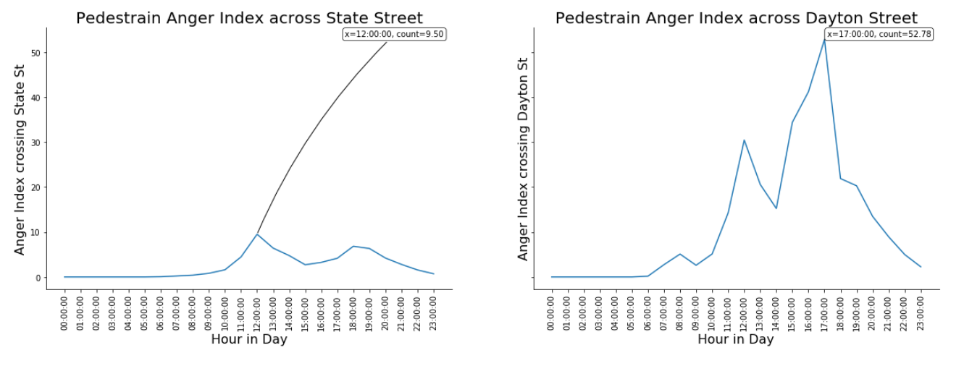
Anger Index

Slide 17
Q&A
Thank you for listening.

