Slide 1

Online news popularity
Springboard capstone project2
Shiyu Chen

Slide 2

Background & Problem Doemstration
Online news is immediate and myriad
Platforms want to promote the most popular article to attract visitors
Writers want to know how to make their article most popular
How can we know the popularity before publication?

Slide 3
Dataset description
Consisted of 39,643 news articles from an online news website called Mashable collected over 2 years from Jan. 2013 to Jan. 2015
Each record contains the URL link of the news and 60 descriptive attributes, like number of words in the title, number of images and weekday it is posted
The dataset was initially published by Mashable (www.mashable.com) and their content as the rights to reproduce it belongs to them
Downloaded from UCI Machine Learning Repository as https://archive.ics.uci.edu/ml/datasets/Online+News+Popularity

Slide 4
Data wrangling
Read and check data info
No missing value, no outlier
Remove the white space in columns name
Add 'weekday' and 'data_channel' columns to aggregate the info
Created two objective attribute for data exploratory convenience

Slide 5
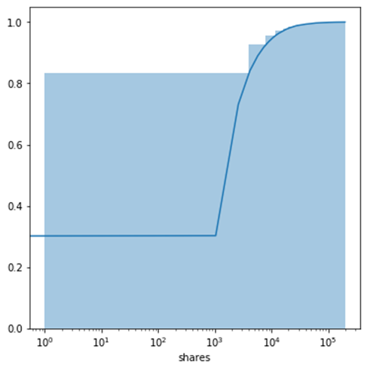
Data Wrangling
Plot cumulative distribution function of shares
Shares of 10% of articles is more than 6000 times.
Create a float attribute called popularity
Top 10% of articles were labelled 1, and others were labelled 0
Popularity column will be used to label the dataset

Slide 6
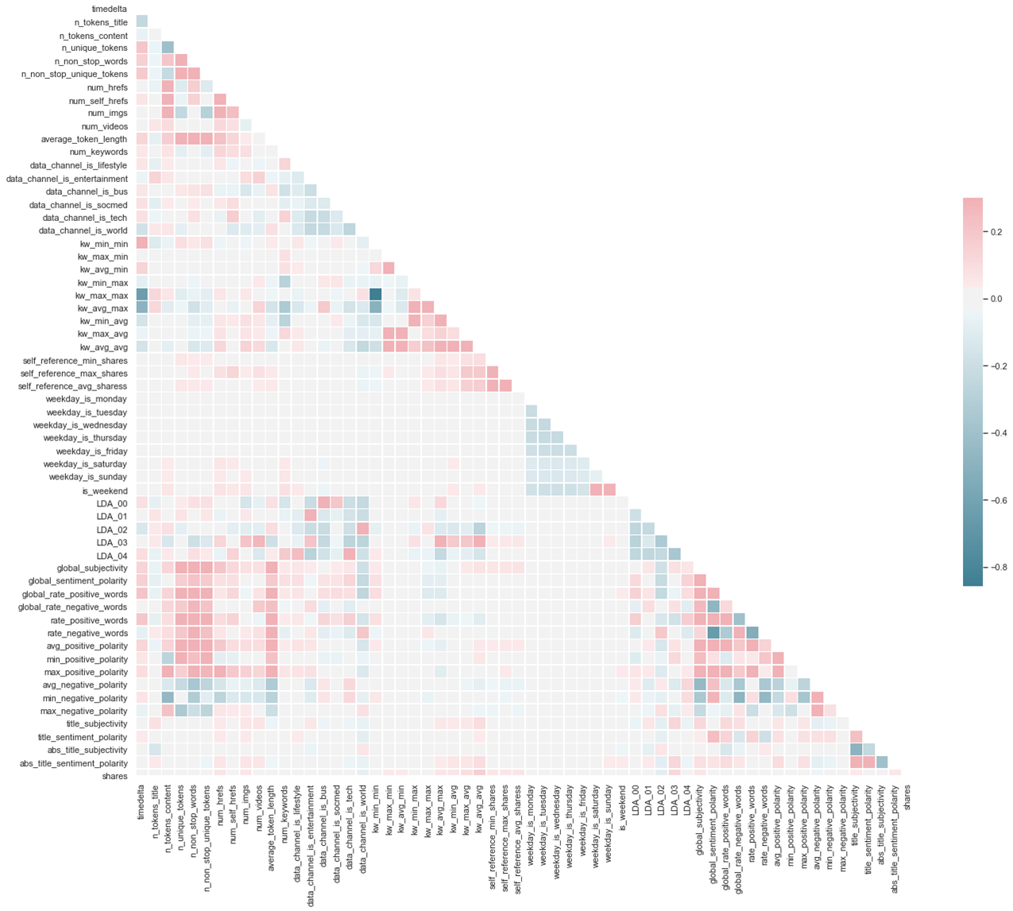
Data Exploratory-Correlation Heatmap

Slide 7
Data Exploratory-Correlation Heatmap
Most of the features don’t have correlation with shares
Only KW(keyword) and LDA (generated by topic model) is correlated with shares.
Most features are not strongly correlated with each other, except for few
For example, positive kw and negative kw
Will use all feature for machine learning process
No strongly corrected features with shares
No strongly correlation between different features

Slide 8
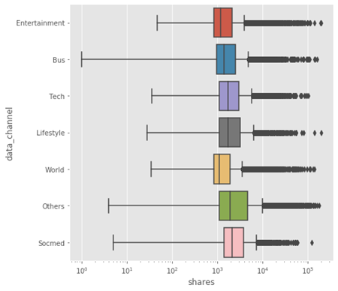
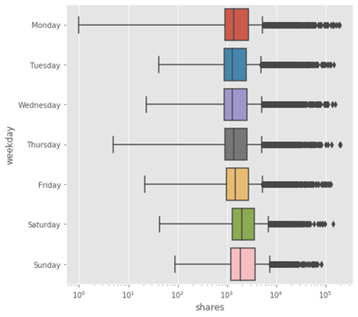
Data Exploratory-objective features
Data_channel VS. Shares
Weekday VS. Shares
Affect of both objects on shares are not obvious

Slide 9
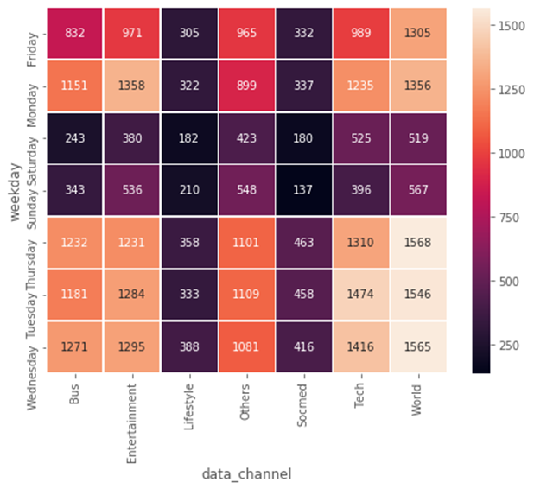
Data Exploratory-objective features
There are less articles published on weekends
The lifestyle and socmed articles are less then others

Slide 10
Machine learning& model evaluation
Because the dataset is unbalanced (10% data are positive), the accuracy score is not a proper metric for model evaluation. The same problem exists when we use confusion metrics.
Logistic Regression
K-Nearest Neighbor
Support Vector Machine
Decision Trees
Random Forest
Naive Bayes
Models | Accuracy Score
Logistic Regression | 0.9
K-Nearest Neighbor | 0.9
Support Vector Machine | 0.9
Decision Trees | 0.9
Random Forest | 0.9
Naive Bayes | 0.83

Slide 11
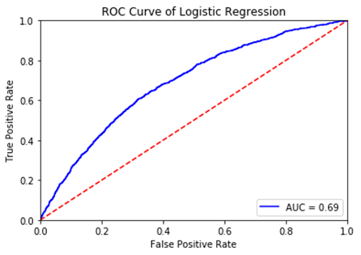
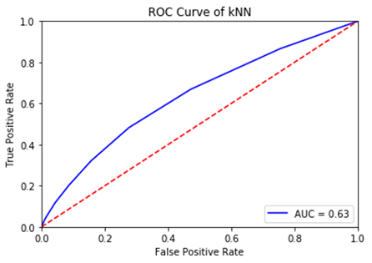
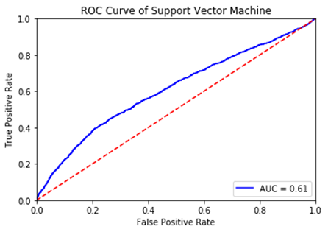
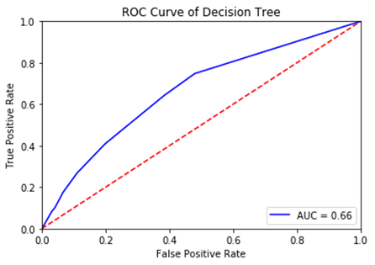
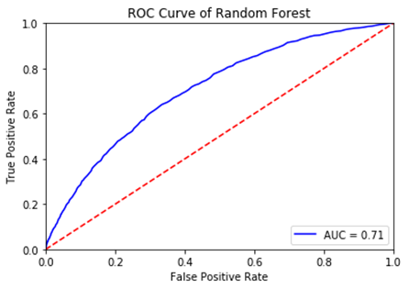
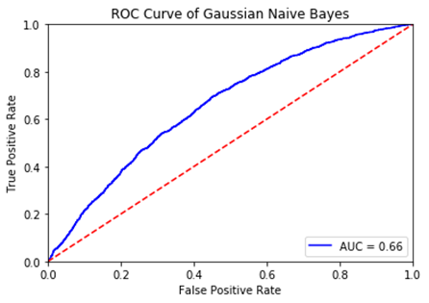
Model Evaluation by ROC curve and AUC
Within all models, random forest has best performance with AUC=0.71

Slide 12
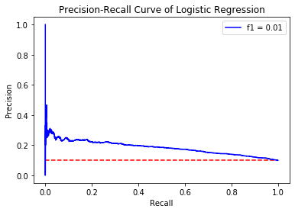
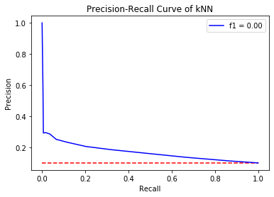
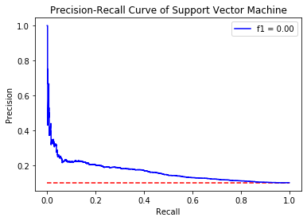
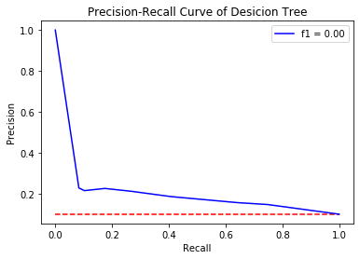
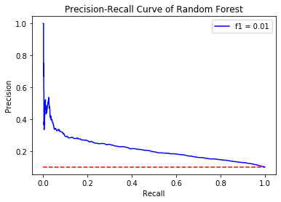
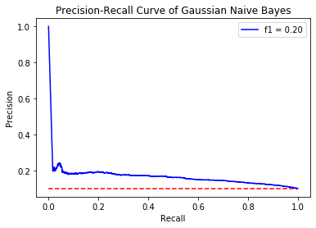
Model Evaluation by Precison-Recall Curve and f1-score
The Gaussian Naïve Bayes model has obvious advantage than other when evaluated by precision-recall curve. The f1-score is 0.2 vs 0-0.01.

Slide 13
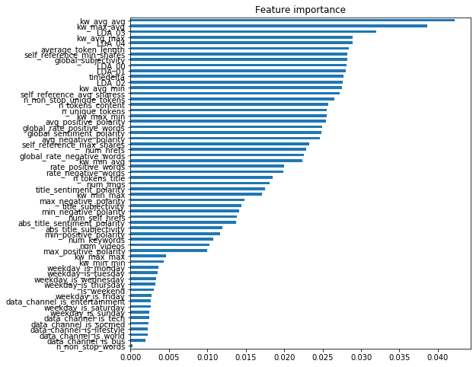
Feature Importance
Keyword and LDA is the top features that affect news popularity
Weekday and data channel have least influence on new popularity

Slide 14
Conclusion & Next step
The model can be applied to comparing the possible popularity of online news
predicting the possibility to be popular
platform can either promote the article or put on front page to attract the attention of readers
The Gaussian Naïve Bayes model is the best choice over all selected classifiers
Best performance evaluated by precison-recall curve
For unbalanced dataset, precision-recall curve is most sensitive to the error
cost much less computer calculation power
The top important features are keyword and LDA
Both features are generated by statistic models
Regular categories (data channel and weekday) have very little affect on popularity
The model is hard to be used by writers
Keep monitoring the performance after applying the model

