Slide 1
Discrete Fourier Transform
Ying shen
School of software engineering
Tongji university

Slide 2

What does DFT do?
Fourier analysis told us:
Any periodical signal can be expressed as linear combinations of sine and cosine functions
$$x_{1}=cos⁡(2π∗2t)$$
Component1
Frequency: 2HZ
Amplitude: 1
Phase: 0
$$x_{2}=\cos\left(2π∗2t\right)+\cos\left(2π∗5t\right)$$
Component1
Frequency: 2HZ
Amplitude: 1
Phase: 0
Component2
Frequency: 5HZ
Amplitude: 1
Phase: 0
DFT
$$x_{3}=\cos\left(2π∗2t+\frac{π}{3}\right)+2\sin\left(2π∗4t\right)+0.5\cos{(2π∗5t)}$$
Component1
Frequency: 2HZ
Amplitude: 1
Phase: π/3
Component2
Frequency: 4HZ
Amplitude: 2
Phase: 0
Component3
Frequency: 5HZ
Amplitude: 0.5
Phase: 0

Slide 3
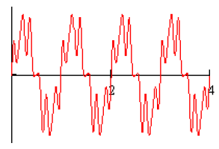
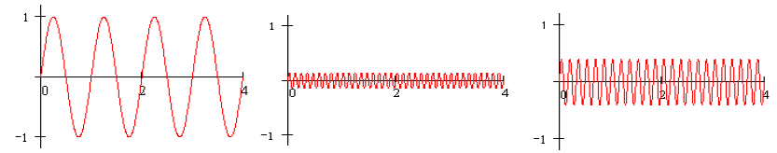

Fourier Series
For any periodic function $f(t)$, how to extract the component of $f$ at a specific frequency?
is composed of the following components

Slide 4
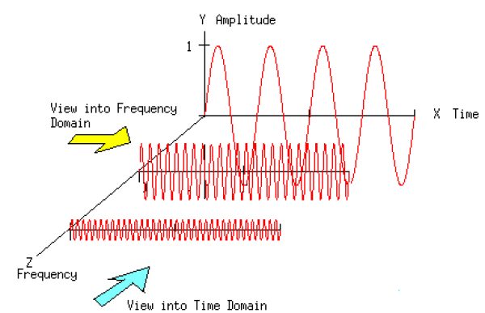

Fourier Series
For any periodic function $f(t)$, how to extract the component of $f$ at a specific frequency?

Slide 5
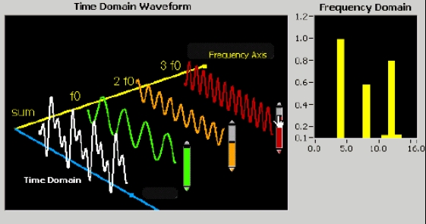
Fourier Series
For any periodic function $f(t)$, how to extract the component of $f$ at a specific frequency?

Slide 6

Fourier Transforms
Fourier transform of $f(t)$ (maybe is not periodic) is defined as
Inverse Fourier transform
How to get these formulas?
Let’s start the story from Fourier series to Fourier transform…

Slide 7
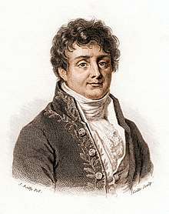
Fourier Transforms
Jean-Baptiste Joseph Fourier (21 March 1768 – 16 May 1830) was a French mathematician and physicist born in Auxerre and best known for initiating the investigation of Fourier series, which eventually developed into Fourier analysis and harmonic analysis, and their applications to problems of heat transfer and vibrations.
In 1822, Fourier published his work on heat flow in Théorie analytique de la chaleur (The Analytical Theory of Heat)
There were three important contributions in this work, one purely mathematical, two essentially physical.
In mathematics, Fourier claimed that any function of a variable, whether continuous or discontinuous, can be expanded in a series of sines of multiples of the variable.
Though this result is not correct without additional conditions, Fourier's observation that some discontinuous functions are the sum of infinite series was a breakthrough.

Slide 8

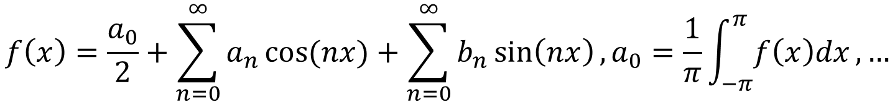
Fourier Series
For any periodic function $f(t)$, how to extract the component of $f$ at a specific frequency?
Fourier Series Any periodic function can be expressed as a sum of sines and cosines of different frequencies each multiplied by a different coefficient
$$f\left(x\right)=\frac{a_{0}}{2}+\sum_{n=0}^{∞}{a_{n}\cos{(nx)}}+\sum_{n=0}^{∞}{b_{n}\sin\left(nx\right)},a_{0}=\frac{1}{π}\int_{−π}^{π}{f\left(x\right)dx},…$$
more details

Slide 9

Fourier Series
For a periodic function $f(t)$, with period $T$
Fourier Series
where
Redundant!
,

Slide 10
From Fourier Series to Fourier Transforms
According to Euler formula
Easy to have
Then, Fourier series become

Slide 11
From Fourier Series to Fourier Transforms
According to Euler formula
Easy to have
Then, Fourier series become
Then, let
Then,

Slide 12
From Fourier Series to Fourier Transforms
We can see that
Thus,

Slide 13

From Fourier Series to Fourier Transforms
,where $C_{n}$ is defined by (2)
This is the Fourier series in complex form
How about a non-periodic function?

Slide 14

From Fourier Series to Fourier Transforms
$f(t)$ is a non-periodic function
We make a new function $f_{T}(t)$ which is periodic and the period is $T$
If $T→+∞$, $f_{T}(t)$ becomes $f\left(t\right)$
According to Fourier series
Let $s_{n}=nω$

Slide 15

From Fourier Series to Fourier Transforms
when $T→+∞$

Slide 16
From Fourier Series to Fourier Transforms
when
,
,
Denote by
Fourier transform
Inverse Fourier transform

Slide 17
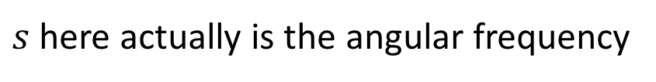
From Fourier Series to Fourier Transforms
$s$ here actually is the angular frequency
In the signal processing domain, we usually use another form by substituting s by , where is the frequency (measured by Herz)

Slide 18
Discrete Fourier Transform (DFT) in 1D Case
Given a discrete sequence with M points
Regard it as a periodic signal, thus its basis frequency is
For its frequency components, the frequencies are,
Its DFT is computed as
Usually, we write it as,

Slide 19

Discrete Fourier Transform (DFT) in 1D Case
Thus, $f$’s DFT also has M points
and
IDFT
For DFT, there is a fast algorithm for computation, FFT (Fast Fourier Transform)

Slide 20
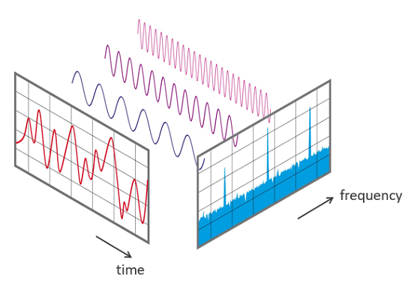
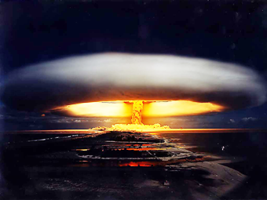
What is FFT (Fast-Fourier-Transform)?
FFT is not one algorithm, many scientists have invented different FFTs
However, today it mostly refers to the algorithm published by James Cooley and John Tukey in 1965 for the purpose of detecting the Soviet Union nuclear test from offshore sensors

Slide 21
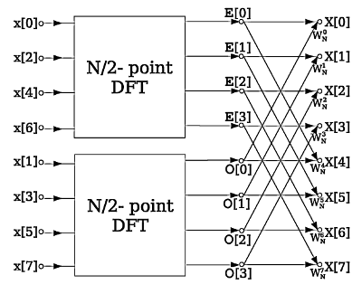






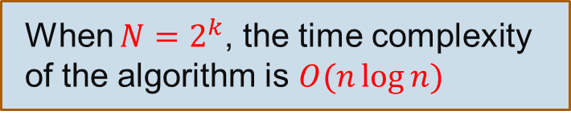

What is FFT (Fast-Fourier-Transform)?
If we choose $N=2^{k}$, $n_{1}$ and $n_{2}$ can be decomposed until length 2 DFTs!
$$O(N^{2})$$
If $N=n_{1}n_{2}$
DFT with length $n_{1}$
$$O(n_{1}^{2})$$
DFT with length N
+
DFT with length $n_{2}$
$$O(n_{2}^{2})$$
When $N=2^{k}$, the time complexity of the algorithm is $O(n\log{n})$

Slide 22
Zero Padding

Slide 23
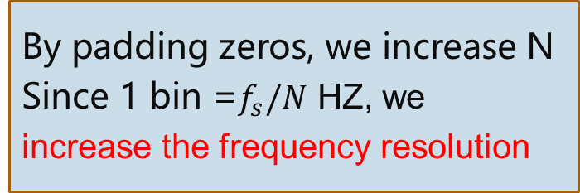
Zero padding
N=8
N=16
N=32
By padding zeros, we increase N
Since 1 bin =$f_{s}/N$ HZ, we
increase the frequency resolution
N=64
Notes:
y1 = fft(signal1,8);
y2 = fft(signal1,16);
y3 = fft(signal1,32);
y4 = fft(signal1,64);

Slide 24
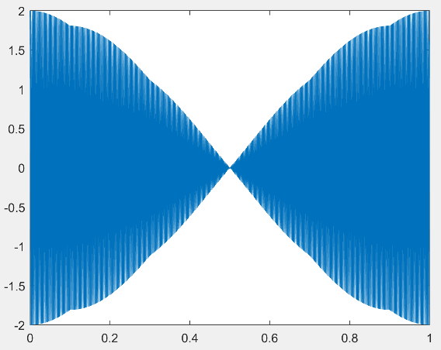





Zero padding
$$x\left(t\right)=\cos\left(2π∗440t\right)+\cos\left(2π∗441t\right)$$
Given a sample rate $f_{s}=4410HZ$
$$x\left[n\right]=\cos\left(2π∗440∗\frac{n}{4410}\right)+\cos\left(2π∗441\frac{n}{4410}\right), n=0,…,4409$$
$$N=4410$$
$$N=8192$$
HZ
HZ
HZ
$$N=16384$$
$$N=32768$$
HZ
HZ

Slide 25

Zero padding
$$N=16384$$

Slide 26
Windowing

Slide 27


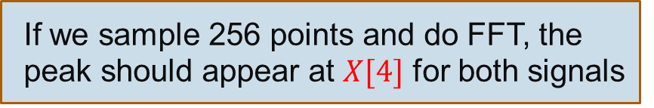
Windowing
Up to now, we assume that the signal oscillates k periods, where k is an integer
Problem with non-integer periods:
$$x_{1}\left[n\right]=\cos\left(2π∗4∗\frac{n}{256}\right), n=0,1,…255$$
$$x_{2}\left[n\right]=\cos\left(2π∗4∗\frac{n}{256}\right), n=0,1,…219$$
If we sample 256 points and do FFT, the peak should appear at $X[4]$ for both signals

Slide 28



Windowing
Time domain
FFT $N=256$
$$N=256$$
lower
$$N=220$$
Spectral Leakage
It seems less harmless if we only want to identify the frequency
But if we want to reconstruct the signal with the frequency representation

Slide 29
Windowing
Hanning Window

Slide 30
Windowing
FFT
Blackman
Hanning

Slide 31
Analyzing Long Signals by Short-Time Fourier Transform (STFT)

Slide 32

What does STFT do?
Producing a spectrogram for a long, non-stationary audio signal
FFT spectrum on the entire signal
660HZ
440HZ
Notes:
fs=16000;
t1=0:1/fs:1-1/fs;
y1 = sin(2*pi*440*t1);
t2=0:1/fs:2-1/fs;
y2 = sin(2*pi*660*t2);
y3 = [y1 y2];
audiowrite('440-660hz-sound.wav', y, fs);
spectrogram(y3,256,240,256,16000,'yaxis');

Slide 33
STFT steps
frame length (typically 10-25ms)
hop size
Multiplied by the window function values
Calculate FFT spectrum
Get the spectrum array for the 1st frame:
[0 0 … 29.9 33.2 36.6 40.0 …]
Get the spectrum array for the 2nd frame:
…

Slide 34
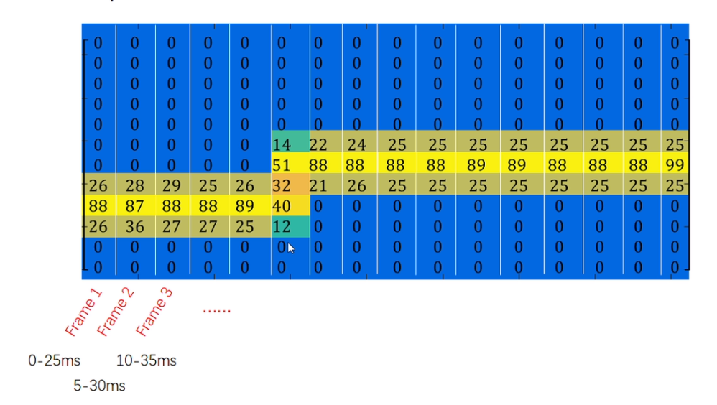
STFT steps
Questions
What is the unit of the horizontal/vertical axis?
What will happen if we increase/decrease the frame length?
What will happen if we change the hop size?

Slide 35
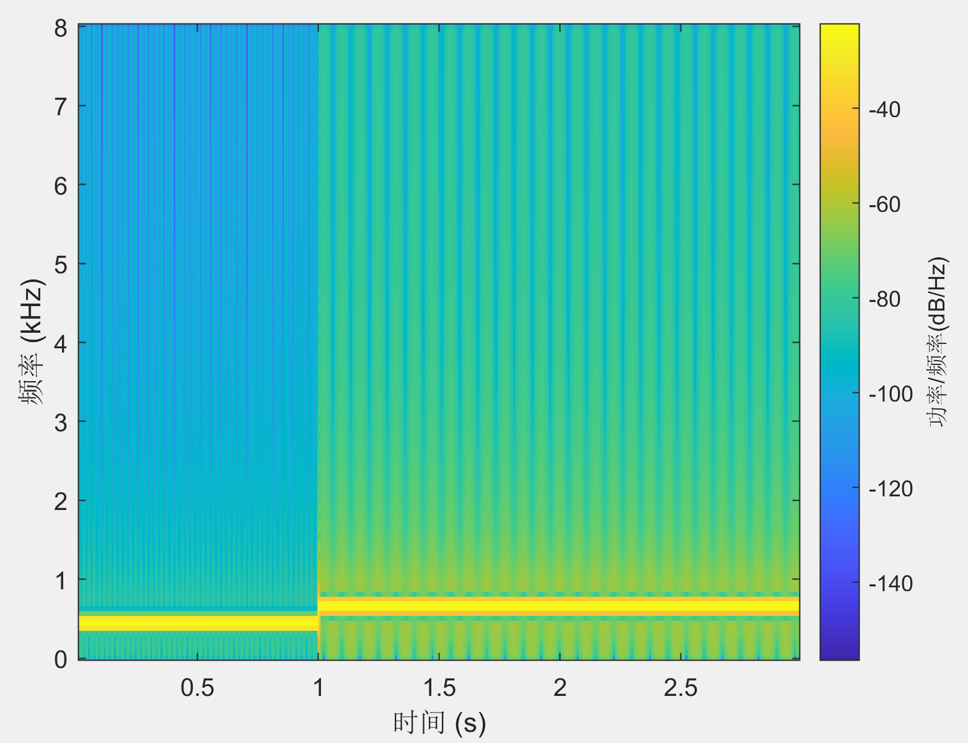
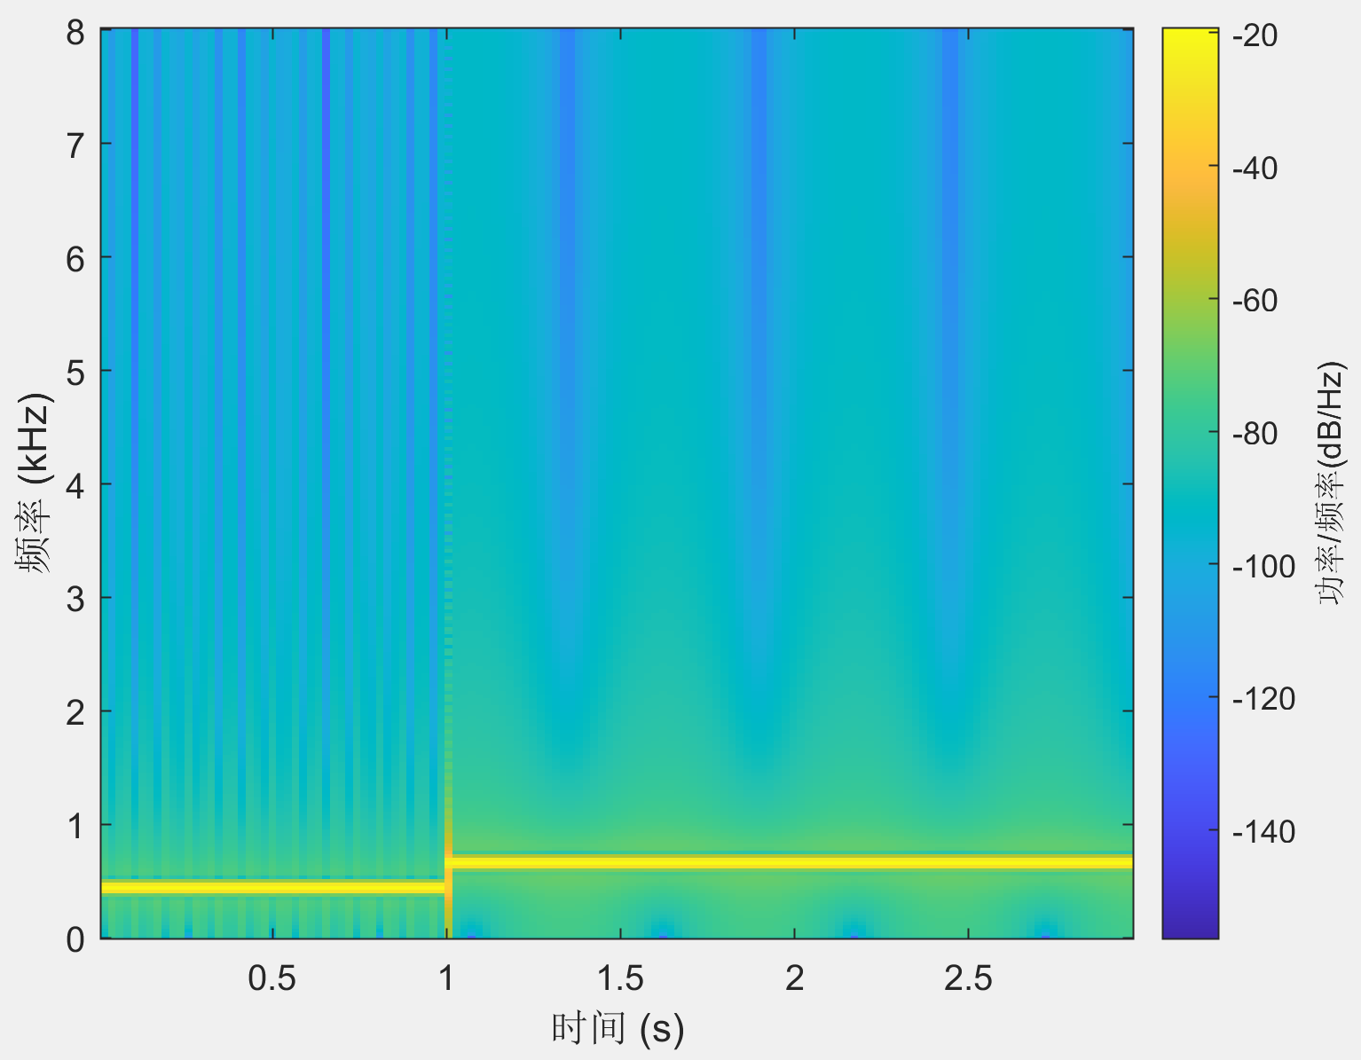
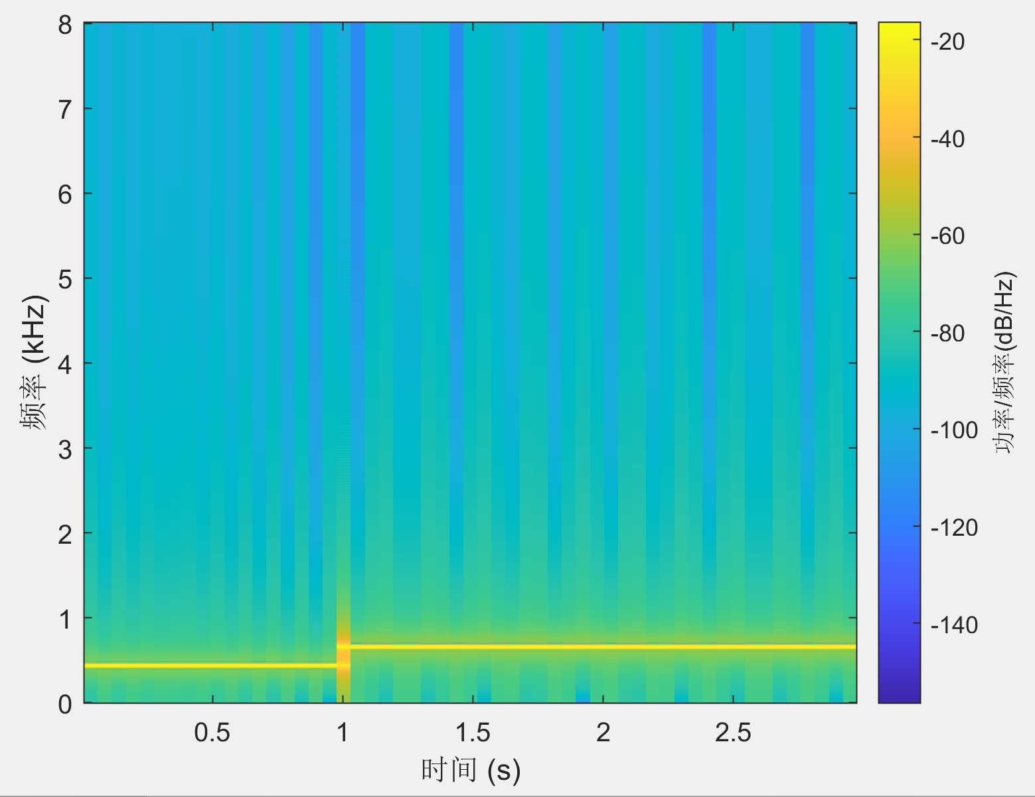
Changing window size
W= 256, overlap= 160
W= 512, overlap= 160
W= 1024, overlap= 160

Slide 36
Changing hop size
W=1024, overlap= 10
W=1024, overlap=512
W=1024, overlap=960
Notes:
If you specify noverlap as empty, then spectrogram uses a number that produces 50% overlap between segments.

