Slide 1
DNN Architectures
Most slides come from https://www.inf.ed.ac.uk/teaching/courses/asr/2022-23/asr12-tdnn-lstm.pdf
Ying shen
School of software engineering
Tongji university

Slide 2
Modelling acoustic context
DNNs allow the network to model acoustic context by including neighbouring frame in the input layer – the output is thus estimating the phone or state probability using that contextual information
Richer NN models of acoustic context:
Time-delay neural networks (TDNNs)
each layer processes a context window from the previous layer
higher hidden layers have a wider receptive field into the input
Recurrent neural networks (RNNs)
hidden units at time t take input from their value at time t − 1
these recurrent connections allow the network to learn state
Both approaches try to learn invariances in time, and form representations based on compressing the history of observations
We’ll also mention CNNs and Transformers

Slide 3
Training of DNN

Slide 4
CNN

Slide 5
LSTM

Slide 6
GRU

Slide 7
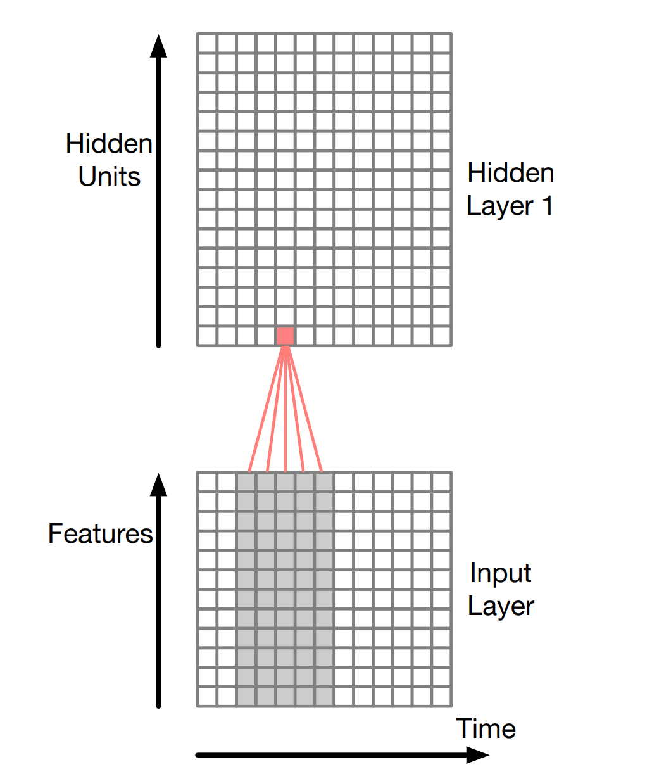
TDNN
TDNNs – first hidden layer receptive field

