Slide 1
Processing Tutorials
Tutorial 3

Slide 2
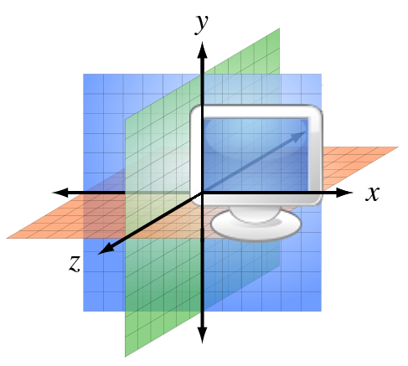
3D primitives in Processing
y
3D coordination system
size(w, h, renderer)
size(400, 400, P3D);
box()
box(size)
box(w, h, d)
sphere(r)
z
x
y
x
z

Slide 3
Transformation of 3D objects
Translation
translate(x, y, z)
Rotation
rotateX(angle)
rotateY(angle)
rotateZ(angle)
Scale
scale(s)
scale(x, y)
scale(x, y, z)

Slide 4
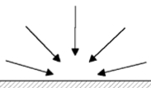

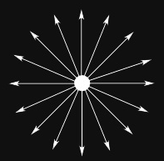
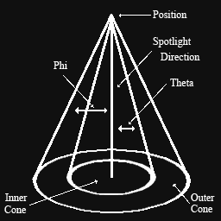
Lights
ambientLight()
directionalLight()
See Lighting example
pointLight()
spotlight()
Parameters:
(v1, v2, v3)
or (v1, v2, v3, x, y, z)
light()

Slide 5
Camera
Sets the position of the camera through setting the eye position, the center of the scene, and which axis is facing upward.
The default position points to the center of the display window with the Y axis as up
camera()
camera(eyeX, eyeY, eyeZ, centerX, centerY, centerZ, upX, upY, upZ)

Slide 6
Introduction to Shapes3D library

Slide 7
Introduction to Shapes3D library
Download: http://www.lagers.org.uk/s3d4p/download.html or http://sse.tongji.edu.cn/yingshen/course/HCI2015Spring/software/Shapes3D V2.1.5.zip
References: http://www.lagers.org.uk/s3d4p/ref/index.html

Slide 8
3D Objects in Shapes3D
Box
See RotateBox example
Cone
See DrawCone example
Ellipsoid
See DrawEllipsoid example
Helix
Toroid
Tube

Slide 9
Picking Objects
See Picking example

Slide 10
Exercise

Slide 11
Exercise
Install Shape3D for Processing library
Run previous examples
Finish the following tasks:
Task 1:
Draw an ellipsoid on the screen;
The ellipsoid can rotate with the movement of the cursor when the left button of the mouse is pressed.
Task 2:
When key “m” is pressed, the ellipsoid should move with the cursor.

