Slide 1
Lab 1: Active shape model
Ying shen
School of software engineering
Sse, tongji university

Slide 2
Getting started
To start the ASM program
Copy the file asm.zip to your working directory
Unpack the archive. A main directory named asm will be created.
Start Matlab.
Go into the ASM directory and type asm in the command window.
The process of the experiment is divided into three stages:
Training
Trying weights
Searching for a shape in an image
Your task is to go through these steps and apply the ASM model to some image data

Slide 3
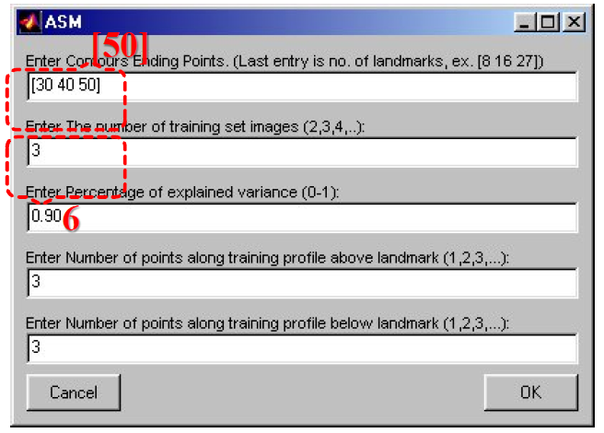
Stage 1: Training
Enter parameters
When you select “training”, the following window will be displayed

Slide 4
Stage 1: Training
Some comments:
You specify how many contours you want, and how many landmarks each contour should have in the field “Enter Contours Ending Points”
You specify the number of training images in the field “Enter the number of training set images (2,3,4,…)”
In the two lower fields, you specify how many points above and below each landmark that should be used for training. Note that the optimal choice depends on how the image looks like around the object shape

Slide 5
Stage 1: Training
Select landmarks
After you have selected your parameters and clicked OK, a file selection box is displayed and you should select an image (a bmp file). The image will be displayed and you then use the mouse to enter landmark
Click the left mouse button to place a landmark
Move the mouse near a landmark and press the space bar to remove a landmark
After you have entered the landmarks you specified, you will be prompted to select the next training image.

Slide 6
Stage 1: Training
Save the results
After you have trained the last image, the training data will be aligned and the ASM model will be computed. You then have the option to save your results. If you choose to save your data, the ASM model will be saved and you can in subsequent session load the data and you don’t have to retrain the model

Slide 7
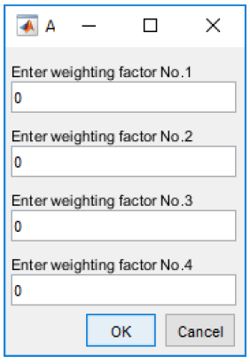
Stage 2: Trying weights
After training, or after you have loaded a saved file, you can look at the modes of variation in your model. To do this, select “Try weights” and the dialogue below will be displayed. You can then enter different weighting factors and the deformed shape will be displayed.

Slide 8
Stage 2: Trying weights
Note:
The weighting factors are given in arbitrary numbers. You can for example try to enter +70 and then -70.
In this example, four weighting factors can be entered. When you train the model on some new data, you may get more or less weighting factors.

Slide 9
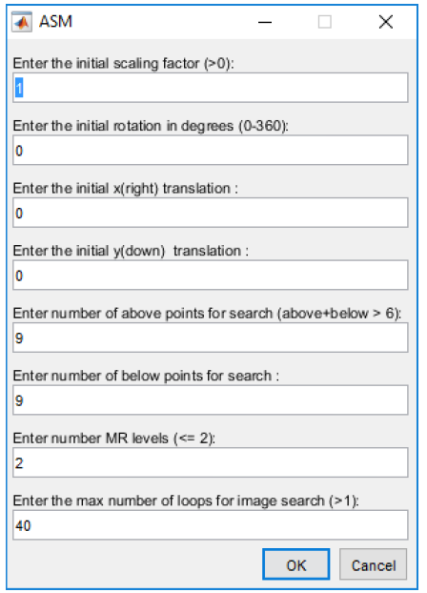
Stage 3: Searching for a shape in an image
In this stage, you can use the ASM model to search for a shape in an image. You will be prompted to select an image and after that, the dialogue below will be displayed.

Slide 10
Stage 3: Searching for a shape in an image
Select parameters and click OK. The image will then be displayed and the contour of the searched shape will be outlined. If the initial position is not close enough, answer no when prompted and adjust the parameters in the dialogue.
Notes: MR levels means multi resolution levels. If you select 5, you will start the optimization at a very low resolution. This may cause the contour to drift away from its position close to the boundary. For most applications, 2 MR levels work fine.

Slide 11
Assignment
The dataset you will work with are 7 binary images right hands from doctorial students at the CBA. All images (hand1.bmp,…, hand7.bmp) are located in the directory asm/images.

Slide 12
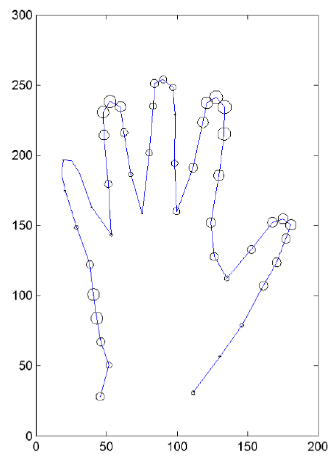
Assignment
Your task:
Train the ASM. To get familiar with the program, you may wish to start with a small structure such as one finger so you just have to enter a few landmarks. Once you are familiar with the interface etc. train the ASM using more landmarks. Try to segment the whole hand.
Note: It’s very important that you should place the landmarks in about the same position in all images. A sketch on a piece of paper can help you to plan the positioning.

Slide 13
Assignment
Your task:
Save the result to a file.
Try weights. Explore the variation of the training set.
Try the third stage and try to search for the trained shape in a new image. Since the model is trained on only a few examples, you can select one of the images in the training set. Alternatively, you can train the ASM on 6 images and then apply the model to the 7th one.

Slide 14
Assignment
As an additional, non-mandatory assignment, you have also, if you have been bored with binary case, three sets of grayscale images available for testing:
head1.bmp,…,head6.bmp. These are MRI-images representing axial slice at the level of the cerebellum.
corp1.bmp,…,corp6.bmp. A close-up of a structure of the brain, the corpus calosum in the sagittal plane.

Slide 15
Report
Describe what is done during the three stages. That is, relate what is done to the theory about ASM and describe shortly what is computed etc. during the stages. Give also a short description of what you did, problems you saw, and include an image of the result.
Answer the following question in the report:
Trying weights: How each mode affects the hand shape by adjusting its value (refer to the weighting factors in Page 8)? Please also take a screenshot of resulting image to illustrate.
Submit your report to TA
A word file: ID_name_lab1.doc(x)
1352830-1552682: lixiyuan00100@126.com
1552684-1556122: htxu@tongji.edu.cn

