Slide 1
Lab 2: Drawing 3D Object
Ying shen
School of software engineering
tongji university

Slide 2
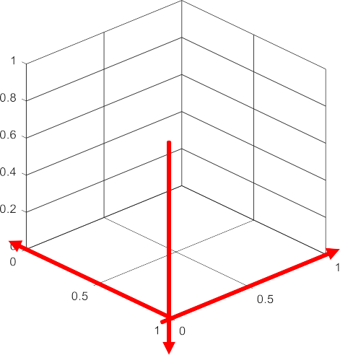
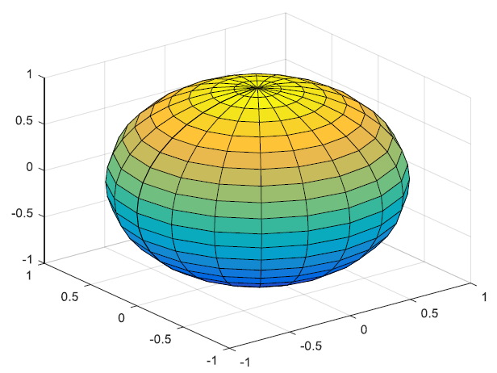
3D primitives
3D coordinate system in matlab
sphere(): generate a sphere consisting of 20-by-20 faces
sphere(n): draw an n-by-n sphere
[X,Y,Z]=sphere(n): You can draw a sphere with surf(X,Y,Z)
See sphereExample.m
You can also do texture mapping (see drawEarth.m)
z
y
x

Slide 3
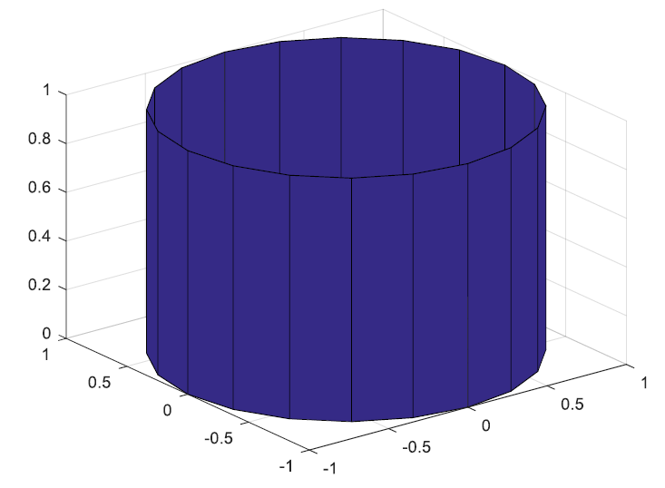
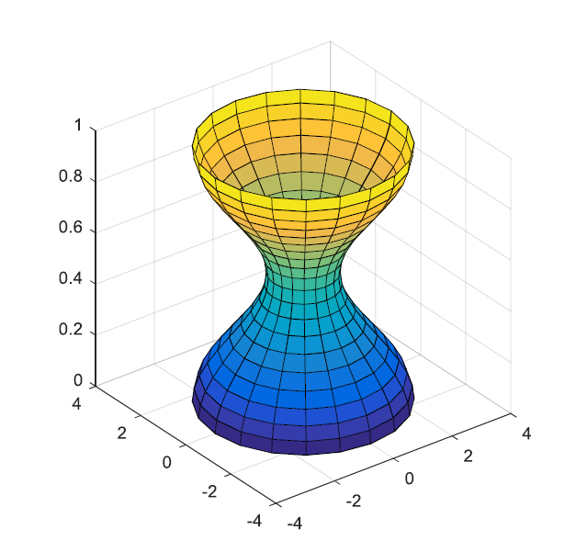
3D primitives
cylinder(): generate x- y- and z-coordinates of a unit cylinder
[X,Y,Z]=cylinder
[X,Y,Z]=cylinder(r) returns the x- y- and z-coordinates of a cylinder using r to define a profile curve
[X,Y,Z]=cylinder(r,n)
See cylinderExample.m

Slide 4
Draw 3D objects
Cone
See cone.m
Ellipsoid
See ellipsoid.m

Slide 5
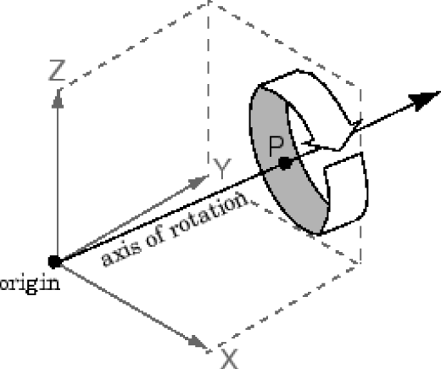
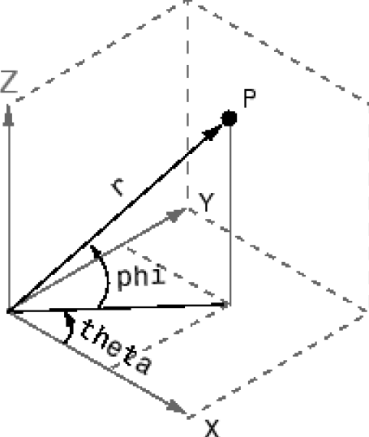
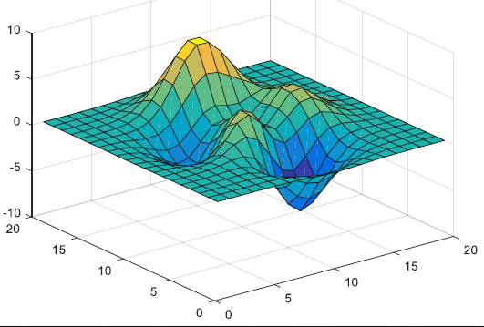
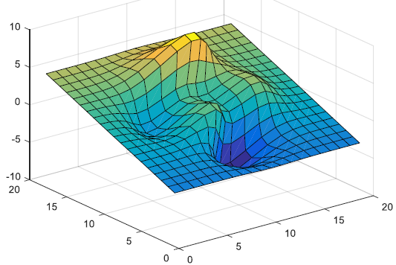
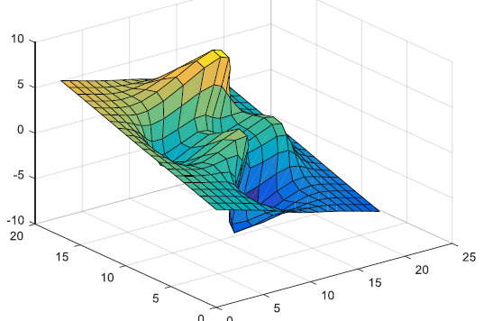
Transformation of 3D object
Translation
x->x+a; y->y+b
Rotation
rotation(h, direction, alpha)
See rotationExample.m
Scale
x->a*x; y->b*y

Slide 6
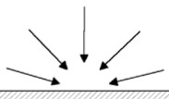
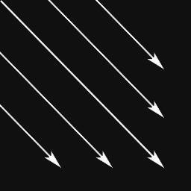
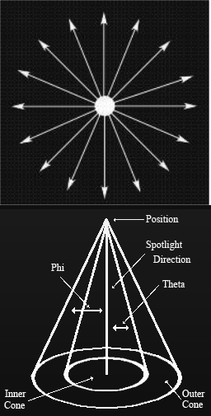
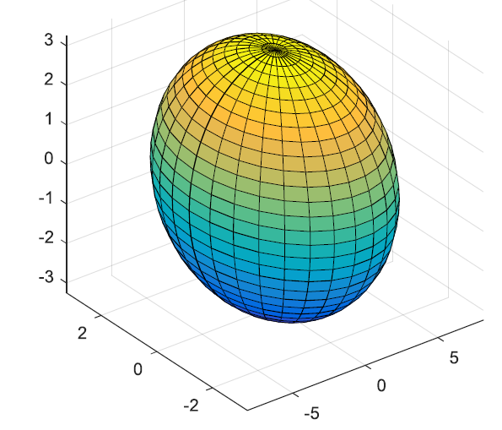
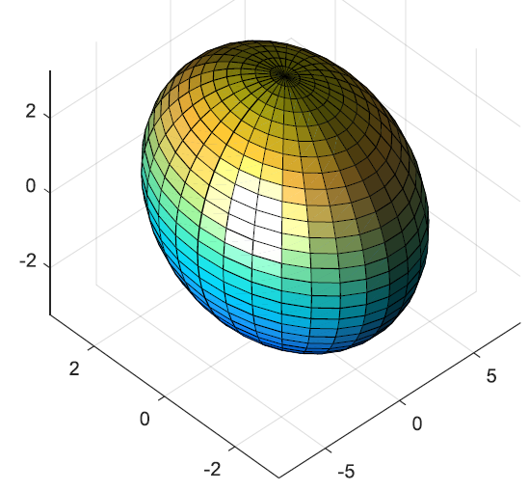
Lights
light() creates a light object in the current axes
light(‘PropertyName’, propertyvalue, ...)
Light properties
Color: [1 1 1] (default) | RGB triplet | color string
Position: [1 0 1] (default) | three-element vector in the form of [x y z]
Style: ‘infinite’ (default) | ‘local’

Slide 7
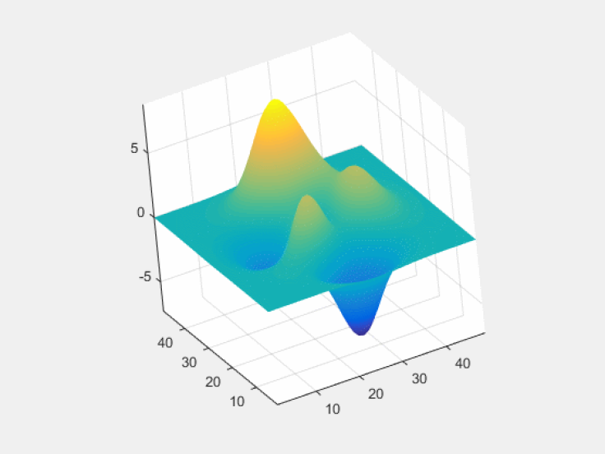
Camera
camorbit
camorbit(dtheta, dphi)
camorbit(dtheta, dphi, ‘coordsys’)
camorbit(dtheta, dphi, ‘coordsys’, ‘direction’)

Slide 8
Exercise
Run previous examples;
Finish the following tasks:
Draw a sphere on the screen;
The sphere will automatically rotate.
Submit your work to TA
Compress the whole project folder into a zip file: ID_name_lab2.zip
1352830-1552682: lixiyuan00100@126.com
1552684-1556122: htxu@tongji.edu.cn

