Slide 1
Matlab Tutorial
Lab 1

Slide 2
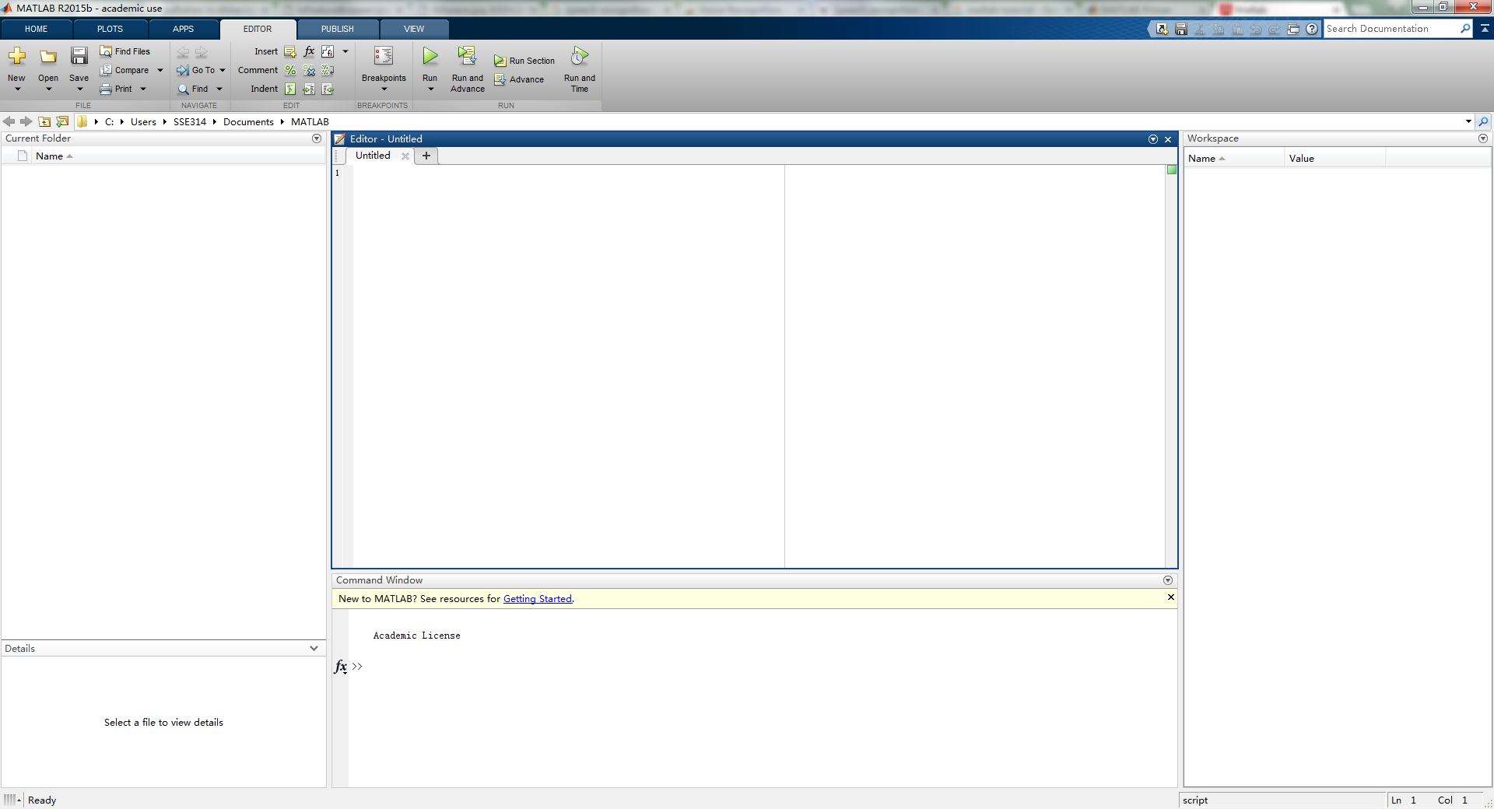
Development Environment
Current working directory
Script editor
Workspace
Command window
Notes:
The desktop includes these panels: • Current Folder — Access your files. • Command Window — Enter commands at the command line, indicated by the prompt (>>). • Workspace — Explore data that you create or import from files.

Slide 3
Commands
Create a variable
a = 1
b = 2
c = a+b
d = cos(a)
sin(a)
e = a*b;

Slide 4
Character Strings
Assign a string to a variable
myText = 'Hello, world';
otherText = 'You''re right'
f = 71;
c = (f-32)/1.8;
tempText = ['Temperature is ',num2str(c),'C']

Slide 5
Calling Functions
Functions
A = [1 3 5];
max(A)

Slide 6
Loops and Conditional Statements
Within a script, you can loop over sections of code and conditionally execute sections using the keywords for, while, if, and switch
nsamples = 5;
npoints = 50;
for k = 1:nsamples
currentData = rand(npoints,1);
sampleMean(k) = mean(currentData);
end
overallMean = mean(sampleMean)

Slide 7
Matrices and Arrays
Array Creation
a = [1 2 3 4] % a row vector
a = [1 2 3; 4 5 6; 7 8 10] % a square matrix
z = zeros(5,1) % a column vector containing 5 zeros
Matrix and Array Operations
a + 10
sin(a)
a'
p = a*inv(a)
p = a.*a

Slide 8
Matrices and Arrays
Concatenation
A = [a, a]
A = [a; a]
Array indexing
A = magic(4)
A(4,2)
A(8)
A(4,5) = 17
A(3, :)

Slide 9
Matrices and Arrays
Deleting Rows and Columns
X = zeros(4);
X(:, 2) = [] % X is a 4*3 matrix

Slide 10
Draw Lines
Draw a line
x = 0:pi/100:2*pi;
y = sin(x);
figure % opens new figure window
plot(x,y)

Slide 11
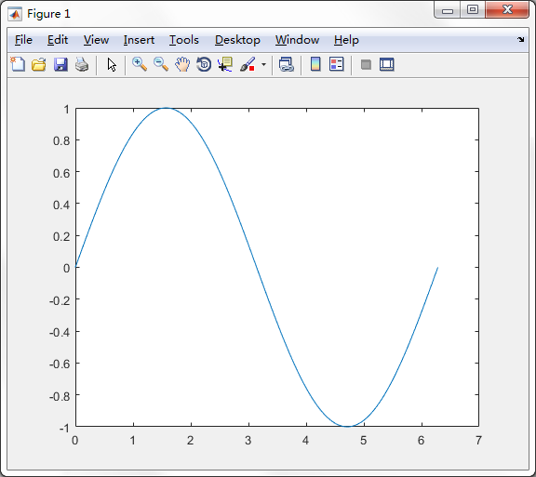
Draw Lines
Draw a line
x = 0:pi/100:2*pi;
y = sin(x);
figure % opens new figure window
plot(x,y)

Slide 12
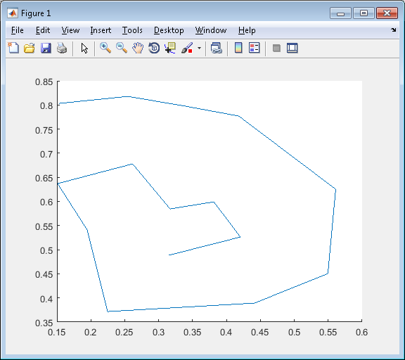
Draw Lines
Draw a line
figure;
[x, y] = getline;
line(x,y);
% press Enter

Slide 13
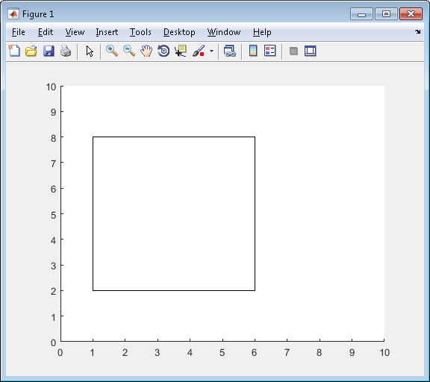
Draw A Rectangle
Rectangle('position', pos)
rectangle('Position',[1 2 5 6])
axis([0 10 0 10])

Slide 14
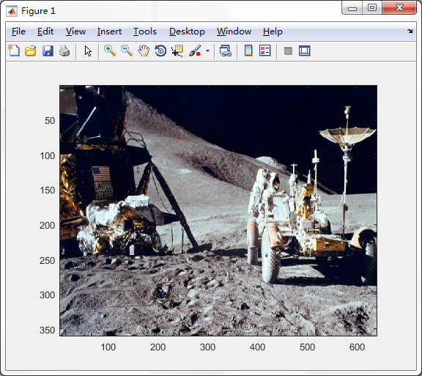
Load An Image
Example
A = imread('moonwalk.jpg');
image(A);

Slide 15
Load Images
Example
img = cell(4,1);
for i = 1:4
img{i} = imread(['bg' num2str(i) '.png']);
end
hold on;
image(0,0,img{1});
image(200,0, img{2});
image(0,100,img{3});
image(200,100,img{4});

Slide 16
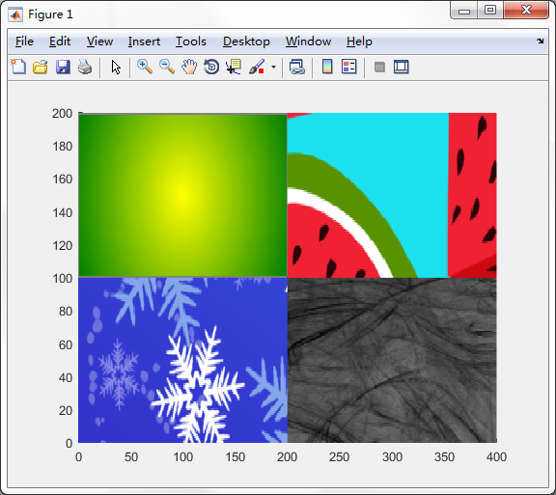
Load Images
Example
img = cell(4,1);
for i = 1:4
img{i} = imread(['bg' num2str(i) '.png']);
end
hold on;
image(0,0,img{1});
image(200,0, img{2});
image(0,100,img{3});
image(200,100,img{4});

Slide 17
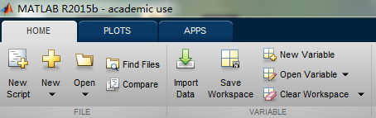
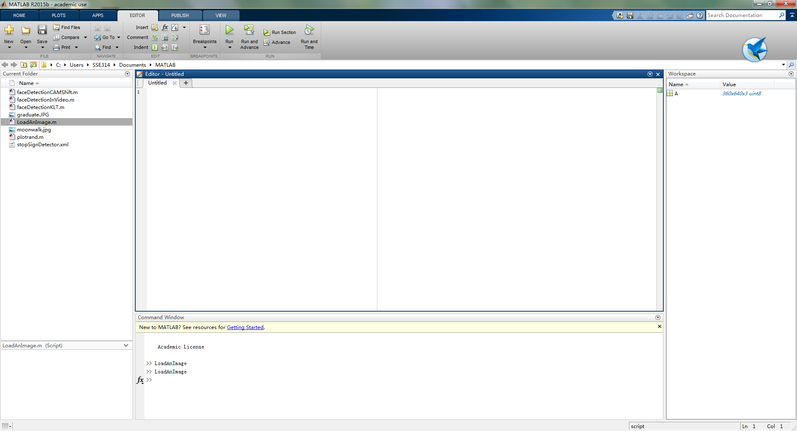
Programming and Scripts
Create a new script

Slide 18
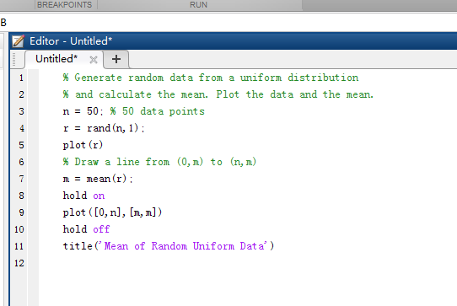
Programming and Scripts
A sample script

Slide 19
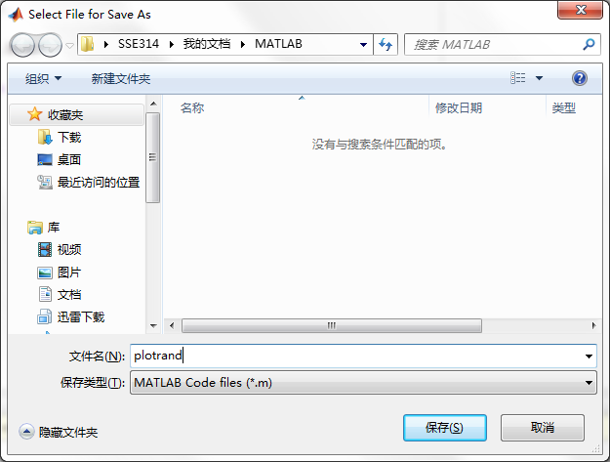
Programming and Scripts
Save the script

Slide 20
Programming and Scripts
Run the script

Slide 21
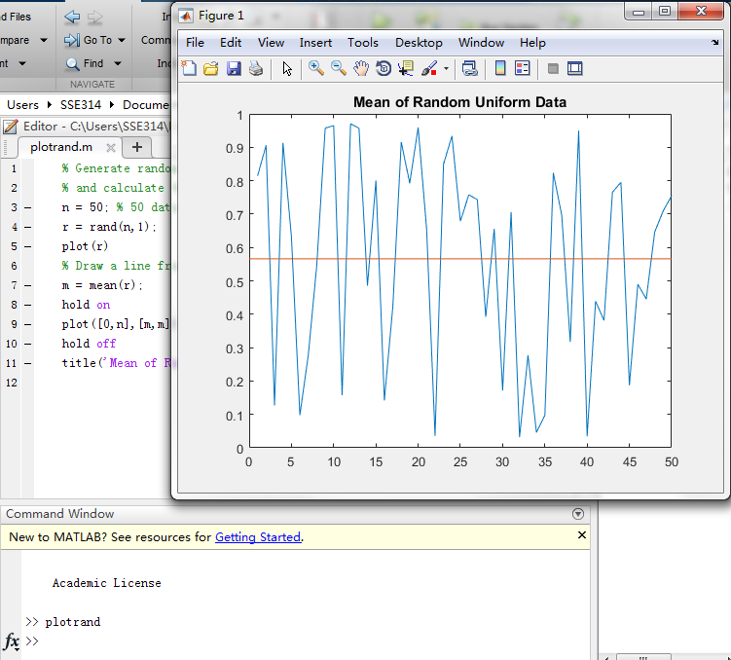
Programming and Scripts
Run the script

Slide 22
Programming and Scripts
Set a breakpoint

Slide 23
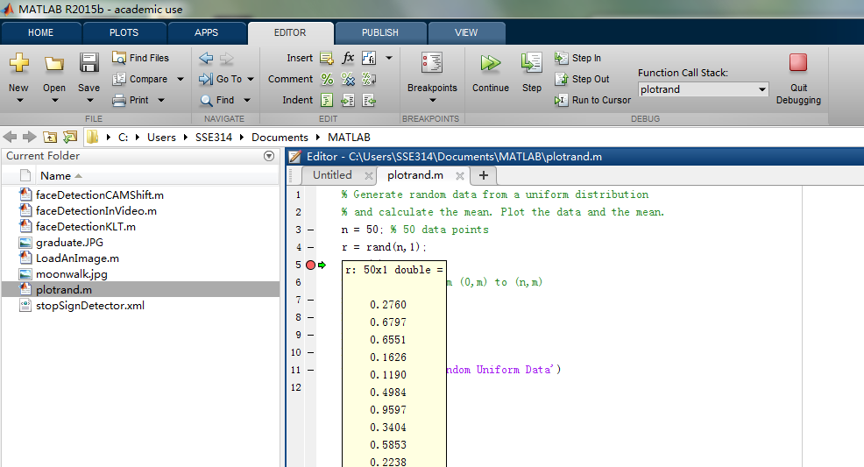
Programming and Scripts
Set a breakpoint

Slide 24
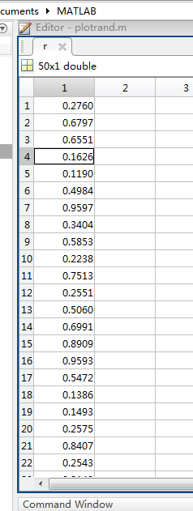
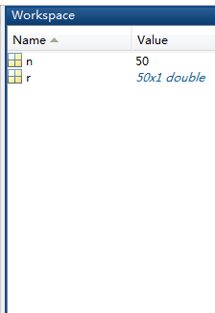
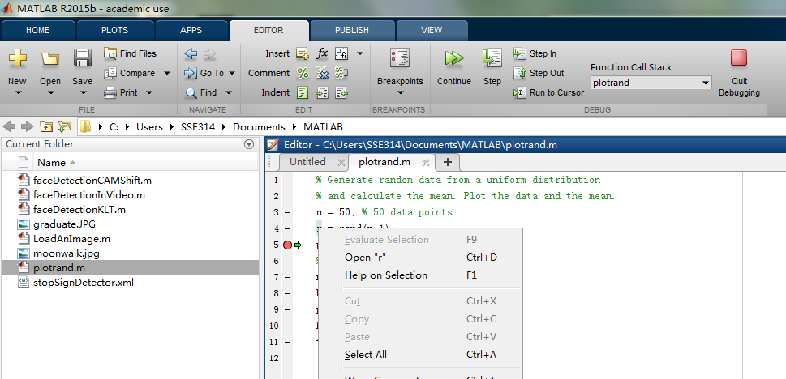
Programming and Scripts
Set a breakpoint

Slide 25
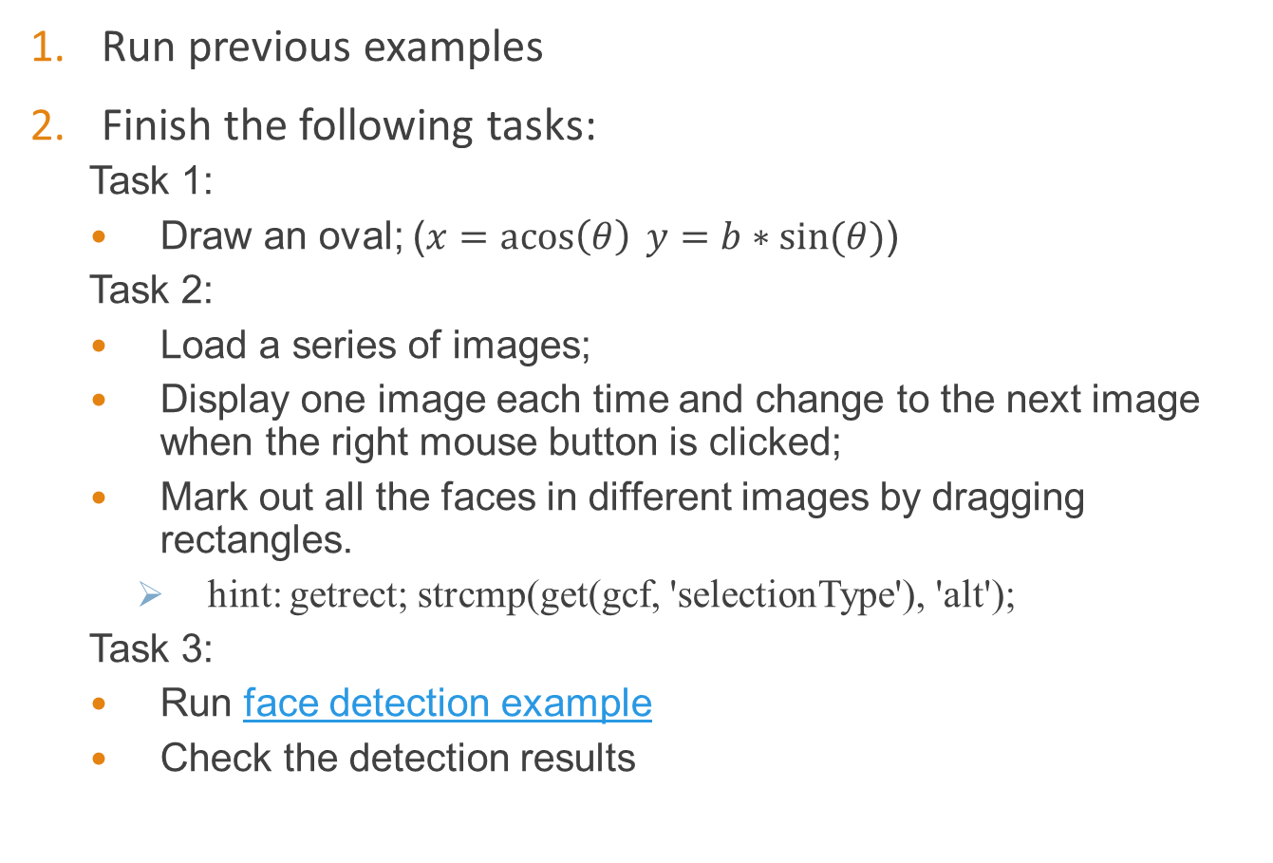
Exercise
Run previous examples
Finish the following tasks:
Task 1:
Draw an oval; ($x=\operatorname{acos}\left(θ\right) y=b∗\sin{(θ)}$)
Task 2:
Load a series of images;
Display one image each time and change to the next image when the right mouse button is clicked;
Mark out all the faces in different images by dragging rectangles.
hint: getrect; strcmp(get(gcf, 'selectionType'), 'alt');
Task 3:
Run face detection example
Check the detection results

