Slide 1
Data
Ying shen
Sse, tongji university
Sep. 2016

Slide 2
Data
A data set can often be viewed as a collection of data objects.
Other names for a data object include record, point, vector, pattern, event, case, sample, observation or entity.
 | sepal length | sepal width | petal length | petal width | class
Sample 1 | 5.1 | 3.5 | 1.4 | 0.2 | Iris-setosa
Sample 2 | 4.9 | 3.0 | 1.4 | 0.2 | Iris-setosa
Sample 3 | 7.0 | 3.2 | 4.7 | 1.4 | Iris-versicolor
Sample 4 | 6.4 | 3.2 | 4.5 | 1.5 | Iris-versicolo
…
Sample 149 | 6.3 | 3.3 | 6.0 | 2.5 | Iris-virginica
Sample 150 | 5.8 | 2.7 | 5.1 | 1.9 | Iris-virginica

Slide 3
Data
Data objects are described by a number of attributes that capture the basic characteristics of an object.
Other names for an attribute are variable, characteristic, field, feature, or dimension.
A data set is usually a file, in which
The objects are records (or rows) in the file and
Each field (or column) corresponds to an attribute.
 | sepal length | sepal width | petal length | petal width | class
Sample 1 | 5.1 | 3.5 | 1.4 | 0.2 | Iris-setosa
Sample 2 | 4.9 | 3.0 | 1.4 | 0.2 | Iris-setosa
Sample 3 | 7.0 | 3.2 | 4.7 | 1.4 | Iris-versicolor
Sample 4 | 6.4 | 3.2 | 4.5 | 1.5 | Iris-versicolo
…
Sample 149 | 6.3 | 3.3 | 6.0 | 2.5 | Iris-virginica
Sample 150 | 5.8 | 2.7 | 5.1 | 1.9 | Iris-virginica

Slide 4
Attributes
An attribute is a property or characteristic of an object that may vary, either from one object to another or from one time to another.
 | sepal length | sepal width | petal length | petal width | class
Sample 1 | 5.1 | 3.5 | 1.4 | 0.2 | Iris-setosa
Sample 2 | 4.9 | 3.0 | 1.4 | 0.2 | Iris-setosa
Sample 3 | 7.0 | 3.2 | 4.7 | 1.4 | Iris-versicolor
Sample 4 | 6.4 | 3.2 | 4.5 | 1.5 | Iris-versicolo
…
Sample 149 | 6.3 | 3.3 | 6.0 | 2.5 | Iris-virginica
Sample 150 | 5.8 | 2.7 | 5.1 | 1.9 | Iris-virginica

Slide 5
Different types of attributes
We can define four types of attributes
Nominal
Ordinal
Interval
Ratio
Nominal and ordinal attributes are collectively referred to as categorical or qualitative attributes.
Interval and ratio attributes are collectively referred to as quantitative or numeric attributes.

Slide 6
Different types of attributes
Nominal
The values of a nominal attribute are just different names.
They provide only enough information to distinguish one object from another.
Examples: eye color, gender.
Ordinal
The values of an ordinal attribute provide enough information to order objects.
Example: grades.

Slide 7
Different types of attributes
Interval
For interval attributes, the differences between values are meaningful.
Example: calendar dates.
Ratio
For ratio variables, both differences and ratios are meaningful.
Example: monetary quantities, mass, length.

Slide 8
Different types of attributes
Another way to distinguish between attributes is by the number of values they can take.
Based on this criterion, attributes can be classified as either discrete or continuous.

Slide 9
Different types of attributes
Discrete
A discrete attribute has a finite or countably infinite set of values.
Such attributes can be categorical, such as gender, or numeric, such as counts.
Discrete attributes are often represented using integer variables.
Binary attributes are a special case of discrete attributes and assume only two values, e.g. true/false, yes/no, male/female, or 0/1.

Slide 10
Different types of attributes
Continuous
A continuous attribute is one whose values are real numbers
Examples include temperature, height or weight.
Continuous attributes are typically represented as floating point variables.

Slide 11
Types of data sets
We consider the following different types of data sets
Record data
Transaction or market basket data
Data matrix
Sparse data matrix

Slide 12
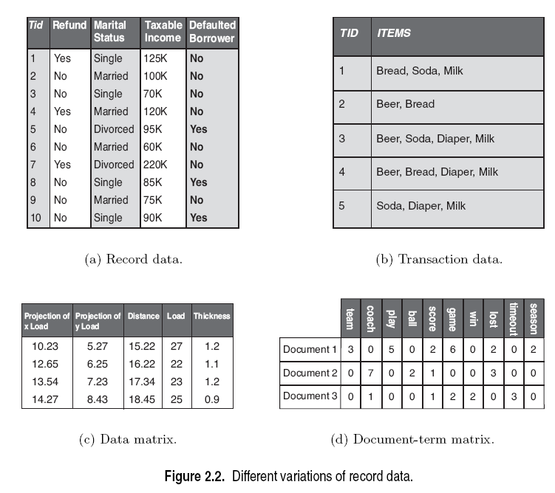
Record data
Each record consists of a fixed set of data fields (attributes).
Record data is usually stored either in flat files or in relational databases.

Slide 13
Transaction or market basket data
Transaction data is a special type of record data.
Each transaction involves a set of items.
Example: the set of products purchased by a customer during one shopping trip constitutes a transaction.

Slide 14
Data matrix
If the data objects all have the same fixed set of numeric attributes, then they can be thought of as points (vectors) in a multi-dimensional space.
This kind of data set can be interpreted as an m by n matrix where
There are m rows, one for each object.
There are n columns, one for each attribute.
Standard matrix operations can be applied to transform and manipulate the data.

Slide 15
Sparse data matrix
A sparse data matrix is a special case of a data matrix in which there are a large number of zeros in the matrix, and only the non-zero attribute values are important.
Sparsity is an advantage because usually only the non-zero values need to be stored and manipulated.
This results in significant savings with respect to computation time and storage.

Slide 16
Sparse data matrix
An example is document data.
A document can be represented as a term vector, where
Each term is a component (attribute) of the vector and
The value of each component is the number of times the corresponding term occurs in the document.
This representation of a collection of documents is often called a document-term matrix.

Slide 17
Data quality
Precision
The closeness of repeated measurements (of the same quantity) to one another.
This is often measured by the standard deviation of a set of values.
Bias
A systematic variation of measurements from the quantity being measured.
This is measured by taking the difference between
the mean of the set of values and
the known value of the quantity being measured.

Slide 18
Data quality
Suppose we have a standard laboratory weight with a mass of 1g.
We want to assess the precision and bias of our new laboratory scale.
We weigh the mass five times, and obtain the values: {1.015, 0.990, 1.013, 1.001, 0.986}.
The mean of these values is 1.001.
The bias is thus 0.001.
The precision, as measured by the standard deviation, is 0.012.

Slide 19
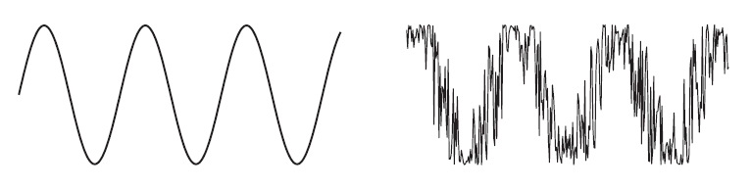
Data quality: Noise and outliers
Noise
Noise is the random component of a measurement error.
Outliers
Data objects that, in some sense, have characteristics that are different from most of the other data objects in the data set.
Values of an attribute that are unusual with respect to the typical values for that attribute.

Slide 20
Data quality: Missing values
It is not unusual for an object to be missing one or more attribute values.
There are several strategies for dealing with missing data
Eliminate data objects
Estimate missing values

Slide 21
Data quality: Missing values
Eliminate data objects
If a data set has only a few objects that have missing attribute values, then it may be convenient to omit them.
However, even a partially specified data object contains some information.
If many objects have missing values, then a reliable analysis can be difficult or impossible.

Slide 22
Data quality: Missing values
Estimate missing values
A missing attribute value of a point can be estimated by the attribute values of the other points.
If the attribute is discrete, then the most commonly occurring attribute value can be used.
If the attribute is continuous, then the average attribute value of the other points is used.

Slide 23
Data preprocessing
There are a number of techniques for performing data preprocessing
Aggregation
Sampling
Dimensionality reduction
Feature subset selection
Discretization and binarization
Variable transformation

Slide 24
Sampling
Sampling is the selection of a subset of the data objects to be analyzed.
Sometimes, it is too expensive or time consuming to process all the data.
Using a sampling algorithm can reduce the data size to a point where a better, but more computationally expensive algorithm can be used.
A sample is representative if it has approximately the same property (of interest) as the original set of data.

Slide 25
Sampling
The simplest type of sampling is simple random sampling.
For this type of sampling, there is an equal probability of selecting any particular item.
There are two variations on random sampling
Sampling without replacement
Sampling with replacement
Sampling without replacement
As each item is selected, it is removed from the set of all objects.
Sampling with replacement
Objects are not removed from the data set as they are selected for the sample.
The same object can be picked more than once.

Slide 26
Sampling
Once a sampling technique has been selected, it is still necessary to choose the sample size.
For larger sample sizes
The probability that a sample will be representative will be increased.
However, much of the advantage of sampling will also be eliminated.
For smaller sample sizes
There may be a loss of important information.

Slide 27
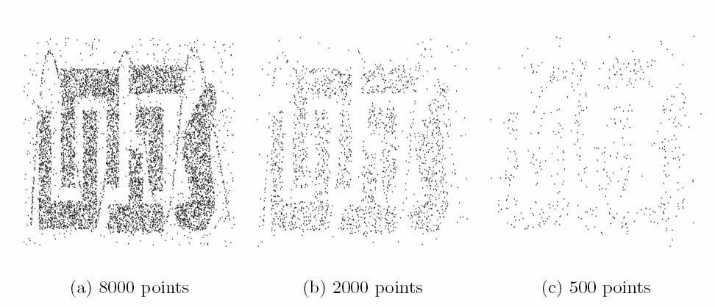
Sampling

Slide 28
Dimensionality reduction
The dimensionality of a data set is the number of attributes that each object possesses.
It is usually more difficult to analyze high-dimensional data (curse of dimensionality).
An important preprocessing step is dimensionality reduction.

Slide 29
Dimensionality reduction
There are a number of benefits to dimensionality reduction
It can eliminate irrelevant features and reduce noise.
It can lead to a more understandable model which involve fewer attributes.
It may allow the data to be more easily visualized.
The amount of time and memory required for processing the data is reduced.

Slide 30
Dimensionality reduction
The curse of dimensionality refers to the phenomenon that many types of data analysis become significantly harder as the dimensionality increases.
As dimensionality increases, the data becomes increasingly sparse in the space that it occupies.
There may not be enough data objects to allow the reliable creation of a model that describes the set of objects.

Slide 31
Dimensionality reduction
There are a number of techniques for dimensionality reduction
Linear algebra techniques: PCA, LDA
Feature subset selection

Slide 32
Linear algebra techniques
Techniques from linear algebra can be used to project data from a high-dimensional space to a low-dimensional space.
Principal Component Analysis (PCA) is a technique that finds new attributes that are
linear combinations of the original attributes.
capture the maximum amount of variation in the data.

Slide 33
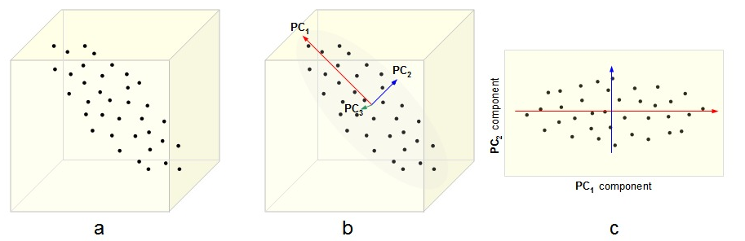
Principal component analysis

Slide 34
Feature subset selection
Another way to reduce the dimensionality is to use only a subset of the features.
This approach is effective if redundant and irrelevant features are present.
Redundant features duplicate much or all of the information contained in one or more other attributes.
Irrelevant features contain almost no useful information for the task at hand.

Slide 35
Feature subset selection
The ideal approach to feature selection is to
Try all possible subsets of features.
Take the subset that produces the best result.
Since the number of subsets involving n attributes is 2^{n}, such an approach is impractical in most situations.
There are three standard approaches to feature selection
Embedded approaches
Filter approaches
Wrapper approaches

Slide 36
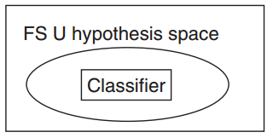
Embedded approaches
Feature selection occurs naturally as part of the algorithm.
The algorithm itself decides which attributes to use and which to ignore.
Example:
Decision trees
Weighted naive Bayes

Slide 37
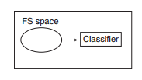
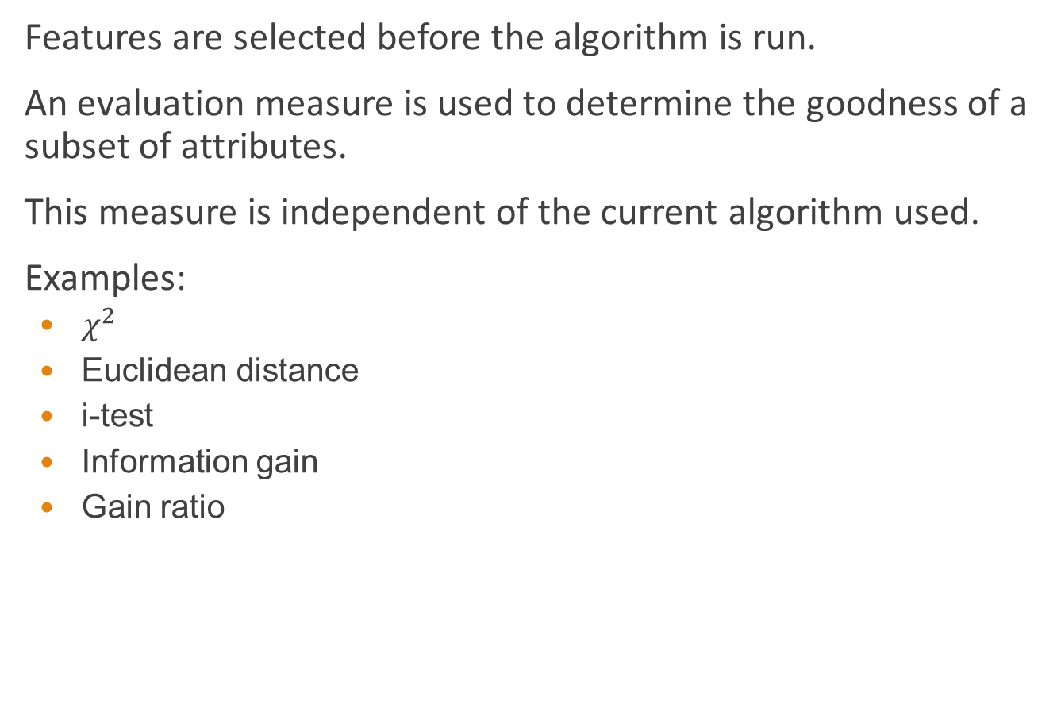
Filter approaches
Features are selected before the algorithm is run.
An evaluation measure is used to determine the goodness of a subset of attributes.
This measure is independent of the current algorithm used.
Examples:
$χ^{2}$
Euclidean distance
i-test
Information gain
Gain ratio

Slide 38
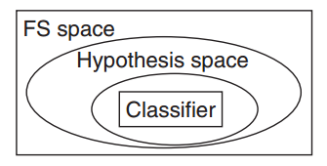
Wrapper approaches
These methods use the target algorithm as a black box to find the best subset of attributes.
Typically, not all the possible subsets are enumerated.

Slide 39
Normalization
The goal of normalization or standardization is to make an entire set of values have a particular property.
If different variables are to be combined in some way, normalization is necessary to avoid having a variable with large values dominate the results of the calculation.

Slide 40
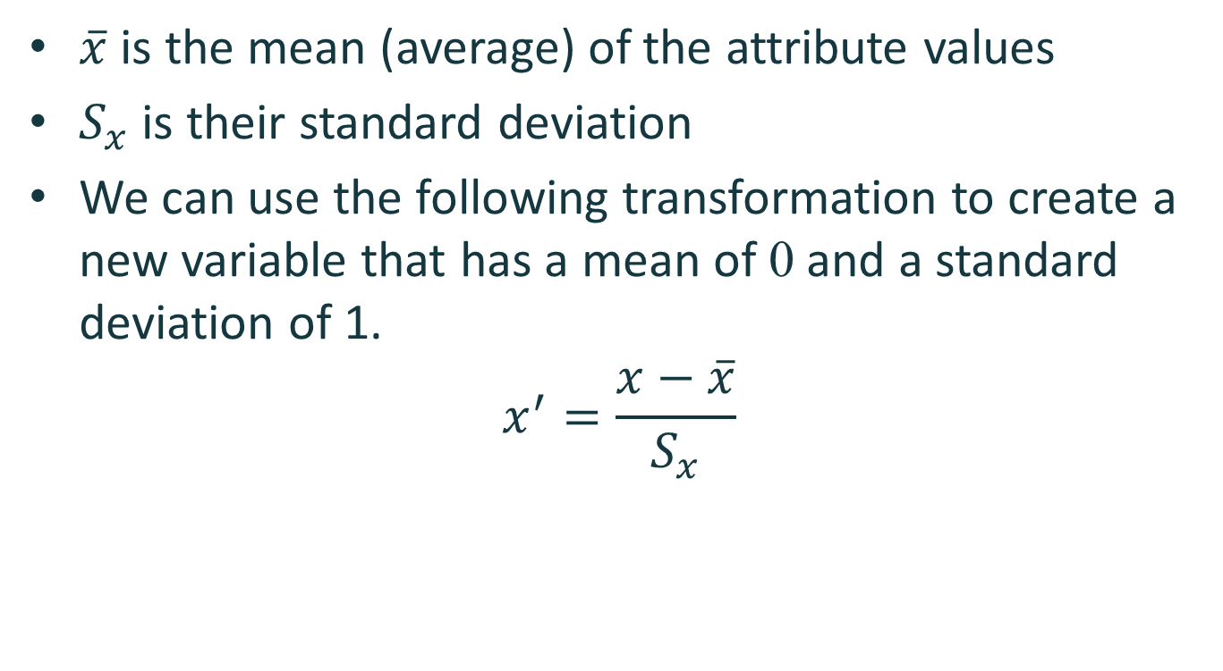
Normalization
$\overline{x}$ is the mean (average) of the attribute values
$S_{x}$ is their standard deviation
We can use the following transformation to create a new variable that has a mean of 0 and a standard deviation of 1.
$$x^{′}=\frac{x−\overline{x}}{S_{x}}$$

