Slide 1
Quality Attributes
Ying SHEN
SSE, Tongji University

Slide 2
Lecture objectives
This lecture will enable students to
be familiar with different system qualities and examples through a real project (ICDE system).

Slide 3
Architecture and requirements
All requirements encompass the following categories:
Functional requirements
Quality attribute requirements
Constraints
Notes:
Requirements for a system come in a variety of forms: textual requirements, mockups, existing systems, use cases, user stories, and more
Functional requirements. These requirements state what the system must do, and how it must behave or react to runtime stimuli.
2. Quality attribute requirements. These requirements are qualifications of the functional requirements or of the overall product. A qualification of a functional requirement is an item such as how fast the function must be performed, or how resilient it must be to erroneous input. A qualification of the overall product is an item such as the time to deploy the product or a limitation on operational costs.
3. Constraints. A constraint is a design decision with zero degrees of freedom. That is, it's a design decision that's already been made. Examples include the requirement to use a certain programming language or to reuse a certain existing module, or a management fiat to make your system service oriented. These choices are arguably in the purview of the architect, but external factors (such as not being able to train the staff in a new language, or having a business agreement with a software supplier, or pushing business goals of service interoperability) have led those in power to dictate these design outcomes.

Slide 4
Functional requirements
Functional requirements state what the system must do, and how it must behave or react to runtime stimuli.
Functionality does not determine architecture.
If functionality is the only requirement, a single monolithic module works!
Although functionality is independent of structure, it is achieved by assigning responsibilities to architectural elements.
Notes:
Functionality is the ability of the system to do the work for which it was intended
Assigning responsibilities to architectural elements is a fundamental architectural design decision.

Slide 5
Quality attribute requirements
Quality attribute (QA) requirements are qualifications of the functional requirements or of the overall product.
A quality attribute can be regarded as measuring the “goodness” of a product along some dimension of interest to a stakeholder.
Notes:
A quality attribute (QA) is a measurable or testable property of a system that is used to indicate how well the system satisfies the needs of its stakeholders

Slide 6
Quality attributes
QAs specify how well the system performs its functions:
How fast must it respond?
How easy must it be to use?
How secure does it have to be against attacks?
How easy should it be to maintain?
Software qualities are not orthogonal.
A change in structure that improves one quality often affects the other qualities.

Slide 7
Constraints
A constraint is a design decision with zero degrees of freedom.
Use a certain programming language or to reuse a certain existing module
Notes:
These choices are arguably in the purview of the architect, but external factors (such as not being able to train the staff in a new language, or having a business agreement with a software supplier, or pushing business goals of service interoperability) have led those in power to dictate these design outcomes.

Slide 8
A Case Study in Quality Attribute
From Essential Software Architecture

Slide 9
ICDE system
Information Capture and Dissemination Environment (ICDE) is a software system for providing intelligent assistance to
financial analysts
scientific researchers
intelligence analysts
analysts in other domains

Slide 10
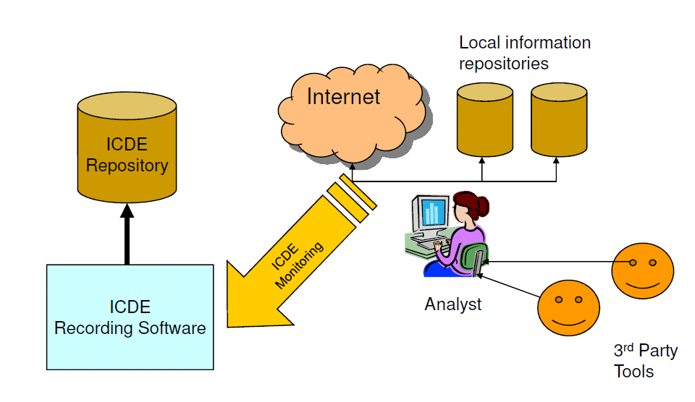
ICDE schematic

Slide 11
ICDE system
ICDE automatically captures and stores data of actions performed by a user when operating a workstation.
Example: When a user performing Google search, ICDE will store in a database:
The search query string
List of returned pages displayed in the browser
Data can be later used by 3rd parties
to offer intelligent help
to find potentially useful details overlooked by users

Slide 12
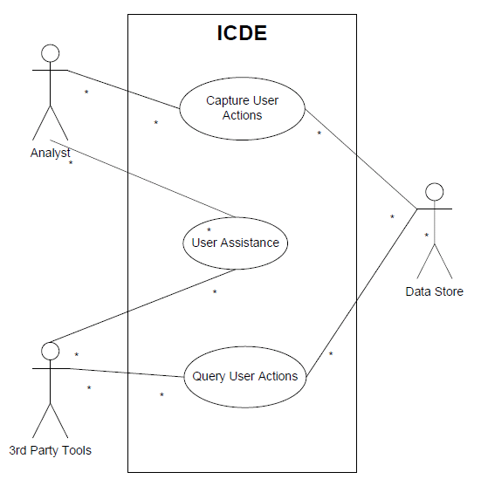
ICDE use cases

Slide 13
ICDE version 1.0
Analyst Workstation
Data Collection
Data Store
Data Analysis
ICDE Version 1.0 application architecture

Slide 14

Data collection
The collection component comprises a number of loosely coupled processes that transparently track the user’s relevant activities and store them in the Data Store.

Slide 15
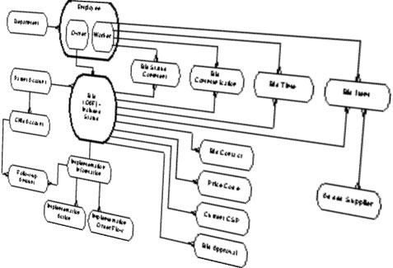
Data store
This component comprises a commercial-off-the-shelf (COTS) relational database.
The relational database stores information in various tables regarding the user activities, with timestamps added so that the order of events can be reconstructed.

Slide 16

Data analysis
A graphical user interface (GUI) based tool supports a set of queries on the data store.

Slide 17
ICDE version 1.0
ICDE version 1.0 in production
Basically a complex, raw information capture tool, GUI for looking at captured data
2 tier client-server, single machine deployment
Java, Perl, SQL,
Programmatic access to data through very complex SQL (38 tables, 46 views)
ICDE v1.0 was only deployed in a small user trial involving a few users.
This deployment successfully tested the software functionality and demonstrated the concepts of data capture and storage.

Slide 18
ICDE version 2.0
ICDE v2.0 scheduled for development in 12 month timeframe
Fixed schedule, budget
Major changes to:
Enhance data capture tools (GUI)
Support 3rd party tool integration, testing, data access and large production scale deployments (150’s of users)

Slide 19
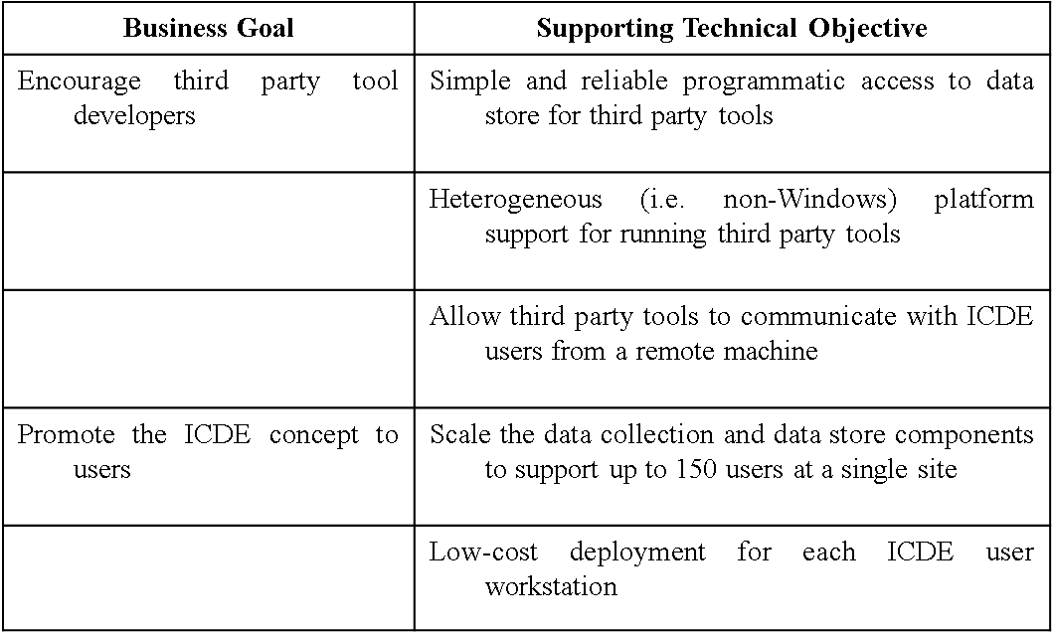
ICDE version 2.0
Business goals:

Slide 20
Architecturally significant requirements for ICDE v2.0
ICDE project requirements:
Heterogeneous platform support for access to ICDE data
Instantaneous event notification (local/distributed)
Over the Internet, secure ICDE data access
Ease of programmatic data access
ICDE project team requirements:
Insulate 3rd party projects and ICDE tools from database evolution
Scalable infrastructure to support large, shared deployments
Minimize license costs for a deployment
Unknowns
Minimize dependencies, making unanticipated changes potentially easier

Slide 21
Summary
ICDE is a reasonably complex system
It will be used to illustrate concepts during the remainder of this course

Slide 22
What are quality attributes
Often know as –ilities
Reliability
Availability
Portability
Scalability
Performance

Slide 23
Quality attribute specification
Architects are often told:
“My application must be fast/secure/scale”
Far too imprecise to be any use at all
Quality attributes (QAs) must be made precise/measurable for a given system design, e.g.
“It must be possible to scale the deployment from an initial 100 geographically dispersed user desktops to 10,000 without an increase in effort/cost for installation and configuration.”

Slide 24

QAs of ICDE system
Performance
Scalability
Modifiability
Security
Availability
Integration
Any other quality attributes?

Slide 25
Performance
A performance quality requirement defines a:
metric of amount of work performed in unit time
deadline that must be met
Enterprise applications often have strict performance requirements, e.g.
1000 transactions per second
3 second average latency for a request
Performance is fundamental for software system.

Slide 26
Performance - Throughput
Measure of the amount of work an application must perform in unit time
Transactions per second
Messages per minute
Is required throughput:
Average?
Peak?
Many system have low average but high peak throughput requirements

Slide 27
Performance - Response time
Measure of the latency an application exhibits in processing a request
Usually measured in (milli)seconds
Often an important metric for users
Is required response time:
Guaranteed?
Average?
E.g. 95% of responses in sub-4 seconds, and
all within 10 seconds

Slide 28
Performance - Deadlines
‘Something must be completed before some specified time’
Payroll system must complete by 2 am so that electronic transfers can be sent to bank
Weekly accounting run must complete by 6 am Monday so that figures are available to management
Deadlines often associated with batch jobs in IT systems.

Slide 29
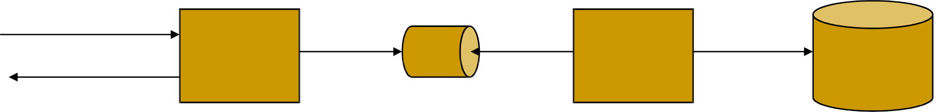
ICDE performance issues
Response time:
Overheads of trapping user events must be imperceptible to ICDE users
Solution for ICDE client:
Decouple user event capture from storage using a queue
5. Write event to ICDE database queue
1. Trap user event
2. Write event to queue
3. Return to user thread
4. Read event from queue

Slide 30
Scalability
“How well a solution to some problem will work when the size of the problem increases.”
4 common scalability issues in IT systems:
Request load
Connections
Data size
Deployments

Slide 31
Scalability – Request load
How does an 100 tps application behave when simultaneous request load grows? E.g.
From 100 to 1000 requests per second?
Ideal solution, without additional hardware capacity:
As the load increases, throughput remains constant (i.e. 100 tps), and response time per request increases only linearly (i.e. 10 seconds).

Slide 32
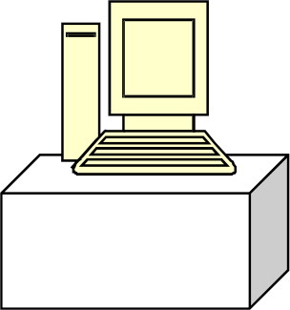
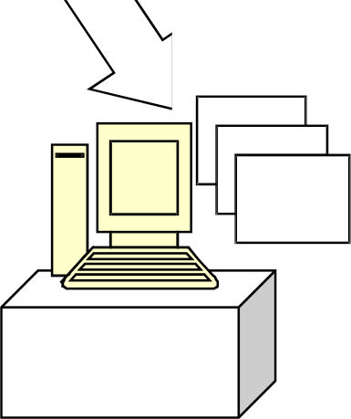
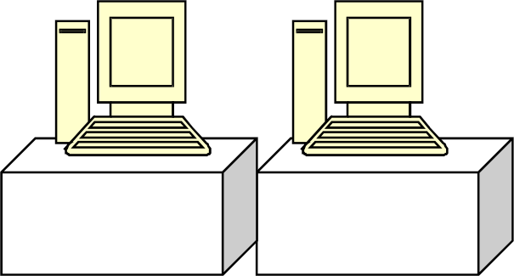
Scalability – Add more hardware …
Scale-out:
Application replicated on
different machines
Application
Scale-up:
Single application instance is
executed on a multiprocessor
machine
Application
CPU
Application
Application
Application

Slide 33
Scalability - Reality
Adding more hardware should improve performance:
Scalability must be achieved without modifications to application architecture
Reality as always is different!
Applications will exhibit a decrease in throughput and a subsequent exponential increase in response time.
Increased load causes increased contention for resources such as CPU, network and memory
Each request consumes some additional resource (buffer space, locks, and so on) in the application, and eventually these are exhausted

Slide 34
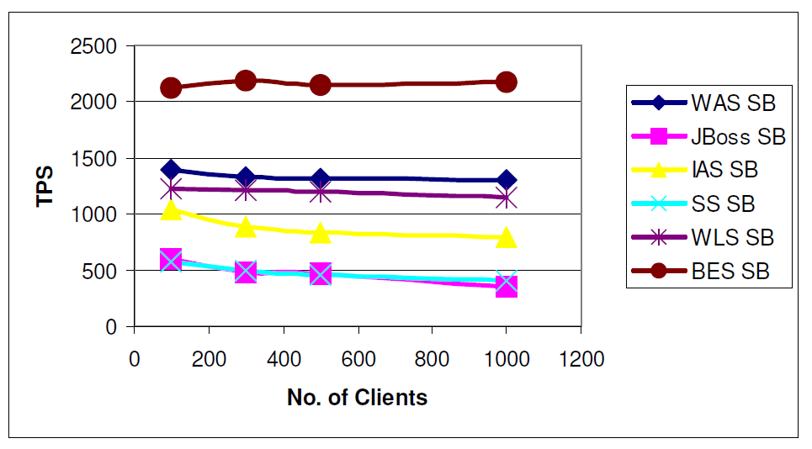
Scalability – J2EE example
I.Gorton, A Liu, Performance Evaluation of Alternative Component
Architectures for Enterprise JavaBean Applications, in IEEE Internet
Computing, vol.7, no. 3, pages 18-23, 2003.

Slide 35
Scalability – Connections
What happens if number of simultaneous connections to an application increases
If each connection consumes a resource?
Exceed maximum number of connections?
ISP example:
Each user connection spawned a new process
Virtual memory on each server exceeded at 2000 users
Needed to support 100Ks of users
Tech crash ….
Notes:
An Internet service provider (ISP) is an organization that provides services for accessing, using, or participating in the Internet.
Internet services typically provided by ISPs include Internet access, Internet transit, domain nameregistration, web hosting, Usenet service, colocation.

Slide 36
Scalability – Data size
How does an application behave as the data it processes increases in size?
Chat application sees average message size double?
Database table size grows from 1 million to 20 million rows?
Image analysis algorithm processes images of 100MB instead of 1MB?
Can application/algorithms scale to handle increased data requirements?

Slide 37
Scalability – Deployment
How does effort to install/deploy an application increase as installation base grows?
Install new users?
Install new servers?
Solutions typically revolve around automatic download/installation
E.g. downloading applications from the Internet

Slide 38
Scalability thoughts and ICDE
Scalability often overlooked.
Major cause of application failure
Hard to predict
Hard to test/validate
Reliance on proven designs and technologies is essential
For ICDE - application should be capable of handling a peak load of 150 concurrent requests from ICDE clients.
Relatively easy to simulate user load to validate this

Slide 39
Modifiability
Modifications to a software system during its lifetime are a fact of life.
Modifiable systems are easier to change/evolve.
Modifiability should be assessed in context of how a system is likely to change
No need to facilitate changes that are highly unlikely to occur
Over-engineering!

Slide 40
Modifiability
Modifiability measures how easy it may be to change an application to cater for new (non-)functional requirements.
‘may’ – nearly always impossible to be certain
Must estimate cost/effort
Modifiability measures are only relevant in the context of a given architectural solution.
Components
Relationships
Responsibilities

Slide 41
Modifiability scenarios
Provide access to the application through firewalls in addition to existing “behind the firewall” access.
Incorporate new features for self-service check-out kiosks.
The COTS speech recognition software vendor goes out of business and we need to replace this component.
The application needs to be ported from Linux to the Microsoft Windows platform.

Slide 42
Modifiability analysis
Impact is rarely easy to quantify.
The best possible is a:
Convincing impact analysis of changes needed
A demonstration of how the solution can accommodate the modification without change.
Minimizing dependencies increases modifiability
Changes isolated to single components likely to be less expensive than those that cause ripple effects across the architecture.

Slide 43
Modifiability for ICDE
The range of events trapped and stored by the ICDE client to be expanded.
Third party tools to communicate new message types.
Change database technology used
Change server technology used

Slide 44
Security
Difficult, specialized quality attribute:
Lots of technology available
Requires deep knowledge of approaches and solutions
Security is a multi-faceted quality …

Slide 45
Security
Authentication:
Applications can verify the identity of their users and other applications with which they communicate.
Authorization:
Authenticated users and applications have defined access rights to the resources of the system.
Encryption:
The messages sent to/from the application are encrypted.
Integrity:
This ensures the contents of a message are not altered in transit.
Non-repudiation:
The sender of a message has proof of delivery and the receiver is assured of the sender’s identity. This means neither can subsequently refute their participation in the message exchange.

Slide 46
Security approaches
SSL
PKI
Web Services security
JAAS
Operating system security
Database security
Etc etc
Notes:
SSL stands for Secure Sockets Layer. It provides a secure connection between internet browsers and websites, allowing you to transmit private data online. Sites secured with SSL display a padlock in the browsers URL and possibly a green address bar if secured by an EV Certificate.
Public key cryptography is a cryptographic technique that enables users to securely communicate on an insecure public network, and reliably verify the identity of a user viadigital signatures.^{[2]}
A public key infrastructure (PKI) is a system for the creation, storage, and distribution of digital certificates which are used to verify that a particular public key belongs to a certain entity. The PKI creates digital certificates which map public keys to entities, securely stores these certificates in a central repository and revokes them if needed.^{[3][4][5]}
WS-Security describes three main mechanisms:
How to sign SOAP messages to assure integrity. Signed messages also provide non-repudiation.
How to encrypt SOAP messages to assure confidentiality.
How to attach security tokens to ascertain the sender's identity.
The Java Authentication and Authorization Service (JAAS) was introduced as an optional package (extension) to the Java 2 SDK, Standard Edition (J2SDK), v 1.3. JAAS was integrated into the J2SDK 1.4.
JAAS can be used for two purposes:
for authentication of users, to reliably and securely determine who is currently executing Java code, regardless of whether the code is running as an application, an applet, a bean, or a servlet; and
for authorization of users to ensure they have the access control rights (permissions) required to do the actions performed.
Operating system security (OS security) is the process of ensuring OS integrity, confidentiality and availability. OS security refers to specified steps or measures used to protect the OS from threats, viruses, worms, malware or remote hacker intrusions. OS security encompasses all preventive-control techniques, which safeguard any computer assets capable of being stolen, edited or deleted if OS security is compromised.

Slide 47
ICDE security requirements
Authentication of ICDE users and third party ICDE tools to ICDE server.
Encryption of data to ICDE server from 3rd party tools/users executing remotely over an insecure network

Slide 48
Availability
Key requirement for most IT applications
Measured by the proportion of the required time it is usable. E.g.
100% available during business hours
No more than 2 hours scheduled downtime per week
24*7*52 (100% availability)
Related to an application’s reliability
Unreliable applications suffer poor availability
Related to recoverability

Slide 49
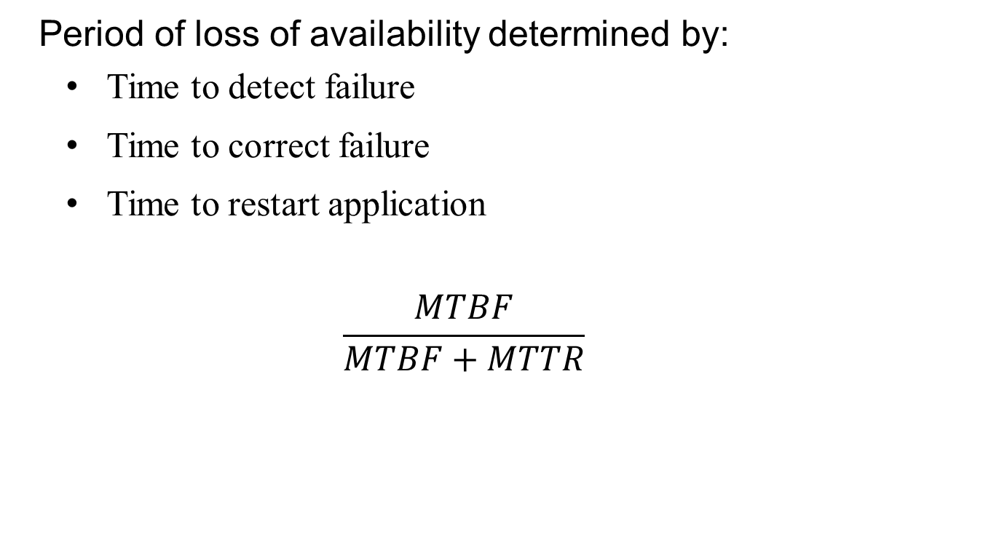
Availability
Period of loss of availability determined by:
Time to detect failure
Time to correct failure
Time to restart application
$$\frac{MTBF}{MTBF+MTTR}$$

Slide 50
Availability
High availability typically refers to designs targeting availability of 99.999 percent (“5 nines”) or greater.
Strategies for high availability:
Eliminate single points of failure
Replication and failover
Automatic detection and restart
Notes:
99 .999 percent availability

Slide 51
Availability
System Availability Requirements
Availability | Downtime/90 Days | Downtime/Year
99.0% | 21 hours, 36 minutes | 3 days, 15.6 hours
99.9% | 2 hours, 10 minutes | 8 hours, 0 minutes, 46 seconds
99.99% | 12 minutes, 58 seconds | 52 minutes, 34 seconds
99.999% | 1 minute, 18 seconds | 5 minutes, 15 seconds
99.999% | 8 seconds | 32 seconds

Slide 52
Availability for ICDE
Achieve 100% availability during business hours
Plenty of scope for downtime for system upgrade, backup and maintenance.
Include mechanisms for component replication and failover

Slide 53
Integration
Ease with which an application can be incorporated into a broader application context
Use component in ways that the designer did not originally anticipate
Typically achieved by:
Programmatic APIs
Data integration

Slide 54
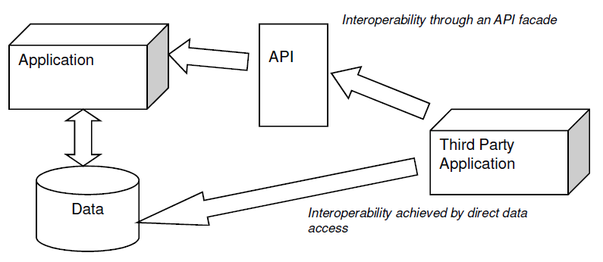
Integration strategies
Data – expose application data for access by other components
API – offers services to read/write application data through an abstracted interface
Each has strengths and weaknesses …

Slide 55
ICDE integration needs
Revolve around the need to support third party analysis tools.
Well-defined and understood mechanism for third party tools to access data in the ICDE data store.

Slide 56
Design trade-offs
QAs are rarely orthogonal
They interact, affect each other
Highly secure system may be difficult to integrate
Highly available application may trade-off lower performance for greater availability
High performance application may be tied to a given platform, and hence not be easily portable
Architects must create solutions that makes sensible design compromises
not possible to fully satisfy all competing requirements
Must satisfy all stakeholder needs
This is the difficult bit!

Slide 57
Summary
QAs are part of an application’s nonfunctional requirements
Many QAs
Architect must decide which are important for a given application
Understand implications for application
Understand competing requirements and tradeoffs

Slide 58
Discussion question
How many other qualities of software can you name that were not covered in this lecture? With which other qualities does it most often interact?

Slide 59
Misc. quality attributes
Portability
Can an application be easily executed on a different software/hardware platform to the one it has been developed for?
Testability
How easy or difficult is an application to test?
Supportability
How easy an application is to support once it is deployed?
Usability

