Slide 1
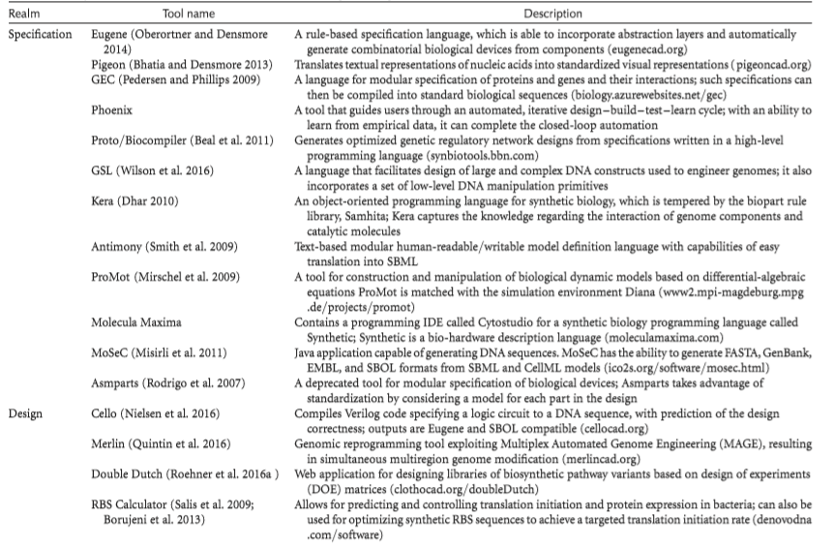
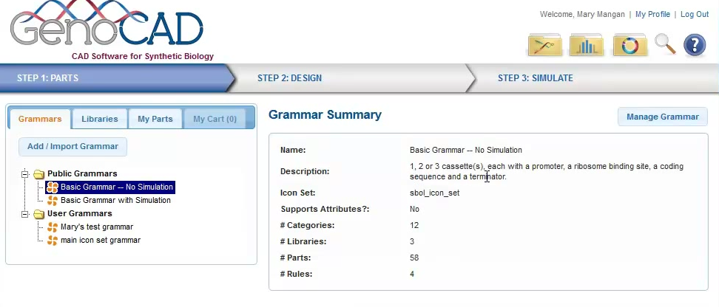
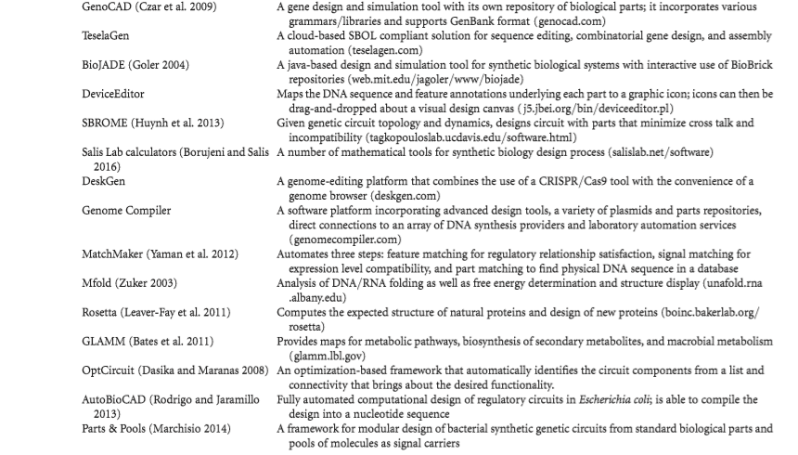
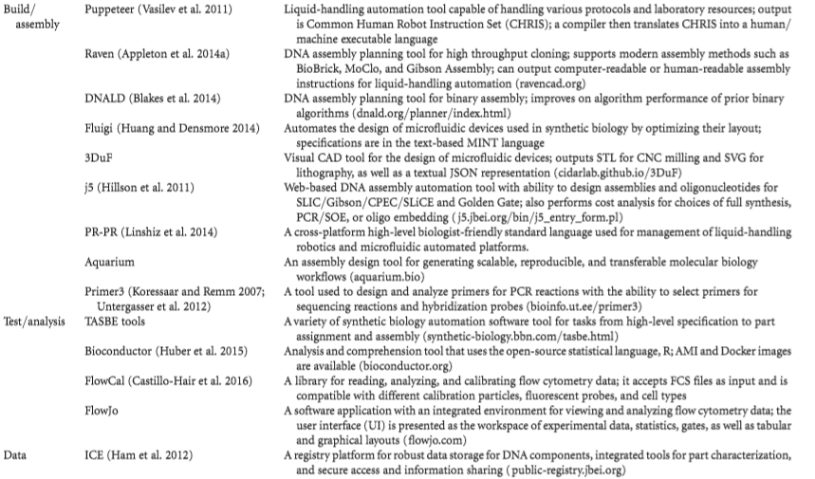
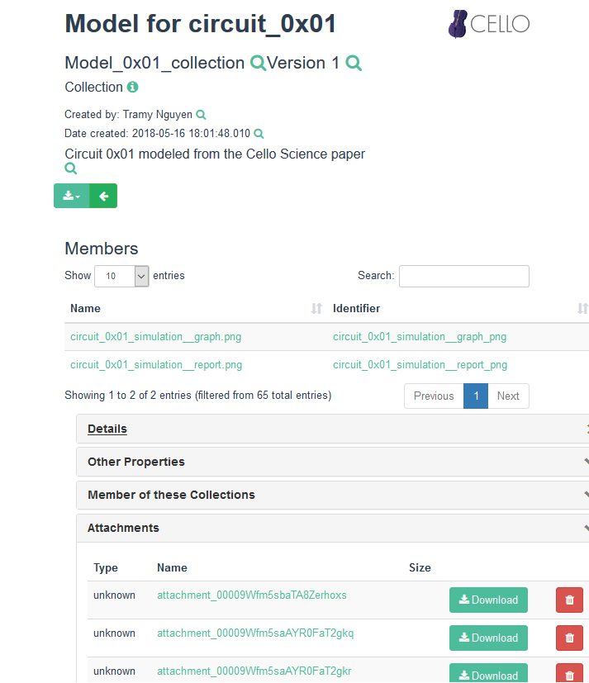
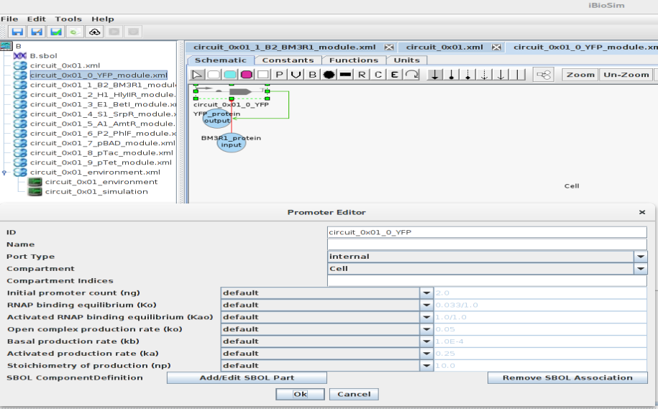
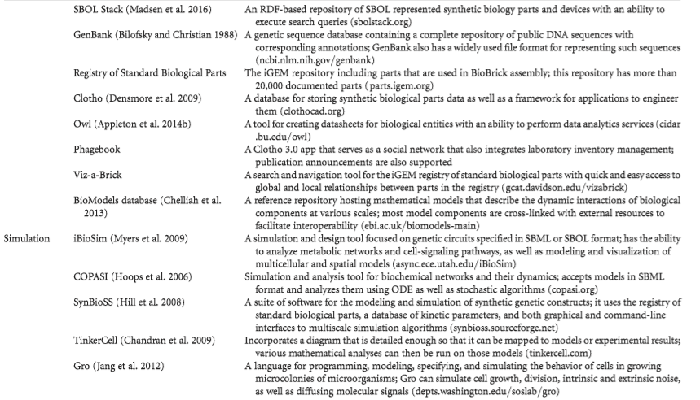
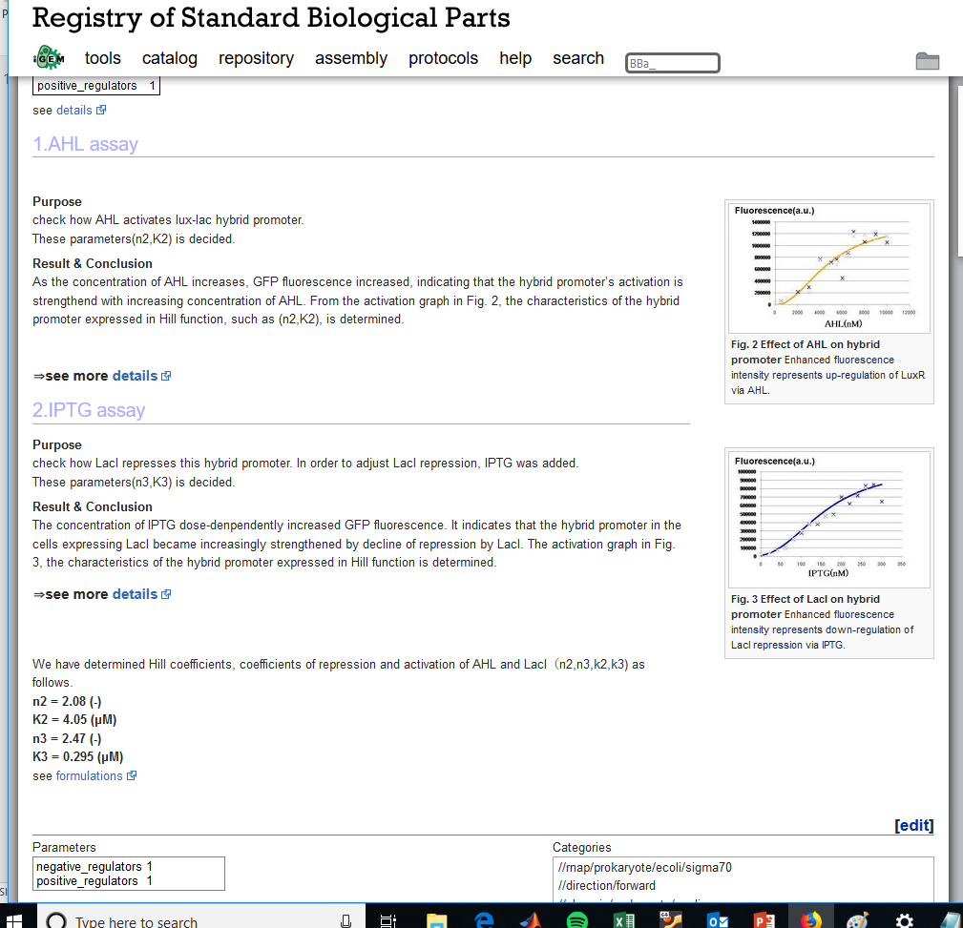
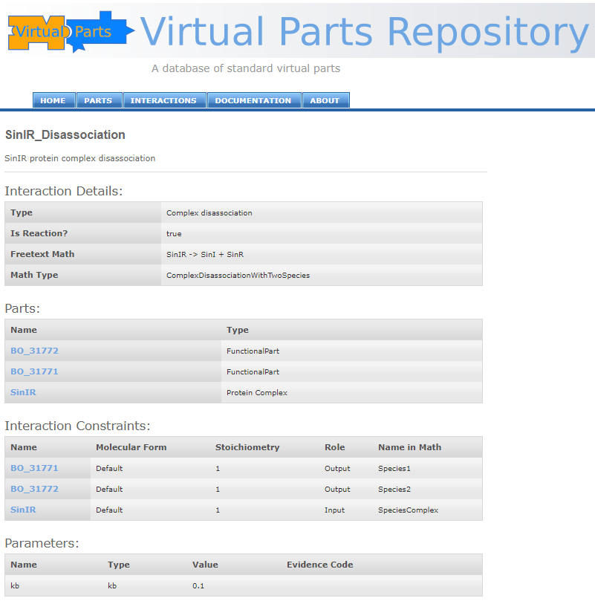
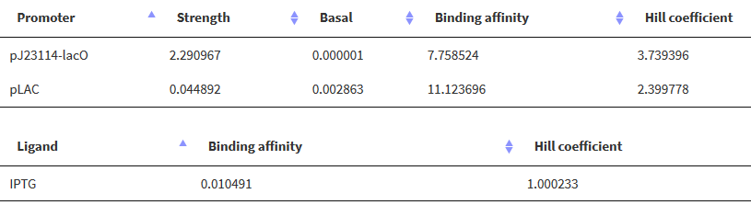
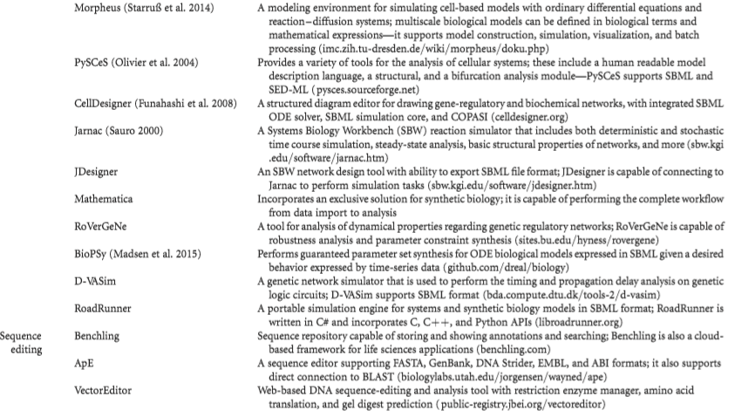
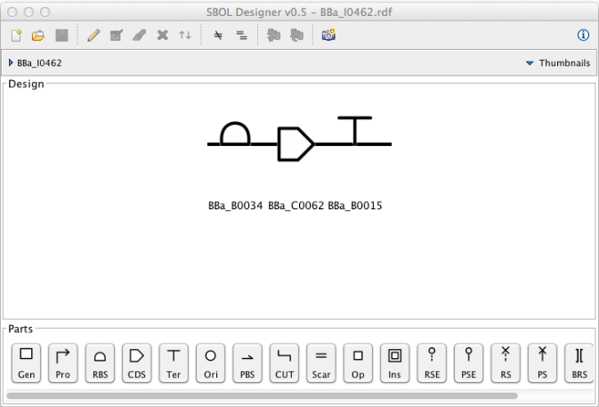
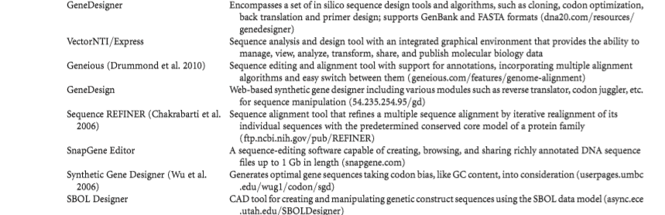
Infographic
Comments | Missing references
Rule based | SBOL-OWL
Visualization
Optimizes with RBS calculator
Not available…
A language for genetic sequence
From SBML to seq
Deprecated.
For steady state only | SYNBADm
Don’t fully understand
Response surface
Thermodynamics
Commercial
Commercial
Old
Only visual
Cannot access
Same as RBS calculator
Commercial
Commercial
Looks similar to Cello but older
Folding
Protein desing
Metabolic network visualization
Similar to SYNBAD
 | Virtual parts repository
 | PAMDB
Data sheet generator
LoL
Just visualization
Nice tool, slow to simulate
 | BMSS
Multiscale
Deprecated.
Web based, no simulation.
iBioSim
Could not find useful information
The work horse of synbiohub.
Not useful
No parameters
Cannot access. Maybe down?
PAMDB
Too generic for synthetic bio.
Cool for testing and debugging SBML only
SBOL Designer

