Slide 1


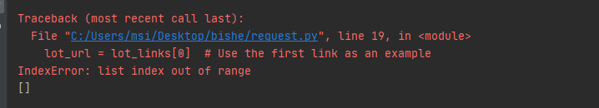
1. why not use the faster request instead of selenium?
Notes:
I would like to start by answering the questions left over from last week:
1. why not use the faster request instead of selenium?
The reason I use selenium is because the content of the page is loaded dynamically and when I try to use requests to get the connection, i.e. the element href, it does not return the correct url and instead displays lot.url: many modern websites use JavaScript to load content dynamically and the requests.get() method only fetches the initial The requests.get() method only fetches the initial HTML content of the page, not the subsequent content that is loaded dynamically via JavaScript. In this case, you may need to use a tool like Selenium, which can simulate browser behaviour, including the execution of JavaScript code.
As a result, the return value of lot_links is empty and therefore unusable.

Slide 2

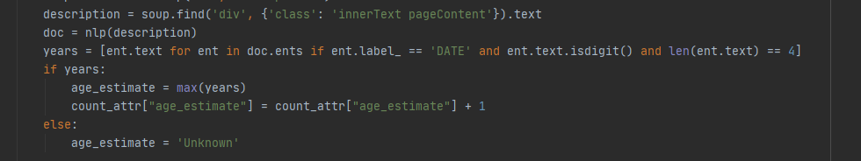
2.The age field does not exist on every page, how do I change it?
Notes:
In the original script, we were trying to estimate the production year of the whisky by looking for numbers in the description text. However, this method was not very accurate because the description text can contain many numbers that are not related to the production year.
To improve the accuracy, we decided to use a technique called Named Entity Recognition (NER). NER is a subtask of information extraction that seeks to locate and classify named entities mentioned in unstructured text into pre-defined categories such as person names, organizations, locations, dates, etc.
We used the spaCy library in Python, which includes a model trained on web text that can recognize dates among other entity types. We parsed the description text with this model and extracted the entities that it recognized as dates.
However, the description text can mention multiple dates, and not all of them are related to the production year. To address this, we made the assumption that the latest date mentioned in the description is the production year. So, we extracted all the recognized dates, filtered out the ones that are not 4-digit numbers (which are likely to be years), and took the latest one as the production year estimate.
This method significantly improved the accuracy of the production year estimate. However, it's worth noting that NER is not perfect and might not recognize all dates correctly, especially in complex sentences. Also, the assumption that the latest date is the production year might not always hold true. Despite these limitations, this method provides a much more accurate estimate than the original approach.
The comparison shows that there is not much room for enhancement and can be added as a supplement when information is lacking. Also, the nlp technique could be improved to better identify production times.

Slide 3
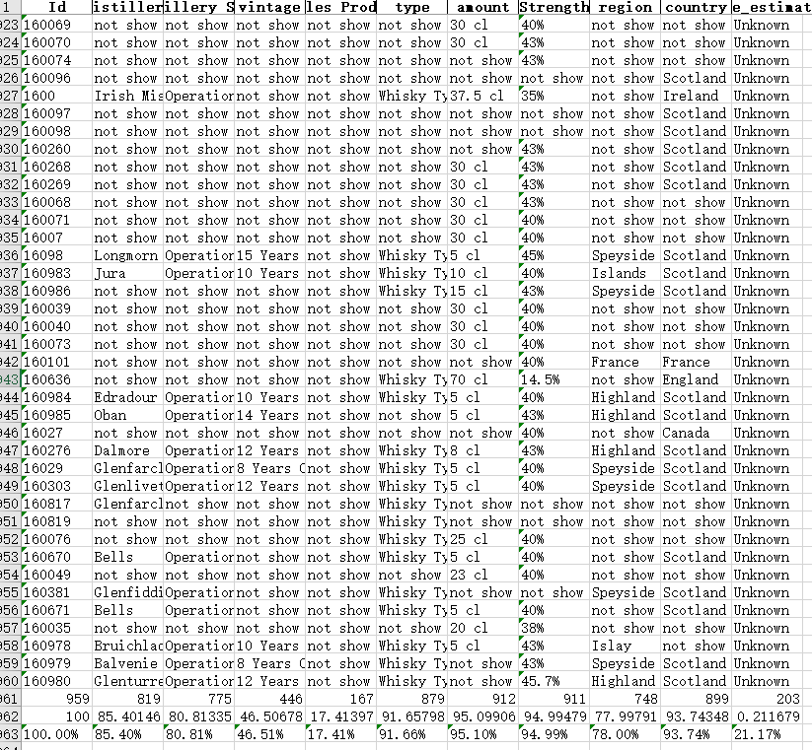
3. This week's progress and results
Id | distillery | Distillery Staus | vintage | Bottles Produced | type | amount | Strength | region | country | age_estimate
100 | 85.40146 | 80.81335 | 46.50678 | 17.41397 | 91.65798 | 95.09906 | 94.99479 | 77.99791 | 93.74348 | 21.16788
Notes:
The results generated were analysed during the week and the different attributes had different frequencies of occurrence. I have summarised the results as shown in the figure:
As can be seen, these attributes appear relatively consistently, while these may not appear necessarily. A better selection of data for analysis will be required at a later stage.

Slide 4
3. This week's progress and results
Cost of Manufacturing
Marketing Costs
Demand from Consumers
Independent Bottling
Cask Prices
Logistics and Other Costs
Alcohol Duties and Taxes
Notes:
Cost of Manufacturing: Whisky production takes time and money. For example, in Scotland, whisky must be aged in an oak cask for at least three years before it can be called whisky. Many smaller producers have high costs to produce whisky because they do not have the same economies of scale as larger producers and may not have access to global markets to sell their products. To keep their businesses sustainable, they often need a larger profit margin​¹​.
Marketing Costs: Especially for smaller distilleries, marketing costs can be significant, particularly if they are trying to enter new markets. This may result in higher prices to cover these costs​¹​.
Demand from Consumers: The tastes and preferences of consumers have been shaped by many years of marketing by the Scotch whisky industry. This has led to a high demand for aged Scotch single malts, and consumers are willing to pay more for these bottles. This demand and willingness to pay more have driven up prices, especially in the secondary market​¹​.
Independent Bottling: Independent bottlings are whiskies bottled by companies or individuals who are not part of the distillery. These bottles are often single cask whiskies at cask strength, non-chill-filtered and do not contain coloring. However, the prices of independent bottlings are also rising due to higher costs, including the costs of casks, logistics, and label design​¹​.
Cask Prices: As more people buy whisky casks for investment and personal bottling, the demand for cask trade has increased. This has resulted in higher cask prices, making it more expensive for smaller independent bottlers to obtain casks for their bottling plans​¹​.
Logistics and Other Costs: If a bottler is not operating in Scotland, they would need to rely on someone in Scotland to store, monitor, and bottle their casks, which can take up to 12 months or more. In addition, the cost of shipping from Scotland to the bottler's location can be expensive. All these costs can drastically increase the price of the final product​¹​.
Alcohol Duties and Taxes: In many countries, alcohol is considered a luxury and is heavily taxed. Importers, distributors, and resellers often have to bear these taxes, which can reduce their business profitability. The higher price is sometimes simply to cover these costs and provide them with a margin​¹​.

