Slide 1
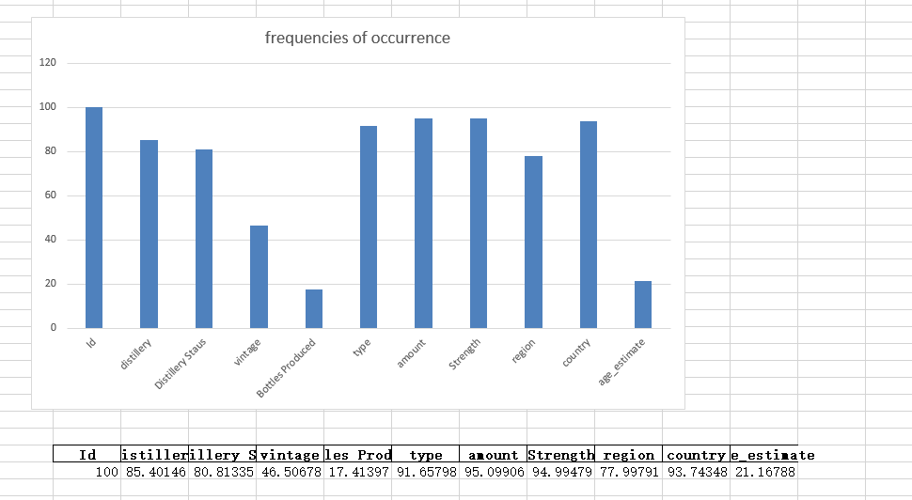
Notes:
I'm sorry I didn't report last week as I missed the change in time, but today I'll give a brief overview of the two weeks' work in one place.
Last week we mentioned the absence of some data modules, such as distillery and Distillery Staus. As distillery is the most important label for whisky sales, I have made an effort this week to explore the reasons for this, and I will give you an overview next.

Slide 2
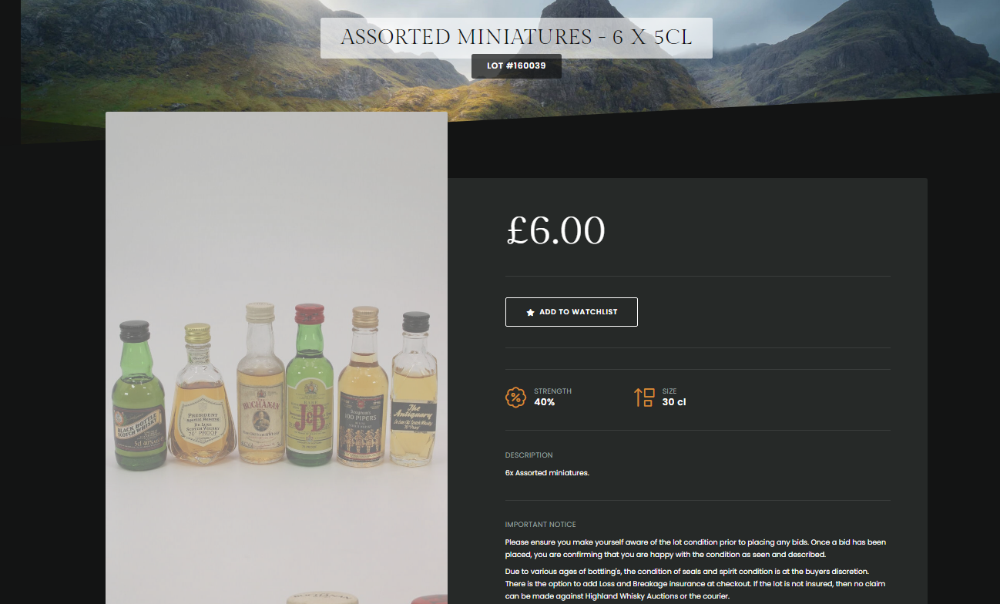
Why is there a lack of distillery data?
Notes:
For most of the data, the distillery, as a necessary data, tends not to be missing. However, in a small number of cases, there are multiple bottles of different types of whisky for mixed sales.
In this chart, for example, we can see that this mix of trial bottles includes six 5cl bottles, which may have come from different distillery and so resulted in the data not showing the relevant content.

Slide 3
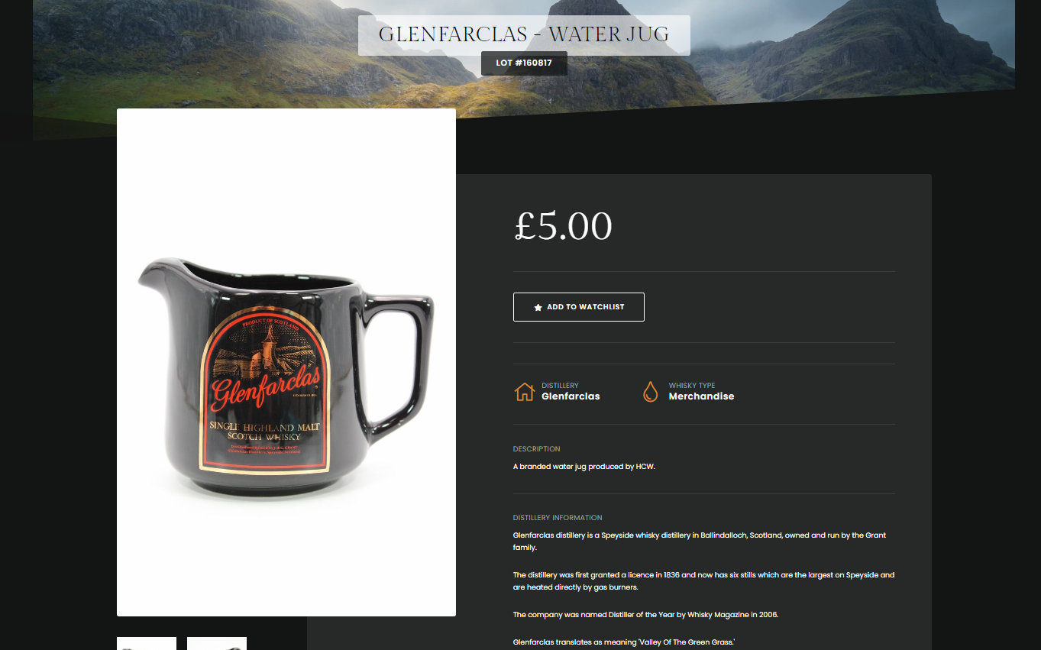
Why is there a lack of distillery data?
Notes:
On the other hand, some auction items are not whisky or related spirits; they belong to the category of accessories for spirits. These parts of the type are uniformly grouped under Merchandise. there are fewer relevant attributes for the items under this category and the basic situation is missing. My suggestion is to remove these data for the sake of the work, as they do not reflect the prices of the relevant spirits and, on the contrary, affect the accuracy of the forecasts.
Similarly, I saw a link posted by ronan in another group chat containing a correspondence between the distillery and distillery status, which is a good piece of data to link to in order to make corrections to the subsequent results.

Slide 4
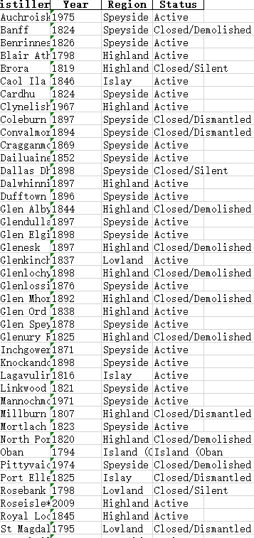
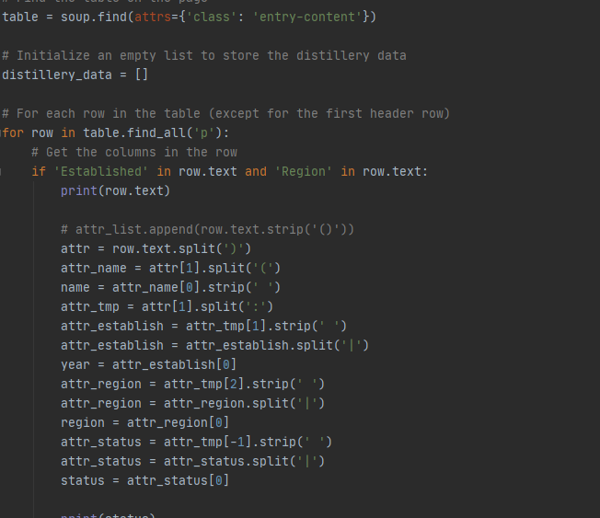
Notes:
So during the week, I processed the data from the links sent by ronan to get the status and region of the corresponding distillery.

Slide 5
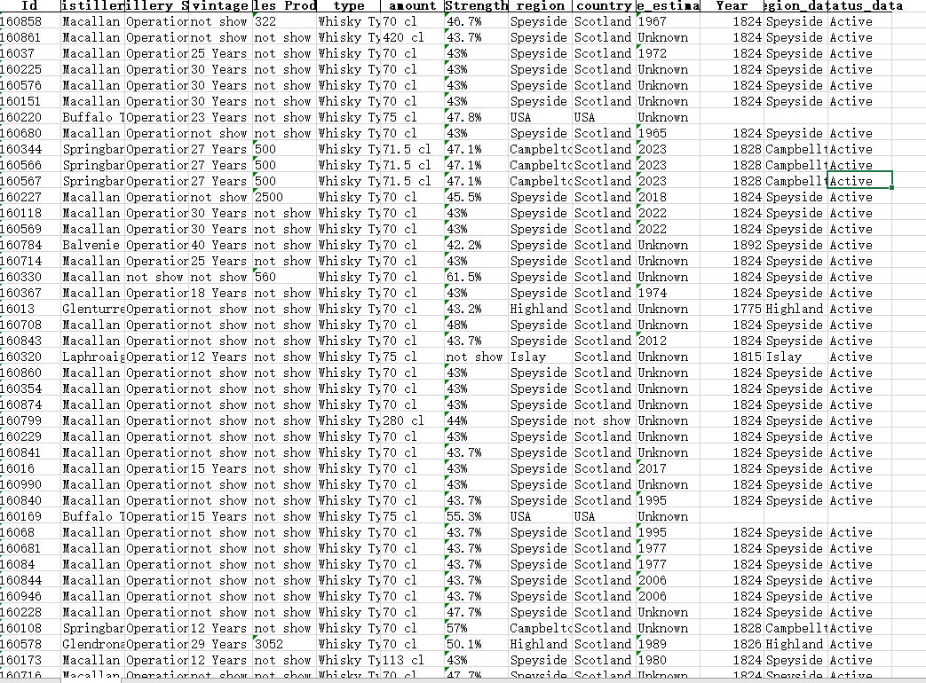
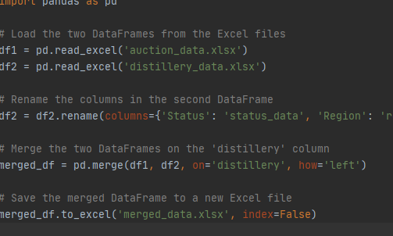
Notes:
At the same time, in order to be able to show the correspondence between the distillery and the corresponding data more visually, I have linked the two tables according to the distillery to obtain a new data table.
Here we can see that some data is missing for some non-Scottish producing whiskies. Also, as I have mentioned above, there may be some missing data due to non-whisky products.

Slide 6
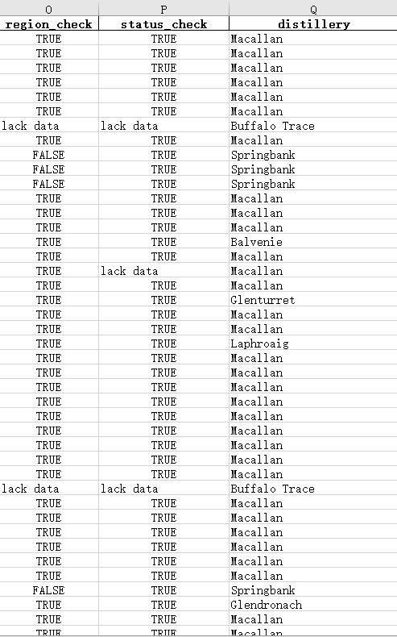
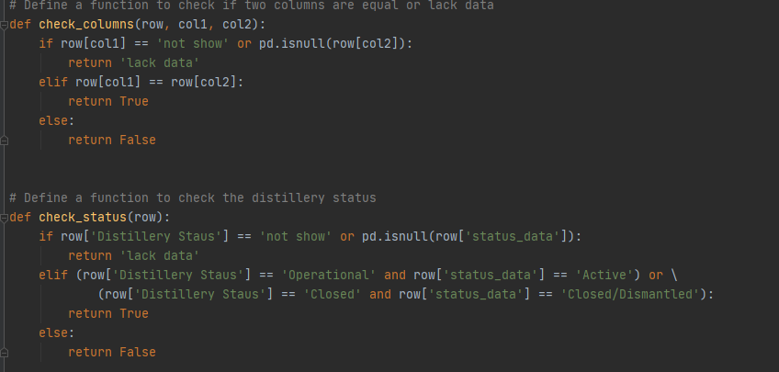
Notes:
So, for better comparison, I set a check attribute to show true when the two states are the same and false otherwise, and to show lack data in the case of missing data.
As we can see from the diagram, for most of the data there is an accurate correspondence, but it is easy to see that there are some discrepancies. The Macallan, for example, is clearly not normal and can be repaired by subsequent work.

Slide 7
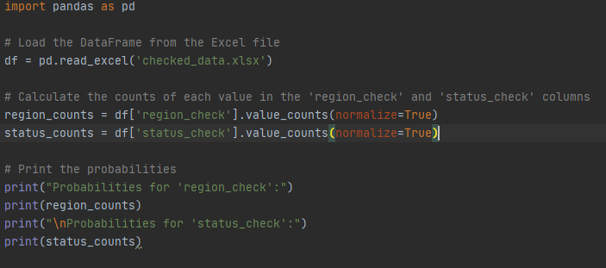
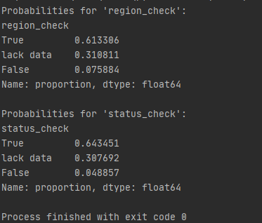
Notes:
In order to get a more visual sense of the differences in the data, I have tabulated the results and come up with the following conclusions.
In order to get a more visual sense of the differences in the data, I have tabulated the results and come up with the following conclusions.
We can see that the error rate is relatively low, kept within one percent, for which the data can be fixed or discarded. For the lacks data, the filtering rules need to be updated for further processing to ensure the integrity and reliability of the data.

Slide 8
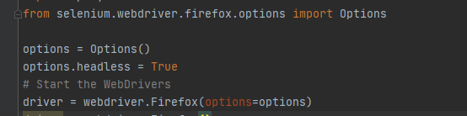
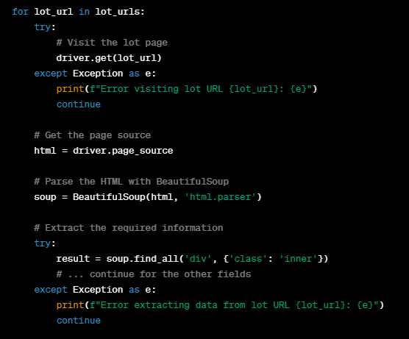
improvements
Notes:
In addition to the work and improvements I have made above,This is followed by the improvements I have made to the code this week and my plans for the rest of the week.
Using a headless browser: Since I don't need to visually see the browser, I can run Selenium in headless mode, which can speed up scraping considerably. This can be done by adding the following lines before initialising the webdriver:
Data validation: Before adding data to my list or DataFrame, validate the data to ensure it is in the expected format. This can help identify any problems in the data extraction. This is the work I will do subsequently.
Error handling: Again, I can add try/except blocks around code that may cause an exception, such as a network request or data extraction. This will make my script more robust and allow it to continue to run, even if one of the batches has an error.

