Slide 1
Computer Hardware and OS

Slide 2
Topics Covered
Computer Organization
Interrupts and OS
Dual Mode Execution

Slide 3
I. Computer Organization

Slide 4

Computer Organization
CPU controls everything
in the computer system

Slide 5
How To Control the CPU ?
We can tell the CPU through machine language
  CPU can understand and execute only instructions
An instruction is a command given to a processor
  Each instruction is a sequence of 0s and 1s
  Physical operations such as load, store, add, sub, mul, …
“Programming” means
  Constructing a sequence of instructions
  The result is called “program”

Slide 6
von Neumann Architecture
von Neumann machine has
  A CPU including registers, RAM (random access memory), …
von Neumann machine works by
  Fetching instructions from memory
  Executing them on registers
CPU
Memory
Registers
0001 load
0002 store
0003 add
…….
0997 mul
0998 sub
0999 load
Arithmetic
Logic Unit
I/O devices
Control
Unit
screen
disk
…

Slide 7
Programming
Programming using assembly language
  One-to-one correspondence with instructions
Assembly programming is difficult and tedious
  Use higher level languages
    C, C++, Java
  Compilation
    High-level language → Assembly code → Machine instructions
Load R1 1000
Load R2 1004
Add R3 R1 R2
Store 1008 R3
Reg[R1] ← Mem[1000]
Reg[R2] ← Mem[1004]
Reg[R3] ← Reg[R1] + Reg[R2]
Mem[1008] ← Reg[R3]

Slide 8
I/O Device Controller
Each I/O device has a controller (or interface)
CPU communicates with the I/O controller
  Control register: write commands
  Status register: read the device’s internal state
  Input register: fetch data
  Output register: write data
Control Registers
Status Registers
CPU
Device’s
I/O Controller
Input Registers
I/O instructions
in, out, ins, outs
Output Registers

Slide 9
II. Interrupts and OS

Slide 10
Interrupts
Interrupt
  Hardware mechanism that transfers control to interrupt service routine (ISR)
Types of interrupts
  Hardware interrupts
    Caused by hardware signal
    Asynchronous
  Software interrupts (a.k.a. Exceptions or Traps)
    Caused either by an error or instruction
    Synchronous

Slide 11
Interrupt Hardware
Interrupt sources
  I/O device controller has a pin that it asserts (send a signal) when it requires service
Interrupt destination
  Microprocessor has input pin often denoted by INTR that detects the signal sent by an I/O controller

Slide 12
Interrupt Hardware
This signal tells the microprocessor
that the serial port chip needs service
Serial
Port
CPU
Network
Interface
Interrupt request pins.
(IRQ)
This signal tells the microprocessor
that the network chip needs service

Slide 13
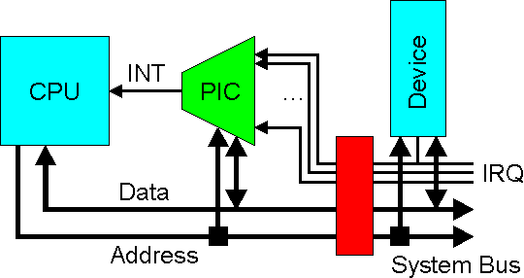
Interrupt Hardware
PIC (programmable interrupt controller)
  Functions as an overall manager in an interrupt-driven system environment
  Can support more I/O devices than the number of IRQ pins

Slide 14
Interrupt Handling
At the time of interrupt,
  Stops the execution of the current program
  Saves the address of the interrupted instruction
  Gets the address of ISR via interrupt request (IRQ) number
  and interrupt vector table
  Jumps to the ISR
While interrupt is being processed,
  Incoming interrupts are disabled to prevent a lost interrupt
After the execution of ISR,
  Returns to the interrupted program using the saved address

Slide 15
III. Dual Mode Execution

Slide 16
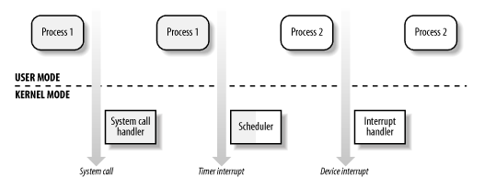
Dual Mode Execution
OS has a dual mode mechanism to protect the system from many types of application faults
  User mode: application code runs
    Using only non-privileged instructions and/or registers
  Kernel mode: kernel code runs
    Using privileged I/O instructions and/or registers

Slide 17
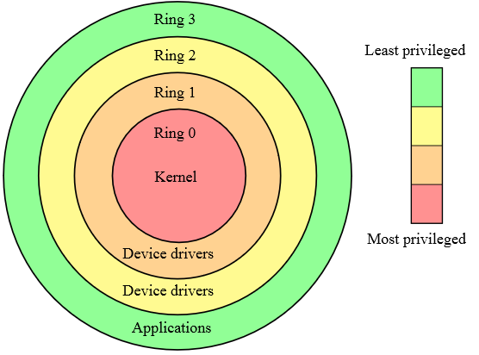
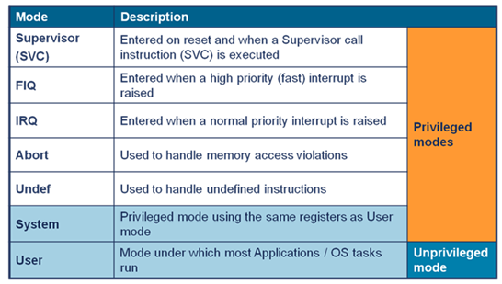
Processor Modes
Processors support different privilege modes
  Intel architectures have four privilege modes
  ARM architectures have eight privilege modes
Intel Protection Rings
ARM Processor Modes

Slide 18
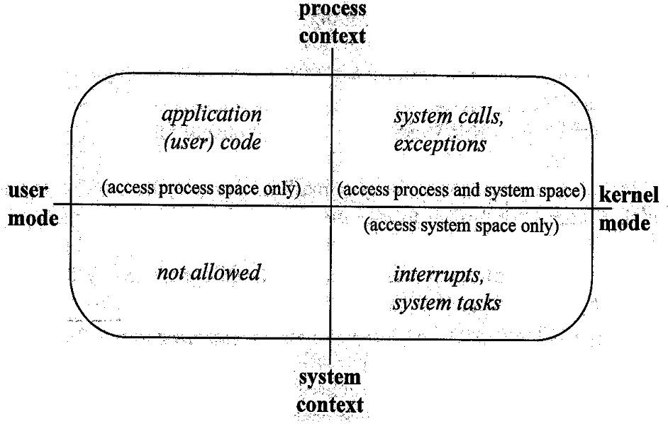
Execution Mode and Context

Slide 19
Memory Space
Memory is divided into two spaces
  User space
  Kernel space
CPU
Memory
pc
Registers
0001 LDR r0, [r1]
0002 SWI 0x1111
0003 0x10001010
0997 0x00101000
0998 ADD r0, r1, #4
0999 BIC r0, r1, r2
0x11001101
0x10001000
code
user
space
Arithmetic
Logic Unit
data
code
Control
Unit
kernel
space
data

Slide 20
Mode Switching via System Call
System calls are similar to function calls, but differ
  The implementations are in the kernel space
  They are executed in the kernel mode
  They use a special exception (such as SWI in ARM) to switch to kernel mode
CPU
Memory
0001 LDR r0, [r1]
0002 SWI 0x1111
0003 0x10001010
0997 0x00101000
0998 ADD r0, r1, #4
0999 BIC r0, r1, r2
0x11001101
0x10001000
Registers
pc
code
user
space
Arithmetic
Logic Unit
data
code
Control
Unit
kernel
space
data

Slide 21
Mode Switching via System Call
CPU
Memory
CPU
Memory
0001 LDR r0, [r1]
0002 SWI 0x1111
0003 0x10001010
0997 0x00101000
0998 ADD r0, r1, #4
0999 BIC r0, r1, r2
0x11001101
0x10001000
0001 LDR r0, [r1]
0002 SWI 0x1111
0003 0x10001010
0997 0x00101000
0998 ADD r0, r1, #4
0999 BIC r0, r1, r2
0x11001101
0x10001000
Registers
pc
Registers
Arithmetic
Logic Unit
Arithmetic
Logic Unit
pc
Control
Unit
Control
Unit
<before invocation>
<after invocation>

Slide 22
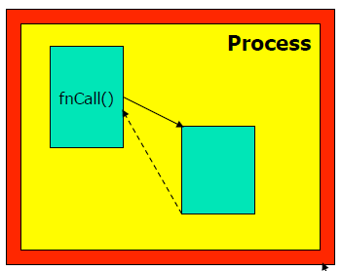
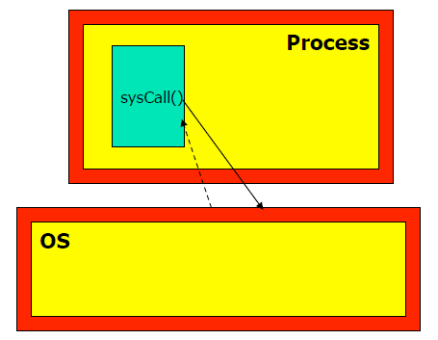
System Calls vs. Function Calls
Function Call
System Call
- Caller and callee are in
the same process
- User space, user mode
- Caller and callee are in
different spaces
- Kernel space, kernel mode

