Slide 1
CPU Scheduling

Slide 2
Topics Covered
Basic Concepts
Scheduling Criteria
Scheduling Algorithms

Slide 3
CPU Scheduler
Selects from among ready processes
  And allocates the CPU to one of them
Scheduling decisions may take place when a process:
  1. Switches from running to waiting state (e.g., I/O request)
  2. Switches from running to ready state (e.g., interrupt)
  3. Switches from waiting to ready (e.g., completion of I/O)
  4. Terminates
Scheduling only under 1 and 4 is nonpreemptive
Otherwise, it is preemptive

Slide 4
Scheduling Criteria
CPU utilization – keep the CPU as busy as possible
Throughput – # of processes that complete their execution per time unit
Turnaround time – amount of time to execute a particular process
  From the time of submission of a process to the time of completion
Waiting time – amount of time a process has been waiting in the ready queue
Response time – amount of time it takes from when a request was submitted until the first response is produced, not output (for time-sharing environment)

Slide 5
Optimization Criteria
Max CPU utilization
Max throughput
Min turnaround time
Min waiting time
Min response time

Slide 6
First-Come, First-Served (FCFS) Scheduling
Process Burst Time
P₁ 24
P₂ 3
P₃ 3
Suppose that the processes arrive in the order: P₁ , P₂ , P₃
The Gantt Chart for the schedule is:
Waiting time for P₁ = 0; P₂ = 24; P₃ = 27
Average waiting time: (0 + 24 + 27)/3 = 17
P₁
P₂
P₃
0
24
27
30

Slide 7
FCFS Scheduling (Cont.)
Suppose that the processes arrive in the order
P₂ , P₃ , P₁ .
The Gantt chart for the schedule is:
Waiting time for P₁ = 6; P₂ = 0; P₃ = 3
Average waiting time: (6 + 0 + 3)/3 = 3
Much better than previous case.
P₂
P₃
P₁
0
3
6
30

Slide 8
Shortest-Job-First (SJF) Scheduling
Associate with each process the length of its next CPU burst. Use these lengths to schedule the process with the shortest time
Two schemes:
  nonpreemptive – once CPU given to the process it cannot be preempted until completes its CPU burst
  preemptive – if a new process arrives with CPU burst length less than remaining time of current executing process, preempt. This scheme is know as the
  Shortest-Remaining-Time-First (SRTF)
SJF is optimal – gives minimum average waiting time for a given set of processes

Slide 9
Example of Non-Preemptive SJF
Process Arrival Time Burst Time
P₁ 0.0 7
P₂ 2.0 4
P₃ 4.0 1
P₄ 5.0 4
SJF (non-preemptive)
Average waiting time = (0 + 6 + 3 + 7)/4 = 4
P₁
P₃
P₂
P₄
0
3
7
8
12
16

Slide 10
Example of Preemptive SJF
Process Arrival Time Burst Time
P₁ 0.0 7
P₂ 2.0 4
P₃ 4.0 1
P₄ 5.0 4
SJF (preemptive)
Average waiting time = (9 + 1 + 0 +2)/4 = 3
P₁
P₂
P₃
P₂
P₄
P₁
0
2
4
5
7
11
16

Slide 11
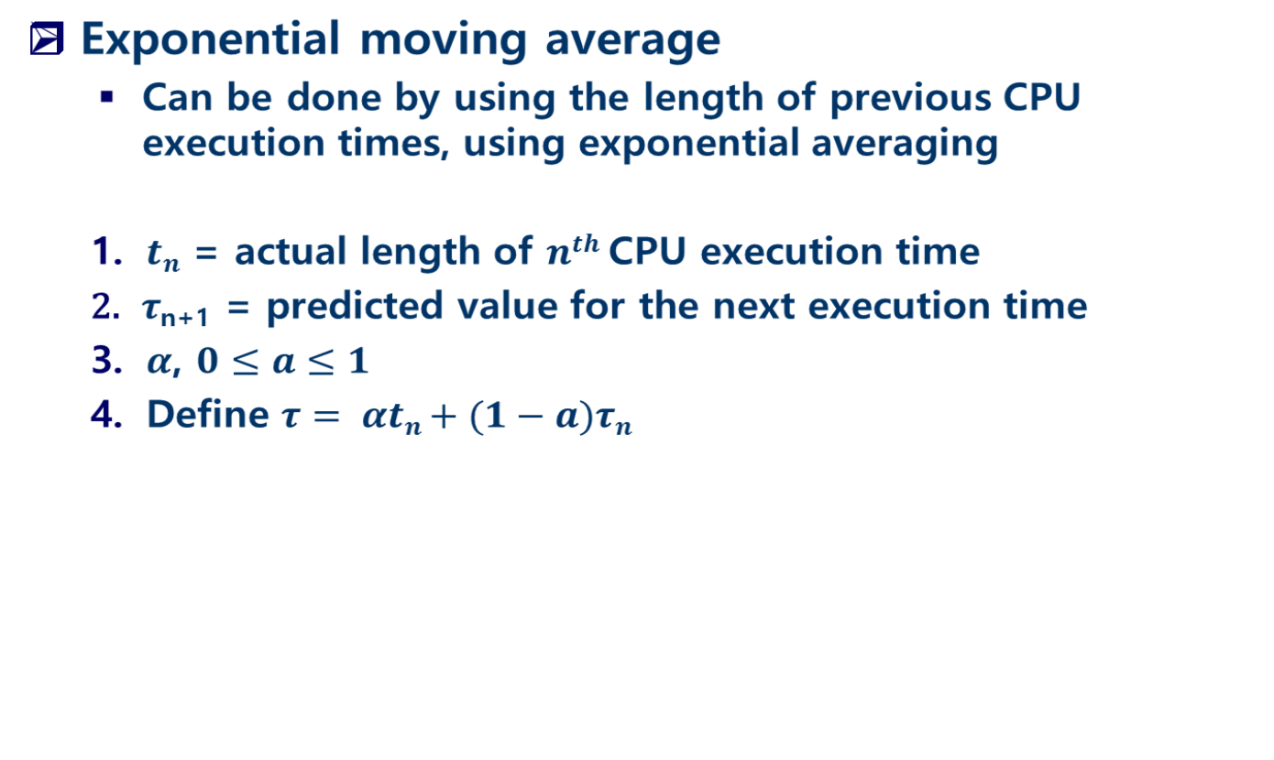
Prediction of Execution Times

Slide 12
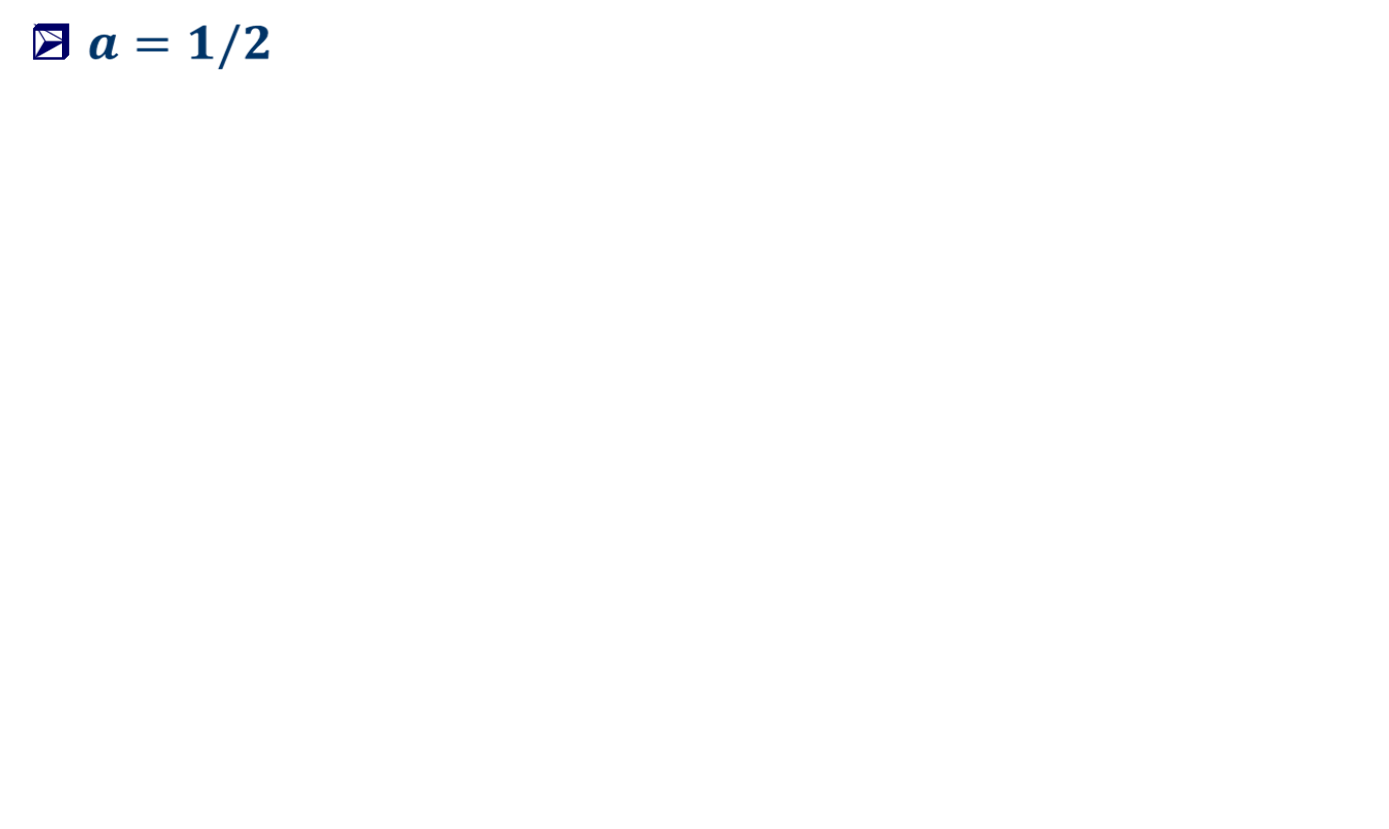


Prediction of Execution Times
12
10
8
6
4
2
CPU burst ( )
6 4 6 4 13 13 13 …
“guess” ( )
10 8 6 6 5 9 11 12 …

Slide 13
Priority Scheduling
A priority number (integer) is associated with each process
The CPU is allocated to the process with the highest priority (smallest integer ≡ highest priority)
  Preemptive
  Nonpreemptive
SJF is a priority scheduling where priority is the predicted next CPU burst time
Problem ≡ Starvation – low priority processes may never execute
Solution ≡ Aging – as time progresses increase the priority of the process

Slide 14
Round Robin (RR)
Each process gets a small unit of CPU time
  time quantum: usually 10-100 milliseconds
  After this time has elapsed, the process is preempted and added to the end of the ready queue
If there are n processes in the ready queue and the time quantum is q,
  then no process waits more than (n-1)q time units

Slide 15
Example of RR with Time Quantum = 20
Process Burst Time
P₁ 53
P₂ 17
P₃ 68
P₄ 24
The Gantt chart is:
Typically, higher average turnaround than SJF, but better response
P₁
P₂
P₃
P₄
P₁
P₃
P₄
P₁
P₃
P₃
0
20
37
57
77
97
117
121
134
154
162

Slide 16
Multilevel Queue
Ready queue is partitioned into separate queues:
  foreground (interactive) and background (batch)
Each queue has its own scheduling algorithm
  foreground (RR) and background (FCFS)
Scheduling must also be done among the queues.
  Fixed priority scheduling; (i.e., serve all from foreground then from background)
  Time slice – each queue gets a certain amount of CPU time which it can schedule amongst its processes;
    80% to foreground in RR
    20% to background in FCFS

Slide 17

Multilevel Queue Scheduling

Slide 18
Multilevel Feedback Queue
A process can move between the various queues
  If a process uses too much CPU time, it can be moved to a lower-priority queue
  Aging can be implemented this way.
Multilevel-feedback-queue scheduler defined by the following parameters:
  number of queues
  scheduling algorithms for each queue
  method used to determine when to upgrade a process
  method used to determine when to demote a process
  method used to determine which queue a process will enter when that process needs service

Slide 19
Example of Multilevel Feedback Queue
Three queues:
  Q₀ – time quantum 8 milliseconds
  Q₁ – time quantum 16 milliseconds
  Q₂ – FCFS
Scheduling
  A new job enters queue Q₀ which is served FCFS. When it gains CPU, job receives 8 milliseconds. If it does not finish in 8 milliseconds, job is moved to queue Q₁
  At Q₁ job is again served FCFS and receives 16 additional milliseconds. If it still does not complete, it is preempted and moved to queue Q₂

Slide 20

Multilevel Feedback Queues

