Slide 1
File Systems

Slide 2
Topics Covered
File Concept
Directory Structure
File System Structure
Allocation Methods

Slide 3
File Concept
The file system is the most visible aspect of an OS
File system consists of two parts; files and directory structures
  Files
    Store related information
  A directory structure
    Organize and provide information about files
File: logical storage unit
  Mapped to physical storage devices
  Usually nonvolatile
    The contents are persistent through power failures and system reboots
Files represent data and programs
  Data: numeric, character, binary
  Program: source and object forms

Slide 4
File Attributes
Name: symbolic file name, the only human-readable information
Identifier: unique tag (number)
Type: needed for systems that support different types.
Location: pointer to file location on device.
Size: current file size
Protection:
  Controls who can do reading, writing, executing.
Time, date, and user identification
  Useful for protection, security, and usage monitoring
  Creation, last modification, and last use
Information about files are kept in the directory structure, which is maintained on the disk

Slide 5
File Operations (1)
A file is an Abstract Data Type
OS provides system calls for common operations that can be performed on files
Minimal set of file operations
  Create, Write, Read
  Reposition within file, Delete, Truncate
  Copy = create + read

Slide 6
File Operations (2)
Most file operations involve searching the directory
Open system call
  To avoid the constant searching
  Open(F_{i}) – search the directory structure on disk for entry F_{i}, and move the content of entry to memory
  OS keeps the open-file table
Close system call
  Close (F_{i}) – move the content of entry F_{i} in memory to directory structure on disk

Slide 7
Unix File I/O (1)
int open (const char *pathname, int oflag, mode_t mode);
int close(int filedes);
off_t lseek(int filedes, off_t offset, int whence);
ssize_t read(int filedes, void* buf, size_t nbytes);
ssize_t write(int filedes, const void* buf, size_t nbytes);
o_flag
  O_RDONLY, O_WRONLY, O_RDWR, O_CREATE, …
mode_t
  S_IRWXU, S_IRUSR, S_IWUSR, S_IXUSR, S_IRWXG, S_IRWXO
whence
  SEEK_SET: from the beginning of the file
  SEEK_CUR: current value plus offset
  SEEK_END: the size of the file plus offset

Slide 8
Unix File I/O (2)
char buf1[ ] = “abcdefghij”;
char buf2[ ] = “ABCDEFGHIJ”;
int main(void)
{
int fd;
if ((fd = open(“file.hole”, O_RDONLY, S_IRWXU)) < 0)
return 0;
write(fd, buf1, 10); // offset now 10
lseek(fd, 40, SEEK_SET); // offset now 40
write(fd, buf2, 10); // offset now 50
}
Open( ) returns the file descriptor
Lseek( ) returns the new file offset
Read( ) and write( ) returns the number of bytes

Slide 9
Open and Close Operations
Multiuser systems use two file tables (e.g., UNIX)
Per-process table
  Process dependent information
  Current file pointer, access rights
System-wide table (open-file table)
  Process independent information
  File location on disk, access date, and file size
  Open count
    Increased by each open and decreased by each close

Slide 10
File Types
OS design consideration for file system
  Should OS recognize and support file types?
  e.g.)
    A user may attempt to execute a text file
    OS can prevent this attempt
Common technique for implementing file types
  Include the type as part of the file name
    Two parts: name + extension
  Extensions are just hints to applications
    .com, .exe, .bat
  Unix uses a magic number to indicate roughly the file type
    To identify the file as a valid executable file and gives further information about its format

Slide 11
File Types and File Structures
File types can be used to indicate the internal structure of the file
Disadvantages of having OS support multiple file structures
  The OS needs to contain the code to support each file type
  The implementation and resulting size of OS is cumbersome
Some OSs impose and support a minimal number of file structures (UNIX, MS-DOS)
  Each file is considered to be a sequence of 8-bit bytes
All OS must support at least one structure
  That of an executable file

Slide 12
Disk Allocation
Logical record unit
  UNIX defines all files to be simply a stream of bytes
  The logical unit of UNIX is 1 byte
Physical record unit
  All disk I/O is performed in units of 1 block
  Say, 512 bytes per block
A file of 1,949 bytes
  Would be allocated 4 blocks (2,048 bytes)
  The last 99 bytes would be wasted
    Internal fragmentation

Slide 13
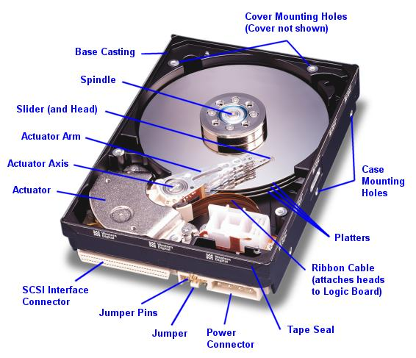

Slide 14
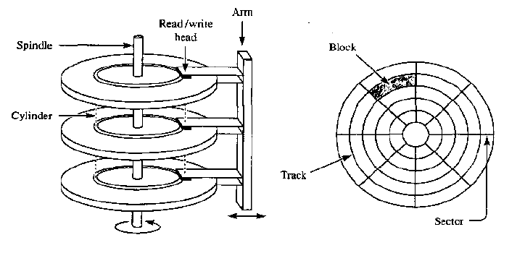

Slide 15

Access Methods – Sequential Access
Sequential access
  The simplest and most common method
  Information in the file is processed in order, one record after another
  Editors and compilers usually access files in this fashion
  A read or write automatically advances a file pointer

Slide 16
Views on Files (1/2)
User file name + byte offset | Kernel ino + logical block # | Device Driver physical block # | Device drive # cylinder # head # sector #
file
file
file system
drive
byte
block
. . .
physical
block
 |  |  | ….
 | … |  | …
fp
block #

Slide 17

Views on Files (1/2)
Mappings of file data between different layers
File
(User’s View)
read/write
Characters (1 B, 2 B)
File
(Kernel’s View)
···
File ID, Block #, Sector #
Blocks (512 B, 1 KB, 4 KB)
Data
Meta Data
Block Device
···
Sector (512 B)

Slide 18
Access Methods – Direct Access
Direct access
  Programs can read and write records rapidly in no particular order
  Based on the disk model which allow random access to any file block
  We have “read n” rather than “read next”
  Databases often use direct access
    When a query arrives, we compute which block contains the answer and read that block directly
  We might use a hash function for information about a large set

Slide 19

Simulation of Sequential Access
Some systems may allow only direct access

Slide 20
Directory Structure (1)
To manage millions of files
First, disks are split into one or more partitions
  Minidisks in the IBM World
  Volumes in the PC and Macintosh arena
  One disk may provide several separate partitions
  Several disks may provide one partition
  Partitions (virtual disk) can store multiple OSs and allow a system to boot
Second, each partition contains information about files within it
  Device directory or volume table of contents
  Directory records name, location, size, and type
  Directory can be viewed as a symbol table

Slide 21

Directory Structure (2)

Slide 22

Single-Level Directory
All files are contained in the same directory
  All files must have unique names
  Keeping tracking of many files is a daunting task

Slide 23

Two-Level Directory
Create a separate directory for each user
  MFD (master file directory)
  UFD (user file directory)

Slide 24
Tree-Structured Directories
Generalization of a two-level directory
  A directory contains a set of files or subdirectories
A directory is simply another file, but is treated specially
  One bit in each directory entry defines the entry
    As a file (0) or as a directory (1)
  Special system calls are used to create and delete directories
Path name
  Absolute path name: root/spell/mail
  Relative path name: prt/first = root/spell/mail/prt/first

Slide 25

Tree-Structured Directories

Slide 26
Acyclic-Graph Directories (1)
A tree structure prohibits the sharing of files and directories
An acyclic graph allows the sharing of directories and files
  Not working on two copies of the file
  Only one actual file exists, so any changes made by one person are immediately visible to another
Common way to implement acyclic directory
  Create a new directory entry called a link
  Link is effectively a pointer to another directory or file

Slide 27

Acyclic-Graph Directories (2)

Slide 28
Acyclic-Graph Directories (3)
Two different names (aliasing)
  The problem becomes significant when we do not want to traverse shared structures more than once
Deletion problem (dangling pointer)
  Dangling pointers to non-existent file or other files
Solutions to deletion problem
  Leave the link dangling
    When an attempt is made to use the link, the access is treated just like any other illegal file name
  Preserve the file until all references to it are deleted
    We should keep a list of all references to a file
    Variable and potentially large size of the file-reference list
    However, we really need to keep only a count of the number of references (UNIX hard link for nonsymbolic links, inode)

Slide 29
Soft Link and Hard Link
Soft link: $ ln –s original.txt new.txt
  Soft links work by redirecting to a file using “name”, so if you rename the original file the soft link will stop pointing to it
  If you create a new file with the original file name, the soft link will then point to that file
  Soft links can go between file systems
Hard link: $ ln exist.txt new.txt
  Renaming has no effect on hard links, because they refer to the inode
  Deleting the original file does not really delete it
  Hard links can't can go between file systems

Slide 30
General Graph Directory
The primary advantage of an acyclic graph is the relative simplicity of the algorithms to traverse the graph
  We want to avoid searching subdirectories again mainly for performance reasons
The general graph allows cycles to exist
  A poorly designed algorithm might result in an infinite loop
  One simple solution is bypass the links during directory traversal

Slide 31

General Graph Directory

Slide 32
File System Mounting
Just as a file must be opened before it is used
A file system must be mounted before it can be accessed
  To get files located on a separate disk or partition,
  one needs to mount that file system
  mount [-t filesystemtype] [-o options] devicename mountpoint
  mount –t iso9660 /dev/hdc /mnt
A unmounted file system (I.e. Fig. 11-11(b)) is mounted at a mount point.

Slide 33
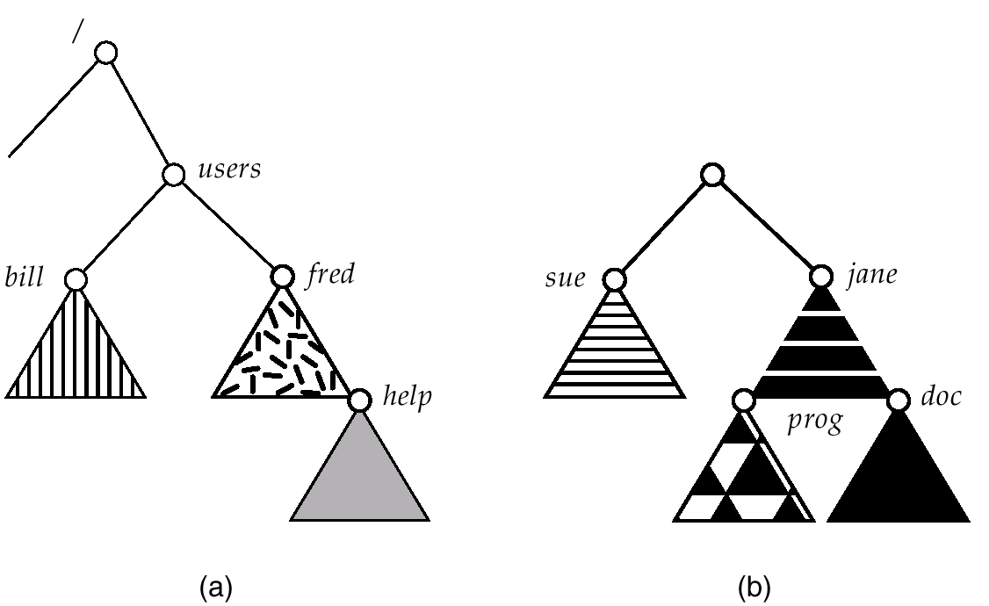
(a) Existing. (b) Unmounted Partition

Slide 34
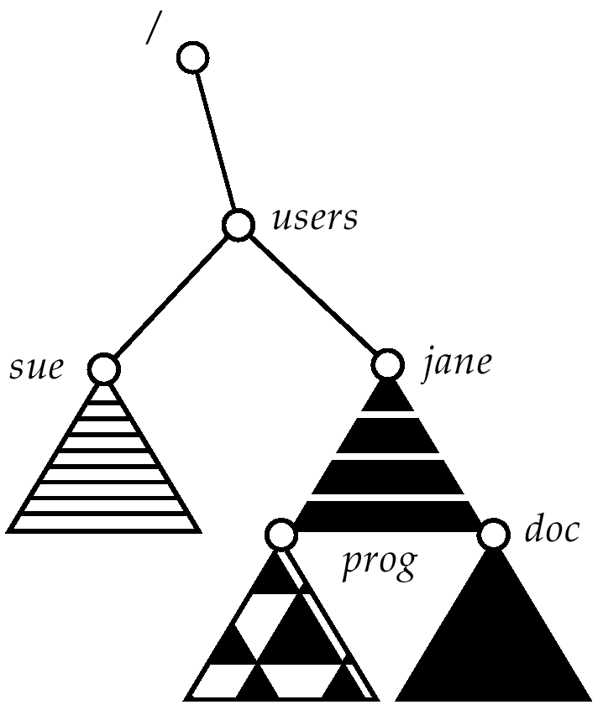
Mount Point

Slide 35
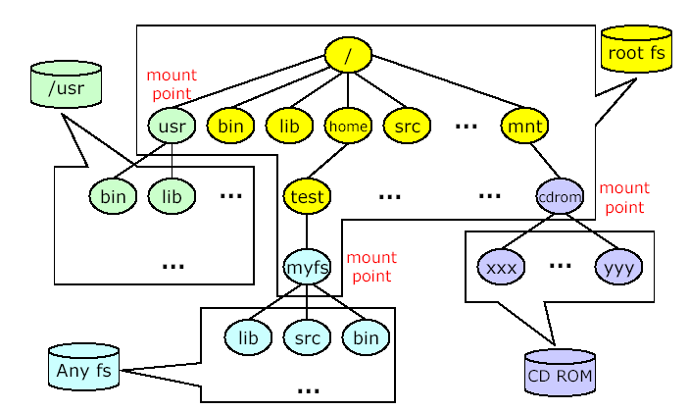
File System Mount

Slide 36
File Sharing
Sharing of files on multi-user systems is desirable.
Sharing may be done through a protection scheme.
On distributed systems, files may be shared across a network.
Network File System (NFS) is a common distributed file-sharing method.

Slide 37
Protection
File owner/creator should be able to control:
  what can be done
  by whom
Types of access
  Read
  Write
  Execute
  Append
  Delete
  List

Slide 38
Outline
File Concept
Directory Structure
File System Structure
Allocation Methods

Slide 39

File-System Structure (1)
File system is composed of many different levels
Directory, File control blocks,
Protection, Security
Logical block -> physical block
Free-space manager
Read/write physical blocks
Device driver, Interrupt Handler

Slide 40
File-System Structure (2)
Device drivers
  Transfer information between the main memory and the disk
  For efficiency, I/O transfers are performed in units of blocks
    Each block is one or more sectors
    Sectors vary from 32 bytes to 4,096 bytes, usually they are 512 bytes
Basic file system
  Issue generic commands to the device driver
  Each physical block is identified by its numeric disk address
    Drive 1, cylinder 73, head 2, sector 10
  Two types of addressing
    CHS (cylinder-head-sector) addressing
    LBA (logical block addressing)
      LBA 0, LBA 1, …

Slide 41
File-System Structure (3)
File organization module
  Translate logical block addresses to physical block addresses
  Logical blocks are numbered from 0 through N
  Free space manager tracks unallocated blocks and provides these blocks to the file organization module when requested
Logical file system
  Manages metadata information
    Metadata includes all information about the files excluding the actual data
  Manages directory structure via FCB (file control block)

Slide 42
Linux File System
File I/O
File I/O
User Space
Kernel Space
Virtual File System (VFS) Layer
Individual Filesystems (EXT3, EXT4, JFFS2, Reiserfs, VFAT, …)
Buffer Cache (Page Cache)
I/O Schedulers
Request Queue
Request Queue
Block Driver
Block Driver (FTL)
Kernel Space
Storage Media
Disk
Flash
Flash
···

Slide 43

A Typical File Control Block

Slide 44
File System Implementation:
On-Disk Structures
Boot control block
  Contains information needed by the system to boot
  The first block of a partition
  Boot block (UFS), partition boot sector (NTFS)
Partition control block
  Number of blocks in the partition, size of blocks, free-block count and free block pointers, free FCB count and FCB pointers
  Superblock (UFS), Master File Table (NTFS)
Directory structure
FCB
  File permissions, ownership, size, size, and location of the data blocks
  Inode (UFS), stored in the Master File Table (NTFS)

Slide 45
File System Implementation:
In-Memory Structures
Partition table
  Information about each mounted partition
Directory structure
System-wide open-file table
  Copy of the FCB of each open file
Per-process open-file table
  Pointer to the appropriate entry in the system-wide open-file table

Slide 46

In-Memory File System Structures

Slide 47
Allocation Methods
An allocation method refers to how disk blocks are allocated for files:
  Main problems are how to utilize disk space effectively and how to access files quickly
Three major methods
  Contiguous allocation
  Linked allocation
  Indexed allocation

Slide 48
Contiguous Allocation
Each file occupies a set of contiguous blocks on the disk
Advantages
  Seek time is short
    Disk addresses define a linear ordering on the disk
    Block b+1 is accessed after block b is accessed
    Head movement is needed only for each track change
  Simple
    Only starting location (block #) and length (number of blocks) are required
  Sequential and random access
Disadvantages
  Finding space for a new file is difficult (external fragmentation)
    Compaction can be done with significant time overhead
  Files cannot grow

Slide 49

Contiguous Allocation of Disk Space

Slide 50
Linked Allocation
Linked allocation solves all problems of contiguous allocation
Each file is a linked list of disk blocks: blocks may be scattered anywhere on the disk
The directory contains a pointer to the first and last blocks of the file
block =
pointer

Slide 51

Linked Allocation

Slide 52
Linked Allocation
Free blocks are initialized to nil to signify an empty file (size field is also set to zero)
To create a file
  Simply create a new entry in the directory with appropriately setting the pointer and size
To write to a file
  Find a free block, write to it, and link it to the list

Slide 53
Linked Allocation
Advantages
  No external fragmentation
  The size of a file does not need to be declared
    A file can continue grow as long as free blocks are available
Disadvantages
  Sequential access only
    To find the ith block, we must start at the beginning of the file, and follow the pointers until we get to the ith block
  Space is needed for pointers
    4 bytes out of a 512-byte block (0.78%)
  Low reliability
    Pointers can be lost or damaged
    An OS bug or HW failure can result in picking up the wrong pointer

Slide 54
File Allocation Table
An important variation of Liked allocation
  Late 1970 and early 1980
  Used by MS-DOS and OS/2
FAT
  A section of disk at the beginning of each partition is set aside to contain the table
  The table has one entry for each disk block, and indexed by block number
  Directory entry contains the block number of the first block number of the the file
Random access time is improved by reading the information on the FAT

Slide 55

File-Allocation Table

Slide 56
Indexed Allocation
Brings all pointers together into the index block
Each file has its own index block
  The ith entry in the index block points to the ith block of the file
  The directory contains the address of the index block
When a file is created
  All pointers in the index block is set to nil
  When ith block is first written, a free block is obtained and its address is put in the ith index-block entry
Wasted space is large
  An entire block must be allocated even if only one or two pointers will be non-nil

Slide 57

Example of Indexed Allocation

Slide 58
Indexed Allocation
How large the index block should be?
If the index block is too small, a mechanism will have to be available to deal with large files
  Linked scheme
    Link several index blocks
    Small header giving the file name
    Set of the first disk-block addresses
    Last address is nil (for a small file) or is pointer to another index block
  Multilevel index
    A variant of linked scheme
    A first level index block to point to a set of second-level index blocks
  Combined scheme (UFS)
    15 pointers of the index block
    The first 12 pointers to direct blocks (data of the file)
    The next 3 pointers to indirect blocks
      Single indirect block: an index block
      Double indirect block and triple indirect block

Slide 59

Combined Scheme:
UNIX (4K bytes per block)

Slide 60
Disk Drive, Partitions, and a File System
disk drive
partition
partition
partition
B
S
inode list
data blocks
boot block
super block
inode
inode
………
inode
Boot block: code required to bootstrap(load and initialize) the OS (it may be empty)
Super block: attributes and metadata of the file system itself
Inode list: linear array of inodes
  Inode list size is configured while creating the file system
  Limits the maximum number of files the partition can contain

Slide 61
Disk Drive, Partitions, and a File System
inode list
data
block
data
block
directory
block
data
block
……
inode
0
inode
1
…
inode
2549
2549
testdir
1
apple
Directory is a special file containing files and subdirectories
  Contains fixed size of 16 bytes each
  2 bytes contains inode, 14 bytes contains the file name

Slide 62
Free-Space Management
To keep track of free disk space, the system maintains a free space list
The free space list records all free disk blocks
Implementation techniques of free space list
  Bit vector
  Linked list
  Grouping
  Counting

Slide 63
Free-Space Management
Bit vector (n blocks)
Simple and efficient
Inefficient if entire vector is not kept in main memory
  Keeping it in memory is possible for small disks
  1.3 GB disk with 512 byte blocks -> 332 KB
0
1
2
n-1
…
0 ⇒ block[i] free
1 ⇒ block[i] occupied
bit[i] =


Slide 64
Free-Space Management (Cont.)
Bit map requires extra space. Example:
block size = 2¹² bytes
disk size = 2³⁰ bytes (1 gigabyte)
n = 2³⁰/2¹² = 2¹⁸ bits (or 32K bytes)
Easy to get contiguous files

Slide 65
Free-Space Management
Linked list (free list)
  Link all the free disk blocks keeping a pointer to the first block in a special location on the disk and caching it in memory
Cannot get contiguous space easily
To traverse the list, we must read each block
Fortunately, traversing is not a frequent action
  Usually, OS simply needs a free block, so the first block is in the free list is used

Slide 66

Linked Free Space List on Disk

Slide 67
Free-Space Management
Grouping (a modification of the free-list)
  Store the addresses of n blocks in the first free block
  The first n-1 of these blocks are actually free
  The last block contains the addresses of another n free blocks
  Large number of free blocks can be found quickly
Counting
  Take advantage of contiguous allocation
  Keep the address of the first free block and the number of n of free blocks that follow the first block

Slide 68
Page Cache and Buffer Cache
Some systems maintain a separate section of main memory for a disk cache
  buffer cache or block cache
  Routine I/O through the file system uses the buffer (disk) cache
Some systems maintain a page cache
  To cache pages rather than disk blocks using virtual memory techniques
  Virtual memory techniques and memory-mapped I/O uses a page cache

Slide 69
I/O Without a Unified Buffer Cache
The virtual memory system cannot interface with the buffer cache
The contents of the file in the buffer cache must be copied into the page table
Double caching problem
  Caching file system data twice

Slide 70
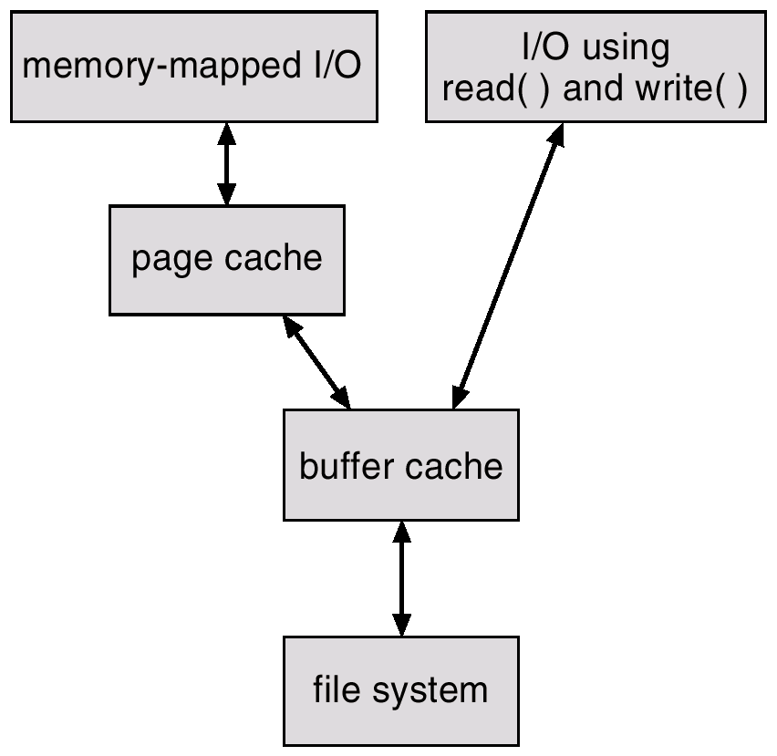
I/O Without a Unified Buffer Cache

Slide 71
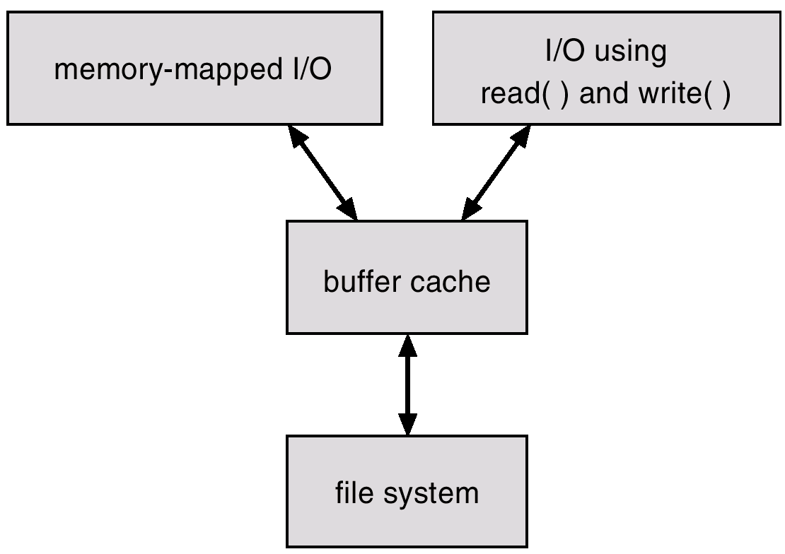
Unified Buffer Cache
A unified buffer cache uses the same buffer cache to cache both memory-mapped pages and ordinary file system I/O

Slide 72
Journaling File System (1/4)
Updating file systems to reflect changes to files and directories usually requires many separate write operations
This makes it possible for an interruption (like a power failure or system crash) between writes to leave data structures in an invalid intermediate state

Slide 73
Journaling File System (2/4)
For example, deleting a file on a Unix file system involves three steps
  Step 1. Removing its directory entry
  Step 2. Releasing the inode to the pool of free inodes
  Step 3. Returning all used disk blocks to the pool of free disk blocks
If a crash occurs after step 1 and before step 2, there will be an orphaned inode and hence a storage leak
  On the other hand, if only step 2 is performed first before the crash, the not-yet-deleted file will be marked free and possibly be overwritten by something else

Slide 74
Journaling File System (3/4)
Detecting and recovering from such inconsistencies normally requires a complete walk of its data structures, for example by a tool such as fsck (the file system checker)
  This must typically be done before the file system is next mounted for read-write access
  If the file system is large and if there is relatively little I/O bandwidth, this can take a long time and result in longer downtimes

Slide 75
Journaling File System (4/4)
To prevent this, a journaling file system allocates a special area—the journal—in which it records the changes it will make ahead of time
  Journal is an on-disk structure (file) containing a log (meta data changes)
After a crash, recovery simply involves reading the journal and replaying changes from this journal until the file system is consistent again
  The changes are thus said to be atomic (not divisible) in that they either succeed (succeeded originally or are replayed completely during recovery), or are not replayed at all (are skipped because they had not yet been completely written to the journal before the crash occurred)

Slide 76



