Slide 1
Secondary Storage Structure

Slide 2
Disk Structure (1)
Disk drives are addressed as large 1-dimensional arrays of logical blocks, where the logical block is the smallest unit of transfer.
The 1-dimensional array of logical blocks is mapped into the sectors of the disk sequentially.
  Sector 0 is the first sector of the first track on the outermost cylinder.
  Mapping proceeds in order through that track, then the rest of the tracks in that cylinder, and then through the rest of the cylinders from outermost to innermost.

Slide 3
Disk Structure (2)
Difficulties for mapping logical arrays onto the sectors of the disk
  Most disks have some defective sectors
    The mapping should hide them by substituting spare sectors from elsewhere on the disk
  The number of sectors per track is not a constant on some drives
    On media that use CLV (constant linear velocity), the density of bits per track is uniform
    The farther a track is from the center of the disk, the greater its length
    Tracks in the outermost zone typically hold 40 percent more sectors than do tracks in the innermost zone
    The drive increases its rotation speed as the head moves from the outer to the innermost tracks to keep the same data rate
    CD-ROM and DVD-ROM uses this method
    The alternative method is CAV (constant angular velocity)
      The disk rotation speed is constant

Slide 4
Disk Scheduling
The operating system is responsible for using hardware efficiently — for the disk drives, this means having a fast access time and disk bandwidth.
Access time has two major components
  Seek time is the time for the disk are to move the heads to the cylinder containing the desired sector.
  Rotational latency is the additional time waiting for the disk to rotate the desired sector to the disk head.
Minimize seek time
Seek time ≈ seek distance
Disk bandwidth is the total number of bytes transferred, divided by the total time between the first request for service and the completion of the last transfer.

Slide 5
I/O Request Scheduling
In time-sharing systems, it may sometimes be the case that there are several disk I/O requests at the same time
  Gives rise to block I/O scheduling
Structure of the block I/O scheduler
Block I/O
Request Producer
Block Layer
Elevator Layer
I/O Scheduler
Device Driver
(FTL)
Request Queue
Block Device
(Flash Memory)

Slide 6
I/O Request Scheduling
Ordering of requests in the queue affects file system performance
  When sector read requests arrive at “1, 5, 2, 4, 3” order
  When the requests are reordered as “1, 2, 3, 4, 5”
①
1
2
3
⑤
4
5
③
②
④
Total 10 seeks
①
1
②
2
③
3
④
4
⑤
5
Total 4 seeks

Slide 7
Disk Scheduling
Several algorithms exist to schedule the servicing of disk I/O requests.
We illustrate them with a request queue (0-199)
  Cylinder numbers below
98, 183, 37, 122, 14, 124, 65, 67
Head pointer 53

Slide 8

FCFS
Illustration shows total head movement of 640 cylinders.

Slide 9
SSTF
Shortest Seek Time First
Selects the request with the minimum seek time from the current head position.
SSTF scheduling is a form of SJF scheduling; may cause starvation of some requests.
Illustration shows total head movement of 236 cylinders.

Slide 10

SSTF (Cont.)

Slide 11
SCAN
The disk arm starts at one end of the disk, and moves toward the other end, servicing requests until it gets to the other end of the disk, where the head movement is reversed and servicing continues.
Sometimes called the elevator algorithm.
Illustration shows total head movement of 208 cylinders.

Slide 12
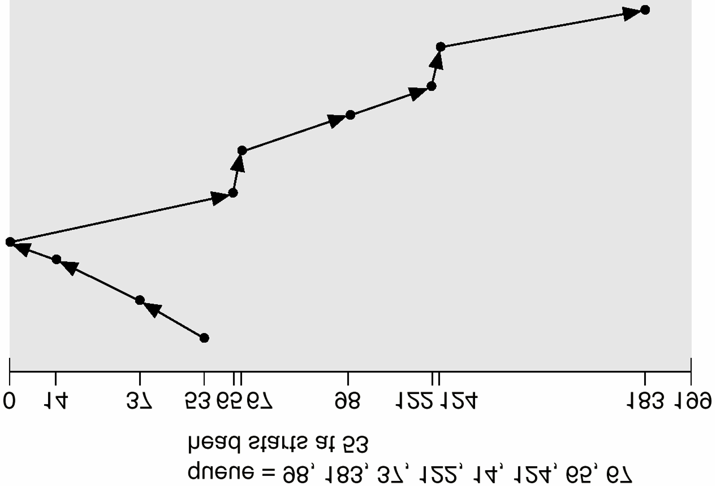
SCAN (Cont.)

Slide 13
C-SCAN
Circular SCAN
Provides a more uniform wait time than SCAN.
The head moves from one end of the disk to the other servicing requests as it goes. When it reaches the other end, however, it immediately returns to the beginning of the disk, without servicing any requests on the return trip.
Treats the cylinders as a circular list that wraps around from the last cylinder to the first one.

Slide 14

C-SCAN (Cont.)

Slide 15
C-LOOK
Version of C-SCAN
Arm only goes as far as the last request in each direction, then reverses direction immediately, without first going all the way to the end of the disk.

Slide 16

C-LOOK (Cont.)

Slide 17
Selecting a Disk-Scheduling Algorithm
SSTF is common and has a natural appeal
SCAN and C-SCAN perform better for systems that place a heavy load on the disk
  Because they are less likely to have a starvation problem
Performance depends on the number and types of requests
Requests for disk service can be influenced by the file-allocation method
The disk-scheduling algorithm should be written as a separate module of the operating system, allowing it to be replaced with a different algorithm if necessary
Either SSTF or LOOK is a reasonable choice for the default algorithm

Slide 18
Disk Management
Low-level formatting, or physical formatting — Dividing a disk into sectors that the disk controller can read and write.
To use a disk to hold files, the operating system still needs to record its own data structures on the disk.
  Partition the disk into one or more groups of cylinders.
  Logical formatting or “making a file system”.

Slide 19

MS-DOS Disk Layout

Slide 20
Boot Block
For most computers, the bootstrap is stored in ROM
  The initial bootstrap initializes all aspects of the system, from CPU registers to device controllers, and the contents of main memory
  Find the OS kernel on disk, loads that kernel into memory, and jumps to an initial address to begin the OS execution
  The problem is that changing the bootstrap code requires changing the ROM hardware chips
A tiny bootstrap loader program in the boot ROM
  It brings in a full bootstrap program from disk
  The full bootstrap program is stored in a partition called the boot block, at a fixed location on the disk
  It is more sophisticated, and able to load the entire OS from a non-fixed location on disk and start the OS running
  Even so, it may be small (MS-DOS uses one 512-byte block)

Slide 21
Bad Blocks (1)
Disks have moving parts and small tolerances
  The disk head flies just above the disk surface
  They are prone to failure (bad blocks)
Disks with IDE handle bad blocks manually
  MS-DOS format command does a logical format scanning the disk to find bad blocks
    If format finds a bad block, it writes a special value into the corresponding FAT entry
  If blocks go bad during normal operation, a special program (chkdsk) must be run manually to search for the bad blocks

Slide 22
Bad Blocks (2)
SCSI disks
  In high end PCs, and most workstations and servers
  The controller maintains a list of bad blocks on the disk
  The list is initialized during the low-level format at the factory, and is updated over the life of the disk
  Low-level formatting also sets aside spare sectors not visible to the OS
  The controller can be told to replace each bad sector logically with one of the spare sectors (sector sparing or forwarding)
  The redirection by the controller could invalidate any optimization by the OS’s disk-scheduling algorithm
  Most disks are formatted to provide a few spare sectors in each cylinder

Slide 23
Swap-Space Management
Swap-space — Virtual memory uses disk space as an extension of main memory.
Swap-space can be carved out of the normal file system, or, more commonly, it can be in a separate disk partition.
Swap-space management
  4.3BSD allocates swap space when process starts; holds text segment (the program) and data segment.
  Kernel uses swap maps to track swap-space use.
  Solaris 2 allocates swap space only when a page is forced out of physical memory, not when the virtual memory page is first created.

Slide 24
Swap-Space Use
Two types of swap-space use
  To hold entire process image
    Including the code and data segment
  To simply store pages that have been pushed out of main memory
The amount of swap space vary depending on the amount of physical memory
  Underestimating swap space may lead to aborting processes or crash
  Overestimation wastes disk space that otherwise used for files, but does no other harm
  Set aside 2x to 4x RAM in swap space

Slide 25
Swap-Space Location
Two places are possible
  Carved out of the normal file system
    Simply a large file within the file system
    Normal file-system routines can be used to implement
    Navigating the directory structure and the disk-allocation data structures takes time and extra disk accesses
  Created in a separate disk partition
    No file system or directory structure is placed on this space
    A separate swap-space storage manager is used to allocate and deallocate the blocks
    The manager uses algorithms optimized for speed, rather than for storage efficiency

Slide 26
RAID Structure
Redundant Arrays of Inexpensive Disks
  Having a large number of disks presents opportunities for improving the rate at which data can be read or written
    If the disks are operated in parallel
  This setup offers the potential for improving the reliability of data storage
    Redundant information can be stored on multiple disks
    Failure of one disk does not lead to loss of data
Now RAIDs are used for their high reliability and higher data-transfer rate, rather than economic reasons
  The I in RAID stand for “Independent”, instead of “Inexpensive”

Slide 27
RAID for Reliability Improvement
Mirroring (or Shadowing)
  The simplest approach
  Duplicate every disk
  A logical disk consists of two physical disks, and every write is carried out on both disks
Metrics for measuring reliability
  MTTF (mean time to failure)
  MTTR (mean time to repair)

Slide 28
RAID for Performance Improvement
Parallel access to multiple disks
  Increases the data-transfer rate
Data striping
  Bit-level striping
    Split the bits of each byte across multiple disks
    If we have an array of eight disks, we write bit j of each byte to disk j
    Eight times the access rate
  Block-level striping
    Blocks of a file are striped across multiple disks
    With n blocks, block j of a file goes to disk (j mod n) + 1
  Other levels of striping is possible
    Bytes of a sector, sectors of a block

Slide 29
RAID Levels (1)
Mirroring provides high reliability, but it is expensive
Striping provides high data-transfer rates, but it does not improve reliability
Numerous schemes have been proposed to provide redundancy at lower cost by using the idea of disk striping combined with parity bits
These schemes have different cost-performance trade-offs and are classified into levels called RAID levels
  In Figure 14.9, four disks’ worth of data is stored

Slide 30

RAID Levels (2)
Block-level striping
Mirroring
Error-correcting code
Bit-interleaved parity
Block-interleaved parity
Block-interleaved distributed parity
P + Q redundancy

Slide 31
RAID Levels (3)
Level 2: ECC (error-correcting code) organization
  Error detection and correction using Hamming code ECC
  Requires three disks’ overhead
    To store parity-addition results of three combinations
Level 3: bit-interleaved parity organization
  Disk controllers can detect whether a sector has been read correctly
  Single parity bit is used, requiring only one parity disk
  N-way striping is N time faster
  Many RAID storage arrays include a hardware controller with dedicated parity hardware to reduce performance overhead
  The array has non-volatile RAM (NVRAM) cache
    To store blocks while the parity is computed and to buffer the writes from the controller to the spindles

Slide 32
RAID Levels (3)
Level 4: block-interleaved parity organization
  Block-level striping with a parity block on a separate disk
  Data transfer rate for each access is slow
  But multiple read accesses can proceed in parallel
Level 5: block-interleaved distributed parity
  Spread data and parity among all N+1 disks
  For each block, one of the disks stores the parity, and the others store data
    The parity of the nth block is stored in disk (n mod 5) + 1
Level 6: P+Q redundancy scheme
  Much like level 5
  Store extra redundant information to guard against multiple disk failures
  Instead of using parity, error-correcting codes such as the Reed-Solomon codes are used

Slide 33
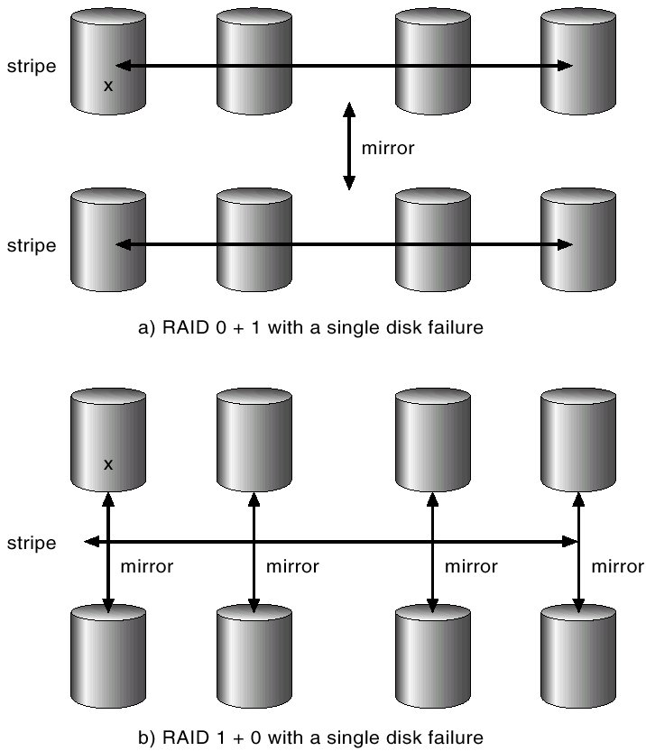
RAID (0 + 1) and (1 + 0)

Slide 34
Disk Attachment
Disks may be attached one of two ways:
Host attached: via an I/O port
Network attached: via a network connection

Slide 35
Host-Attached Storage
The typical desktop PC uses and I/O bus architecture called IDE or ATA
  Supports a maximum of two drives per I/O bus
High-end workstations and servers use more sophisticated I/O architectures such as SCSI and fiber channel (FC)
  SCSI is a bus architecture and the protocol supports a maximum of 16 devices on the bus
    1 host (SCSI initiator) and 15 devices (SCSI targets)
    A typical SCSI target is a SCSI disk, and the protocol supports 8 logical units
  FC is a high-speed serial architecture over optical fiber
    Large switched fabric having a 24-bit address space
    Expected to dominate in the future and the basis of SAN (storage-area network)

Slide 36
NAS and SAN
NAS (Network-Attached Storage)
  A special-purpose storage system
    Remote access over a data network
    Clients access NAS via a remote-procedure-call interface such as NFS for UNIX or CIFS for Windows
    RPCs are carried via TCP or UDP over an IP network
    Usually implemented as a RAID array
SAN (Storage-Area Network)
  One drawback of NAS is that the storage I/O operations consume bandwidth on the data network
  SAN is a private network among the servers and storage units
    Using storage protocols rather than networking protocols

Slide 37
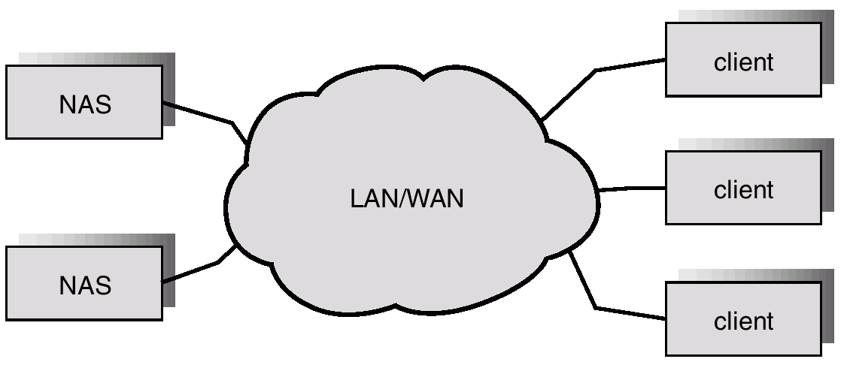
Network-Attached Storage

Slide 38
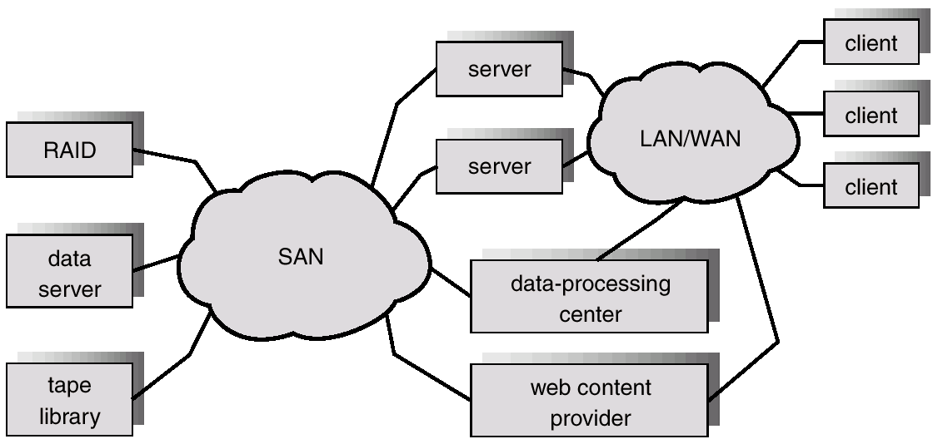
Storage-Area Network
FC switch, Gigabit ethernet switch, or Infiniband switches can be used
(FC-SAN, IP-SAN, or Infiniband SAN)

Slide 39
Infiniband (1)
Infiniband is a channel-based, switched-fabric architecture for data transfer between processors and I/O devices
  Initially was expected to replace other interconnect technologies, such as PCI
  By InfiniBand Trade Association
    Compaq, IBM, and Hewlett-Packard, Intel, Microsoft, and Sun Microsystems
Throughput of up to 2.5 gigabytes per second
  Even up to 10 Gbps
Support for up to 64,000 addressable devices

Slide 40
Infiniband (2)
Serial (bit-at-a-time) bus
  Instead of sending data in parallel (typically 32 bits at a time, but in some computers 64 bits) across the backplane bus (data path)
  Fewer PINs and other electrical connections are required, saving manufacturing cost and improving reliability
  The serial bus can carry multiple channels of data at the same time in a multiplexing signal
Internet Protocol Version 6 (IPv6) with its 128-bit address
  Almost limitless amount of device expansion
  Data is transmitted in packets that together form a communication called a message.
  A message can be a remote direct memory access (RDMA) read or write operation, a channel send or receive message, a transaction-based operation (that can be reversed), or a multicast transmission

Slide 41
Stable-Storage Implementation (1)
Three outcomes of a disk write
  Successful completion
  Partial failure
    The sector being written during the failure may have been corrupted
  Total failure
    The failure occurred before the disk write started
    The previous data values on the disk remain intact
Stable-storage used by write-ahead log
  The system must maintain two physical blocks for each logical block (information redundancy)
    Write onto the first one, then write the same information onto the second one
  Many storage arrays add NVRAM as a cache to improve performance

Slide 42
Stable-Storage Implementation (2)
Write-ahead logging
  The system maintains, on stable storage, a data structure called the log
  Each log record describes a single operation of a transaction write
    Transaction name, data item name, old value, new value
  Before a transaction T starts its execution, the record <T starts> is written to the log
  The information in the log is used to reconstructing the state of the data items
    Two recovery procedures are undo or redo

