Slide 1
Threads

Slide 2
Topics Covered
Thread Concepts
Multithreading Models
Threading Issues
Examples

Slide 3
I. Thread Concepts

Slide 4
Processes vs. Threads
Processes
  Unit of execution (scheduling unit)
  Have a full resource ownership
    Has an address space
    Has the control of some resources (files, I/O devices, …)
Threads
  Unit of execution (scheduling unit)
  Need minimum resources required for execution
    Processor registers
    Stack space

Slide 5

Threads
Thread is often called lightweight process
  Thread needs minimum resources
  Traditional process is called heavyweight process
Thread has a thread ID, a program counter, a register set, and a stack

Slide 6
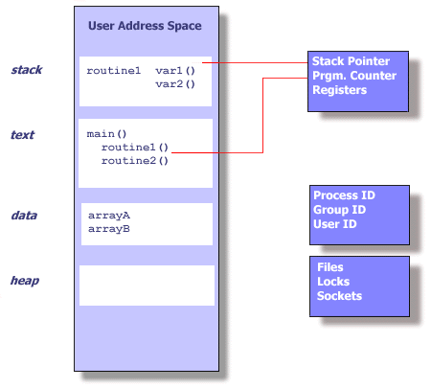
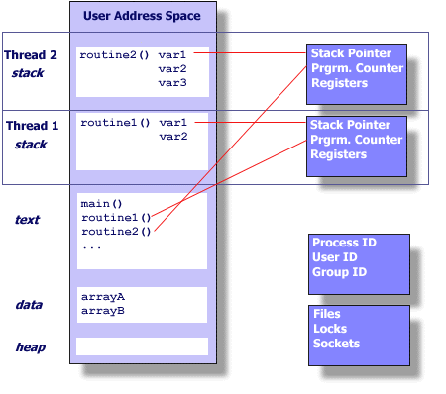
Single- vs. Multi-Threaded Application

Slide 7
More about Threads
Thread has an execution state (running, ready, stopped)
Thread needs context switching
Thread shares the address space (code and data) and resources of its process
  When one thread alters a global variable, all other threads (of the process) see the change
  A file opened by a thread is available to other threads

Slide 8
Thread Example – Create and Exit
#include <pthread.h>
#include <stdio.h>
#define NUM_THREADS 5
void *PrintHello(void *threadid)
{
printf("\n%d: Hello World!\n", threadid);
pthread_exit(NULL);
}
int main (int argc, char *argv[])
{
pthread_t threads[NUM_THREADS];
int rc, t;
for(t=0;t < NUM_THREADS;t++){
printf("Creating thread %d\n", t);
rc = pthread_create(&threads[t], NULL, PrintHello, (void *)t);
if (rc){
printf("ERROR; return code is %d\n", rc);
exit(-1);
}
}
pthread_exit(NULL);
}
int
pthread_create (pthread_t *thread_id,
const pthread_attr_t *attr,
void *(*thread_function)(void *),
void *arg);
1. It returns the new thread ID via the thread_id argument
2. The attr parameter is used to set thread attributes. We can specify a thread attributes object, or NULL for the default values.
3. The thread_func is a C routine that the thread will execute once it is created
4. A single argument may be passed to start_routine via arg

Slide 9
Pthreads APIs
pthread_t pthread_self ()
  Get its own thread id
int pthread_equal (pthread_t t1, pthread_t t2)
  Compare two thread id's
int pthread_join (pthread_t thread, void **status_ptr)
  Wait on the termination of another
int pthread_detach (pthread_t thread; **value_ptr)
  Indicate that the resources allocated to the thread can be reclaimed when it terminates
  Detached means it can never be joined

Slide 10
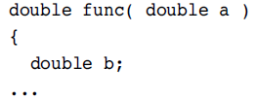
Thread Private Data
Variables held on the stack are thread-private data
  Parameters passed into functions are also thread private data
  Both variables a and b are private to a thread

Slide 11
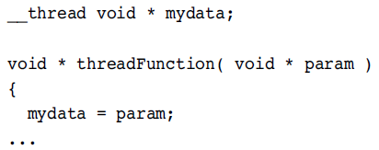
Thread Local Variables
A thread-local variable is global data that is visible to all the routines, but each thread sees only its own private copy of the data
  The variable mydata is local to the thread, so each thread can see a different value for the variable

Slide 12
Benefits
Responsiveness
  Using threads allow a program to continue running even if part of it is blocked
Resource sharing
  Threads share the memory and resources
Economy
  Economical for creation and context switch
Utilization of multiprocessor architectures
  Multithreaded process can increase concurrency
Concurrent programming model

Slide 13
Example: Multithreading for Web Server
Web server process
Dispatcher thread
Worker thread
User space
Web page cache
Kernel
Kernel space
Network connection

Slide 14
Example: Multithreading for Web Server
while (TURE){
get_next_request(&buf);
dispatch_work(&buf);
}
while (TURE){
wait_for_work(&buf)
look_for_page_in_cache(&buf, &page);
if(page_not_in_cache(&page))
read_page_from_disk(&buf, &page);
return_page(&page);
}
Dispatcher Thread
Worker Thread

Slide 15
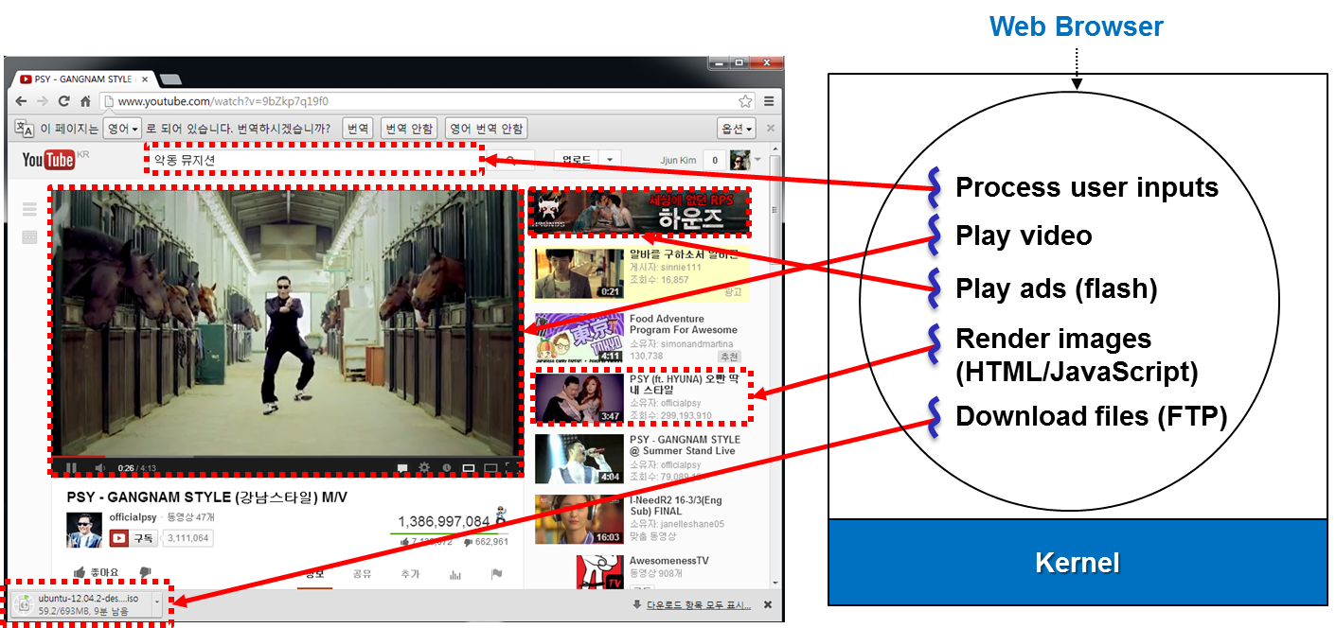
Multithreading for Web Browser

Slide 16
Multithreading Models

Slide 17
User Threads
Thread management is done
  By a thread library at user-level (user space)
  With no support from the kernel
Strength
  Generally fast to create and manage (no kernel intervention)
Drawback
  If the kernel is single threaded, then any user-level thread performing a blocking system call will cause the entire process to block
Examples
  POSIX Pthreads, Mach C-threads

Slide 18
Kernel Threads
Thread management is
  Supported directly by the kernel
  The kernel performs thread creation, scheduling, and management in kernel space
    Slower to create and manage than user threads
Examples
- Windows 95/98/NT/2000
- Solaris
- Tru64 UNIX
- BeOS
- Linux

Slide 19



Multithreading Models
Many-to-One, One-to-One, and Many-to-Many

Slide 20
Multithreading Models
Many-to-one
  Many user-level threads mapped to single kernel thread
  Used on systems that do not support kernel threads
One-to-one
  Each user-level thread maps to kernel thread
  Examples
    Windows 95/98/NT/2000, OS/2
Many-to-many
  Allows many user level threads to be mapped to many kernel threads
  Allows the operating system to create a sufficient number of kernel threads
  Examples
    Solaris 2, Windows NT/2000 with the ThreadFiber package

Slide 21
Threading Issues

Slide 22
Threading Issues - fork
Semantics of fork() system call
  If one thread calls fork(); then there are two possibilities
    The new process can duplicate all threads
    The new process can be single-threaded
  Many systems compromise by offering two variants of fork()

Slide 23
Threading Issues – Other System Calls
All threads in a process share a common set of file descriptors
  What if one thread closes a file that another is currently reading or writing?
  We need some file locking protocol
All threads in a process share a common address space
  What if they manipulate it concurrently through systems calls such as mmap and brk?
  Such system calls must be thread-safe

Slide 24
Threading Issues – Thread Pool
A pool of threads
  Create a number of threads at process startup and place them into a pool
  When the process receives a request, it awakens a thread from the pool passing it the request to service
  Once the thread completes its service, it returns to the pool
  Benefits
    Faster to service a request with an existing thread than creating a new thread
    Limits the number of threads for systems that cannot support a large number of concurrent threads
  Useful for Web server multithreading

Slide 25
Threading Issues – Stack Overflow
When a UNIX process overflows its stack,
  It leads to a segmentation violation fault
  The kernel recognizes that the fault occurred in the stack segment and automatically extends the stack up to a configurable limit instead of signaling the process
    Hard and soft limit in SVR4
For user threads, the kernel has no knowledge of user stacks
  A thread usually specify the size of the stack it needs
  Stacks are allocated by the user thread library
  The library may protect against overflow by allocating a write-protected page just beyond the end of the stack
  This causes a protection fault when the stack overflows and the kernel responds by sending a SIGSEGV signal to the appropriate thread

Slide 26
Examples

Slide 27
Pthreads
POSIX standard (IEEE 1003.1c) API for thread creation and synchronization
API specifies behavior of the thread library, implementation is up to development of the library
Common in UNIX operating systems

Slide 28
Solaris 2 Threads
Solaris 2 provides support for threads at the kernel and user level
  Between user- and kernel-level threads are lightweight processes (LWP)
LWP
  Kernel supported user thread
  Each process contains at least one LWP
  The thread library multiplexes user-level threads on the pool of LWPs

Slide 29

Solaris 2 Threads

Slide 30
Solaris 2 Threads
Kernel-level threads
  Each LWP has a kernel-level thread
  Some kernel-level threads have no associated LWP and run on the kernel’s behalf
  Kernel-level threads are the only objects scheduled within the system
User-level threads (bound or unbound)
  A bound user-level thread is permanently attached to an LWP
    Quick response time (real-time applications)
  All unbound threads in an application are multiplexed onto the pool of available LWPs for the application
    Threads are unbound by default

Slide 31

Solaris Process

