Slide 1
Demand Paging

Slide 2
Topics Covered
Memory Space Utilization
Demand Paging
Page Replacement
Memory Allocation Issues
Other Issues

Slide 3
Obtaining Better Memory-Space Utilization
In early approaches
  The entire program and data of a process must be in physical memory for the process to execute
  The size of process is limited to the size of physical memory
For better memory-space utilization, we can use
  Dynamic loading
  Dynamic linking
  Overlay
  Swapping

Slide 4
Dynamic Loading
A routine is loaded into memory only when it is called by some other routine
  To start with, only the main routine is loaded into memory
  When the main routine calls another routine, that is loaded into memory
This can be quite significant
  Very often a particular execution path in a program may not use all the routines
The overhead is that it takes time to load a program into memory if it is not already there

Slide 5
Dynamic Linking
Linking is postponed until execution time
  Small piece of code, stub, used to locate the appropriate memory-resident library routine
  Stub replaces itself with the address of the routine, and executes the routine
Dynamic linking generally requires help from the OS
  OS should check whether the needed routine is in another process’s memory space or allow multiple processes to access the same memory addresses
Dynamic linking is particularly useful for shared libraries

Slide 6
Overlays
Keep in memory only those instructions and data that are needed at any given time
Implemented by user
  A programmer writes an overlay driver in addition to its core functionality
  The function of the overlay driver is to simply load the relevant code of each phase into memory before the phase starts
  No special support needed from operating system
  Some microcomputer compilers provide the programmer with support for overlays to make the task easier

Slide 7

Overlays for a Two-Pass Assembler

Slide 8
Swapping (1)
Swap a process temporarily out of memory to a backing store
  Bring it back into memory later for continued execution
  (e.g.) In round-robin scheduling, when a quantum expires, the memory manager will swap out the process that just finished and swap in another process to the memory
Backing store
  Fast disk large enough to accommodate copies of all memory images for all users; must provide direct access to these memory images
  Chunk of disk separate from the file system

Slide 9
Swapping (2)
Major part of swap time is transfer time
  Total transfer time is directly proportional to the amount of memory swapped
Modified versions of swapping are found on many systems, i.e., UNIX, Linux, and Windows
  In UNIX, swapping is normally disabled
  Enabled when many processes are running

Slide 10

Schematic View of Swapping

Slide 11
Topics Covered
Memory Space Utilization
Demand Paging
Page Replacement
Memory Allocation Issues
Other Issues

Slide 12
Virtual Memory
We have learned some techniques for better memory space utilization
  Dynamic loading, dynamic linking, overlays, and swapping
Virtual memory – separation of user logical memory from physical memory
  Only part of the program needs to be in memory for execution
  Logical address space can therefore be much larger than physical address space
  The programmer no longer needs to worry about the amount of physical memory available
Virtual memory can be implemented via:
  Demand paging

Slide 13
Demand Paging
Swapping
  Processes reside on secondary memory (disk)
  When we want execute a process, we swap it into memory
  Swapper is concerned with entire processes
Demand paging is similar to swapping
  “Lazy swapper”
  We now view a process as a sequence of pages
  Bring a page into memory only when it is needed
  Pager is concerned with the individual pages
Page is needed ⇒ reference to it
  invalid reference ⇒ abort
  not-in-memory ⇒ bring to memory

Slide 14
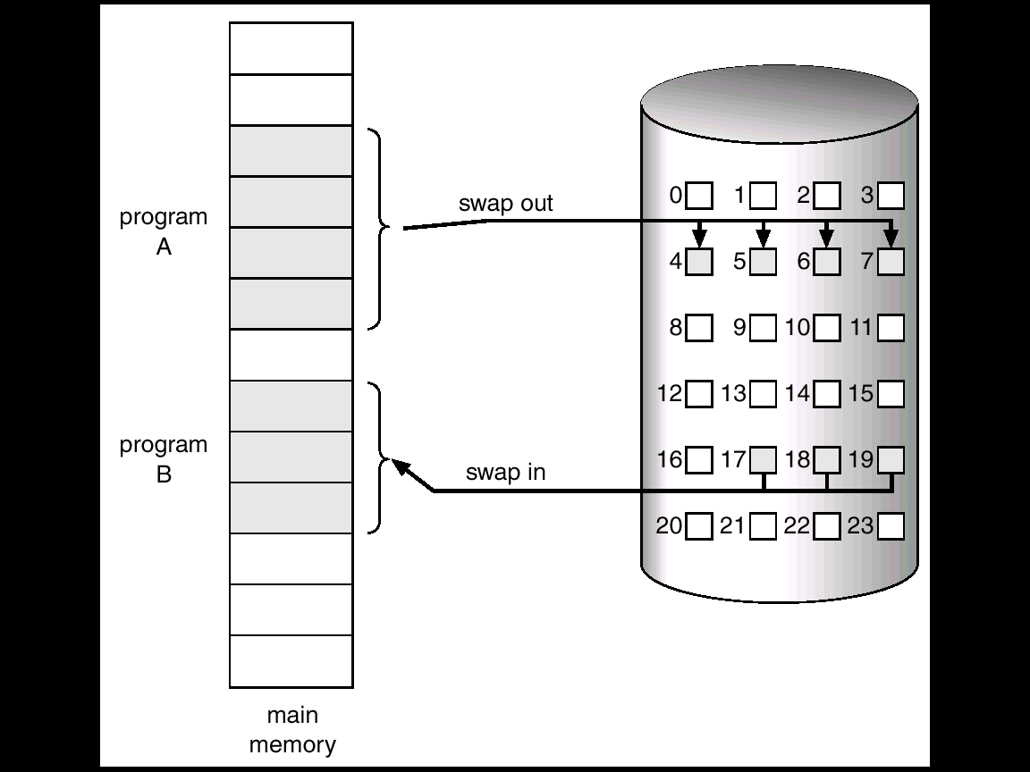
Swapping

Slide 15
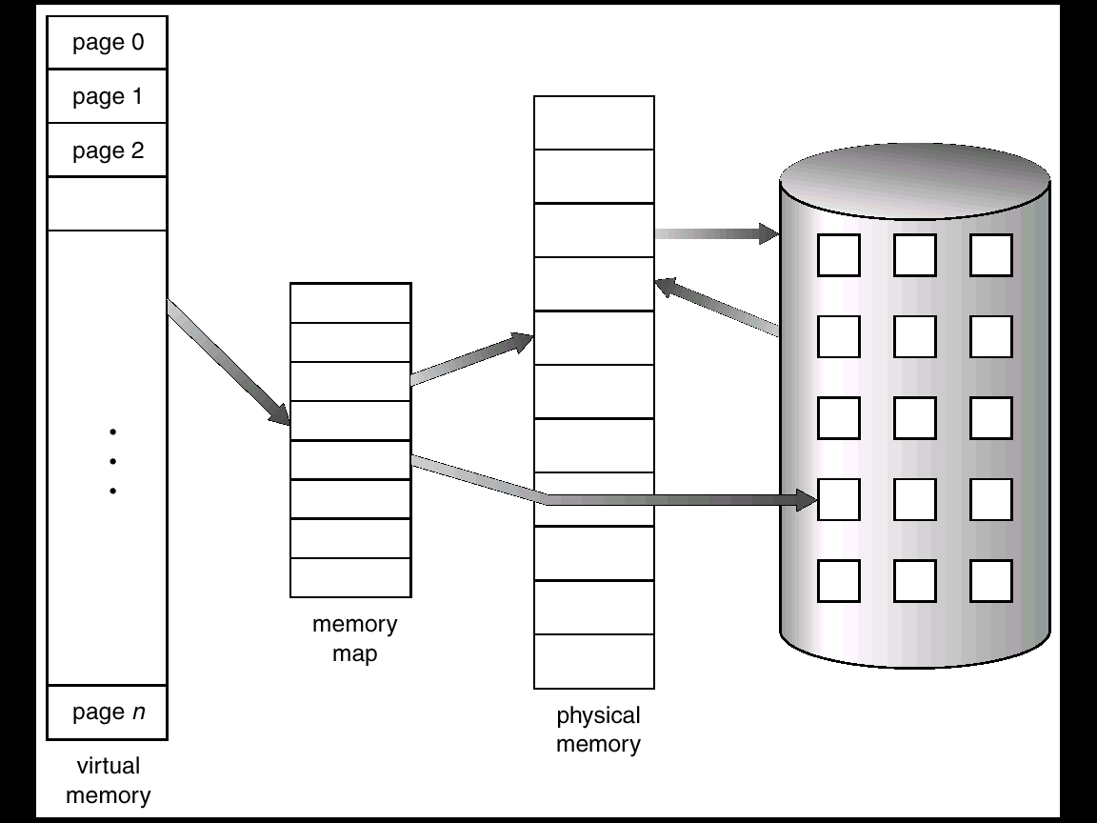
Paging

Slide 16
Basic Concepts
Pager brings only necessary pages into memory
  How can we distinguish between those pages in memory and those pages on the disk ?
  The valid-invalid bit scheme can be used
Valid-invalid bit
  With each page table entry a valid–invalid bit is associated
    (1 ⇒ legal and in-memory, 0 ⇒ illegal or not-in-memory)
  Initially valid–invalid but is set to 0 on all entries

Slide 17
Valid-Invalid Bit
Example of a page table snapshot
During address translation, if valid–invalid bit in page table entry is 0 ⇒ page fault
Frame #
valid-invalid bit
1
1
1
1
0

0
0
page table

Slide 18

Page Table When Some Pages Are Not in Memory

Slide 19
Page Fault Handling
If there is ever a reference to a page,
  First reference will trap to OS ⇒ page fault
OS looks at PCB to decide:
  Invalid reference ⇒ OS terminates the process
  Just not in memory
    This is the result of OS’s failure, not the process
In the second case (not in memory)
  OS gets empty frame
  Brings the desired page into memory
  Valid bit = 1
  Restart the instruction that was interrupted by the trap

Slide 20
Page Fault Example (Not in Memory)
0x00000000
0x00001000
0x00002000
CPU
0x00005129
0x?????129
0x00003000
page
number
0x00004000
0x00005000
0x00006000
0x00001
0x00007
0x00003
0x00002
0x00004
…
0x00007000
0x00008000
?
0x00009000
…
Physical
Memory
Page Table

Slide 21

Steps in Handling a Page Fault

Slide 22
Performance of Demand Paging
Page Fault Rate 0 ≤ p ≤ 1.0
  if p = 0 no page faults
  if p = 1, every reference is a fault
Effective Access Time (EAT)
  EAT = (1-p)m + pf
    Memory access time (m)
    Page fault handling time (f)
  e.g.,
    m = 100 nanosec
    f = 25,000,000 nanosec
    EAT = (1-p)100 + 25,000,000 x p = 100 + 24,999,900 x p
    What if we want less than 10% degradation ?
      110 > 100 + 24,999,900 x p
      0.0000004 > p

Slide 23
Topics Covered
Memory Space Utilization
Demand Paging
Page Replacement
Memory Allocation Issues
Other Issues

Slide 24
Over-Allocation of Memory
Suppose that
  We have 40 frames
  Processes requires 10 pages
  Processes actually use 5 pages
  We could run 4 processes without demand paging
  We could run 8 processes with demand paging
    Over-allocation of memory
    Increased level of multiprogramming
It is possible that
  Each process may suddenly try to use all ten of its pages
  When a page fault occurs, the system would find that there are no free frames
  What should we do?

Slide 25
Basic Page Replacement
Find the location of the desired page on disk
Select a victim frame
  - Using a page replacement algorithm
Read the desired page into the (newly) free frame
Update the page and frame tables
Restart the process
2 page transfers → doubles EAT
  Swapping out the victim page
  Swapping in the desired page

Slide 26

Page Replacement

Slide 27
Page Replacement Algorithms
To evaluate an algorithm
  Use a particular string of memory references
    reference string
  Compute the number of page faults on that string
Example
  Memory address sequence with 100bytes per page
    0100, 0232, 0301, 0412, 0102, 0203, 0504, …
  The reference string is
    1, 2, 3, 4, 1, 2, 5, 1, 2, 3, 4, 5.

Slide 28
First-In-First-Out (FIFO) Algorithm
Reference string: 1, 2, 3, 4, 1, 2, 5, 1, 2, 3, 4, 5
3 frames (3 pages can be in memory at a time)
There are 9 page faults with 3 frames
1 2 3 4 1 2 5 1 2 3 4 5
1
1
1
4
4
4
5
5
5
5
5
1
2
2
2
1
1
1
1
1
3
3
2
3
3
3
2
2
2
2
2
4
5

Slide 29
First-In-First-Out (FIFO) Algorithm
Reference string: 1, 2, 3, 4, 1, 2, 5, 1, 2, 3, 4, 5
4 frames (4 pages can be in memory at a time)
There are 10 page faults with 4 frames
  Belady’s Anomaly
1 2 3 4 1 2 5 1 2 3 4 5
1
1
1
1
1
1
5
5
5
5
4
4
2
2
2
2
2
2
1
1
1
1
5
3
3
3
3
3
3
2
2
2
2
4
4
4
4
4
4
3
3
3

Slide 30

FIFO Illustrating Belady’s Anomaly

Slide 31

General Behavior

Slide 32
Optimal Algorithm
Replace page that will not be used for longest period of time
4 frames example
Now there are 6 page faults
But this algorithm requires future knowledge of the reference string
It is used mainly for comparison studies
1 2 3 4 1 2 5 1 2 3 4 5
1
1
1
1
1
1
1
1
1
1
4
4
2
2
2
2
2
2
2
2
2
2
5
3
3
3
3
3
3
3
3
3
2
4
4
4
5
5
5
5
5
3

Slide 33
Least Recently Used (LRU) Algorithm
FIFO uses
  The time when a page was brought into memory
OPT uses
  The time when a page is to be used
LRU (Least Recently Used ) uses
  The recent past as an approximation of the near future
  Chooses the page that has not been used for the longest period of time
  Programs tend to have locality of reference
  Optimal backward-looking algorithm

Slide 34
Least Recently Used (LRU) Algorithm
4 frames example
Now there are 8 page faults (compare with 10 and 6)
1 2 3 4 1 2 5 1 2 3 4 5
1
1
1
1
1
1
1
1
1
1
1
1
2
2
2
2
2
2
2
2
2
2
2
3
3
3
3
5
5
5
5
4
4
4
4
4
4
4
4
3
3
3

Slide 35
LRU Implementation
Counters
  Every page entry has a counter (time-of-use)
  Every time a page is referenced through this entry, copy the clock into the counter
  Replace the page with the smallest time value
Stack
  Keep a stack of page numbers
  Whenever a page referenced, move it to the top
    Top → most recently used
    Bottom → least recently used
  Best implemented by a doubly linked list

Slide 36
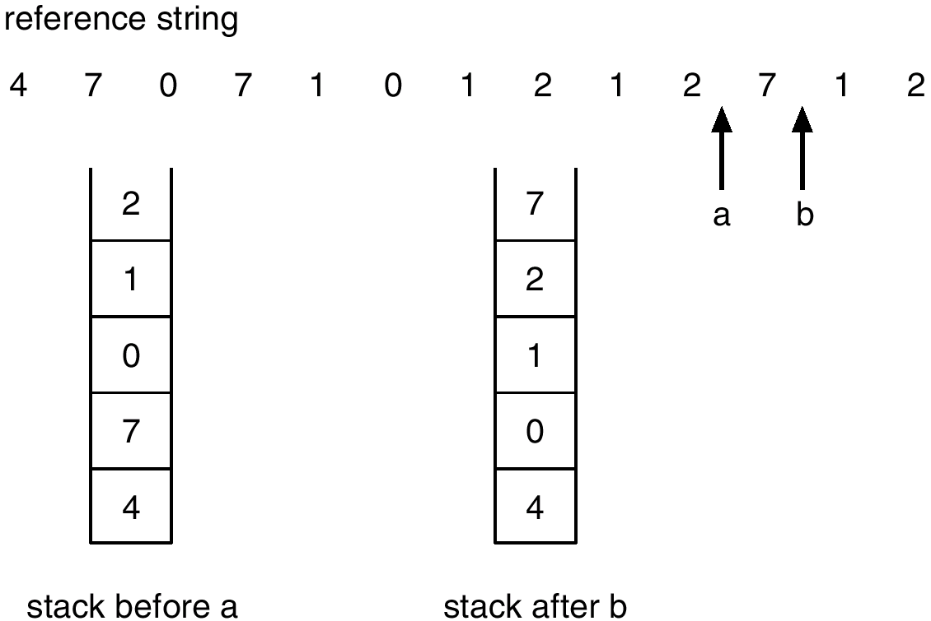
Stack Implementation

Slide 37
LRU Algorithm and Implementation
LRU implementation is not conceivable without hardware assistance
  The updating of the clock fields or stack must be done for every memory reference
  It we were to use an interrupt for every reference, we would see unacceptable performance
Few computer systems provide sufficient hardware support

Slide 38
LRU Approximation Algorithms
Reference bit
  Many systems provide some help in the form of reference bit
  With each page associate a bit, initially = 0
  When page is referenced the bit is set to 1 by HW
  Replace the one which is 0 (if one exists)
    We do not know the order, however
Additional-Reference-Bits
  Keep an 8-bit byte for each page
  At regular intervals (e.g., 100 milisec), the OS shifts the reference bit
  10000000 → 01000000 → 10100000 → 11010100
  11000000 has been used more recently than 01110111

Slide 39
LRU Approximation Algorithms
Second chance
  Based on FIFO algorithm
  Need reference bit
  If reference bit value is 0, replace the page
  If reference bit value is 1
    Set reference bit 0
    Leave page in memory
    Move onto the next FIFO page
  In the worst case, when all values are 1,
    The algorithm degenerates to FIFO

Slide 40

Second-Chance (Clock) Algorithm

Slide 41
Counting Algorithms
Keep a counter of the number of references that have been made to each page
LFU (Least Frequently Used) Algorithm
  Replaces page with smallest count
  Give preference to actively used pages
MFU (Most Frequently Used) Algorithm
  Replaces page with largest count
  Based on the argument that the page with the smallest count was probably just brought in and has yet to be used
Neither MFU nor LFU is common

Slide 42
Topics Covered
Memory Space Utilization
Demand Paging
Page Replacement
Memory Allocation Issues
Other Issues

Slide 43
Allocation of Frames for Multiple Processes
Each process needs minimum number of pages
  Example: IBM 370 requires 6 pages to handle SS MOVE instruction (memory-to-memory):
  instruction is 6 bytes, might span 2 pages
  2 pages to handle from
    Indirect addressing like; add @(R1), @(R2)
  2 pages to handle to
The maximum number is defined by the amount of available physical memory
In between, we are still left with significant choice
  Two major allocation schemes
    fixed allocation
    priority allocation

Slide 44


Fixed Allocation
Equal allocation – e.g., if 100 frames and 5 processes, give each 20 pages
Proportional allocation – Allocate according to the size of process

Slide 45
Priority Allocation
Use a proportional allocation scheme using priorities rather than size
If process P_{i} generates a page fault,
  select for replacement one of its frames
  select for replacement a frame from a process with lower priority number

Slide 46
Global vs. Local Allocation
Global replacement – process selects a replacement frame from the set of all frames; one process can take a frame from another
Local replacement – each process selects from only its own set of allocated frames

Slide 47

Thrashing
If a process does not have “enough” pages, the page-fault rate is very high: This leads to
  low CPU utilization
  operating system thinks that it needs to increase the degree of multiprogramming
  another process added to the system
Thrashing ≡ a process is busy swapping pages in and out

Slide 48
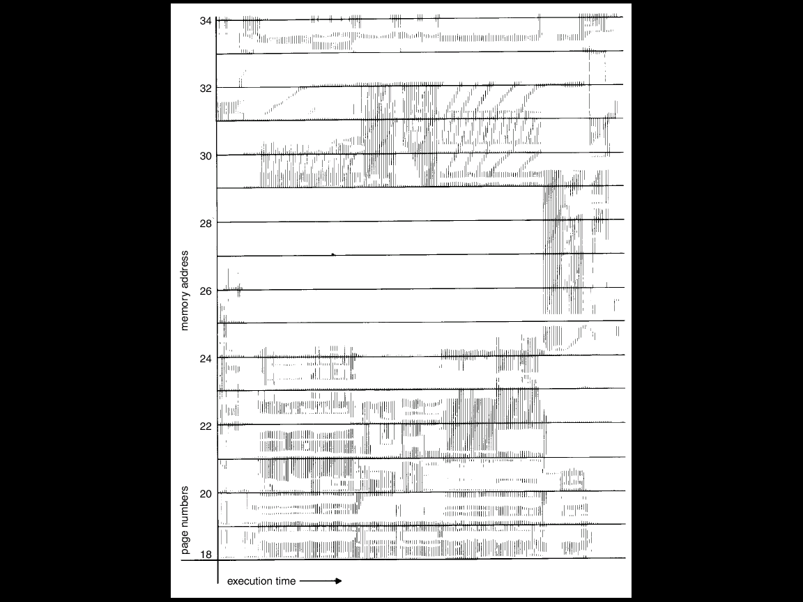
Locality In A Memory-Reference Pattern
We can use locality model to avoid thrashing

Slide 49

Working-Set Model
Δ ≡ working-set window ≡ a fixed number of page references
  Δ = 10 memory references
WSS_{i} (working set size of Process P_{i})
  Total number of pages referenced in the most recent Δ if Δ too small -> will not encompass entire locality
  if Δ too large -> will encompass several localities
  if Δ = ∞ -> will encompass entire program

Slide 50
Working-Set Model
D = Σ WSS_{i} ≡ total demand frames
M = number of available frames
  if D > m ⇒ Thrashing
Policy
  if D > m, then suspend one of the processes

Slide 51
Keeping Track of the Working Set
Approximate with
  interval timer + a reference bit + 2 in-memory bits
Example: Δ = 10,000
  Timer interrupts after every 5000 time units
  Whenever a timer interrupts copy and clear the values of reference bits
  If one of the bits in memory = 1 ⇒ page in working set
Why is this not completely accurate?
Possible improvement
  Use 10 in-memory bits and interrupt every 1000 time units

Slide 52

Page-Fault Frequency Scheme
Another strategy to tackle thrashing using PFF
Establish “acceptable” page-fault rate
  If actual rate too low, process loses frames
  If actual rate too high, process gains frames

Slide 53
Topics Covered
Memory Space Utilization
Demand Paging
Page Replacement
Memory Allocation
Other Issues
  Resident set
  Balance set
  Copy-on-Write
  Memory-Mapped Files
  Modify Bit
  Prepaging
  Page Size
  TLB Reach
  Belady’s Anomaly

Slide 54
Resident Set (1/2)
Approximation of working set in VAX VMS
  Resident set of a process
    A set of its pages resident in physical memory
  Each process has a resident set limit
    Max # of physical pages that can be assigned to that process
  Resident set limit is dynamically adjusted based on page fault rate
    No need for costly computation of working set information

Slide 55
Resident Set (2/2)
How can we use the notion of residence set
  Thrashing avoidance with resident set
    When a process is made inactive, all of its pages in resident set are swapped out to the swap space
    When a process is made active, all pages in its resident set are loaded
      Each process has a resident set list in its context

Slide 56
Balance Set (1/2)
Motivation
  Working sets are not enough by themselves to make sure memory doesn’t get over committed
  We must also introduce the idea of a “balance set”
Balance set
  A collection of processes whose working sets are
  resident in physical memory

Slide 57
Balance Set (2/2)
How it works
  If the sum of the working sets of all runnable processes is greater than the size of memory, then refuse to run some of the processes (for a while)
  Divide runnable processes up into two groups
    Active and inactive
    The collection of active processes is the balance set
  When a process is made active, its working set is loaded
  When it is made inactive, its working set is migrate back to disk
  Some algorithm must be provided for moving processes into and out of the balance set
    What happens if the balance set changes too frequently? (Thrashing)

Slide 58
Copy-on-Write
The fork( ) creates a copy of parent’s address space for the child
  Duplicating the pages belonging to the parent
Copy-on-Write (COW) allows both parent and child processes to initially share the same pages in memory
  If either process modifies a shared page, only then is the page copied
  COW allows more efficient process creation as only modified pages are copied
  We use “zero-fill-on-demand” technique for COW

Slide 59
Memory-Mapped Files
Memory-mapped file I/O allows file I/O to be treated as routine memory access by mapping a disk block to a page in memory
  Unix provides mmap( ) system call
A file is initially read using demand paging
  A page-sized portion of the file is read from the file system into a physical page
  Subsequent reads/writes to/from the file are treated as ordinary memory accesses
Simplifies file access by treating file I/O through memory rather than read() write() system calls
  Writes to the memory-mapped file may not necessarily be immediate writes to the file on disk
  Usually, closing the file results in all the memory-mapped data being written back to disk

Slide 60
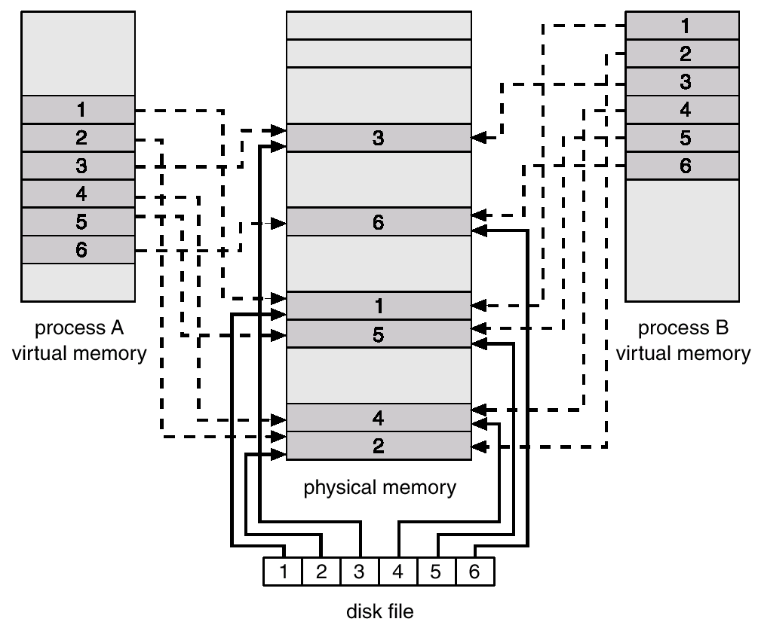
Memory Mapped Files

Slide 61
I/O Interlock
I/O Interlock – Pages must sometimes be locked into memory
Consider I/O
  Pages that are used for copying a file from a device must be locked from being selected for eviction by a page replacement algorithm

Slide 62
Modify Bit
Using modify (dirty) bit can reduce overhead of page transfers
  The modify bit of a page is set whenever any word or byte in the page is written into
  Only modified pages are written to disk
Using modify bit is not enough
  Suppose that a non-modified page is replaced and the process references the page later
  The page must be brought back into memory
  This will replace some other page in the process
We need an efficient algorithm that can minimize page faults

Slide 63
Prepaging
Pure demand-paging incurs a large number of page faults when a process is started
Bring into memory at one time all the pages
  When we suspend a process, we remember the working set of the process
  When the process is resumed, we automatically bring back into memory its entire working set

Slide 64
Page Size
Page size selection
  Generally ranges from 4KB to 4MB
  The smaller the page size,
    the smaller I/O time and internal fragmentation
    the larger page table size
  The larger the page size,
    the lower page fault frequency

Slide 65
TLB Reach
TLB Reach - The amount of memory accessible from the TLB
TLB Reach = (TLB Size) X (Page Size)
Ideally, the working set of each process is stored in the TLB
  Otherwise there is a high degree of page faults

Slide 66
Increasing the Size of the TLB
Increase the Page Size.
  This may lead to an increase in fragmentation as not all applications require a large page size
Provide Multiple Page Sizes
  This allows applications that require larger page sizes the opportunity to use them without an increase in fragmentation

Slide 67
Belady’s Anomaly
Neither OPT nor LRU suffers from Belady’s anomaly
Stack algorithms never exhibit Belady’s anomaly
  The set of pages in memory with n frames is always a subset of the set of pages that would be in memory with (n+1) frames

Slide 68
Windows NT
Uses demand paging with clustering
  Clustering brings in pages surrounding the faulting page
Processes are assigned working set minimum and working set maximum
Working set minimum is the minimum number of pages the process is guaranteed to have in memory
A process may be assigned as many pages up to its working set maximum
When the amount of free memory in the system falls below a threshold, automatic working set trimming is performed to restore the amount of free memory
  Working set trimming removes pages from processes that have pages in excess of their working set minimum

Slide 69
Solaris 2
Maintains a list of free pages to assign faulting processes
Lotsfree – threshold parameter to begin paging
  1/64 of the size of physical memory
  The kernel checks if the number of free memory is less than lotsfree (four times per second)
When the number of free memory falls below lotsfree
  Paging is performed by pageout process
  Pageout scans pages using modified clock algorithm
  Scanrate is the rate at which pages are scanned
    This ranges from slowscan to fastscan
  Pageout is called more frequently depending upon the amount of free memory available

Slide 70
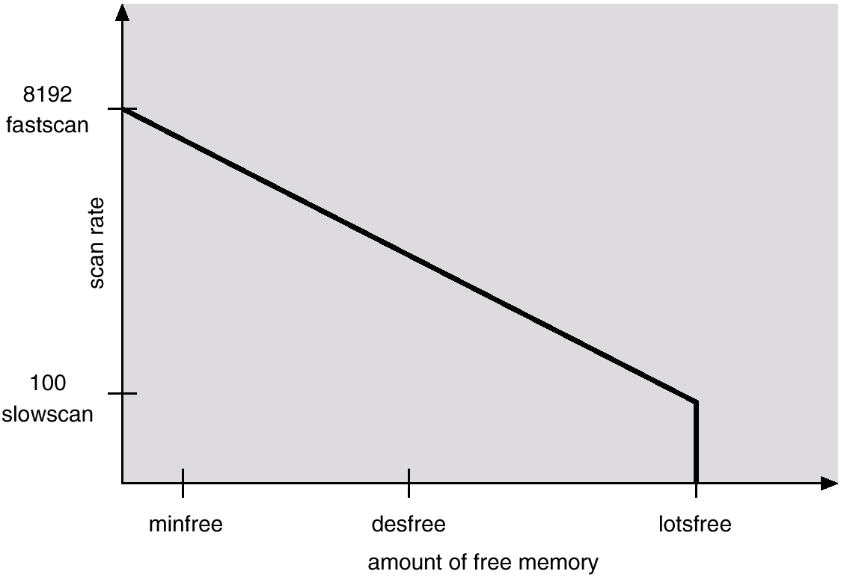
Solaris 2 Page Scanner

