Slide 1
Lecture 19: Testing (2)

Slide 2
Testing
Testing a set of activities with the objective of identifying failures in a software or system and to evaluate its level of quality, to obtain user satisfaction. It is a set of tasks with clearly defined goals.

Slide 3
Defects
Defects are introduced at the same time the code is written, by the same persons.
Root cause
- Lack of education
- Communication problems
- Immature processes
- Omissions or oversights
Impact on Products
Impact perceived by users
Error → defects/fault -→ failure
Poor quality software
Dissatisfaction, loss of confidence

Slide 4
Sources of Problems
Requirements Definition: Erroneous, incomplete, inconsistent requirements.
Design: Fundamental design flaws in the software.
Implementation: Mistakes in chip fabrication, wiring, programming faults, malicious code.
Support Systems: Poor programming languages, faulty compilers and debuggers, misleading development tools.

Slide 5
Sources of Problems (2)
Inadequate Testing of Software: Incomplete testing, poor verification, mistakes in debugging.
Evolution: Sloppy redevelopment or maintenance, introduction of new flaws in attempts to fix old flaws, incremental escalation to inordinate complexity.
Notes:
修复和迭代过程中的错误与疏忽、试图修复旧问题而引入新的问题，功能迭代过大 导致软件的复杂度直线上升

Slide 6
Common Goals of Testing
Software testing focuses on two complementary but distinct aspects:
defect and failure detection, so that these can be fixed and thus the quality of the product delivered to customers and users is improved;
allows decisions to be made on the basis of the information provided regarding the level of risks associated with the delivery of the software to the market, and on the efficiency of the organization’s processes which are the root cause of the identified defects and/or failures.

Slide 7
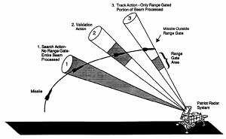
Patriot Missile Software Problem
A report from the United States General Accounting Office begins “On February 25, 1991, a Patriot missile defense system operating at Dhahran, Saudi Arabia, during Operation Desert Storm failed to track and intercept an incoming Scud. This Scud subsequently hit an Army barracks, killing 28 Americans”

Slide 8
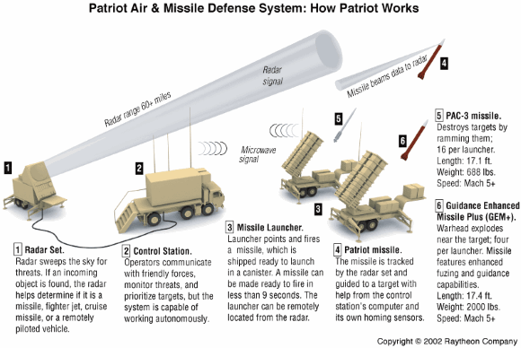
Patriot Missile Software Problem (2)
February 11, 1991, the Israeli forces inform the Patriot Project Office about a defect found in the Patriot surface-to-air missile defense system. They discovered that running the system for consecutive 8 hours resulted in a 20% targeting precision loss, and estimated that after continuous operation for 20 hours the inaccuracy would grow so big that the Patriot would no longer be able to lock on, track, and intercept ballistic missiles.

Slide 9
The Psychology of Testing
The mindset which we apply during Testing and Reviewing is different from the one that we use during Designing or Developing.
While building the software, we work positively towards the software with an intent to meet customer requirements. However, when we test or review the product, we lookout for defects in the product.
Notes:
开发的人的评价指标 kpi就是错误越少越好 测试的人的kpi就是能找到的错越多越好
测试开发 争斗
开发方面的成就感 和对测试人员的偏见

Slide 10
The Psychology of Testing (2)
A human psychology element called Confirmation bias refers to thinking that makes it difficult to accept information that disagrees with currently held beliefs.
For example, Developers believe that their code has no errors. So, it is difficult for them to take that their code is incorrect. Testing is often looked upon as bearer of bad news by Developers as it highlights defects/failures in the system. It’s difficult to see the bigger picture that these defects eventually make the software better and more usable.
Notes:
证实偏见

Slide 11
Characteristics of a Software Tester
Software testers also need to acquire the following skills in addition to technical skills:
Interpersonal skills: Firstly, there should be effective communication between testers & developers about defects, failures, test results, the progress of tests and risks, etc. The way of conveying message should be very concise, complete, and humble. Additionally, they should to build friendly relations with developers so that they are comfortable to share feedback.
Sharp observation: Secondly, the software testers must have an “eye for detail”. The testers can quickly identify or detect many critical errors if they observe sharply. Moreover, they should examine the software for the parameters such as ‘look & feel’ of GUI, incorrect data representation, ease of use, etc.
Notes:
人际交往关系
敏锐的洞察力

Slide 12
Characteristics of a Software Tester (2)
Customer-oriented perspective: the software testers should adopt a customer-oriented perspective while testing the software product. They should be able to place themselves in customer shoes and test the product as a mere end-user.
Cynical but friendly attitude: Regardless of the nature of the project, the tester must be tenacious when questioning even the minor ambiguity until it is proven. Different situations may arise during the test. For instance, the detection of a large number of errors may cause a more significant delay in the shipment of the product. It can lead to a tight situation between testers and other development teams. The tester must balance this relationship. It should not happen at the expense of errors. Testers should convince and defend the intentions of “attacking software issues but not software developers.”
Notes:
3. 以客户为主导的思维 把自己当成客户按照客户的思维去测试
4.愤世嫉俗的犬儒主义 对待问题必须精益求精 而且要坚持自己的测试结果 同时也要平衡团队关系

Slide 13
Characteristics of a Software Tester (3)
Organized, flexible, and patient at work: Testers realize that they can also make mistakes. Therefore, they should be excellent organizers -they must-have checklists, facts, and figures to support their findings. Additionally, the tester should be flexible and open to new strategies. Sometimes, significant tests must be re-run that would otherwise change the fundamental functionality of the software. Therefore, the tester should have the patience to retest the software for as many new errors as may arise. Testers must be patient and stay prepared in projects where requirements change rapidly.
Notes:
有组织、灵活而有耐心的工作 。1。测试人员也会犯错 那么对于测试过程的规范组织就非常重要，一切讲究有理有据 2. 接受新的测试技术 新的测试方案 AI测试 3. 有耐心去retest

Slide 14
Characteristics of a Software Tester (4)
Objective and neutral attitude: No one likes to hear and believe the bad news. Well, testers resemble messengers of bad news in a software project team. No matter how brilliant the testers are at their job; nobody wants to share the bad news. But, the tester always communicates the wrong part of the software, which the developers do not like. The tester must be able to deal with the situation in which he has to face the accusation of doing his job (i.e., detecting errors) too well. The tester’s work should be appreciated, and the development team should welcome the errors. That is because every potential error encountered by the tester would mean a reduction of an error that the client might have encountered.
Notes:
客观并且中立的态度

Slide 15
Reasons that Bugs Escape Testing
User executed untested code.
User executed statements in a different order than was tested.
User entered an untested combination.
User’s operating environment was not tested.
Notes:
但是有的时候一些情况下有一些bug的逃逸 即使是最好的软件也会有各种各有的bug

Slide 16
Why Can’t Every Bug be Found?
Too many possible paths.
Too many possible inputs.
Too many possible user environments.

Slide 17
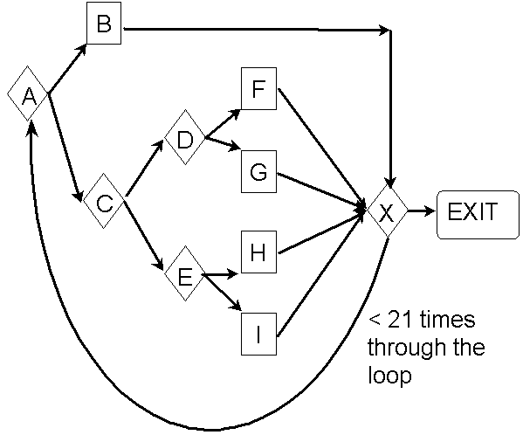
Too Many Possible Paths

Slide 18
Too Many Possible Paths
There are 5 paths from A to X without passing through the loop.
There are 5²⁰ paths from A to X after passing through the loop 20 times.
There are 5 + 5² + 5³ +…+ 5²⁰ = 100 trillion possible paths in this program.
If you could test a path per second it would take more than 3 million years!

Slide 19
Too Many Possible Inputs
Problems take input in a variety of ways: mouse, keyboard, and other devices.
Must test Valid and Invalid input.
Most importantly, there are an infinite amount of sequences of inputs to be tested.

Slide 20




Too Many Possible User Environment
Difficult to replicate the user’s combination of hardware, peripherals, OS, and applications.
Impossible to replicate a thousand-node network to test networking software.
Notes:
不同类型的设备 不同类型的操作系统 即使同一个操作系统也会有不同的版本

Slide 21
Paradoxes and Main Principles
Testing identifies the presence of defects.
Testing enables the identification of defects present in a piece of code, but does not show that such defects are not present.
Exhaustive testing is impossible
It is impossible to undertake exhaustive testing, to test “everything”.
Notes:
悖论和主要的准则
1. 测试可以帮助尽可能发现现在的问题，但是不能说吗 目前的software没有错误
2. 穷尽测试不可能

Slide 22
Paradoxes and Main Principles (2)
Early testing
Test early in the development cycle or “early testing”
This principle is based on the fact that costs, whether development costs, testing costs, defect correction cost, etc. increase throughout the project. It is economically more sensible to detect defects as early as possible; thus avoiding the design of incorrect code, the creation of test cases, which require design and maintenance of the created test cases, the identification of defects that have to be logged, fixed, and retested.

Slide 23
Paradoxes and Main Principles (3)
Defect clustering
Even if bugs do not have a real life, it is frequent that a number of defects are concentrated according to identical criteria. These can be a piece of code (such as a complex section of an algorithm), a sub-assembly of components designed by the same person (where a similar error is repeated), or a group of components designed in the same period of time, or even a defective off-the-shelf component (COTS). This principle means also that if you find a defect, it might be efficient to look for other defects in the same piece of code.

Slide 24
Paradoxes and Main Principles (4)
Pesticide paradox
The pesticide paradox, or lack of efficiency of tests when they are used over a period time.
This loss of efficiency is due to the re-execution of identical test (same data, same actions) on software paths that have already been tested. If a failure has been identified and corrected during a previous execution of that test, it will not be detected anymore during the re-execution of that test at a later time.

Slide 25
Paradoxes and Main Principles (5)
Testing is dependent on the context.
Safety-critical systems will be tested differently and with a more intense effort. However, this principle goes much further, because it also applies to the evolution of the context of your own software application. During the first tests of your software, you will design tests based on your knowledge of the software at that moment in time. During subsequent tests, or tests of the next version of the software, your knowledge of the software will have evolved, and you will design other tests, focusing, for example, on identified risks, on components where defect clustering occurred, or taking into account the pesticide paradox.
Notes:
不同时期 不同上下文需要的测试不同的 如果是evolution 如果是敏捷开发中的迭代

Slide 26
Paradoxes and Main Principles (6)
Absence of error fallacy
Very frequently, the reduction of number of defects is considered to be the ultimate goal of testing. However, it is not possible to assure that a software application, even if it has no defect, suits the needs of the public. If the software does not correspond to what the users need or to their expectations, identification and correction of defects will not help the architecture or the usability of the software, nor the financial success of the software.
Notes:
错误谬误：
通过测试来减少出错的机会 和错误的个数都是我们的最终目标，但是始终无法保障 一个软件最终没有错误了或者 无法说所有的测试用例都跑通了 就没有错误了
2.

Slide 27
Test Team

Slide 28
Test Groups
There is no right or wrong ways to organize test teams.
The structure one chooses will affect productivity, quality, customer satisfaction, employee morale, and budget.
Unit tests are developed and executed by the software developers themselves, rather than an independent unit test group.
Notes:
如何组织团队永远没有对错之分
团队的结构选择 （正确选择团队的重要性）不光是技术上的 而且性格等

Slide 29
Test Groups (2)
It is recommended to have at least two test groups:
integration test group
system test group
The acceptance test group is formed on a demand basis consisting of people from different backgrounds.
The acceptance test group is dismantled after the project is completed.
Notes:
用户接受了测试按需产生 按需解散 通常为用户 或者潜在用户 建议为用户 注意区分用户不一定是甲方

Slide 30
Integration Test Group
The mandate of this group is to ensure that unit-tested modules operate correctly when they are combined.
The leader of the integration test group reports to the software development manager.
The software developers, who together built the modules, must be involved in performing integration testing.
In practice, the developers themselves may integrate the system.
The system architects are also involved in integration testing for complex systems.
The test group may perform other duties, such as:
code inspection, configuration management, release management, and management of development laboratory.
Notes:
集成测试 的集成方案的选择

Slide 31
System Test Group
The mandate of this group is to ensure that the system requirements have been satisfied and that the system is acceptable.
The system test group is truly an independent group, and they usually have a separate headcount and budget.
The manager of this group is a peer to the hardware or software development managers.
The group executes business acceptance tests identified in the user acceptance test plan.
Notes:
事实上很多企业中的测试组就是系统测试组 ，因为继承测试 和 单元测试都用开发者团队来做 部门领导是测试经理 级别同软硬件经理译英

Slide 32
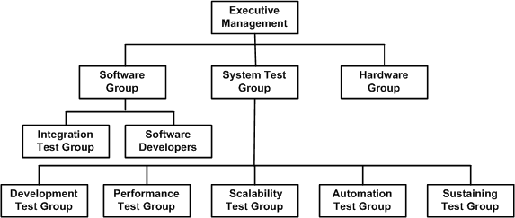
System Test Group (2)
Notes:
问题 为何不讲测试组放在开发团队中
话语权
测试的重要行

Slide 33
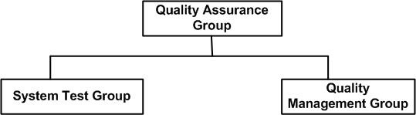
Software Quality Assurance Group
Software quality assurance deals not only with the location of defects, but also mechanism to prevent defects.
Software quality assurance group has a larger role in ensuring, conformance to the best development practices throughout the organization.
Notes:
质量保证 不光是看错误或者异常 也要看如何提高产品的质量

Slide 34
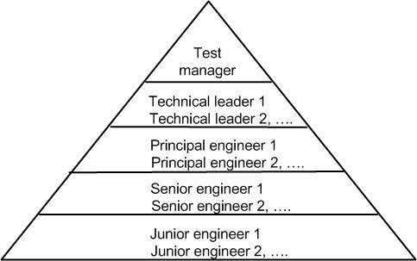
System Test Team Hierarchy
Test manager: a key person in charge of all aspects of the assigned testing task.
The technical leader provides the strategic direction for software testing, assists test managers, coordinates test plan review meetings, attends entry/exit criteria review meetings, and participates in cross-functional review meeting
The principal engineers are test specialists responsible for test planning, test automation, test environment planning, test tool development, procurement of test equipment, performance modeling, reliability engineering, and business acceptance testing. In addition, the principal engineers execute test cases and mentor junior engineers within the group.

Slide 35
System Test Team Hierarchy (2)
The senior engineers design, develop, and execute test cases. They design and set up test laboratories and environments. Senior engineers assist software developers in reproducing known defects
New, inexperienced test engineers are put at a junior level. They gain experience by assisting the senior and principal engineers in charge of test execution, setting up of test beds, and developing scripts for test automation

Slide 36
Effective Staffing of Test Engineers
A successful test team is made up of members whose strengths are complementary
It is advisable to have people on the test team with diverse background and experience, such as:
developers
integration testers
information technology administrators
technical support personnel
technical writers
quality management personnel
experienced test engineers
recent graduates
Notes:
一个好的团队往往是一个优势互补的团队

Slide 37
Effective Staffing of Test Engineers (2)
Test engineers are expected to have the following skills
Have credibility with software developers
Understand developers’ terminologies
Know when the code is ready for testing
Be able to evaluate the impact of a problem on the customers
Assist software developers in expediting defect resolution
Reduce false-positive and false-negative results in testing
Develop expertise in test automation
Mentor the junior test engineers
Notes:
1. 对程序员相信、认同
2. 理解专业术语
3. 懂得要测试的代码
4. 可以估计出错误的严重程度 --- 优先级
5. 帮助开发人员加速完成错误的解决
6. 降低测试过程中的误报和漏报
7. 自动测试的专家
8. 辅助新人。

Slide 38
Testing Progress

Slide 39
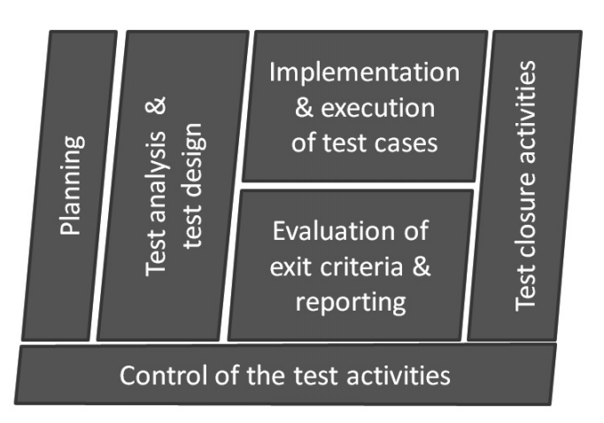
Fundamental Test Process
Testing is not limited to the execution of software with the aim of finding failures: it is also necessary to plan, define goals, identify test conditions, create test data, start and exit criteria, test environments, and of course, control all these activities

Slide 40
Fundamental Test Process (2)
The fundamental test process includes:
Test planning and control;
Analysis and design of tests;
Implement and execution of tests;
Evaluation of the exit criteria and production of test report;
Test closure activities.

Slide 41
Planning
Before any human activity, it is necessary to organize and plan the activities to be executed. This is also applicable for software and system testing.
Test planning activities include organization of the tasks, and coordination with the other stakeholders, such as development teams, support teams, user representatives, management, customer, etc.

Slide 42
Control
Control activities are executed throughout the test campaign, They are often grouped with planning activities because they ensure that what has been planned is correctly implemented.
Control identifies deviations from planned operations, or variants with regards to planned objectives, and proposes actions to reach these objectives. This implies the ability to measure the progress of activities in terms of the resources used as well as in terms of objectives reached.
Notes:
控制通常是用来保证测试计划活动的正确性
通过控制活动来检查 测试计划是否正确是否有错误 哪些地方需要调等

Slide 43
Test Analysis and Design
The analysis and design phase is where global test objectives, as defined by organization at the test plan level, are used to create the test conditions for the software.
Analysis of the basis of the test include
Contractual documents, such as the contract, statement of work, and any amendments or technical attachments, etc;
Software specification, high-level design, detailed architecture of the components, database organization or file system organization;
User documentation, maintenance or installation manuals, etc;
The risks identified or associated with the use of the development of the software;
Applicable standard, whether they be company specific, profession specific or mentioned in the contractual documents.
Notes:
定义测试条件 测试目标
什么软件 在那些条件下测试
比如深水的机器人软件

Slide 44
Test Analysis and Design (2)
Test design
Test objectives correspond to the reasons or goal that we have, during test design and execution. These will guide our actions and will lead to the detailed design of the test cases.
Test design consists of applying the test objectives under obvious test conditions, and then applying them to test cases.
Notes:
测试目标往往反映着我们测试的最终目的。

Slide 45
Test Design
Test design phase comprise:
Identification and prioritization of the test conditions based on an analysis of the test objects, of the structure of the software and system;
Design and prioritization of high-level test cases;
Identification of the test environment and test data required for test execution;
Provision for control and tracking information that will enable evaluation of test progress.

Slide 46
Test Implementation
Test implementation is the conversion of test conditions towards test cases and test procedures, with specific test data and precise expected results. Detailed information on test environment and test data, as well as on the sequence of the test cases are necessary to anticipate test execution.

Slide 47
Test Execution
Test execution in the test environment enables the identification of differences between the expected and the actual results and includes tasks linked to the execution of test cases, test procedures, or test suites. This includes:
Ensuring that the test environment is ready for use, including the availability of test data;
Executing test cases, test procedures, and test suites, either manually or automatically, according to the planned sequence and priority;
Recording test execution results and identifying the version of the component tested, of the test tools, and test environment;
Notes:
测试预期结果 和实际上的执行结果是否有差距
确保测试的环境是可以用 包括测试中所需要的各种数据
确保各个测试用例 测试过程 测试套件 都按计划排序 （对应前面 测试人员测试需要排序）
记录测试结果

Slide 48
Test Execution (2)
Comparing expected results with actual results;
Identifying and analyzing any discrepancy between expected and actual results, and clearly define cause of the discrepancy. Recording these differences as incidents or defects, by providing the highest level of detail possible to facilitate defect correction in the future;
Providing tracking and control information to allow efficient management of test activities.

Slide 49
Analysis of Exit Criteria
Analysis of the exit criteria evaluates the test object with regards to the test objectives and criteria defined during the planning phase.
This evaluation include:
Analysis of the test execution logs and reports;
Comparison of the objectives reached versus objectives identified during the planning phase, and evaluation of the need to test more thoroughly or to modify the exit criteria;

Slide 50
Reporting
Test activity results interest a large number of stakeholders:
Testers, to evaluate their own progress and efficiency;
Developers, to evaluate the quality of their code, and the remaining workload, whether it is on the basis of remaining defects to be fixed, or components to deliver;
Quality assurance managers, to determine the required process improvement activities, whether in the requirement elicitation phase or reviews, or during design or test phases;
Customer and end users, or marketing, to advise them when the software or system will be ready and released to the market;
Upper management, to evaluate the anticipated remaining expenses and evaluate the efficiency and effectiveness of the activities to date.

Slide 51
Test Closure Activities
Once the software or system is considered ready to be delivered, or the test project is considered complete, it is necessary to close the test activities. This consists of:
Ensuring that the planned components have been delivered;
Determining the actions that must be taken to rectify unfixed incidents or remaining defects. This can be closure without any action, raising change requests on a future version, delivery of data to the support team to enable them to anticipate user questions;
Document the acceptance of the software or system;
Archive test components and test data, drivers and stubs, test environment parameters and infrastructure for future usage;
Identify possible lessons learned or return on experience, so as to document them and improve future projects and deliveries, and

Slide 52
Testing Progress

Slide 53
Test Phase
Requirement Specification
Inspection
Unit Test
Functional Requirement
Unit Test
Integration Test
Functional Test
System Test
User Acceptance Test
System
Inspection
Non-functional Requirement
Unit Test

Slide 54
Types of Tests
Test object: Unit test, integration test, functional test, system test, user acceptance test.
Test techniques: Black-box (specification-based), white-box (structure-based)
Execution: Execution-based testing, Nonexecution-based testing;

Slide 55
Component level test/Unit test/Class test
Test object:
components, program modules, functions, programs,
Objective:
detect failures in the components,
Entry criteria:
the component is available, compiled, and executable in the test environment;
the specifications are available and stable.
Exit criteria:
the required coverage level has been reached;
defects found have been corrected;
the corrections have been verified;
regression tests have been executed on the last version and do not identify any regression;
traceability from requirements to test execution is maintained
Notes:
Regression testing 介绍一下

Slide 56
Integration Level Testing
Test object:
components, infrastructure, interfaces, database systems, and file systems.
Objective:
detect failures in the interfaces and exchanges between components.
Entry criteria:
at least two components that must exchange data are available, and have passed component test successfully.
Exit criteria:
all components have been integrated and all message types (sent or received) have been exchanged without any defect for each existing interface;
statistics (such as defect density) are available;
the defects requiring correction have been corrected and checked as correctly fixed;
the impact of not-to-fix defects have been evaluated as not important.
Notes:
集成测试
测试接口 和 compoent直接的信息交互 重点是避免错误

Slide 57
Types of integration
Integration of software components
typically executed during component integration tests
Integration of software components with hardware components
Integration of sub-systems
typically executed after the system tests for each of these sub-systems and before the systems tests of the higher-level system.

Slide 58
System Test
Test object:
the complete software or system, its documentation, the software configuration and all the components that are linked to it
Objective:
detect failures in the software, to ensure that it corresponds to the requirements and specifications, and that it can be accepted by the users.
Entry criteria:
all components have been correctly integrated, all components are available.
Exit criteria:
the level of coverage has been reached;
must-fix defects have been corrected and their fixes have been verified;
regression tests have been executed on the last version of the software and do not show any regression;
bi-directional traceability from requirements to test execution is maintained;
statistical data are available, the number of non-important defects is not large;
the summary test report has been written and approved.

Slide 59
Design of Test Cases

Slide 60
Test cases and Test suite
Test a software using a set of carefully designed test cases:
The set of all test cases is called the test suite

Slide 61
Test cases and Test suite
A test case is a triplet [I,S,O]:
I is the data to be input to the system,
S is the state of the system at which the data is input,
O is the expected output from the system.

Slide 62
Design of Test Cases
What aspects does a test case contain?
1) Objective: Here the tester mentions what he plans to achieve with that particular test case.
2) Steps to Follow: Here the tester mentions the steps that need to be followed to achieve the objective.
3) Expected Output: Here the tester mentions the output which is expected as per the requirements provided.
4) Actual Output: Here the tester mentions the actual output achieved by following the steps.
5) Pass/ Fail: If the tester fails to achieve the ‘Expected Output’ by following the steps then he will mention ‘Fail’ against that particular test case. Similarly, if the tester is able to achieve the ‘Expected Output’ then he will mention ‘Pass’ against the test case.

Slide 63
Design of Test Cases (2)
Test Cases:
Representative;
Explore the weakness/defects in system design and functionalities;
Positive Testing (i.e., valid inputs) and Negative Testing (i.e., invalid inputs);
Environments and Scenarios;

Slide 64

Case Study: Paper Cup

