Slide 1
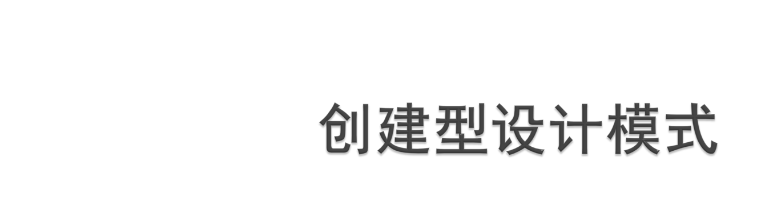

Slide 2
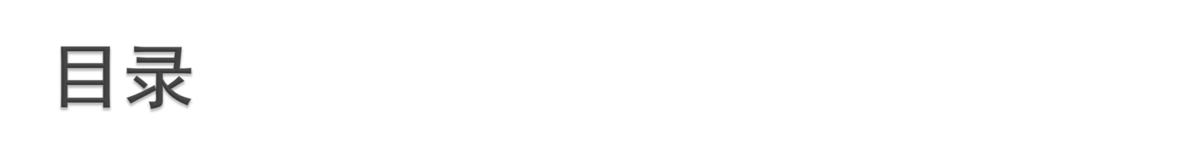
工厂方法模式 (factory method pattern)
单例模式（singleton pattern）
抽象工厂模式 (abstract factory pattern)
生成器模式 (builder pattern)
原型模式（prototype pattern）

Slide 3
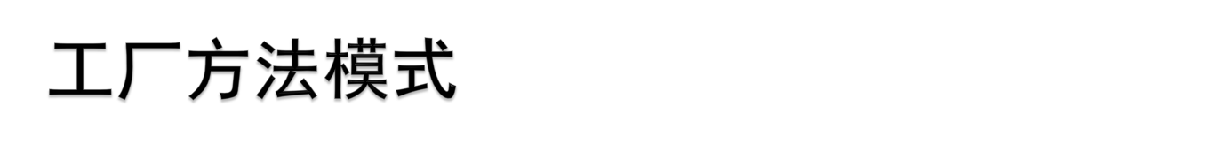
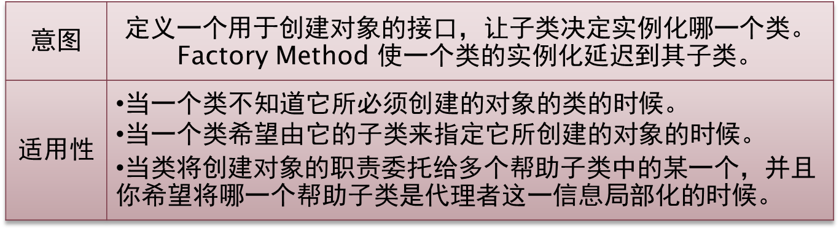
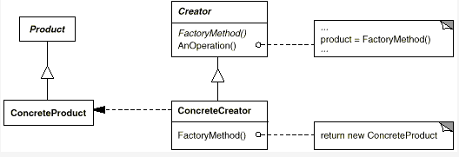
Notes:
OOP中，经常会遇到对象创建和初始化。主要是上述的两种情况
在第一种情况中，对象比较复杂，包含很多的初始化代码，因此应该将这些代码放到一个Factory类中，充当类工厂，以减少重复的对象创建代码。典型的例子是数据库的链接创建（演示示例图） 。
第二种情况也较为常见，OOP中的一个重要概念就是类的继承。派生于同一个基类的对象往往都是具备相似的功能，仅仅是具体的实现根据不同环境而异，因此创建这些对象的时候就需要根据不同的情况（或者输入参数）而异。将这些代码移入专门的Factory类同样对减低代码重复有非常明显的作用。典型例子是XMLDB的DAO对象创建（演示示例图）

Slide 4
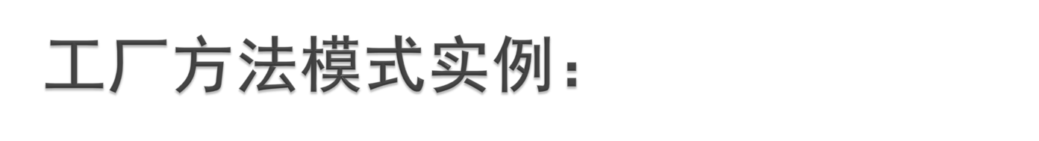
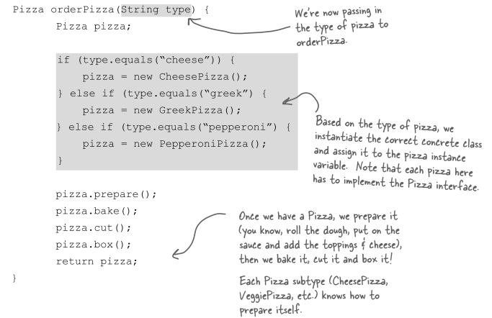
采用new的if-else设计

Slide 5
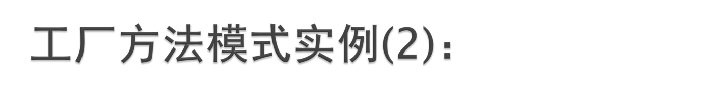
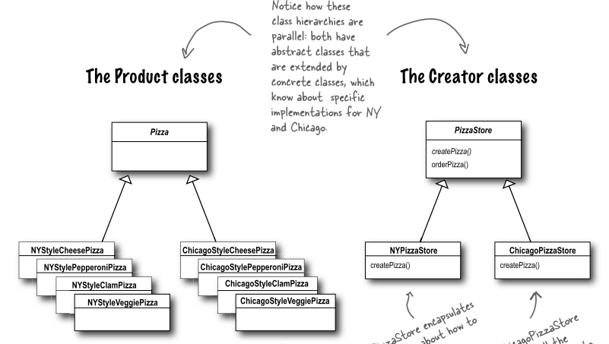
工厂方法模式

Slide 6
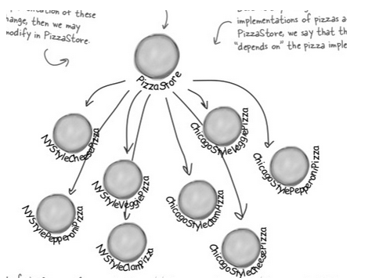

Slide 7

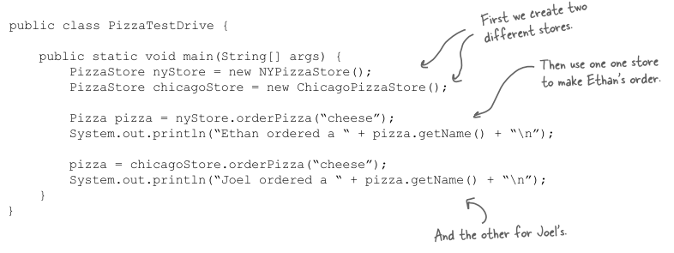
客户端代码

Slide 8
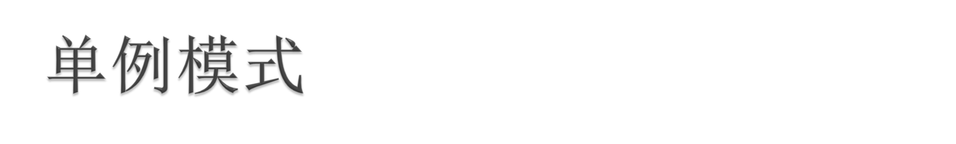
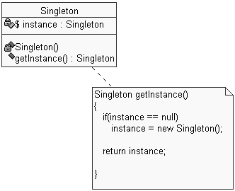
Singleton: a class that has only one instance

Slide 9

singleton: an object that is the only object of its type
  ensures that a class has at most one instance
  provides a global access point to that instance
  takes responsibility of managing that instance away from the programmer (illegal to construct more instances)
  provide accessor method that allows users to see the (one and only) instance
  possibly the most known / popular design pattern! (this should tell you something)

Slide 10

One way to avoid creating objects:
use static methods instead
  Math, System, JOptionPane
  is this a good alternative choice? Why or why not?
Problem: lacks flexibility
  Example: static methods can't be passed as an argument to a method, nor returned
Problem: cannot be extended
  Example: static methods can't be subclassed and overridden like a singleton's could be

Slide 11

make constructor(s) private so that they can not be called from outside
declare a single static private instance of the class
write a public getInstance() or similar method that allows access to the single instance
  possibly protect / synchronize this method to ensure that it will work in a multi-threaded program

Slide 12

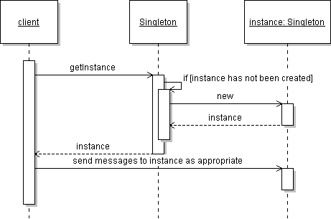

Slide 13

consider a singleton class RandomGenerator that generates random numbers
public class RandomGenerator {
private static RandomGenerator gen = new RandomGenerator();
public static RandomGenerator getInstance() {
return gen;
}
private RandomGenerator() {}
...
}
possible problem: always creates the instance, even if it isn't used

Slide 14

variation: don't create the instance until needed
// Generates random numbers.
public class RandomGenerator {
private static RandomGenerator gen = null;
public static RandomGenerator getInstance() {
if (gen == null) {
gen = new RandomGenerator();
}
return gen;
}
...
}
What could go wrong with this version?

Slide 15

variation: solve concurrency issue by locking
// Generates random numbers.
public class RandomGenerator {
private static RandomGenerator gen = null;
public static synchronized RandomGenerator getInstance() {
if (gen == null) {
gen = new RandomGenerator();
}
return gen;
}
...
}
Is anything wrong with this version?

Slide 16

variation: solve concurrency issue without unnecessary locking
// Generates random numbers.
public class RandomGenerator {
private static RandomGenerator gen = null;
public static RandomGenerator getInstance() {
if (gen == null) {
synchronized (RandomGenerator.class) {
// must test again -- can you see why?
// sometimes called test-and-test-and-set (TTS)
if (gen == null) {
gen = new RandomGenerator();
}
}
}
return gen;
}
}

Slide 17
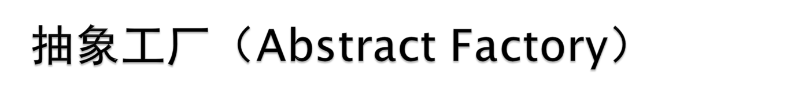
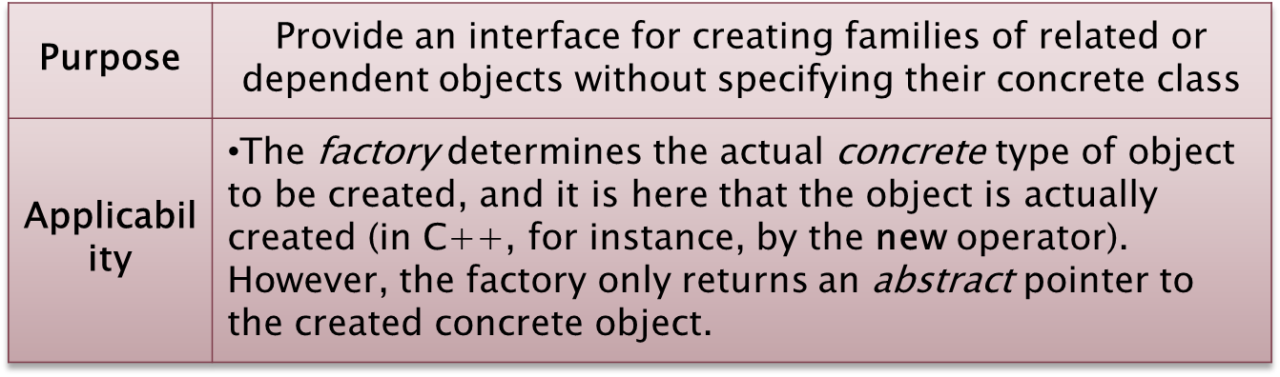

Notes:
虚线代表创建,因为客户端只和AbstractFactory，AbstractProductA, AbstractProductB相识,因此当有新产品加入时，只需加入这些具体的产品以及相应的具体工厂实现即可，客户端代码不需要修改。

Slide 18
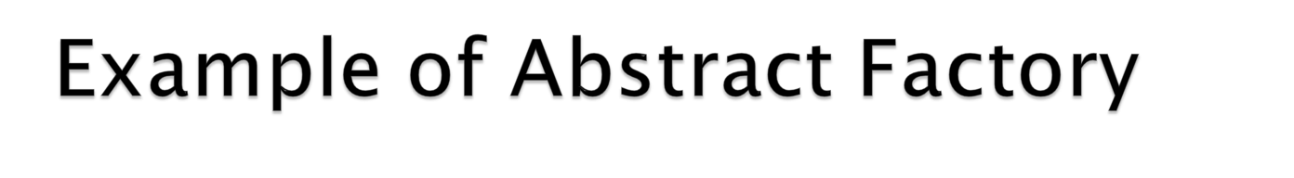
An example of this would be an abstract factory class DocumentCreator that provides interfaces to create a number of products (e.g. createLetter() and createResume()). The system would have any number of derived concrete versions of the DocumentCreator class like FancyDocumentCreator or ModernDocumentCreator, each with a different implementation of createLetter() and createResume() that would create a corresponding object like FancyLetter or ModernResume. Each of these products is derived from a simple abstract class like Letter or Resume of which the client is aware. The client code would get an appropriate instance of the DocumentCreator and call its factory methods. Each of the resulting objects would be created from the same DocumentCreator implementation and would share a common theme (they would all be fancy or modern objects). The client would only need to know how to handle the abstract Letter or Resume class, not the specific version that it got from the concrete factory.

Slide 19
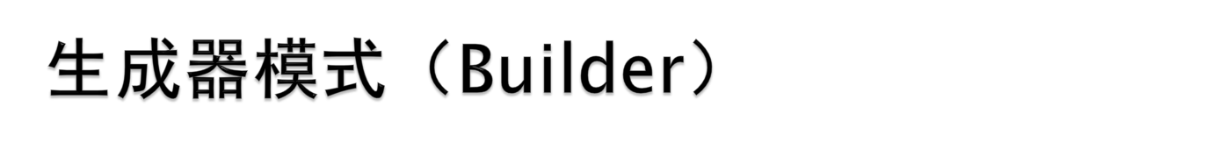
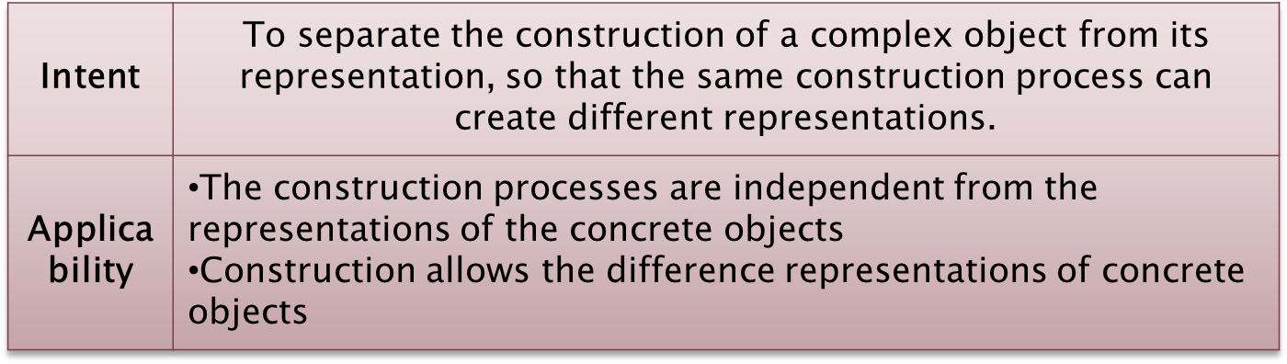
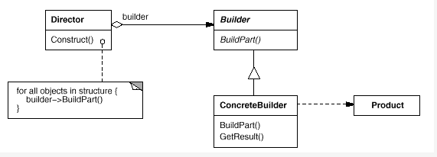
Notes:
复杂对象有多个子对象，但是子对象的构建过程是一样的，只是每个子对象的表示不同，这样每个子对象的具体表示封装在具体生成器中，Director可以调用抽象类的构建过程接口。当有新类型的子对象时，只需要动态得创建相应的生成器并把该生成器引用传给Director，而无需改变Director的代码。

Slide 20
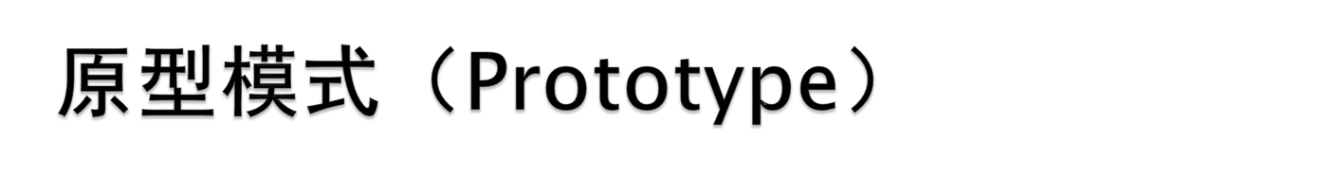
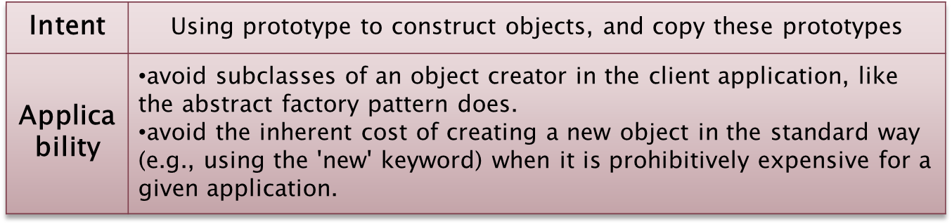
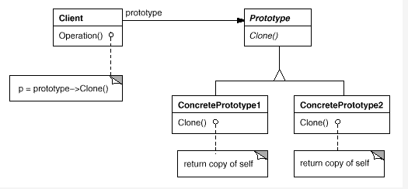
Notes:
最大的优点是允许只通过客户注册原型实例就可以讲一个新的具体产品类并入系统。比其他创建型模式更为灵活。

Slide 21
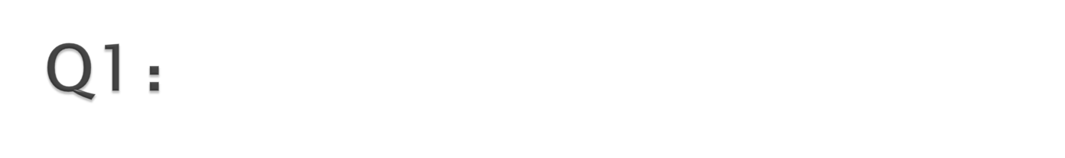
Summarize the differences among the five creational design patterns？
Difference between copy constructor and prototype pattern?

