Slide 1

Spring 2019 Illini Datathon
Team 20 – chris szul, Tejo Nutalapati, Idris Kuti, Vishal Sriram

Slide 2
Agenda
Methodology
Data Processing
Data Visualization
Natural Language Processing
Summary

Slide 3
Initial Thoughts
Compare each of the four companies we have to their competition
Look for market trends
Variables connecting the companies and their competition together
Use a neural network to figure out any patterns that we could forget
Look into 10-K Annual Reports from each company
Scrap media sources for articles that point to a market failure that would affect the companies given

Slide 4
Methodology
Use the given data to train a Geometric Brownian Motion model
Focus on the end of the data back 4 years
Clear out parts of the data that did not change drastically to look for trends
Use Twitter to determine if there is negative or positive feelings towards the company

Slide 5

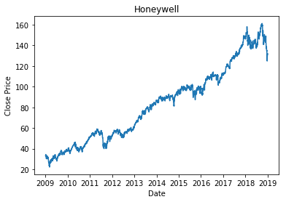
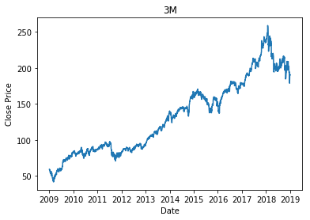



Data

Slide 6
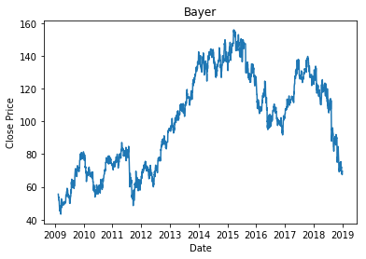
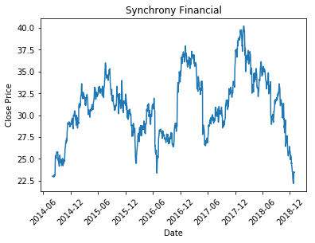
Data

Slide 7
Geometric Brownian Motion model
First, find the Daily Returns
Daily Returns = Today’s Closing - Yesterday’s Closing
Then, plug that vector of returns into Drift and Diffusion parameters
Finally, using the formulas for Geometric Brownian Motion in Python

Slide 8
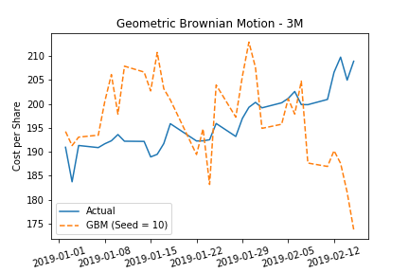
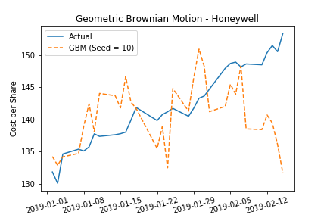
Geometric Brownian Motion Model

Slide 9
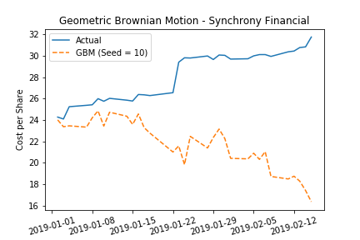
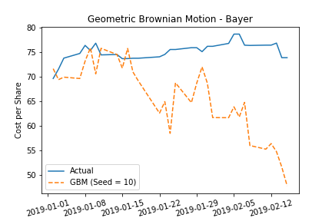
Geometric Brownian Motion Model

Slide 10
Clearing Data for Easier Trend Analysis
Filter through the data
If the next closing value was less than 1% different than the current closing value, ignore it and move to the next closing value
Purpose
Emphasize changes in stock closings
Remove data points that are not essential to establish a trend

Slide 11
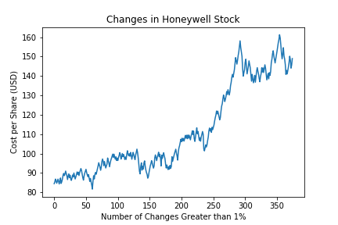
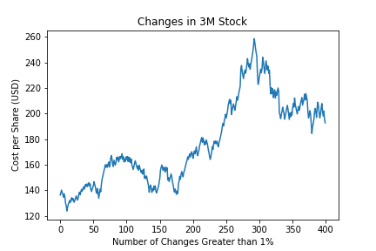
Clearing Data for Easier Trend Analysis

Slide 12
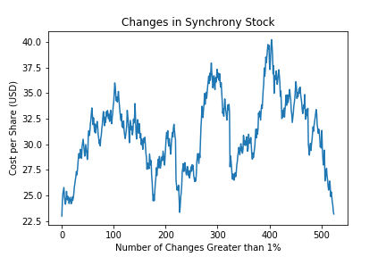
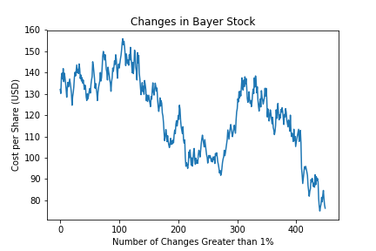
Clearing Data for Easier Trend Analysis

Slide 13
Using Twitter to gage people’s feelings to the companies
Look at each Twitter tweet for negative or positive comments about one of the four companies
Negative: -1
Neutral: 0
Positive: 1
Used the Twitter API to gather each of the posts and used TextBlob to analyze the sentiment behind the tweet

Slide 14
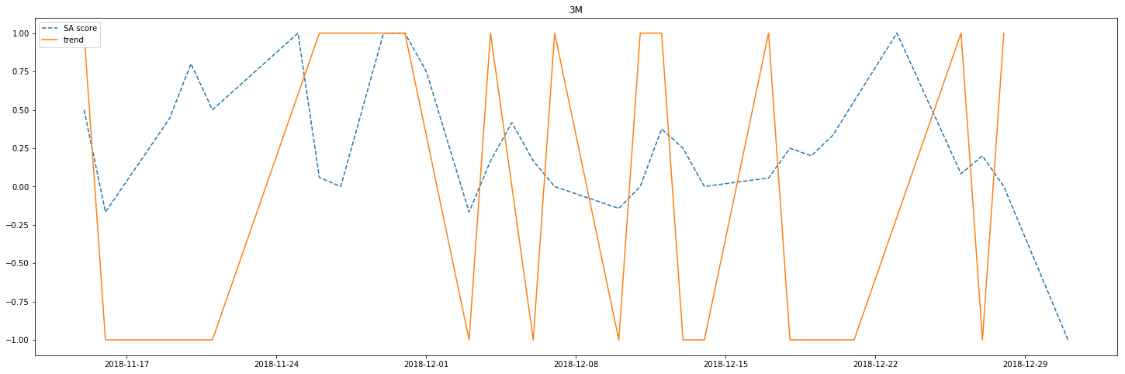
Using Twitter to gage people’s feelings to the companies (3M)

Slide 15
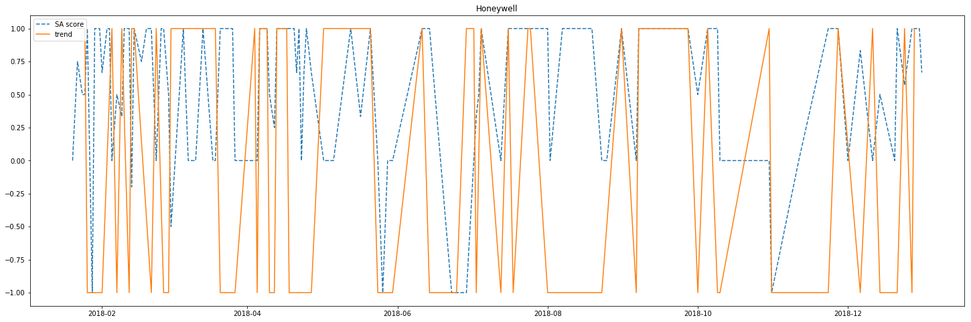
Using Twitter to gage people’s feelings to the companies (Honeywell)

Slide 16
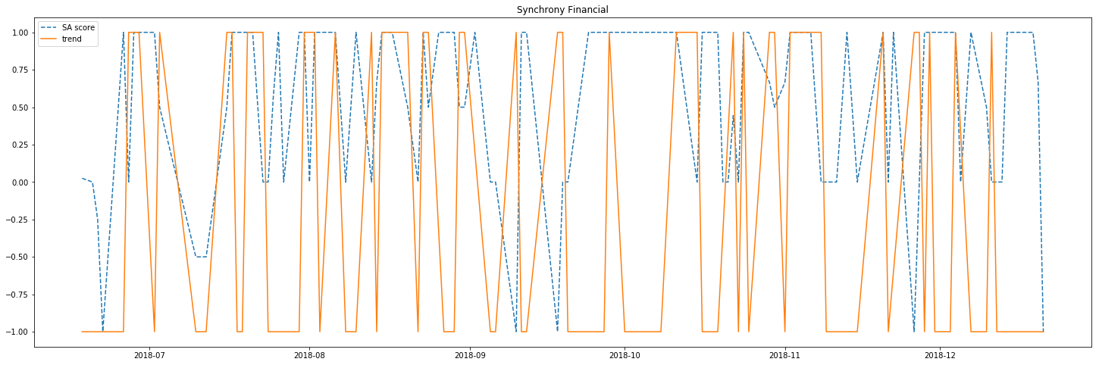
Using Twitter to gage people’s feelings to the companies (Synchrony)

Slide 17
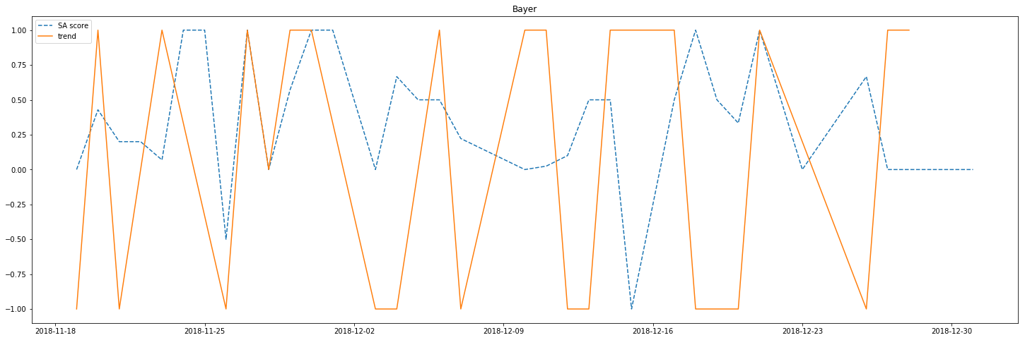
Using Twitter to gage people’s feelings to the companies (Bayer)

Slide 18
Summary
It would have been smart to invest in Synchrony
The Geometric Brownian Motion model had issues following the trends
If there was more time, we were thinking of using a Monte Carlo simulation to determine the best parameters for the Geometric Brownian Motion model
There is little correlation with Tweet sentiment and stock value
If there was more time, we were thinking about looking for posts from company CEO’s or people with a lot of followers

Slide 19
Questions?

