Slide 1
FoodMart Data Analysis
Shery Cheong
December 1st 2015

Slide 2
1: Data Visualization

Slide 3
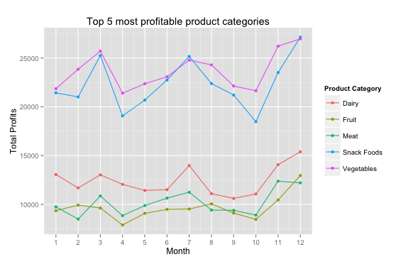
Grocery staples are (unsurprisingly) strong sales performers
This plot shows the month-to-month profits for the top 5 most profitable product categories, where profit per transaction is calculated as: profit = (store_sales – store_cost)*unit_sales.
While the majority of the categories are grocery staples such as Vegetables and Dairy, it is also interesting to see Snack Foods as one of the top most profitable categories for FoodMart.

Slide 4
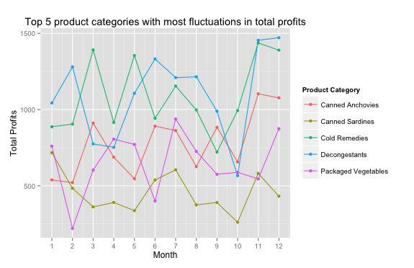
Some canned goods are actually seasonal items
This plot shows month-to-month profits for the product categories with the most fluctuations in total profits. The product categories are ranked by the sum of the absolute value of the month-to-month percentage change in profit.
Some of these product categories are seasonal products, like Cold Remedies and Decongestants, which tend to spike in monthly profits around March or November when the seasons change. However, canned anchovies and sardines also made the list.

Slide 5
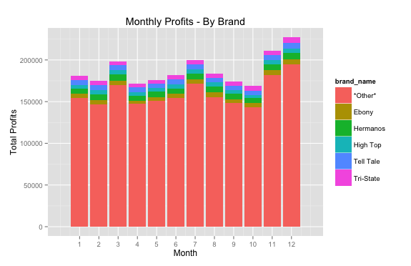
There is no strong brand domination in month to month profits
This plot shows month-to-month profits for by brand, where the top 5 most profitable brands are highlighted and the rest are grouped in an “Other” bucket. It appears that the top 5 brands have relatively similar profit margins, where no single brand is dominating even as the overall profits change from month to month.
It is also interesting to note the correlation between profits and major holidays, with March (Superbowl), July (Independence Day), and November/December (Thanksgiving, Christmas, etc.) being the most profitable months for FoodMart.

Slide 6
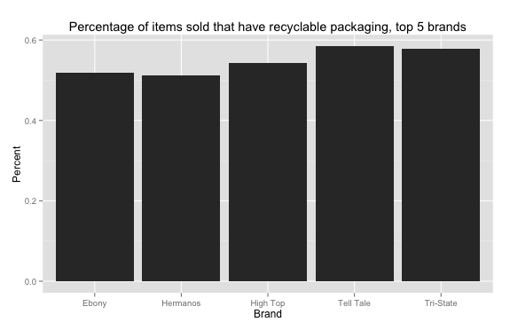
Going green is more than just a trend
One peculiar variable given in the dataset relates to the growing sector of environmentally conscious consumers. Looking at the top 5 most profitable brands, all of them have about 50% of their products sold with recyclable packaging.

Slide 7
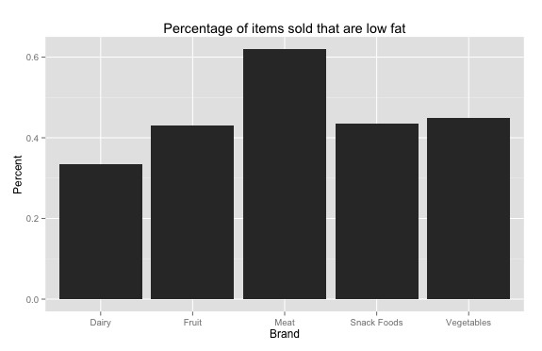
More than half of the meat products sold are low-fat
While a smaller percentage of dairy products sold are considered “low-fat”, a large percentage of meat products sold are, presumably, leaner cuts of meat.

Slide 8
2: Opportunities

Slide 9
Promotions
For this particular assignment, I chose to focus on promotional offerings
Promotions can be costly to execute, and in order to maximize ROI, they should be targeted more efficiently.

Slide 10
Methodology
Separate transaction data into two groups: promotion and non-promotion
For each group, calculate the average sales for each product across all transactions (I.e. what is the average number of Washington Colas sold under a certain promotion? How about under no promotion?)
Use ANOVA to test the statistical significance of:
Any Promotion vs. No Promotion
Pairwise comparison between promotion types
Focusing only on promotion types that are statistically significant, calculate the incremental percentage change between the average units sold under a promotion and average units sold without a promotion, then averaging the results across department categories (i.e. Snacks, Dairy)
Rank the percentage changes in descending order to get the top most effective promotion types and department categories.

Slide 11
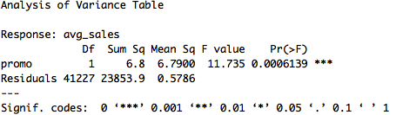
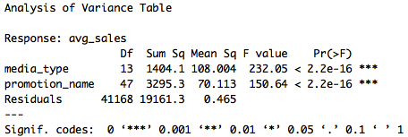
ANOVA Results
The average number sold, for each product, is different for a product under any type of promotion compared to a product not under promotion.*
The average number sold, for each product, is different depending on the media type and the promotion name, for at least one pair of factors.*
*95% confidence under alpha level = 0.05

Slide 12
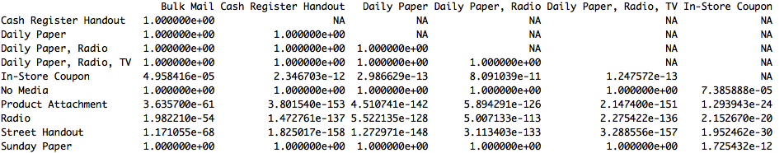
Pair-wise ANOVA Results
Since our F-test results from ANOVA are significant, the next step is determining which pairs in particular are significant. This is a (partial) matrix showing the p-values for significance between pairs of media types using the Pairwise t-test.
When compared to “No Media”, the other media types have a very high p-value (aside from In-Store Coupon). This suggests that while some media types (i.e. Radio vs. Bulk Mail) cause a statistically significant difference in average units sold for each product, we cannot say this is necessarily the case when they are compared to “no promotion”.

Slide 13
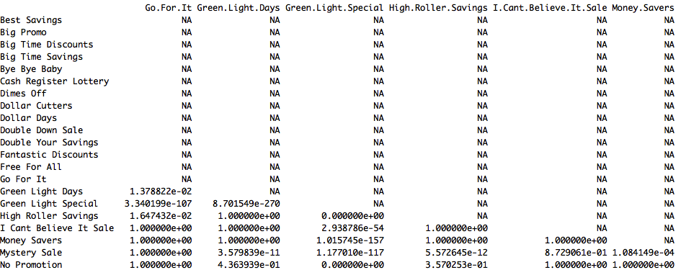
Pair-wise ANOVA Results
However, for promotion names, we get a lot more significant pairings (at p-value <0.05). This suggests that the promotion name has a much greater impact on sales units sold that simply the media type.
The promotions that affect* sales of units sold are: Price Savers, Sales Winners, Super Duper Savers, and Tip Top Savings
*95% confidence under alpha level = 0.05

Slide 14
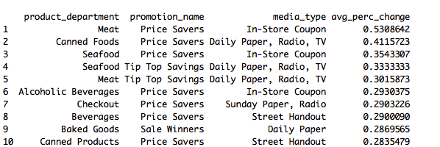
Results
The promotions that affect (positively or negatively) the number of units sold are: Price Savers, Sales Winners, Super Duper Savers, and Tip Top Savings
Here are the top 10 promotions and their media types that lead to the biggest average percent increase in units sold:
For example, an in-store coupon advertising “Price Savers” for meat lead to an increase of 53% in units sold.

Slide 15
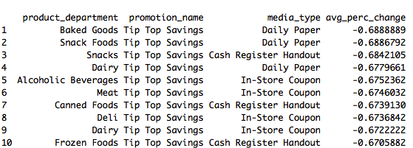
Results
Here are the promotions and their media types that lead to the biggest average percent decrease in units sold:
Note how all of them relate to the promotion “Tip Top Savings”

Slide 16
Executive Summary
“Price Savers” campaigns work really well to increase sales numbers, but avoid launching “Tip Top savings” campaigns.
Since “Price Savers” have a strong positive effect on sales of meat products, this is a huge area of growth. Meat products are in the top 5 most profitable product categories (5% of total profits come from meat)
Promotions are particularly effective towards Seafood, and both “Price Savers” and “Tip Top savings” increase seafood sales by 35% and 33% respectively.

