Slide 1


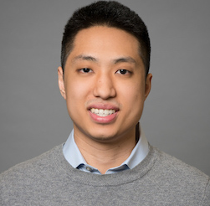
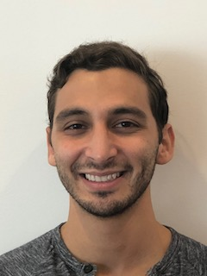
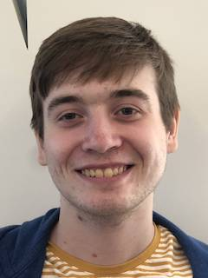
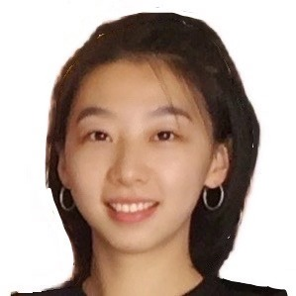
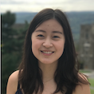
Team 72:
Weill Transformers
Weilly
Michael Chan
Zach Gittelman
Alex Popeil
Catherine Wang
Jenny Yi

Slide 2
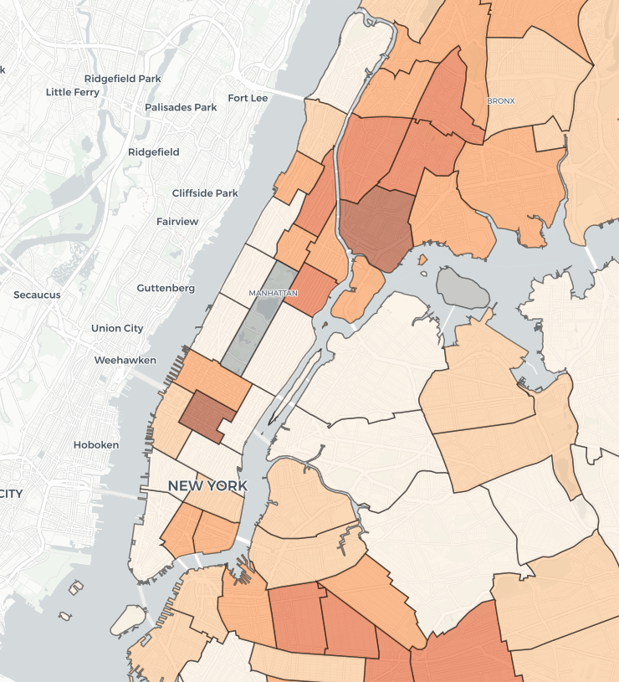
How Might We: Transform Medical Training?
Company:
Weill Cornell
New York Presbyterian
Notes:
-training dependent on cases
-assaults in bronx vs manhattan
-high variability is a problem
-location, urban vs. rural
-socioeconomic status

Slide 3




MSight
Training Background
Procedure History
Procedure Credentials
Oversight
Transfers
Credential Check
Doctors
Nurses
Management
Notes:
Training Background
Procedure History
Procedure Credentials
Doctors - Identifying Training Needs
Management -
Nurses - Checking Procedural Credentials of Physicians

Slide 4
Risk-Mitigating Sequence
Integration
Share Data?
API Availability?
Data Structure?
User Interface
Diagrams to Visualize Data?
User-friendly Interface?
Native or Web?
Customization Requirements?
Prototype
A/B Testing
Training Needs
Data-Driven Decisions?
Treatment vs Control Group
Primary Data
User Engagement
Secondary Data
Will they Use It?
Pilot

Slide 5


Experiment 1: Value of Data in Determining Training Needs
Adult Medical Resuscitation
Adult Trauma Resuscitation
Cardiac Pacing
Central Venous Access
Chest Tubes
Cricothyrotomy
Dislocation Reduction
ED Bedside Ultrasound
Intubations
Lumbar Puncture
...
…..
…
…
…
…
…
...
Compare Differences
…..
…
…
…
…
…
...
Notes:
Overview:
Ask a group of physicians to evaluate a list of procedures by how necessary they believe training is.
Experiment Details
Control Group: Ratings will be done per existing procedures.
Experiment Group: Data on these procedures from the past year will be provided to aid in the decision making.
Rate the procedure from 1-10 and rank them in order of training importance
Compare results and interview participants

Slide 6
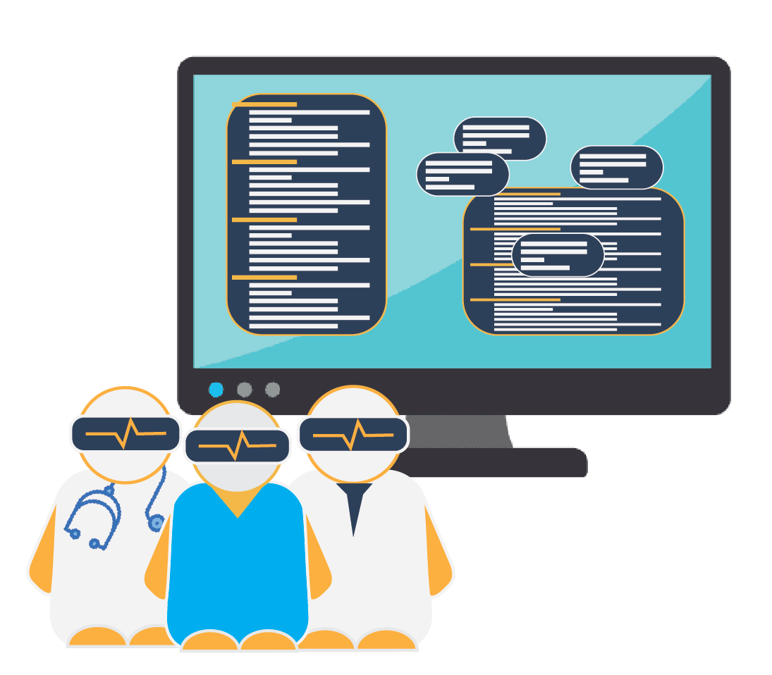
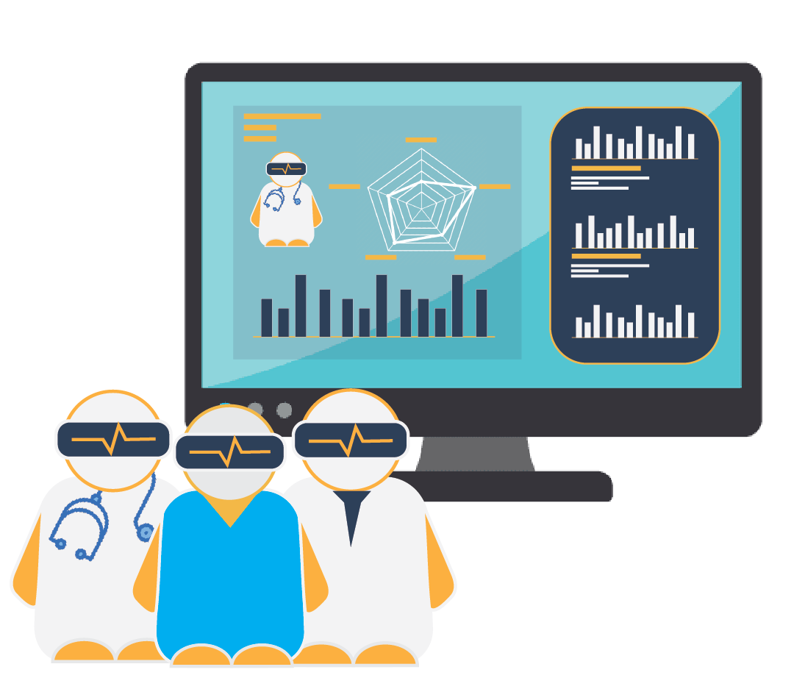
Experiment 2: User-Friendly Interface
Tasks
Find credentials for...
How many...
Select the physician...
Would this physician..
How could he/she...
Find requirements...
What are the strength...
Compare Differences in Time

Slide 7
Thank You!
Weilly
-Team72 & Weilly
Michael Chan
Zach Gittelman
Alex Popeil
Catherine Wang
Jenny Yi

Slide 8
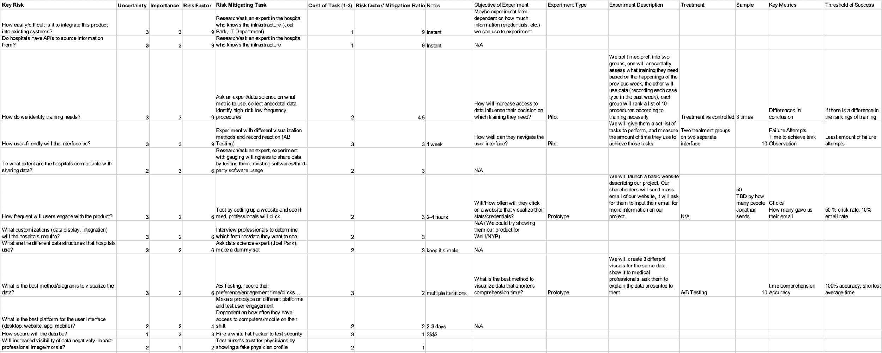
Appendix

