Slide 1
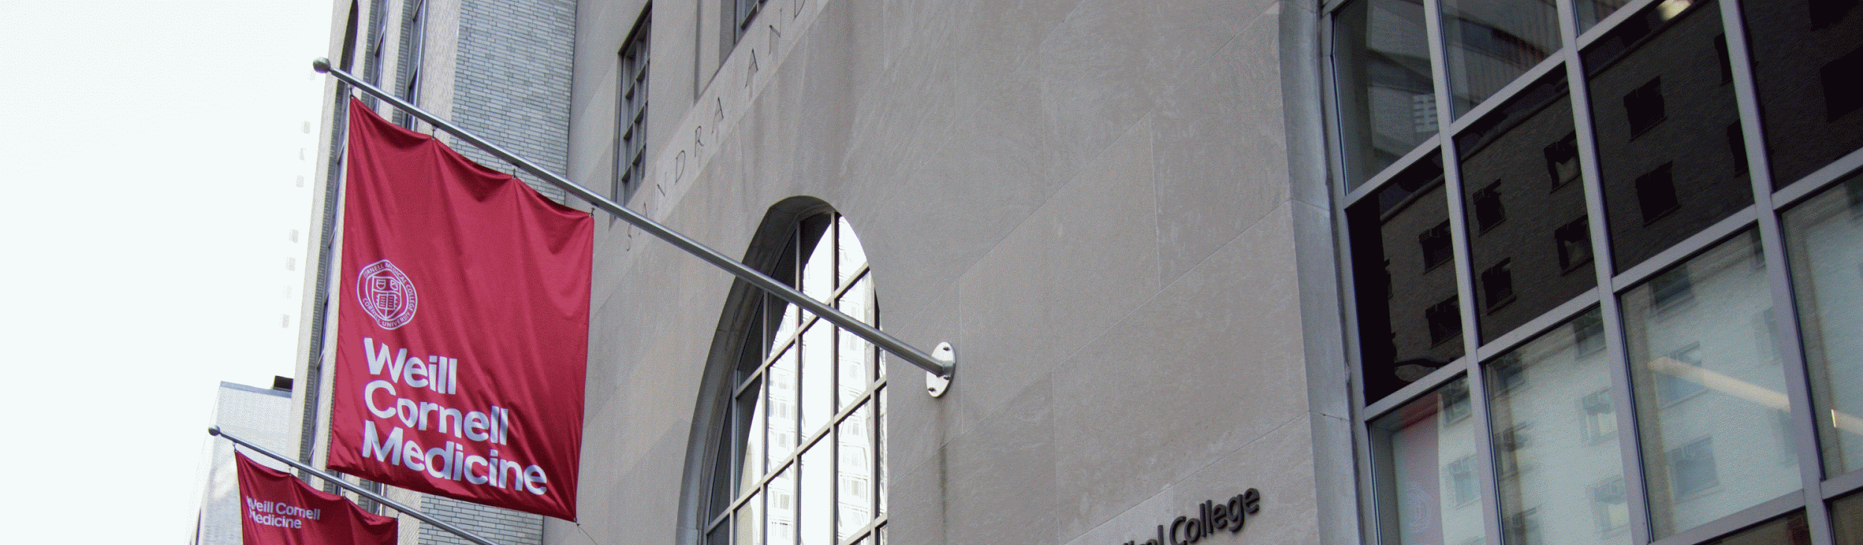


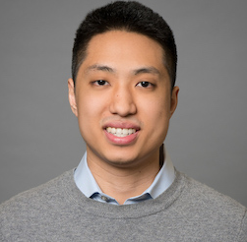
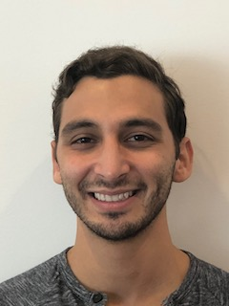
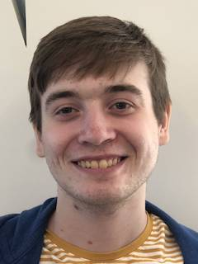
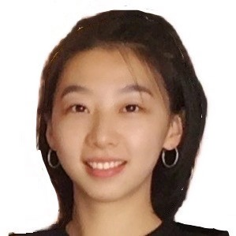

Team 72:
Weill Transformers
Weill Cornell New York Presbyterian
Michael Chan
MBA
Zach Gittelman
HT
Alex Popeil
CS
Catherine Wang
ORIE
Jenny Yi
AAP

Slide 2

Imagine You Are an Emergency Department Doctor
Notes:
Imagine you’re an emergency room doctor, last week a patient came into the ER and required a cardiac pacing. Cardiac pacing is a rare procedure. The last time you performed a cardiac pacing was during residency so you realize you need a refresher. You read up on the procedure, and everything goes smoothly, but the next day you’re concerned because you don’t want to be in a similar position of doubt in the future. You want to be more proactive in managing your procedural skills, so the next day you try to identify what procedures you need a refresher course on, you try to look through your case history but its time consuming and unorganized. You ask your data department to provide you with an overview of your procedural history, but they tell you its going to take 2 months to get approval to release that data. There must be an easier way.

Slide 3
The Problem
Clinicians have limited visibility into their procedural experience.
Why is there no data visibility?
Poorly organized collection
Non uniform software systems
Red-taped access to data

Slide 4

The Solution
What is MSight?
Visualize procedural experience
Insight into training needs
Features
Procedural History
Credentials
Training suggestions

Slide 5
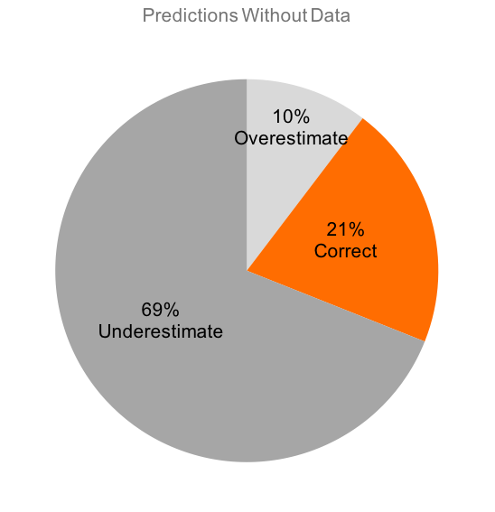
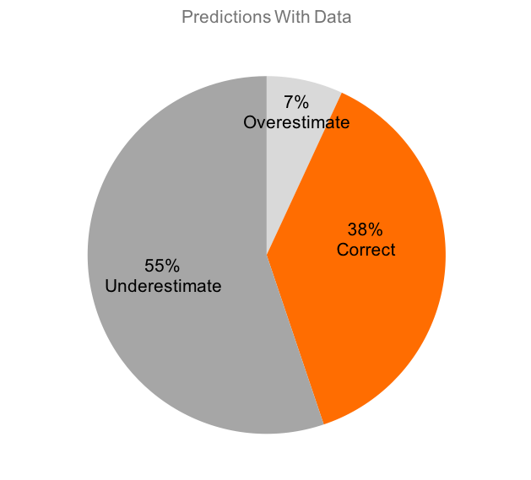
Why Data Matters
Notes:
Collecting statistics on procedural length and complications
Standardizing performance metrics
Improved visibility into strengths/weaknesses
Better care
No standard measurement on performance for procedures
Would need to collect different statistics to determine difficulty of procedures
Even complications are usually just noted in free text
All procedures are high risk

Slide 6
DEMO
Notes:
Initial users: emergency department residents and attending physicians, the department that’s exposed the most breadth of cases in a fast paced environment
Initial configuration: procedural experience, credentials,

Slide 7
Next Steps
50 intubations in 3 months by 5 physicians
10+ intubations = 100% Familiar
40% familiar--TRAINING!
10% familiar--TRAINING!
17
13
15
4
1

Slide 8
Thank You!
-Team72 & Weilly
Michael Chan
MBA
Zach Gittelman
HT
Alex Popeil
CS
Catherine Wang
ORIE
Jenny Yi
AAP

